Slide 1


Properties of smokes emitted during smoke-chamber tests
BLAbla
J. Moraine , J. Yon, M. Talbaut, A. Coppalle
UMR 6614 CORIA, Université et INSA de Rouen,
Avenue de l’université, B.P. 8, 76801 Saint-Etienne du Rouvray, France
Outline of the presentation
- Context and objectives
- Experimental set-up
- Transmission, mass conc. and size of the particles
- the specific extinction coefficient
- Conclusion and perspectives
CNRS – UNIVERSITE et INSA de Rouen
1/16

Slide 2
1 . Context and objectives
Context : Aircraft fire projected (financially supported in the frame of the FP7)
During fire, materials can be exposed to radiative flux
===> production of smokes by pyrolysis and combustion of materials
- Emission depends on materials, exposition time and radiative flux
=> Consequence: light extinction -> reduction of the visibility
=> Emissions of aircraft materials are not well known, in particular composites
Objectives :
To determine: - Optical properties of smoke
- Their variations as a function of concentration and materials
Measurements of 3 parameters for several materials :
- The mass concentration
- The particle size
- The optical density
Measurements are carried out in a smoke chamber (standard)
2/16

Slide 3
2 . Experimental set-up
3 standards to determine the optical density of smoke:
- The international standard : ISO 5659-2 2006
- The american standard : ASTM E662-9
- The french standard : NF X10-702
Main differences:
 | ASTM E662-9 NF X 10-702 | ISO 5659-2
Exposition (furnace -> sample) | vertical | horizontal
Radiative flux (kW/m²) | 25 | 25 - 50
In this study, the ISO standard is used
3/16

Slide 4
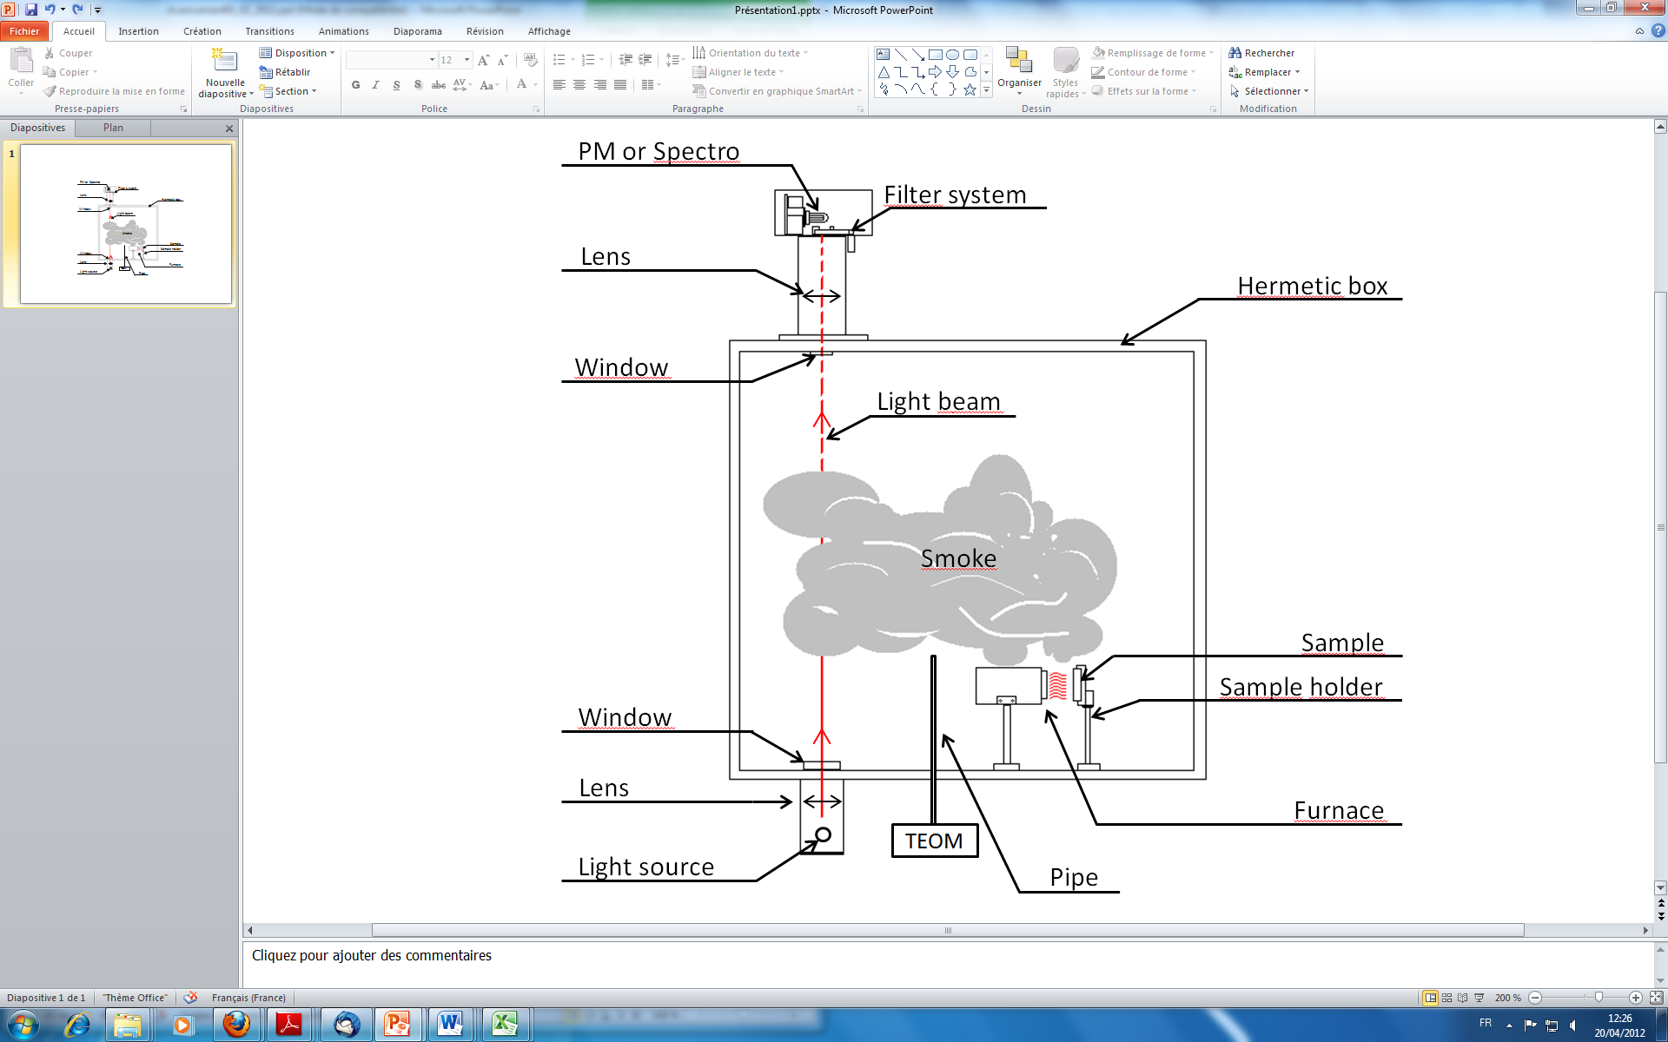
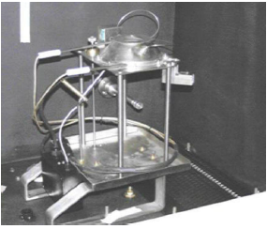
2 . Experimental set-up
Photomultiplier: measure the intensity of transmitted light I
Transmittance:
optical density
Specific optical density:
Extinction coefficient
transmitted intensity I
With the photomultiplier:
Total transmittance
And extinction coef.
in the visible range,
between 350 and 700 nm
initial intensity I₀
5/16

Slide 5
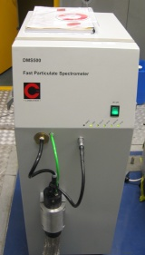
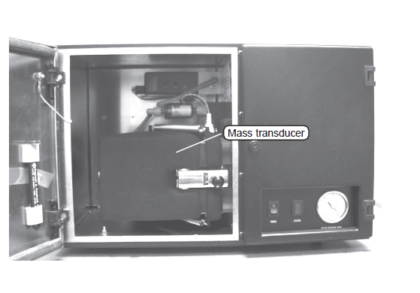
2 . Experimental set-up
Particle instrumentation of the smoke chamber :
TEOM: Mass concentration
(tapered element oscillating microbalance)
DMS: particules size distribution
6/16

Slide 6
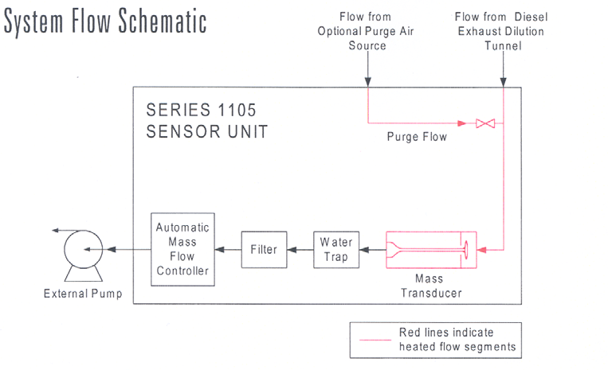
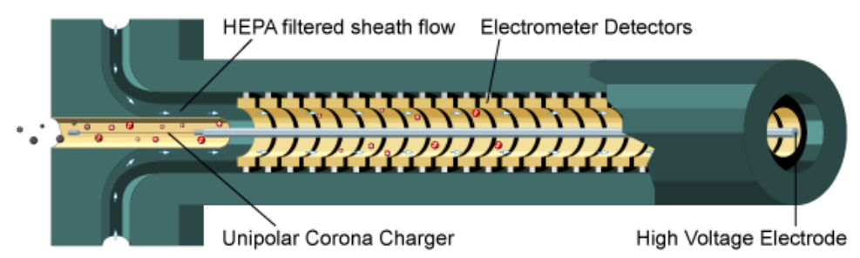
Aircraft Fire, le 10/05/2012
2 . Experimental set-up
TEOM: the mass concentration of particles
Mass rate on the filter:
Mass concentration:
Knowing the sampled flow rate Q_{samp}
DMS: particle size distribution
4/13

Slide 7
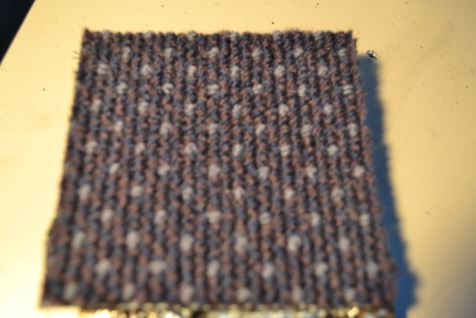
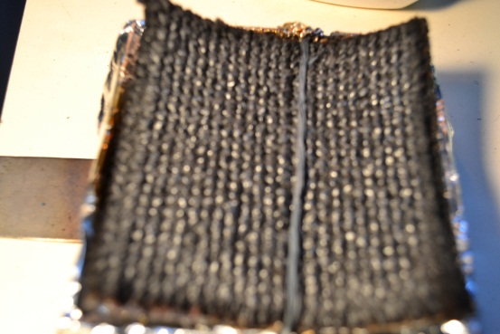
3. Transmission, mass concentration and size of the particles
carpet: irradiance 25kW/m2 with non flaming condition
Material before the test
Material after the test
No black carbon
Modal diameter: 100nm
transmission
Mass rate on the filter
Particle size distribution,
7/13

Slide 8

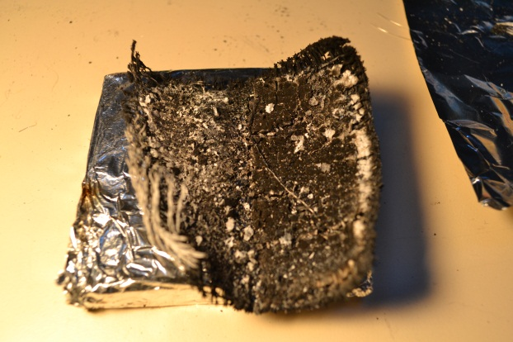
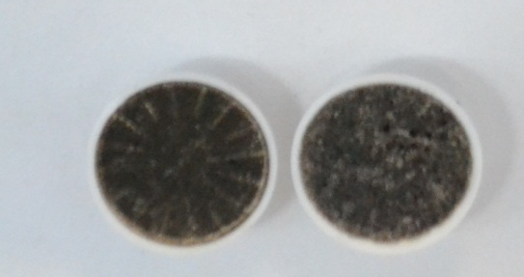
3. Transmission, mass concentration and size of the particles
carpet: irradiance 50kW/m2 with flaming condition
Material before the test
Material after the test
black carbon = soot
Modal diameter: 100nm
transmission
Mass rate on the filter
Particle size distribution,
7/13

Slide 9
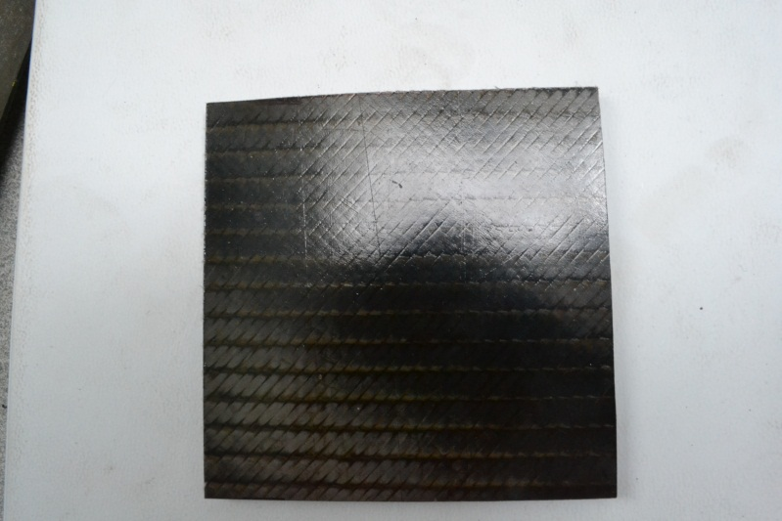
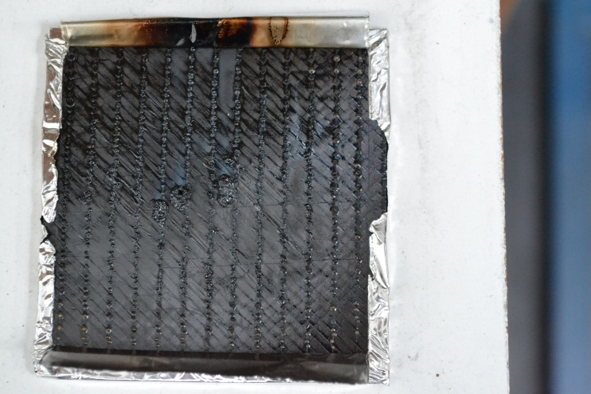
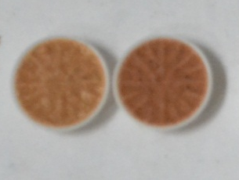
3. Transmission, mass concentration and size of the particles
ACF7: 25 kW/m2
No soots
Material before the test
Material after the test
Modal diameter: 100nm
transmission
Mass rate on filter (ng/s)
Particle size distribution,

Slide 10
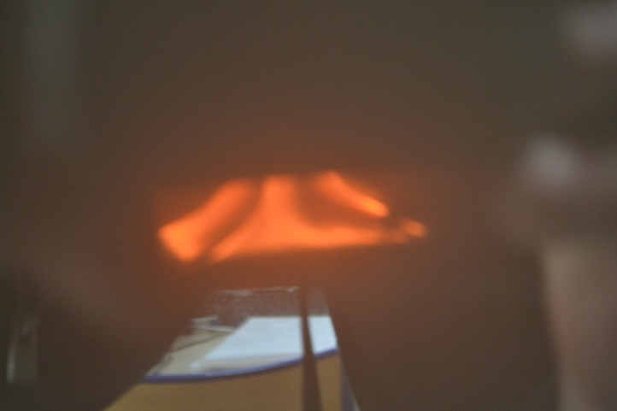
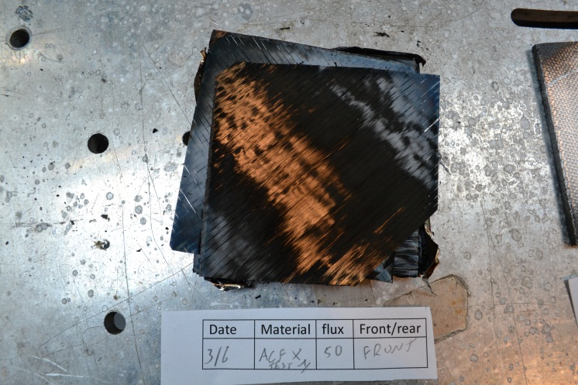
3. Transmission, mass concentration and size of the particles
ACF7: 50 kW/m2
black carbon = soot
Important: flames can be only at the contour of the sample
Important: strong delamination
Large samples
Small samples
Always slow transmission
Always high soot concentration
Modal diameter: 200 & 400 nm
In order to increase the accuracy of the transmission or OD measurements:
other tests with half sizes (1/4 of the initial surface)
transmission
Mass rate
Particle size distribution,

Slide 11
3. Transmission, mass conc. and size of the particles
ACF7: 50 kW/m2 with dilution
Modal diameter: 200 & 400 nm
lower optical density with dilution
lower soot concentration with dilution
transmission
Mass rate on filter
Particle size distribution,

Slide 12
Aircraft Fire, le 10/05/2012
4 . the specific extinction coefficient
It is possible to determine a mean extinction coefficient K_{ext} with Bouguer’s law:
where L is the length of light beam
and T the transmittance
!
Bouguer’s law is not valid with polychromatic spectra
So this K_{ext} is not an exact average extinction coefficient over wavelength
But it is useful to have a link between mass concentration and transmittance of light via a specific extinction coefficient σ_{s}(m²/g) [Mulholland 2002,Putorti 1999]:
!
At low transmission (high optical density) multiple scattering occurs:
===> σ_{s} is better determined at low value of K_{ext}
11/13

Slide 13
Aircraft Fire, le 10/05/2012
4 . the specific extinction coefficient
carpet
50kW/2 and 25 kW/m2: σ_{s} =slope kext(m-1)/Cs(g/m2) = 6 (m²/g)
- same values for 25kW and 50kW
25 and 50kW/m2: non flaming condition at short times, no soots
===> extinction (=scattering?) by small droplets of condensed gas
12/13

Slide 14
4 . the specific extinction coefficient
ACF7: 25 kW/m2
non flaming condition, no soots,
===> extinction (=scattering?)
by small droplets
of condensed combustible gas
25 kW/m2: σ_{s} =slope kext(m-1)/Cs(g/m2) = 1.25 (m²/g)
ACF7: 50 kW/m2
σ_{s} lower than for carpet
50kW: flaming condition,
===> absorption by soots
50 kW/m2: σ_{s} =slope kext(m-1)/Cs(g/m2) = 2.5 (m²/g)

Slide 15
5 . Conclusions and perspectives
Emissions of smokes by composites is very high
===> a dilution inside the smoke chamber is recommended
    For low irradiance, if non flaming condition
    ===> No soot content in the smoke produced with non-flaming conditions
    ===> However strong reduction of the transmission
For high irradiance: Flaming condition
    ===> fast increase of soot production (during 10 to 30s)
    ===> Stronger optical density compared to ‘non flaming’ conditions
The specific extinction coefficient
Carpet without soot : 6 (m²/g)
ACF7 with or without: 1.25-2.5 (m²/g)
Particle size===> smaller than one μm
Other materials to be tested
Spectral measurement of the transmission is planned
13/13

