Slide 1
AVIATION HEAT FLUX CALIBRATION STANDARD
2013 Triennial International Fire & Cabin Safety Research Conference
Philadelphia, PA
Michael Burns, FAA Tech Center
December, 2013

Slide 2
AGENDA
History
Aviation Heat Flux Calibration Standard
  Specification, Method & Procedures
Next

Slide 3
BRIEF HISTORY
06/08 – Discovery of Heat Flux Gage Calibration Discrepancy
Visit to Manufacturers / NIST
06/09 – International Heat Flux Gage Calibration Study
Industry Submitted Gages To FAA Technical Center For Calibration Comparison
07/09 – Heat Flux Sensitivity Study Using Gages Installed In Test Apparatus (HRR, NBS Smoke Density & Radiant Panel tester)
10/09 – Sensitivity Study
Effect On Data By Varying Heat Flux Levels
10/10 – Development Of Interim Aviation Heat Flux Gage Calibration Standard
11/12 – Development Of Aviation Heat Flux Gage Calibration Standard

Slide 4
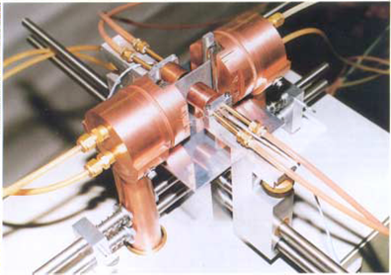

Slide 5
Chapter HF: Aviation Heat Flux Calibration Standard
introduction
Transfer of National Institute of Standards and Technology (NIST) Primary heat flux calibrations to total heat flux gauges used in flammability testing of aircraft materials.
Apparatus:
  Reference heat flux gauge
  Radiant heat source capable of producing flux levels up to 5 W/cm²
  Precision alignment system

Slide 6
Chapter HF: Aviation Heat Flux Calibration Standard
Definitions
Heat Flux: The rate of thermodynamic energy transfer per unit area that is incident on a material. The accepted units for heat flux is Watts per centimeter squared (W/cm²).
Heat Flux Gauge (HFG): A transducer used in determining heat flux levels.
NIST: National Institute of Standards and Technology (USA). The NIST is considered the owner of the Primary Heat Flux Standard.

Slide 7
Chapter HF: Aviation Heat Flux Calibration Standard
Calibration Factor (Scale Factor): The calibration factor is a constant multiplier which converts a HFGs millivolt signal to the measured value of heat flux. It is derived from Incident Flux [W/cm²] / Sensor Output [mV]. The responsivity (sensitivity) is the reciprocal of the calibration factor.
Secondary Standard HFG: The Secondary Standard HFG must be calibrated by NIST using their heat flux calibration service. Minimum data points shall include 1.0, 2.5 and 4.0 W/cm². This gauge is used to transfer NIST calibration values to a Transfer Standard HFG.

Slide 8
Chapter HF: Aviation Heat Flux Calibration Standard
Transfer Standard HFG: The Transfer Standard HFG must be calibrated by a Secondary Standard HFG. This gauge is used to transfer NIST calibration values to a Working HFG.
Standardized HFG: A Secondary Standard HFG or a Transfer Standard HFG is considered to be a Standardized HFG.
Working HFG: A HFG received from a testing facility to be calibrated. This gauge is used for setting heat flux levels in day to day laboratory flammability testing.
HFG Calibration Hierarchy:
NIST → Secondary Standard HFG → Transfer Standard HFG → Working HFG

Slide 9
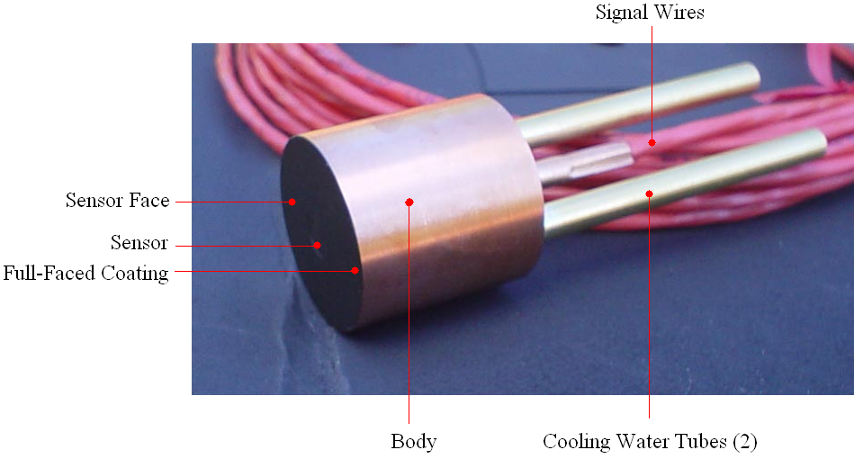
Chapter HF: Aviation Heat Flux Calibration Standard
Heat Flux Gauge Specification
Type: Gardon or Schmidt-Boelter HFG
Range: 0 – 5 W/cm²
Construction: Continuously water-cooled, cylindrical, one inch diameter body. A mounting flange attached to the body is permissible. Cooling water tubing length and diameter may vary.

Slide 10
Chapter HF: Aviation Heat Flux Calibration Standard
Coating: The HFG must have a thin, full-faced, opaque coating of high quality, high-temperature, ultra-flat black paint.
The nominal dry film thickness of the coating on the sensor face shall be 1.0 ± 0.3 Mils.
The coating on the HFG to be calibrated must be removed and replaced prior to calibration.
Cooling Water: The HFG cooling water temperature, pressure and flow shall be maintained within the manufacturer’s recommendations.
It is not recommended to connect cooling water circuits in series.

Slide 11
Chapter HF: Aviation Heat Flux Calibration Standard
Data Acquisition System Specification
The data acquisition system must have a minimum scan rate frequency of 4 Hz, a measurement uncertainty less than ± 0.01 mV (at 95% confidence, k=2) and be able to collect the two HFG signals within 1⁄10th of a second of each other.
Calibration Interim
Secondary Standard HFG: The Secondary Standard HFG must be calibrated at NIST using their heat flux calibration service at least once every 5 years.
Transfer Standard HFG: The Transfer Standard HFG must be calibrated by a Secondary Standard HFG at least once every year.
Working HFG: The Working HFG must be calibrated by a Standardized HFG at least once every year.
Data Acquisition System: The data acquisition system must be calibrated to NIST traceable voltage sources at least once every year.

Slide 12
Chapter HF: Aviation Heat Flux Calibration Standard
Laboratory Environment
The air circulating around the apparatus must be draft-free (stagnant). The ambient laboratory dew point must be lower than 5°F below the cooling water temperature (for example, at 73°F, the ambient relative humidity shall be less than 80% to achieve this). This is to prevent condensation from forming on the sensor face.
Calibration Set-up
Method: Incident heat flux, vertical orientation.
Gauge Type: When transferring a calibration from a standardized gauge to a non-standardized gauge, both must be of the same type.
Mounting HFGs for Calibration: When securing the cylindrical one inch body of the instruments into position for calibration, avoid obstructing the sensors’ 180° field of view of the radiant heat source.

Slide 13
Chapter HF: Aviation Heat Flux Calibration Standard
Mounting Fixture: If more than one HFG mounting fixture is used they must be identical in construction.
HFG Position: Mount a Standardized HFG and the unit to be calibrated in the vertical orientation. Each gauge must be located an equal distance or within 0.002 inches of each other with the sensor face parallel to the radiant heat source. Use extreme care when setting the distance from the radiant heat source by avoiding contact with sensor face.
Cooling Water: Ensure there is proper water flow to each sensor before initiating the HFG exposure to radiant heat.
Condensation: Ensure that there is no condensation that occurs on either sensor face prior to, or during, the calibration procedure .
Electrical: Connect the signal wires of each HFG to the data acquisition system ensuring that each HFGs polarity is set correctly with an increase in heat flux corresponding to an increase in millivolt signal.

Slide 14
Chapter HF: Aviation Heat Flux Calibration Standard
Calibration Procedure
STEP 1
Measure the zero flux voltage and resistance of the HFGs.
STEP 2
Apply radiant heat to both sensors until the standardized HFG reading reaches 5 W/cm².
STEP 3
At 5 W/cm² begin recording signal data continuously for both HFGs.

Slide 15
Chapter HF: Aviation Heat Flux Calibration Standard
Calibration Procedure (Continued)
STEP 4
Decrease the radiant heat to less than 1 W/cm² recording signal data as the radiant source cools. A cool down rate from 5 W/cm² to 1 W/cm² shall occur over a minimum time period of ninety seconds to aid in a uniform cooling of the radiant source.
STEP 5
Repeat STEP 1 verifying the HFGs return to previous conditions and document results

Slide 16
Chapter HF: Aviation Heat Flux Calibration Standard
Requirements/Analysis
Repeatability
It must be shown that if the locations of the two HFGs remain the same and the calibration is repeated, the difference in the successive calibration factor must be less than 2.0%.
Reproducibility
It must be shown that if the locations of the two HFGs are interchanged and the calibration is repeated, the difference in the successive calibration factor must be less than 2.0%.

Slide 17
Chapter HF: Aviation Heat Flux Calibration Standard
Required Reporting Parameters
General:
Facility Conducting Calibration
Customer (Lab performing Future Tests With The Working HFG)
Calibration Date
Calibration Expiration Date

Slide 18
Chapter HF: Aviation Heat Flux Calibration Standard
General (Continued):
HFG cooling water
  Temperature
  Pressure
  Flow rate
XY Plot or Raw Data Table
Linearity of HFG mV Signals During Calibration (Confidence Level)
Calibration Traceability
Calibration Certificates of Devices Used

Slide 19
Chapter HF: Aviation Heat Flux Calibration Standard
Working HFG Information:
Manufacturer
Part number / Serial number
Sensor type
Sensor coating material
New calibration factor (W/cm²)
Sensor voltage and ohm reading between signal leads at zero flux (Pre/Post)

Slide 20
Chapter HF: Aviation Heat Flux Calibration Standard
Working HFG Information (Continued):
Prior Calibration Data (If available)
Date
Calibration Factor (W/cm²)
Facility Where Calibration was Conducted
% Change in Calibration Factor
Traceability Records to a Standardized HFG

Slide 21
Chapter HF: Aviation Heat Flux Calibration Standard
Standardized HFG Information:
Manufacturer
Part number / Serial number
Sensor Type
Sensor Coating Material
Calibration Factor (W/cm²)
Sensor Voltage and Ohm Reading Between Signal Leads at Zero Flux (Pre/Post).
Calibration Date of Standardized HFG
Traceability Records to NIST Primary Standard HFG

Slide 22
NEXT
Develop Conformity Checklist
Validation Testing
Develop Round Robin

