Slide 1
Revised Rate of Heat Release Test Method
2013 December
Triennial Conference
Philadelphia, PA USA
Michael Burns, FAA Tech Center

Slide 2

Agenda
Test Method
Background for Revision
Improvements
Prototype Data
Next

Slide 3

Heat Release Rate Test Method
Required by Federal Aviation Administration
Qualify large surface area interior materials for use in commercial passenger aircraft
  Ceilings
  Stow bins
  Sidewalls
Federal Register 14 CFR parts 25 and 121
  Description
  Use
  Calibration
  Pass / Fail criteria

Slide 4
Revised Heat Release Rate Test Method
Goal: Simplify and Streamline the Test Method
Multi-laboratory studies in which the same material was tested at different locations indicate reproducibility of test results can be improved.
Many factors can contribute to poor agreement between test laboratories.
This presentation describes a detailed revision of the test apparatus conducted by the International Aircraft Materials Fire Test Working Group to better standardize components, procedures and calibration of equipment for this test method.

Slide 5
Categories Of Improvements
  Airflow (Dual Flow to Single Flow)
  Standardized Construction
  Procedures / Software
  Calibration Equipment
  Changes in Documentation (Chapter HR)

Slide 6
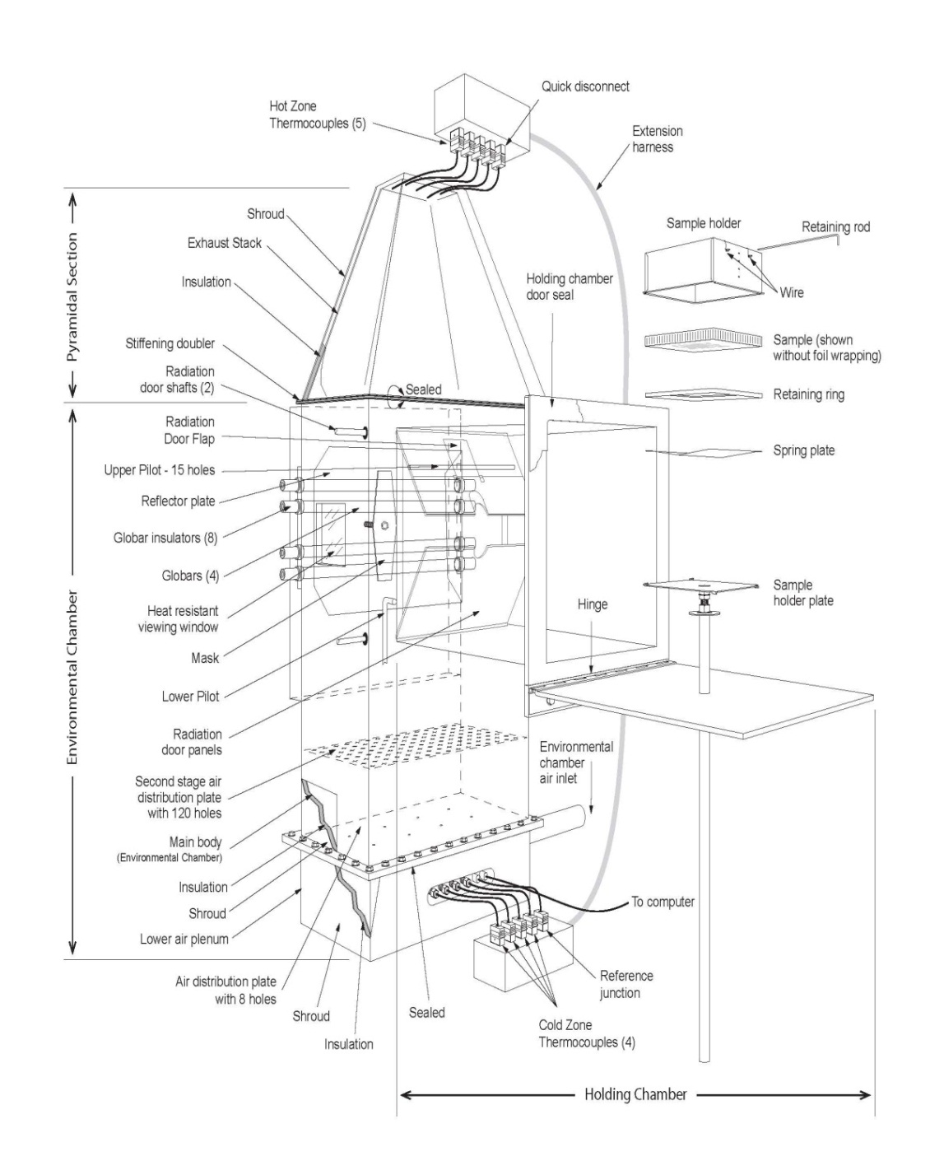
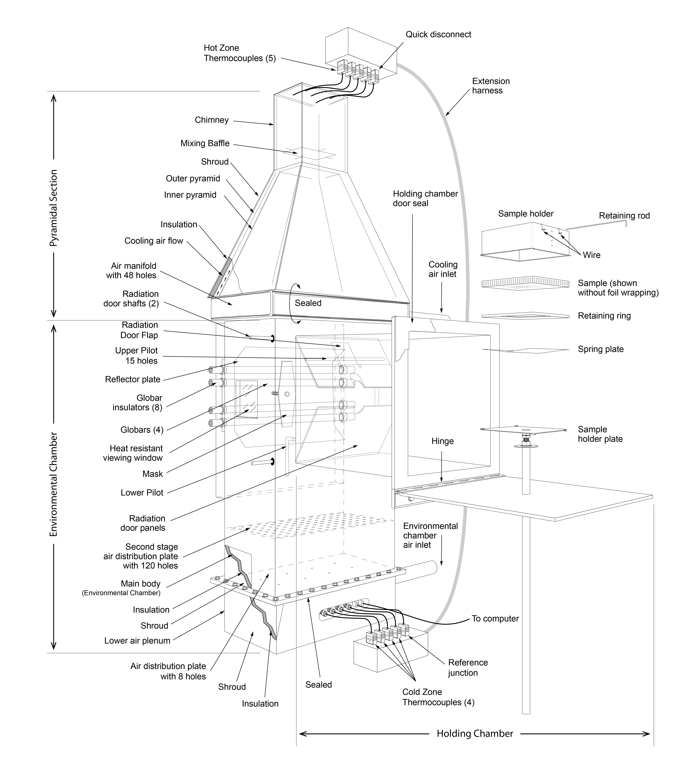
Airflow – Single Flow Design
OSU: Orifice Meter, Natural 3:1 Airflow Split
HR2: Mass Flow Meter Controlled

Slide 7
Removal of Bypass Air and Components
  Chimney
  Baffle Plate
  Outer Pyramid
  Bypass Air Manifold
  Piping
  Surplus Gasket Material and Hardware
  Orifice Meter/Mercury Manometer

Slide 8
Removal of Bypass Air and Components
PROS
  Single air source
    1 MFM Req’d
    Smaller Compressed Air System Req’d
  Easier to clean, inspect, maintain
  Fewer Components
  Lower Manufacturing / Operating costs
  Quieter system
  Thermocouples operating in a better performance range
  Higher gain in the Thermopile output signal
  Lower Calibration Factor (Approx. 4.0 kW/m²/mV or 0.09 kW/mv)
CONS
  Higher Exhaust Gas Temperatures (approx. 500 degrees F)

Slide 9
Airflow
Defined Air Quality
  “…free of oil mist, water and foreign particles”
Airflow (MFM/MFC Controlled)
  Calibrated To STP 0º C at 760 mmHg
  Accuracy: 1% Reading, 0.2% Full Scale
  Flow Rate: 20 ± 0.5 SCFM
  Positioned within 24 inches of the inlet port to the system
  Provision for Flow Straightening Piping

Slide 10
Standardized Construction
Insulation - Thermal Conductivity Criteria
Overlap Criteria
Component Metal Thickness & Tolerances Table
New Previous Component
¼ inch Aluminum | Unchanged | Holding Chamber Door
 | Unchanged | Air Distribution Plate
0.036 +/- 0.003 Alum. | Not Specified | Exhaust Stack Covering (New)
0.125 ± 0.005 | Not Specified | 1/8 inch Retaining Rod
0.048 ± 0.004 | (0.049 ± 0.002) | Main Body
 | Not Specified | Globar Pan
 | Not Specified | Holding Chamber
 | Not Specified | Second Stage Plate
 | Not Specified | Lower Air Plenum

Slide 11
Standardized Construction
New Previous Component
0.042 ± 0.004 | (0.042 ± 0.002) | Diamond Mask
0.036 ± 0.003 | (0.030 ± 0.008) | Reflector Plate
 | 24-Gauge Steal | Sample Holder Plate
0.030 ± 0.003 | (0.031 ± 0.002) | Outer Pyramid (Removed)
 | Not Specified | Radiation Doors (2)
0.018 ± 0.002 | Unchanged | Inner Pyramid (Modified)
 | Unchanged | Chimney (Removed)
 | Unchanged | Baffle Plate (Removed)
 | Unchanged | Sample Holders
 | Unchanged | Holder Spring
 | Unchanged | Retaining Ring

Slide 12
HR2 Exhaust Assembly
1” Stiffening Doubler
1” Flange

Slide 13
Standardized Construction
Exhaust Stack Mounting
  #10-32 x ¾” Bolts / Washers / nuts (28)
  Gasket
  0.036 +/- 0.003 Aluminum Covering
  No substitutions permitted
Main body
  Dimensions
  Observation window
  Inner radiation doors
  Rear globar pan
  Reflector plate
  Diamond plate shaft
  Upper Pilot/Calibration Burner
  Second Stage Plate
    Hole pattern (Centered in Chamber)
    Perimeter sealed
    Removable

Slide 14
Standardized Construction
Holding Chamber
  Dimensions
  Outer door
  Preheat sample position
Specimen Holder / Components
  Dimensions
  Retaining Ring
  Spring Plate
  Retaining Rod
  Drip Pan
HFG Mounting
  Refractory Board (Thickness, HFG flush mount)
  Corner HFG position

Slide 15
Standardized Thermopile / Globars
Thermopile mV Generating System
  New Thermocouples (9)
  Detailed Wiring Diagram
  96 inch Overall Length
  24 Gauge, Solid Conductor, Thermocouple Grade Wire
  Quick Disconnects
  Cold Junctions Centrally Located in Lower Plenum: 1.5 inch Spacing
  Reference Junction: Closest To Air Inlet
Globars
  Construction: CHZ, Length, Diameter, Resistance
  Rheostat control of upper/lower pairs or individually
  Advisory on final power adjustments / Uniformity
  Voltage Fluctuation Tolerance (Globars)

Slide 16

New Procedures: Calibration
  Goals:
    Achieve better stability at each step change in flow
    Obtain largest mV rise possible for each step change in flow (resulting in the low calibration factor)
    Linear analysis to mV rise per step change in flow
    Low % error (<5%)
    Reduce time req’d to complete the calibration process
    Reduced use of Methane Gas
    Make it easier

Slide 17
New Procedures: Calibration
Replaced Wet Test Meter with Mass Flow Meter (MFM)
Calibration Gas MFM
  Thermal-based
  0.25 inch inlet/outlet fittings
  Calibrated annually with NIST traceability
  Calibrated for Methane gas
  Accuracy: 0.5% Reading, 0.1% Full Scale, 2-sigma level of confidence
  STP 0ºC at 760 mmHg
  Signal Output To Data Acquisition System
  Flow deviation of < 0.2 SLPM
Dual Purpose Burner (Upper)
  Calibration Burner (Removed T-Burner)
  Upper Pilot Burner during testing – 2 SLPM / Air (Approx. 50/50 Ratio)

Slide 18
New Procedures: Calibration
Calibration Method Changes
  Optimized flow settings from 1,4,6,8 L/min to 1,2,3,4 SLPM
  Entire calibration sequence defined (Beginning to end)
  3 minute Preheat at 4 L/min
  Step Change: 1-2, 1-3, 1-4 SLPM
  Longer dwell – Increased from 2 to 3 minutes (last 10 second average)
  Methane MFM/MFC output recorded with Thermopile output
  Only 3 step changes in flow (previously 5)
  Exhaust ventilation system must be on
Calibration Pass / Fail Criteria
  Unchanged @ 5% STDEV error between the three calibration constants derived during the calibration process (1-2, 1-3, 1-4 SLPM)

Slide 19
HR2 Prototype
CALIBRATION PARAMETERS
METHANE FLOW (SLPM) |  |  |  |  | THERMOPILE OUTPUT (mV)
Low Range | TARGET | High Range |  |  | Low Range |  | TARGET | High Range
0.98 | 1.0 | 1.02 |  |  | 60.0 |  | 61.0 | 62.0
1.96 | 2.0 | 2.04 |  |  | 67.0 |  | 68.0 | 69.0
2.94 | 3.0 | 3.06 |  |  | 73.0 |  | 75.0 | 77.0
3.92 | 4.0 | 4.08 |  |  | 78.0 |  | 80.0 | 82.0
CALIBRATION FACTOR RANGE
Low Range |  |  | TARGET |  |  | High Range
0.07 kW/mv |  |  | 0.08 kW/mV |  |  | 0.09 kW/mV
3.0 kW/m²/mV |  |  | 3.5 kW/m²/mV |  |  | 4.0 kW/m²/mV

Slide 20
New Procedures: Heat Flux
HFG Type: Replaced Gardon with Schmidt-Boelter
HFG Guidance: Paint / Care / Mounting
New insitu method (Center)
  3.65 +/- 0.05
New Uniformity Tolerance (4-Corners)
  3.65 +/- 0.10

Slide 21
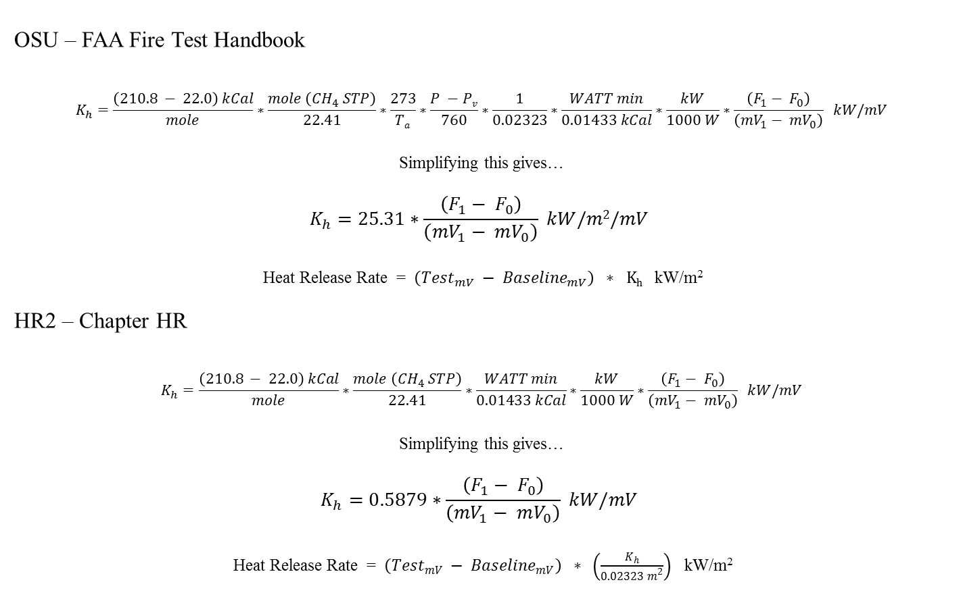
Calibration Factor / HRR Equation
Deleted
Sample Area Moved to HRR Calculation
OSU – FAA Fire Test Handbook
$$K_{h}=\frac{\left(210.8 − 22.0\right) kCal}{mole}∗\frac{mole \left({CH}_{4} STP\right)}{22.41}∗\frac{273}{Ta}∗\frac{P −Pv}{760}∗\frac{1}{0.02323}∗\frac{WATT min}{0.01433 kCal}∗\frac{kW}{1000 W}∗\frac{\left(F_{1}− F_{0}\right)}{\left({mV}_{1}− {mV}_{0}\right)} kW/mV$$
Simplifying this gives…
$$K_{h}=25.31∗\frac{\left(F_{1}− F_{0}\right)}{\left({mV}_{1}− mV_{0}\right)} kW/m2/mV$$
Heat Release Rate = $\left({Test}_{mV} − {Baseline}_{mV}\right) ∗ Kh$ kW/m²
HR2 – Chapter HR
$$K_{h}=\frac{\left(210.8 − 22.0\right) kCal}{mole}∗\frac{mole \left({CH}_{4} STP\right)}{22.41}∗\frac{WATT min}{0.01433 kCal}∗\frac{kW}{1000 W}∗\frac{\left(F_{1}− F_{0}\right)}{\left({mV}_{1}− {mV}_{0}\right)} kW/mV$$
Simplifying this gives…
$$K_{h}=0.5879∗\frac{\left(F_{1}− F_{0}\right)}{\left({mV}_{1}− mV_{0}\right)} kW/mV$$
Heat Release Rate = $\left({Test}_{mV} − {Baseline}_{mV}\right) ∗ \left(\frac{K_{h}}{{0.02323 m}^{2}}\right)$ kW/m²

Slide 22
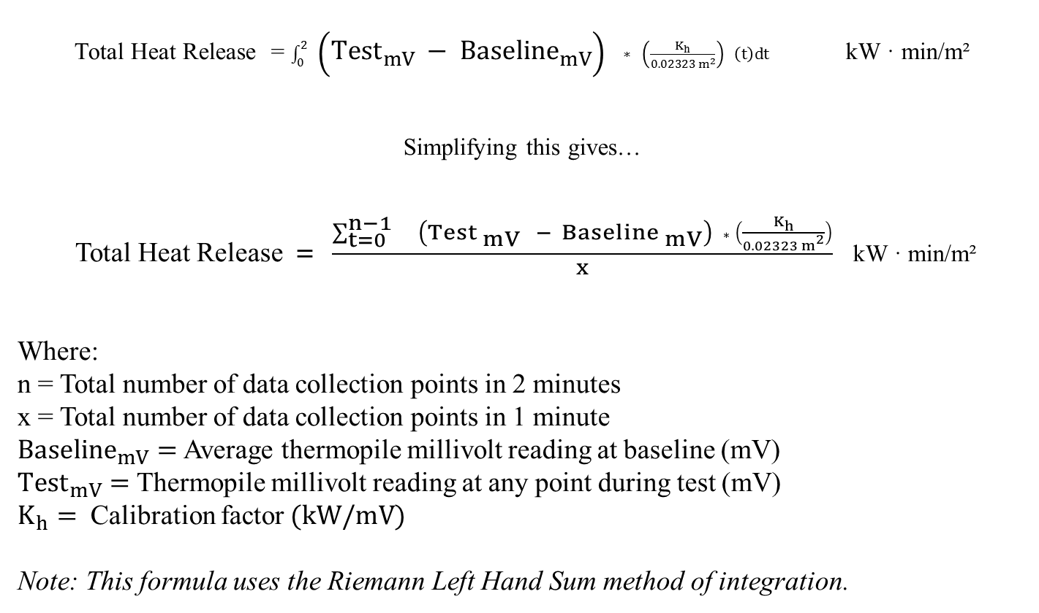
HR2: Total Heat Release Calculation
Total Heat Release = $\int_{0}^{2}{ \left({Test}_{mV} − {Baseline}_{mV}\right) ∗ \left(\frac{K_{h}}{{0.02323 m}^{2}}\right) \left(t\right)dt}$ kW · min/m²
Simplifying this gives…
Total Heat Release$= \frac{\sum_{t=0}^{n−1}{ \left({Test}_{ mV} − {Baseline }_{mV}\right) ∗ \left(\frac{K_{h}}{{0.02323 m}^{2}}\right)}}{x}$ kW · min/m²
Where:
n = Total number of data collection points in 2 minutes
x = Total number of data collection points in 1 minute
${Baseline}_{mV}=$Average thermopile millivolt reading at baseline (mV)
${Test}_{mV}=$Thermopile millivolt reading at any point during test (mV)
$K_{h}=$ Calibration factor$(kW/mV)$
Note: This formula uses the Riemann Left Hand Sum method of integration.

Slide 23
Chapter HF: Definitions
Calibration Factor (K_{h}) - Correlates the heat released by a specimen when burned to the known heat content of Methane.
Thermopile
Mass Flow Meter (MFM)/Mass Flow Controller (MFC)
Methane Gas (CH4) - Minimum purity of 99%
Supply pressures – Methane @ 20 ± 2 psig, Air @ 30 ± 2 psig
NIST - The National Institute of Standards and Technology (USA)
NIST Traceability - A calibration entity using NIST traceable calibration instrumentation.
  Heat flux gauges (Chapter HF)
  Data acquisition / Display devices
  Flow meters (System Airflow and MFM for thermopile calibration)
Stability Criteria - Heat flux, Chamber equilibrium

Slide 24
Chapter HF: Calibration Requirements and Frequency
Equipment
  Heat Flux gauges
  Data Acquisition System/Display Devices
  MFM / MFC (Air)
  MFM / MFC (Methane)
Procedures
  System Heat Flux
  Heat Flux Uniformity
  Thermopile (Gas Calibration)

Slide 25
Chapter HF: Misc.
General / Scope
Drawings
  System Overview Drawing (assembled)
  Individual Components - 29 Detailed Drawings
Test Procedure
  Aluminum foil thickness criteria
  Sample Insertion / Removal Time - Approximately 3 to 5 seconds
  Cleaning procedures
Requirements
  65/65 (Peak HRR / Total HR) - Unchanged
  < 80 % must pass

Slide 26
HR2 Prototype Testing
Materials (5 coupons each)
Schneller Panel (2012 RR)
Light Brown Panel (2012 RR)

Slide 27
HR2: 53.5

Slide 28
HR2: 69.6

Slide 29
HR2: 47.9

Slide 30
HR2: 36.9

Slide 31
Next
Participation in 2013 Round Robin
Conformance Documentation Development
Additional Unit Buildups for Comparative Testing

