Slide 1
Recommendations for Cargo Compartment Fire Safety
Joseph Panagiotou

Slide 2
Three Major Cargo Fires in the Past 7 Years....
Feb 7, 2006 UPS flight 1307
  Philadelphia, PA.
Sept 3, 2010 UPS flight 006
  Dubai, UAE
July 28, 2011 Asiana Cargo flight 991
  Jeju Island, South Korea

Slide 3
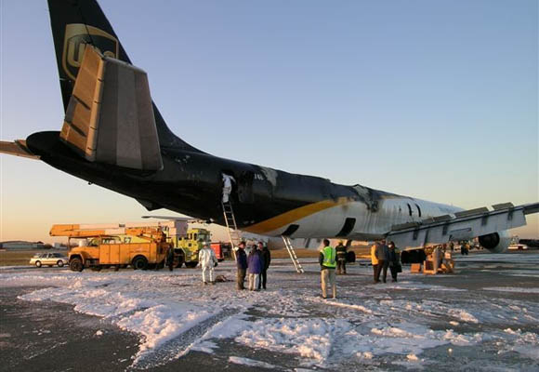
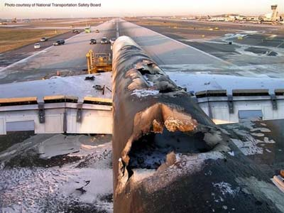
UPS Flight 1307
McDonnell Douglas DC-8
long time between smell of smoke and cargo fire alarm
No fire suppression in flight
Unidentified fire source
Aircraft was a total loss
NTSB Report:
http://www.ntsb.gov/doclib/reports/2007/AAR0707.pdf

Slide 4
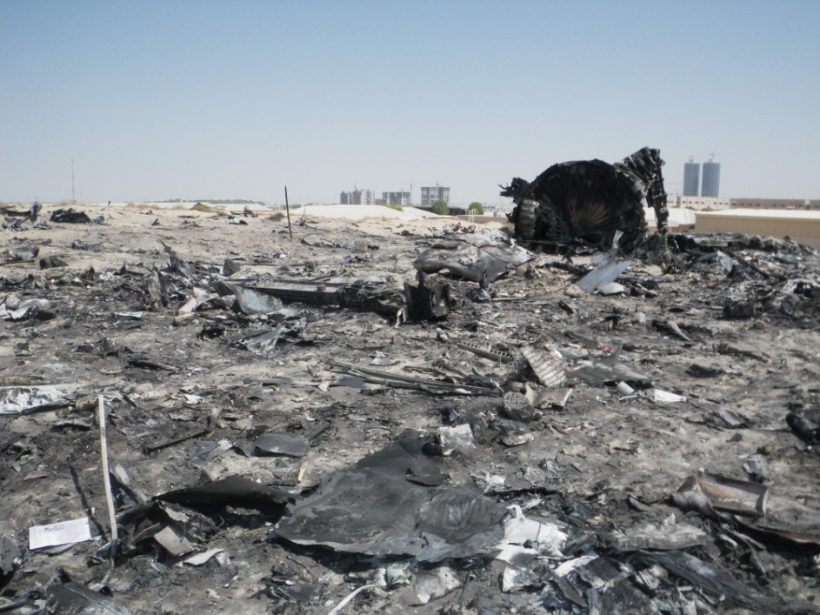
UPS Flight 006
Boeing 747-400F
2 ½ minutes between cargo fire alarm and onset of system loss
Heavy smoke in the flight deck
suppression by depressurization ineffective
aircraft out of control
Unidentified source
loss of crew and aircraft

Slide 5
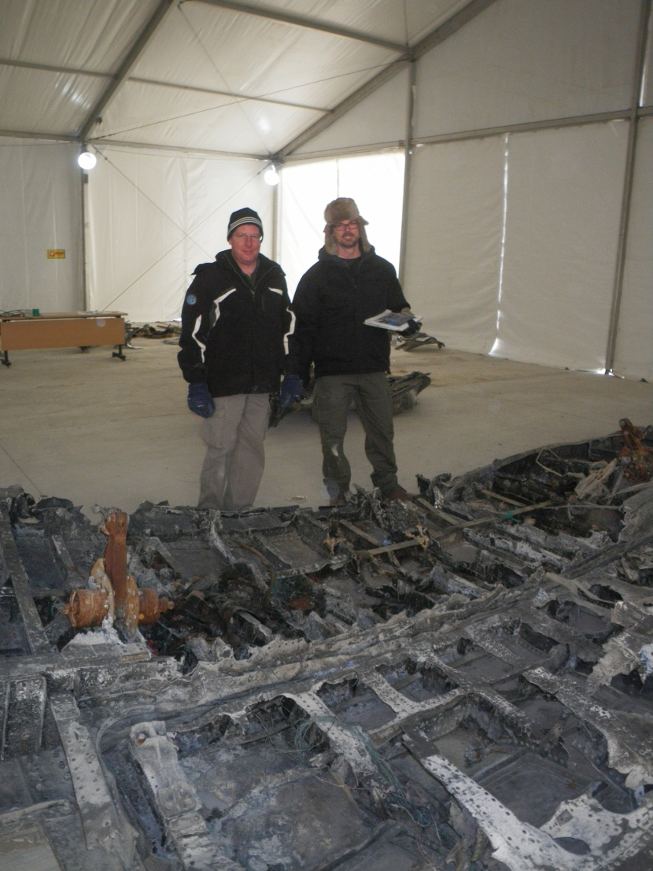
Asiana Cargo Flight 991
Boeing 747-400F
Short time between cargo fire alarm and control difficulties
smoke in the flight deck
Aircraft out of control
loss of crew and aircraft
This accident is still under investigation by the South Korean government.

Slide 6
Accident Similarity
short time between fire detection and onset of damage*
smoke in flight deck*
no suppression
unidentified source
loss of aircraft.
* The UPS flight 1307 fire did not exhibit these conditions.

Slide 7
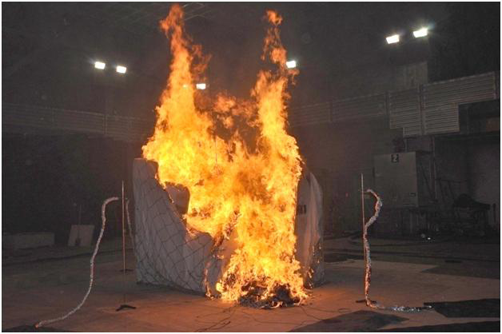
Full Scale Container Fire Test Findings
Container design effects time to detection
Exceeds 1 min detection time regulation
Container materials can add to the fire load
Fire growth rate after becoming detectable is rapid
For information about the NTSB’s cargo container fire study (NTSB Materials Laboratory Study Report 12-019), see case number DCA10RA092 on the NTSB’s website at http://www.ntsb.gov/investigations/dms.html.
http://www.fire.tc.faa.gov/pdf/systems/Nov11Meeting/Panagiotou-1111-HeatReleaseRate.pdf

Slide 8
Current Regulations for Main Deck Cargo Compartments
Cargo container construction materials
    materials subjected to horizontal Bunsen burner test
    (UL-94) with a performance of < 4”/min
Time to detection <1min
  14 CFR 25.858
Suppression not required in Class E compartments

Slide 9
NTSB Recognizes That Progress is Being Made..
UPS
FedEx
FAATC

Slide 10
NTSB recommendations for Cargo Compartment Safety
Issued November 28, 2012
Develop fire detection system performance requirements for the early detection of fires originating within cargo containers and pallets and, once developed, implement the new requirements. (A-12-68) (This safety recommendation supersedes Safety Recommendation A-07-98, which is classified “Closed—Acceptable Action/Superseded.”)
http://www.ntsb.gov/doclib/recletters/2012/A-12-068-070.pdf

Slide 11
NTSB recommendations for Cargo Compartment Safety
Ensure that cargo container construction materials meet the same flammability requirements as all other cargo compartment materials in accordance with Title 14 Code of Federal Regulations 25.855. (A-12-69)
Require the installation and use of active fire suppression systems in all aircraft cargo compartments or containers, or both, such that fires are not allowed to develop. (A-12-70)

