Slide 1
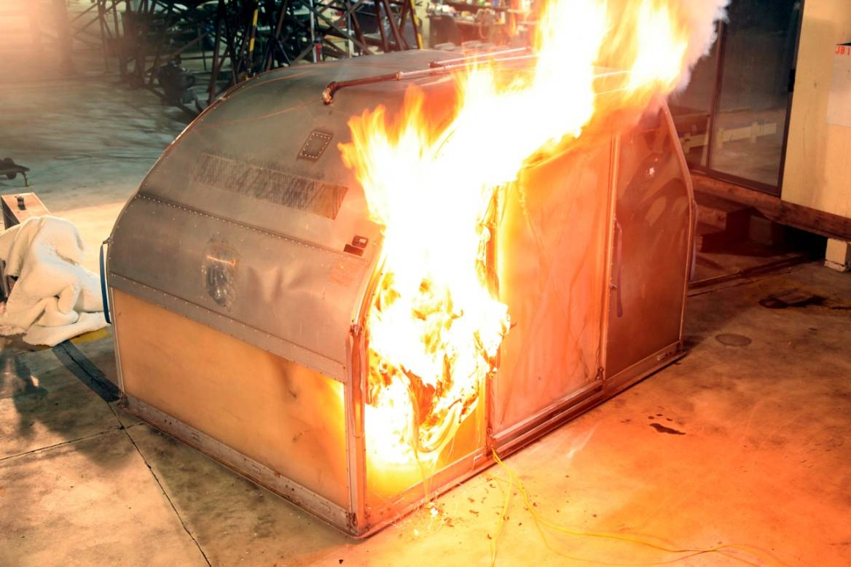
Fire Suppression in a Class E Cargo Compartment
International Aircraft Systems Fire Protection Working Group, Philadelphia
Dhaval Dadia, FAA Technical Center Atlantic City, NJ
December 2-5, 2013

Slide 2
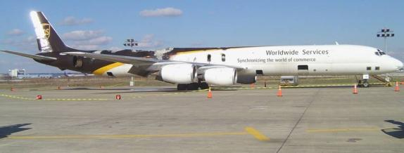
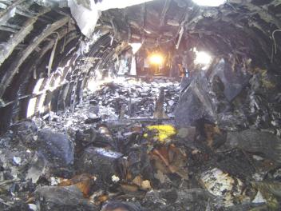
Accident History
UPS DC-8
Feb. 7, 2006
Philadelphia, PA
Notes:
Plane landed safely but was damaged substantially from a cargo fire.

Slide 3
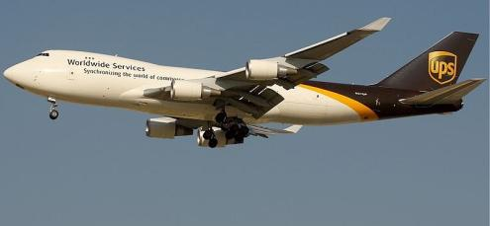
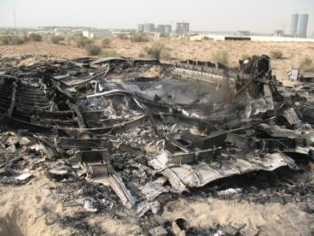
Accident History
UPS Boeing 747
Sept. 3, 2010
Dubai, UAE
Notes:
22 minutes into a flight at an altitude of 32000 feet, crew got a waning of a fire in the Class-E cargo compartment. Airplane was decimated from the crash and post-crash fire.

Slide 4
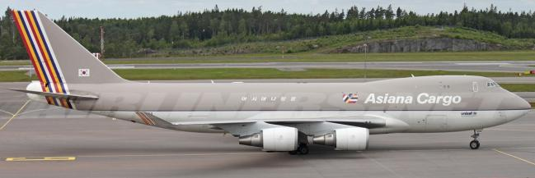
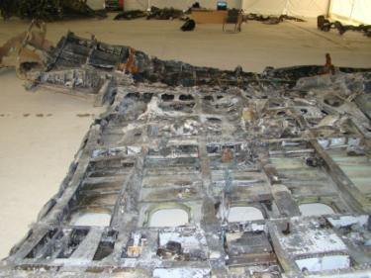
Accident History
Asiana Airlines Boeing 747
July 28, 2011
South Korea
Notes:
Declared an emergency and crashed. Within a short amount of time after the warning, the crew observed flight control and aircraft system failure.

Slide 5
Current Regulations
Appendix F to Part 25 - Part I - (a)(v) Except for small parts (such as knobs, handles, rollers, fasteners, clips, grommets, rub strips, pulleys, and small electrical parts) that would not contribute significantly to the propagation of a fire and for electrical wire and cable insulation, materials in items not specified in paragraphs (a)(1)(i), (ii), (iii), or (iv) of part I of this appendix may not have a burn rate greater than 4.0 inches per minute when tested horizontally in accordance with the applicable portions of this appendix.
SAE and ISO are working on creating regulations for the materials used in the construction of a container to be similar to a cargo liner burnthrough test.

Slide 6
NTSB Safety Recommendation
“Container design has a significant effect on the time it takes for an internal fire to become detectable to a smoke detector outside the container.”
“Container construction materials have a significant effect on the total fire load and energy release rate of a cargo fire.”

Slide 7
Engineering a Solution
Identifying ways to suppress fires in class-E cargo compartments
  Aerosol Fire Suppression Agent
  Oxygen Starvation (Fire Resistant Container)
  FRC + Aerosol Fire Suppression Agent
  Water Mist System

Slide 8
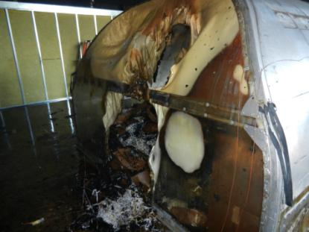
Aerosol Fire Suppression Agent
Currently used ULDs can withstand deep seated fires for approximately 8 minutes with an aerosol based fire suppression agent.
The agent escapes from the door which allows for fresh air to enter the container.
Notes:
Normally used AAY container with a fire suppression agent.

Slide 9
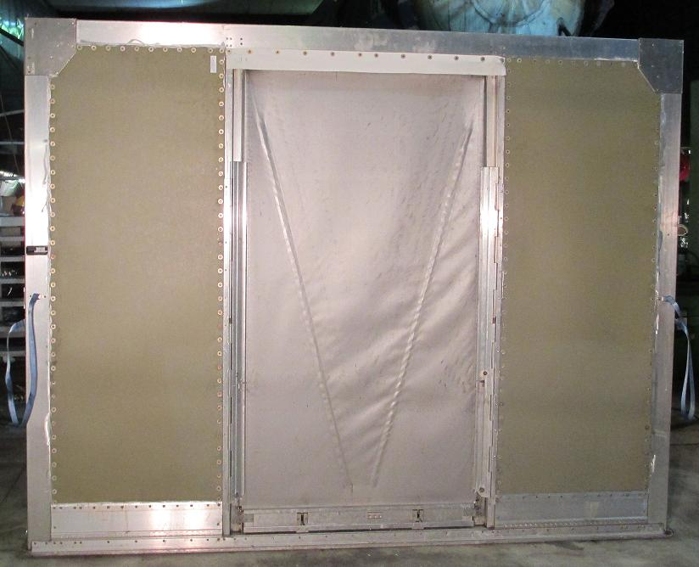
Oxygen Starvation (FRC)
Develop materials that can withstand fires within the container.
Reduce the air exchange rate to
  Reduce oxygen replenishment
  Retain the aerosol based fire suppression agent within itself
Reduction in the weight of the container by using the composite material.

Slide 11
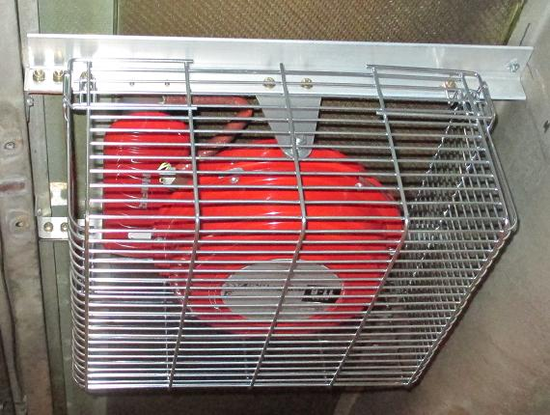
Secondary Fire Suppression Agent
Detects and activates fires within the container.
Extinguishes the fire within the container.
Maintains a low oxygen concentration environment.
Excess aerosol triggers smoke detectors outside the container.

Slide 13

Video of Composite Cargo Container with Fire Suppression Agent

Slide 14
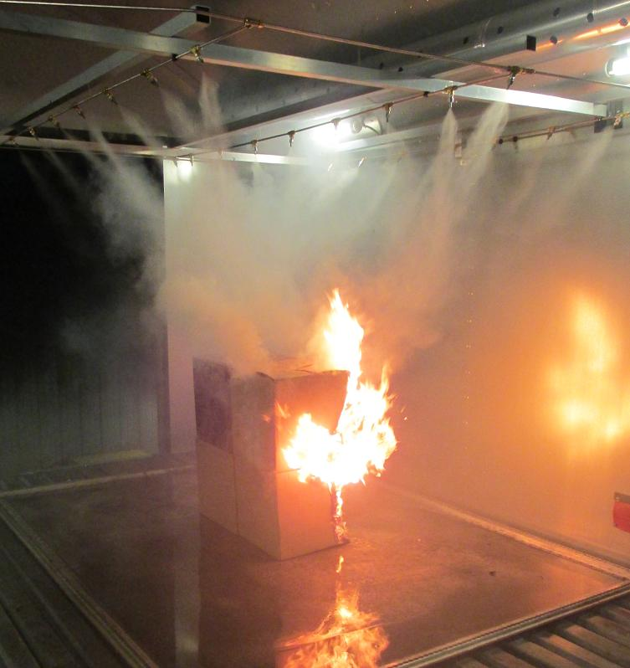
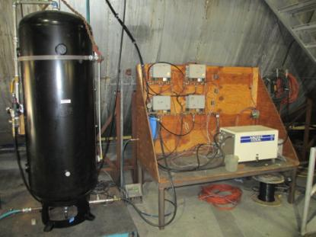
Zone Based Water Mist System

Slide 15
Zone Based Water Mist System
Environmental Engineering Concepts water mist system used in Class-C testing is being repurposed for use in Class-E Cargo.
  High Pressure, Pump Driven System
  Zones will be divided by each container position.
  Each zone consists of 23 nozzles.
  System Flow Rate ~ 0.54gpm (1 zone) to 1.84gpm (4 zones)
  System Operating Pressure ~ 550psig (4 zones activated) to 1150psig (1 zone activated)

Slide 16
Zone Based Water Mist System
Activation of Water Mist System
  Automated activation triggered when ceiling temperature reaches 200°F.
  The system stays on until ceiling temperatures decrease to under 200°F.
Effectiveness of the system will be based on the amount of water used in various test scenarios.
  The amount of water will be determined based on difference in the weight of the water holding tank before and after the test.

Slide 17
Zone Based Water Mist System
Test scenarios to measure the effectiveness of the system.
  Full and half load pallet fires.
  Palette fires with Fire Containment Covers (FCC).
  Full and half load fires in Polycarbonate / Aluminum AAYs.
  Full and half load fires in Fire Resistant Containers (FRC).

Slide 18
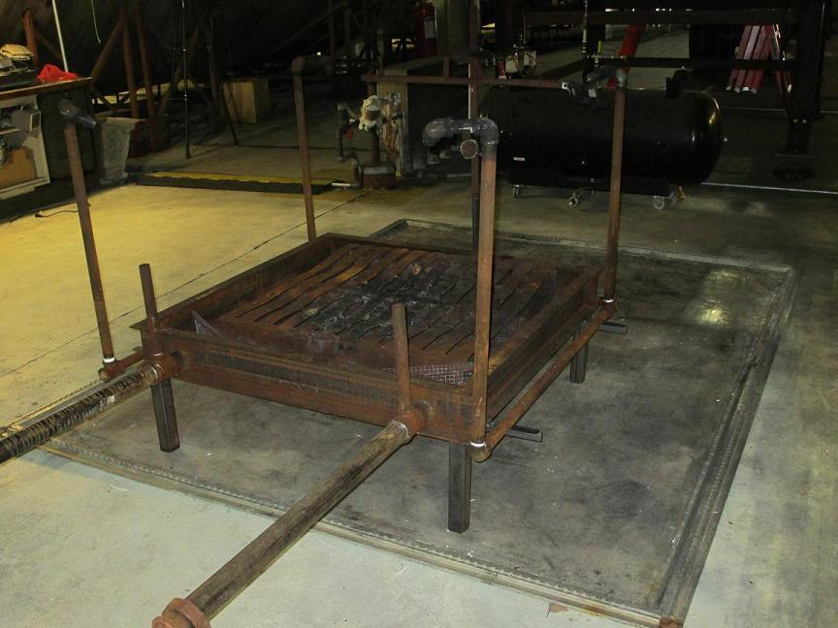
Lithium Battery Testing
Test FCC and FRC against lithium batteries as a fire load.
  Lithium-ion 5000 18650 cells
  Lithium metal 4800 SF123A cells
Test will be conducted within a Class E compartment of a 727.
Notes:
Mention 727 is under construction. Will first conduct a 5000 lithium metal battery test outside the test article to study what will happen under the FCC.

Slide 19
Lithium Battery Testing
Instrumentation
  Thermocouples
  Calorimeter
  Smoke meter
  Gas Measurement – CO, CO2, O2
  Pressure Measurement

Slide 20
Conclusion
A solution set has been achieved in suppressing fires in class-E cargo compartments by combining oxygen starvation with an effective fire extinguishing agent.
The capability of FRCs and FCCs against lithium battery fires is yet to be determined.

