Slide 1
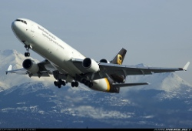
Freighter Fire Protection During Smoke/Fire/Fume Events
Captain Bob Brown
UPS/IPA Safety Task Force

Slide 2
Presentation Objectives
Describe the Changing Nature of Air Shipments
Discuss 4 Areas for Improving
Freighter Fire Protection
Provide Thoughts for the Industry to Consider

Slide 3
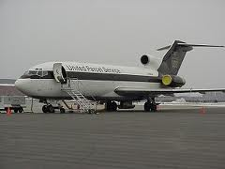
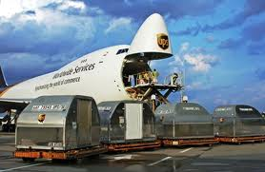

The Air Business Model Has Changed
How has our Business Changed?
  A growing percentage of payload involves technology
  Evolving high-energy technologies
  Growing consumer demand
Battery energy costs have dropped from $3.17/watt hour in 1991 to $0.12/watt hour in 2013
  2010 - $0.18/ watt hour
1988
2013

Slide 4
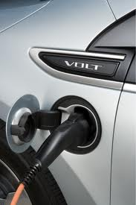
The Battery Market is Growing
The global lithium-ion market in 2012 was $11.7 billion
That market is expected to double by 2016
Today 64% of the lithium-ion battery market is in consumer batteries
North America will remain the largest market for industrial lithium-ion batteries in 2016

Slide 5
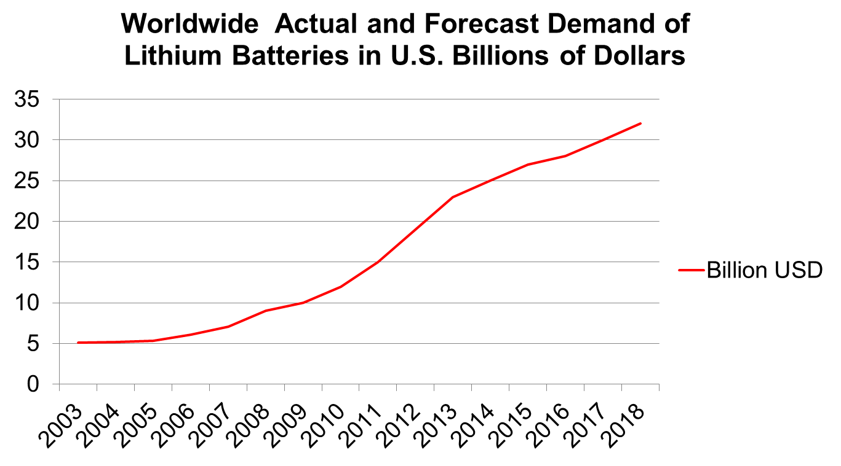
Global Lithium Battery Market in ($US) Billions

Slide 6

The Issue is Safely Transporting High Energy Shipments by Air

Slide 7
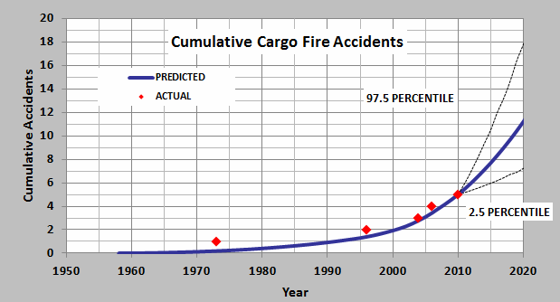
FAA Study on Cargo Fire Accidents
FAA Safety Analysis of U.S. domestic freighters predicts
approximately six (6) accidents likely to occur from now to 2021

Slide 8
4 Areas for Improving
Freighter Fire Protection
Flight Deck
Training
Containers
Certification

Slide 9
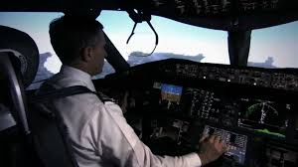
Pilots and the Flight Deck
Flight Deck
Protection
The Last Line of Defense

Slide 10
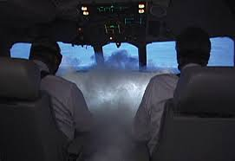
Important Facts About Cockpit Smoke
Flight Deck
"Smoke is the leading defined cause of emergency landings for ETOPS” (Air Safety Week)
"The time from first indication of smoke to an out-of-control situation may be very short." (Boeing Aero 14)
In-flight smoke events on transport jets are twice as likely as in-flight engine failures
(ALPA Safety Report)
Notes:
.

Slide 11
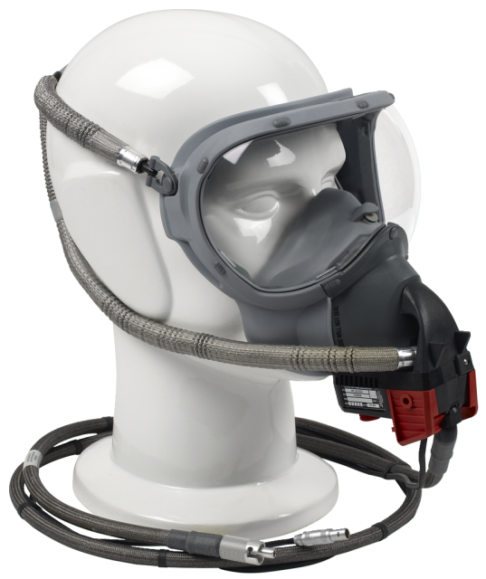
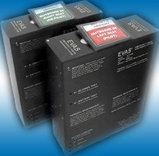
The Combination of Two
Technologies Greatly Improves Safety
Flight Deck

Slide 12
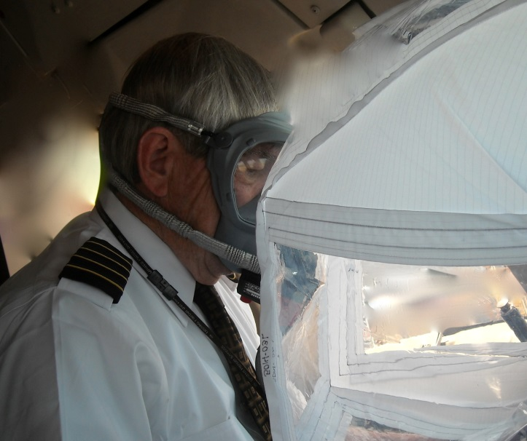
Emergency Vision Assurance System
Flight Deck
Emergency Vision Assurance System (EVAS) manufactured by VisionSafe is being installed on all UPS aircraft
When a crewmember deploys EVAS, it inflates in about 1 minute to provide a clear view of primary flight instruments and outside front windshield
EVAS testing conducted by UPS demonstrated pilots could still safely fly an aircraft in a densely smoke-filled cockpit

Slide 13
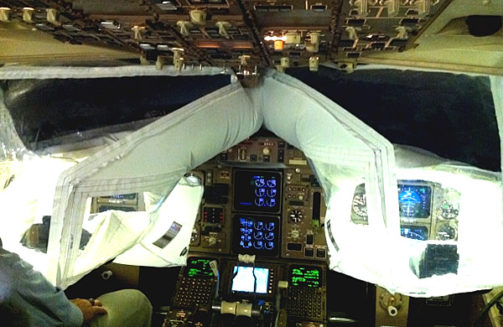
Emergency Vision Assurance System
Flight Deck

Slide 14
Full-Face Oxygen Masks
Flight Deck
Flight crews must be protected not only from smoke, but also from toxic fumes
Smoke goggles have been found to be ill-fitting for some eyeglass wearers
Full-Face Masks don quicker, reduce operational complexity and allow a better fit and more effective mask purging.

Slide 15
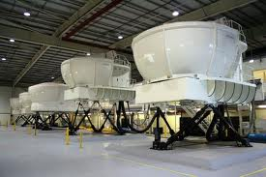
Pilot Training
Training
Improving the Process

Slide 16
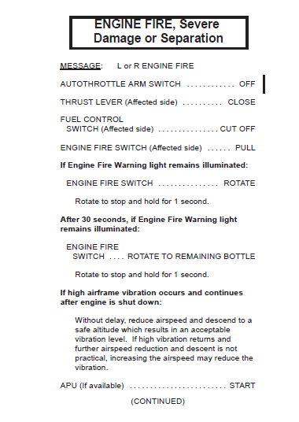
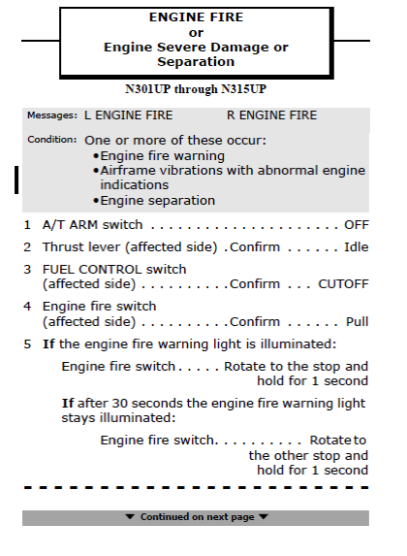
Checklist Design
Human Factors Example:
Checklist Numbering System
Training
Notes:
Key Points
For certain key points, I’ll simply place a few words on a slide without any other visuals, especially when I can’t find an appropriate picture and I want the words to linger in the minds of my audience.
Again, I’ll always tell a story that brings the key point alive for the audience while I keep the words on the screen, effectively “burning“ an image in their mind.

Slide 17
Checklist Design
Human Factors Example:
Condition and Confirmation Steps
Training

Slide 18
Training Center
Training
Flight Training Centers should emphasize the importance of training aircraft emergency equipment
Alternate recurrent training scenarios with comprehensive Smoke/Fire in Cockpit (EVAS) Training and Water/Land Evacuation Procedures

Slide 19
Training Center
Training
Incorporate Sequence Based Instruction into Smoke/Fire/Fumes Emergency Training
“The order in which material is presented can strongly influence what is learned, how fast performance increases, and sometimes even whether the material is learned at all.”
"Sequence learning". Trends in Cognitive Sciences

Slide 20
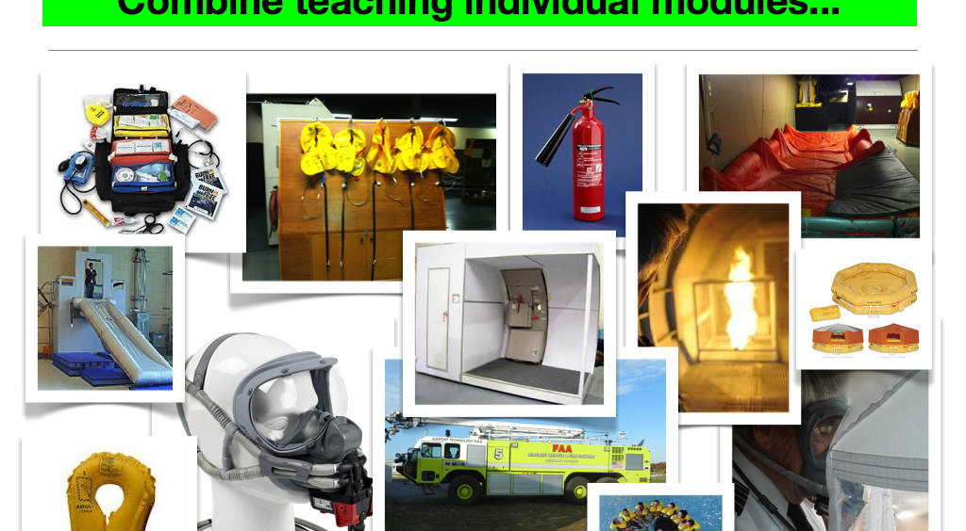
Combine teaching individual modules
Training

Slide 21
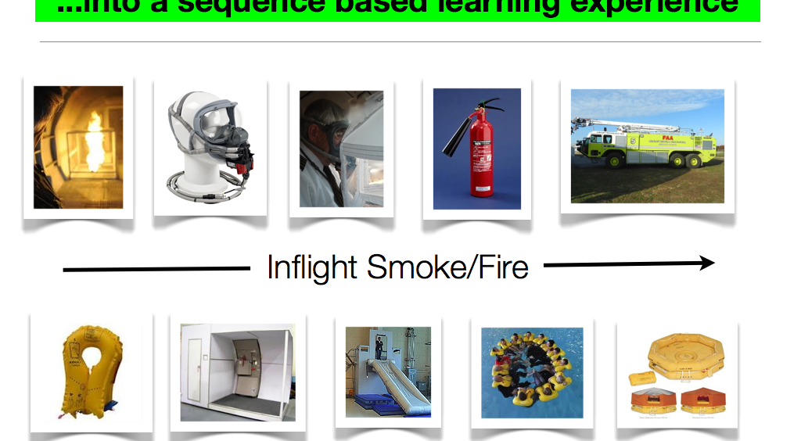
Into a sequence based learning experience…
Training

Slide 22
Protecting the Aircraft
Containers
FCC and ULD
New materials and designs are making a difference

Slide 23
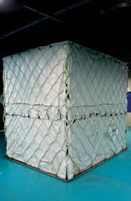
Fire Containment Covers (FCC)
Containers
17 UPS Asian gateways are covering high-energy shipments and unknown palletized freight from origin to final destination
Covers are quickly returned to origin gateways for reuse
It requires no additional time to place an FCC on a pallet then a cargo net

Slide 24
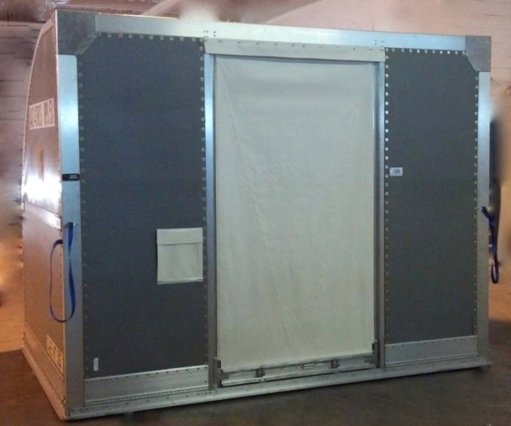
Unit Load Device (ULD)
Containers
The goal of the ULD project is to:
Contain a fire to the ULD only
Fire containment objective is 4 hours
Testing by UPS has repeatedly shown that 4 hour containment has been achieved

Slide 25
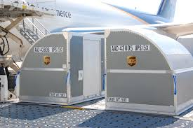
Unit Load Device (ULD)
Containers
UPS has done extensive research and testing on ULD materials and door designs
MACROlite material has proven to be lighter weight, more durable and exhibited tremendous fire resistant properties
UPS placed an order for 1821 ULDs made with MACROlite material for delivery by January 2014

Slide 26
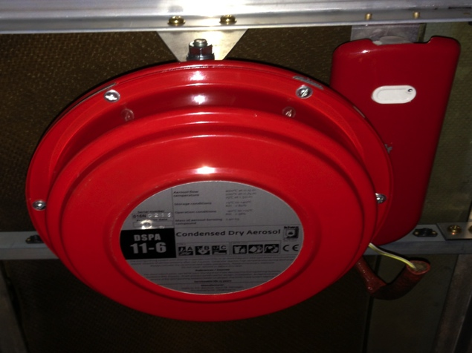
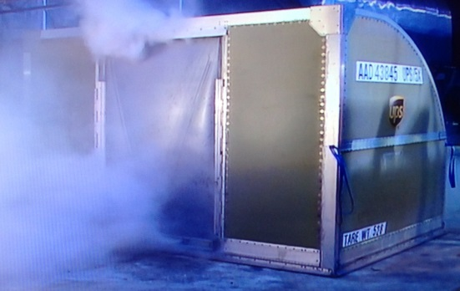
ULD with Suppression
Containers
ULD has applied for an STC and is in the process of certificating a ULD suppression system
Both FedEx and UPS fire suppression systems recognize you have to fight the fire in the container
More certification testing planned (including 5000 lithium-ion and lithium metal battery)
UPS Test, October 2012 Video

Slide 27

Containers

Slide 28

Certification
Certification
Regulations
Exploring regulations and certification requirements

Slide 29
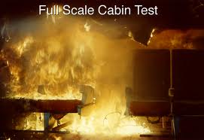
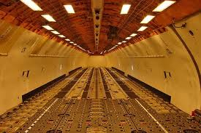
Continuous Smoke Testing
Certification
FAA’s Part 25 aircraft advisory materials AC25-9a (last updated 20 years ago) recommend all aircraft be tested during continuous smoke to prove systems can protect crewmembers during a smoke event.
Historically, smoke has entered the cockpit numerous times due to fire onboard an aircraft and remained a continuous threat. (UPS 6, Asiana 991)
The published and voluntary standards are not consistent with real-world experience

Slide 30
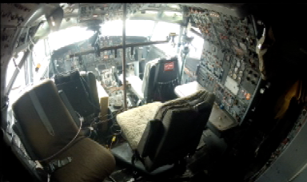
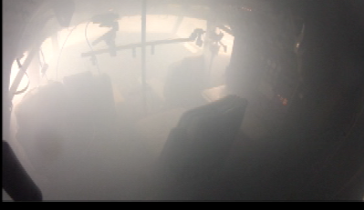
Real World Standards
Certification
B727 at 10 Minutes
From 1990 to 2010 there have been 18 major accidents involving in-flight fire. These accidents resulted in 423 fatalities (Flight Safety Foundation)
Recent full-scale battery testing by the FAA Technical Center (Feb 26, 2013) using a Boeing 727 proved that even with air conditioning packs on and manufacturer’s emergency procedures followed, smoke enters the cockpit
B727 at 14 Minutes

Slide 31
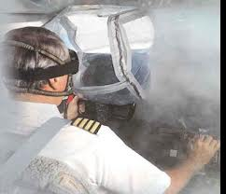
Real World Standards
Certification
Theatrical smoke and battery-fire smoke are different due to density, toxicity and pressure
FAA should require manufacturers to
Demonstrate the capability to evacuate dense, continuous smoke, or
Provide equipment, such as EVAS, to maintain pilots’ view of flight instruments and out the windshield in dense continuous smoke conditions

Slide 32
Final Thoughts…
A greater level of aviation safety is possible
New materials and design for ULD construction show great promise
New technology in the area of fire suppression has proven very effective
Industry and regulators need to work together to develop fire-safety certification rules and standards reflecting current (and future) technologies

Slide 33
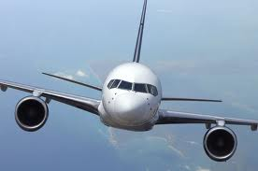
Final Thoughts…
If we do our jobs well, Aviation safety will be greatly enhanced and more aircraft cargo fires will become survivable events

Slide 34
Questions

