Slide 1
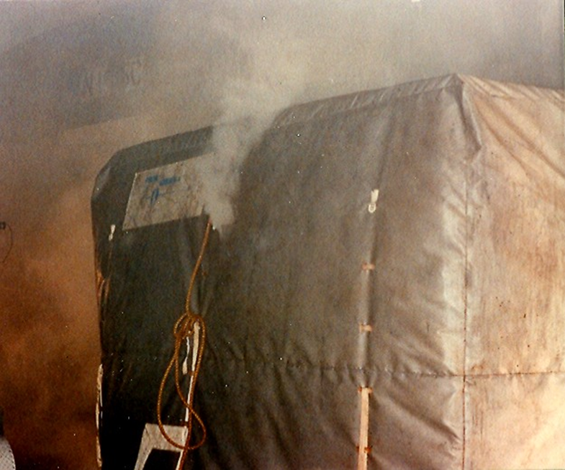
SAE/ISO Fire Containment Covers (FCCs) and Fire Resistant Containers (FRCs) Standards Development
Presented to: 7th Triennial International Fire and Cabin Safety Research Conference, Philadelphia, PA
Presented by: Dave Blake, FAA Technical Center, Fire Safety Branch
Date: Dec 4, 2013

Slide 2
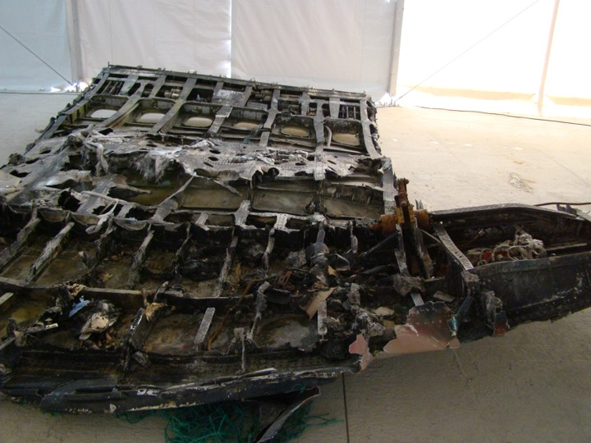
Recent Inflight Cargo Aircraft Fires
ASIANA 747-400
July 28, 2011
130 km West of Jeju, South Korea
The flight crew reported a main deck cargo fire 50 minutes after takeoff from Incheon, South Korea on a scheduled flight to Shanghai, China. It crashed into the sea 18 minutes later while attempting to divert to Jeju. There were no survivors. The accident investigation of this event is ongoing.

Slide 3
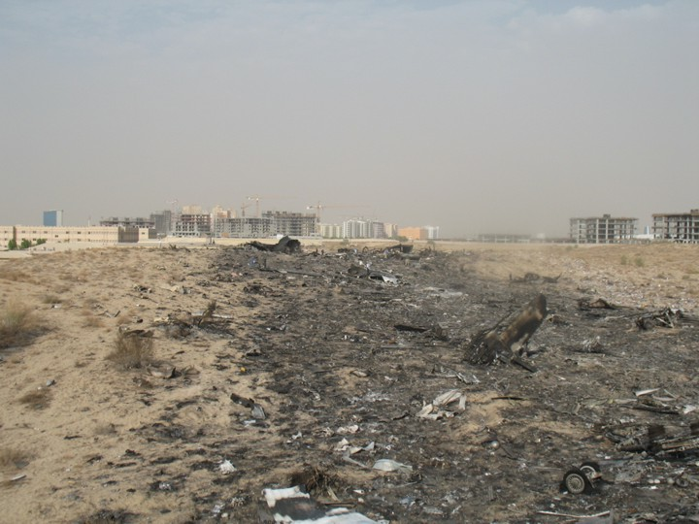
Recent Inflight Cargo Aircraft Fires
UPS 747-400
September 3, 2010
Dubai, UAE
The flight crew reported a main deck cargo fire 23 minutes after takeoff from Dubai on a scheduled flight to Koeln, Germany. It crashed near Dubai 28 minutes later while attempting to return to the airport. There were no survivors. A summary of the final report on the cause of this accident identified an uncontrolled main deck cargo fire which led to the inability to control the aircraft.

Slide 4
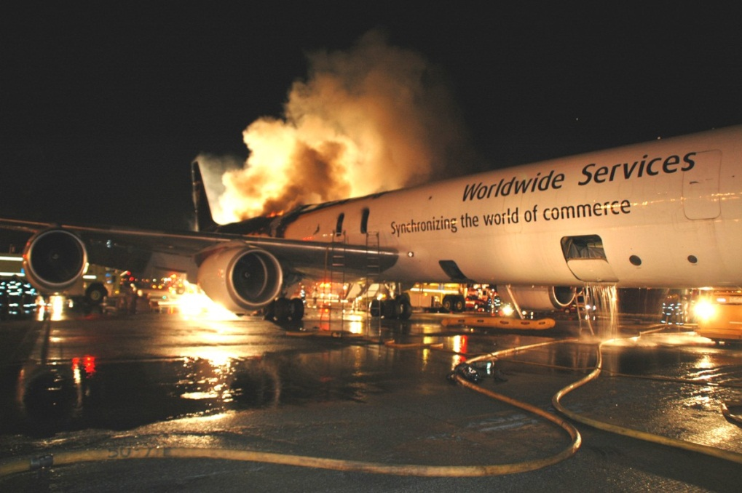
Recent Inflight Cargo Aircraft Fires
UPS DC-8
Philadelphia, PA
February 7, 2006
The flight crew discussed a smoke smell in the flight deck 94 minutes after takeoff from Atlanta, Georgia on a scheduled flight to Philadelphia. The main deck smoke detectors alarmed 20 minutes later during final descent. The aircraft landed safely and the 3 crew members evacuated with minor injuries. The aircraft was subsequently destroyed by fire. The probable cause of the accident was a main deck cargo fire of undetermined origin.

Slide 5
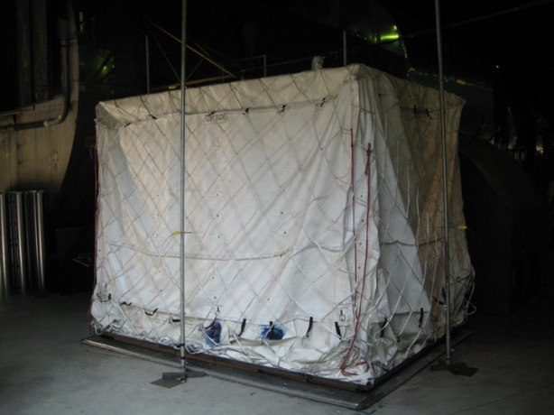
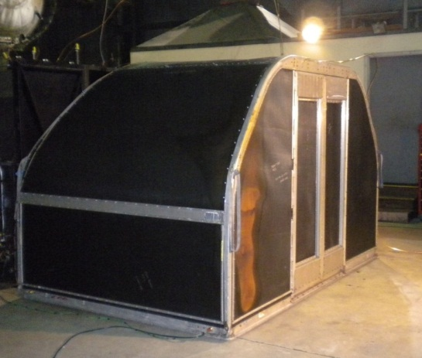
FCCs are flexible covers constructed of fire resistant materials that are intended for use on pallets of cargo.
FRCs are rigid containers constructed of fire resistant materials that are intended to be used in place of standard unit load devices (ULDs) where more robust fire protection is desired or required.
Both FCCs and FRCs have demonstrated effectiveness in containing fires involving ordinary combustible materials through oxygen starvation.

Slide 6
In a effort to standardize the performance of FCCs and FRCs, the FAA is requesting that SAE develop new industry standards for both FCCs and FRCs.
The international organization ISO has initiated the development of corresponding standards.
The intent is for the SAE and ISO standards to be essentially identical.
Working groups made up of industry and regulatory participants have finalized the first editions of the SAE and ISO FCC standards. (SAE AS6453 and ISO/CD 14186)
SAE and ISO working groups have started the development of new standards for FRCs. (SAE AS6278 and ISO NP19281)

Slide 7
FCC Standard
Requires testing for resistance to abrasion, puncture, UV, humidity, and fungus.
Requires the FCC material pass the burn-through resistance fire test required for cargo liner material. This test exposes the material to a oil burner flame of at least 1600°F (871°C) for 5 minutes. The oil burner flame must not penetrate the material and the temperature 4” above the horizontal sample must not exceed 400°F (204°C). (14 CFR Part 25 App. F Part III)

Slide 8
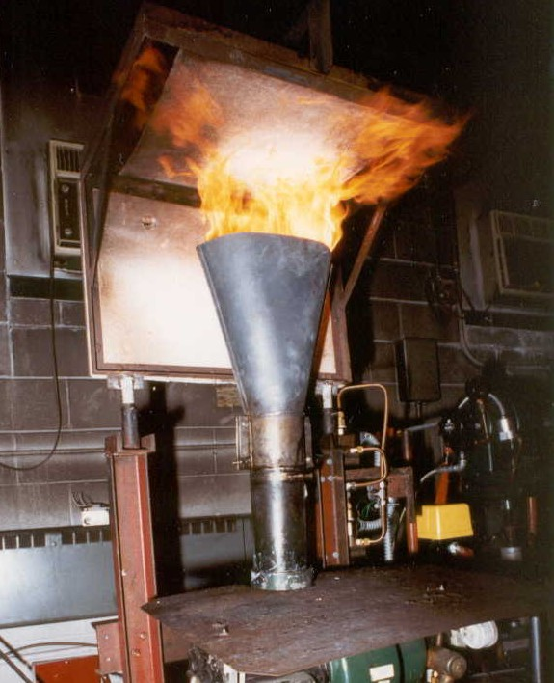
FCC Standard
14 CFR Part 25 App. F Part III Oil Burner Flammability Test

Slide 9
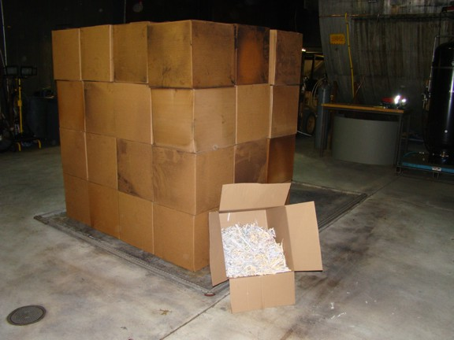
FCC Standard
Requires a full scale mock up fire test using cardboard boxes partially filled with shredded newspaper. The test duration is 6 hours or for the maximum diversion time of the airplane it will be used on. The pass/fail criteria is that the fire is completely contained under the FCC with no external flaming.

Slide 10
Full Scale FCC Fire Test

Slide 11
FRC Standard
Preliminary discussions of the SAE/ISO working groups indicate that the FRC standards will be very similar to the FCC standards.
There has been some interest in the cargo airline industry in installing built in fire suppression systems within FRCs. Preliminary working group discussions indicate that the new FRC standards would not include suppression and/or detection features at this time.

Slide 12
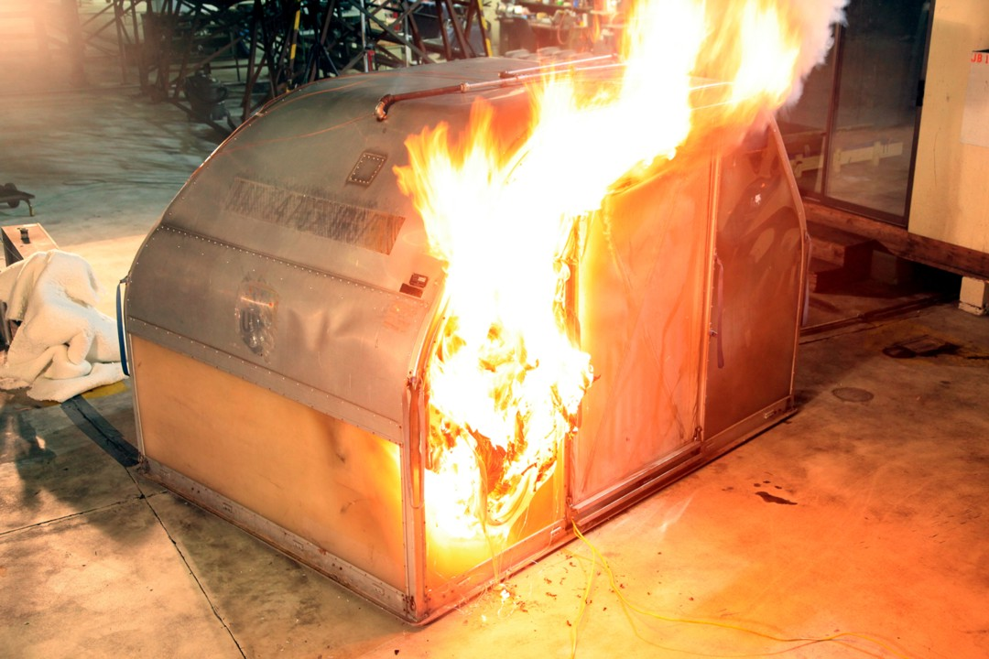
The FAA intends to use the TSO as a means of incorporating, by reference, the new SAE FCC and FRC standards.
This action is intended to provide desired standardization for the certification of these potential improvements to the fire suppression capability of aircraft cargo compartments.

