Slide 1
CARGO COMPARTMENT SMOKE DETECTOR STANDARD AS8036 UPDATE
Ken Bell, Kidde

Slide 2
INTRODUCTION
FAA Approached SAE to update the AS8036 Standard to include nuisance tests
TSO C1, Cargo Compartment Fire Detection Instruments calls out AS8036
AS8036
Hasn’t been updated since 1985
Has no requirements for minimum performance for false alarms resistance
Working group was put together in April/May 2011 to update the document to
Reflect current test standards
Improve false alarm resistance of new designs
This presentation will detail the changes to the standard

Slide 3
WORKING GROUP FROM THE FAA, SAE, BOEING, AIRBUS AND SMOKE DETECTOR MANUFACTURERS
Keely Andrews SAE
Ken Bell Kidde
Dave Blake FAA Tech Center
Ian Campbell Meggitt
Laura Feix SAE
Andre Freiling Airbus
Loic Frere Siemens
Stephen Happenny FAA
Joan Hughson FAA
Larry Lamberth Honeywell
Bruce Mahone SAE
Bruce Miller Boeing
Gerd Wedler AOA-Gauteng
Ulrich Wollenweber, AOA Gauteng

Slide 4
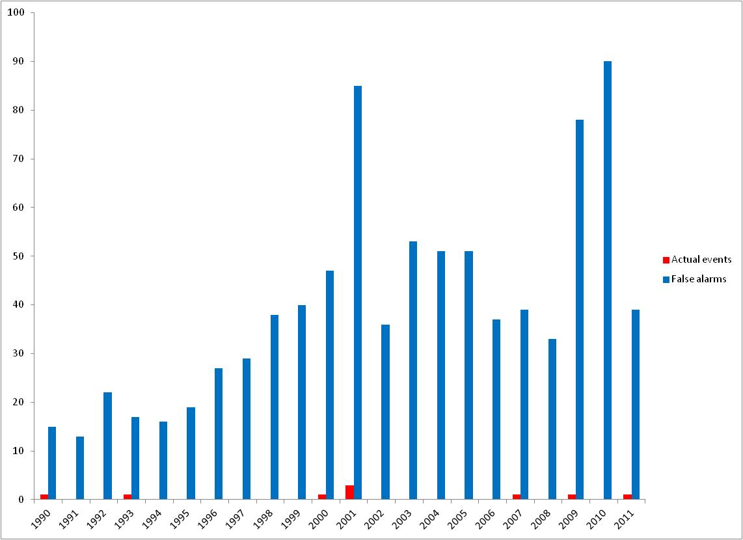
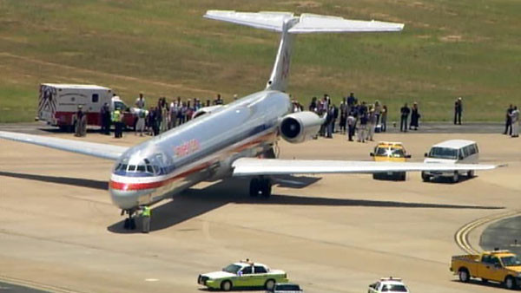
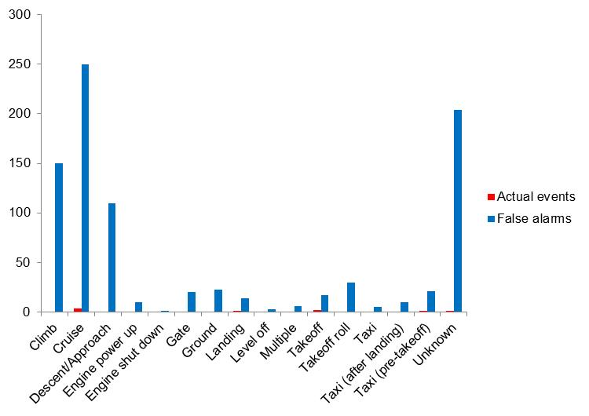
CARGO FALSE ALARMS

Slide 5
UPDATES MADE TO AS8036 FOR STANDARD ENVIRONMENTS
DO-160G called out for the following environments, where appropriate
Temperature
Altitude
Decompression
Overpressure
Temperature Variation
Humidity
Shock
Vibration
Explosion proofness
Waterproofness
Fluids Susceptibility
Sand and Dust
Fungus Resistance
Salt Spray
Magnetic Effect
Power Input
Voltage Spike
Audio Frequency Conducted Susceptibility
Induced Signal Susceptibility
Radio Frequency Susceptibility (Radiated and Conducted)
Emission of Radio Frequency Energy
Lightning Induced Transient Susceptibility
Lightning Direct Effects
Icing
Electrostatic Discharge
Fire, Flammability

Slide 6
TESTS ADDED TO AS8036
Smoke detection performance testing
False alarm resistance against airborne dusts
False alarm resistance against insecticide aerosol
False alarm resistance against intense ambient light
False alarm resistance against fog - combined environments

Slide 7
FIRE DETECTION TESTING
Test fires from UL268 or EN54-7 shall be selected to demonstrate that the detector can successfully detect fire
UL268 test fires
Test B (Wood Fire)
Test C (Flammable Liquid Fire)
EN54-7 test fires
TF2 (Smouldering Wood Fire)
TF5 (Flaming Liquid).

Slide 8
FALSE ALARM TESTING - DUSTS
No alarm shall occur as a result of normal dust present at instrument location, nor from dust that normally accumulates within the instrument. No false pre-flight system test indication shall occur due to accumulated dust.
When subjected to dust aerosolized in test equipment similar to the description in Figure 1, the instrument must not suffer a false alarm and operate electrically and/or mechanically, where appropriate.
The dust test shall be performed 2 times, at different rates of rise for the dust concentration.
1. A rate of rise of approximately 0.4%/ft/min (1.31%/m/min) shall be used
2. A rate of rise of approximately 3.4%/ft/min (10.72%/m/min) shall be used
For the dust testing the minimum test concentration shall be at least 7%/ft (21.2%/m). The average test concentration shall be maintained for at least one minute.
For detectors calibrated to alarm at a smoke level X (where X ≤5%/ft (15.5%/m)) obscuration, the detector shall not alarm when subjected to a minimum test dust concentration of 7%/ft (21.2%/m).
For detectors calibrated to alarm at a smoke level Y (where Y > 5%/ft (15.5%/m)) obscuration, the detector shall not alarm when subjected to a minimum test dust concentration of Y + 2 %/ft (6.4%/m).
The test shall be repeated 3 times. All consecutive tests shall be passed.

Slide 9
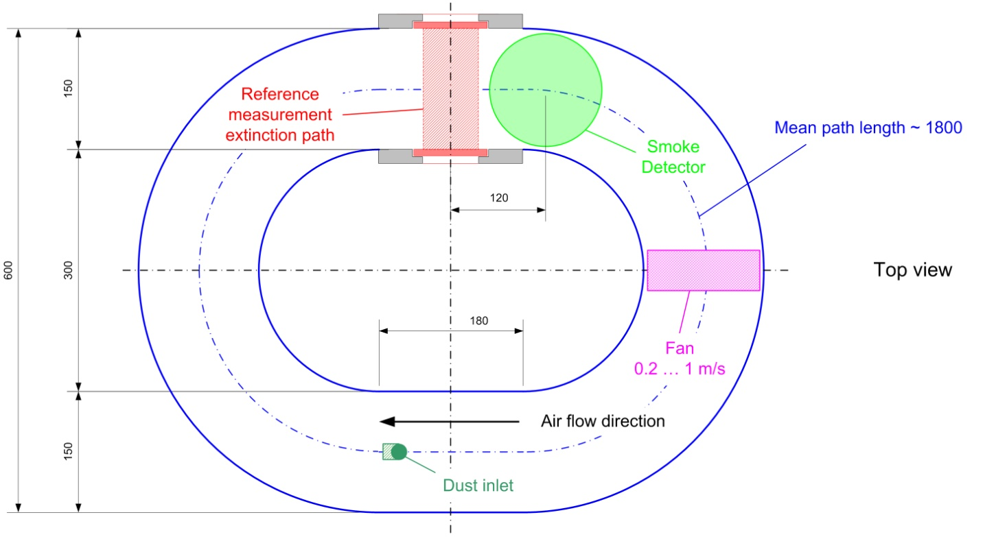
DUST TESTING APPARATUS

Slide 10
FALSE ALARM TESTING - INSECTICIDE
No alarm shall occur as a result of insecticide aerosol present at instrument location. When subjected to insecticide aerosol in test equipment described in Figures 2 and 3, the instrument must not suffer a false alarm and operate electrically and/or mechanically, where appropriate.
The insecticide test shall be performed 2 times, at different rates of rise for the insecticide concentration.
1. A rate of rise of approximately 0.4%/ft/min (1.31%/m/min) shall be used
2. A rate of rise of approximately 3.4%/ft/min (10.72%/m/min) shall be used
For the insecticide testing the minimum test concentration shall be at least 7%/ft (21.2%/m) to be verified by a reference measurement device. The average test concentration shall be maintained for at least one minute. The test aerosol may be generated by use of a pressurized insecticide aerosol such as Callington One-Shot or equivalent.
For detectors calibrated to alarm at a smoke level X (where X ≤5%/ft (15.5%/m)) obscuration, the detector shall not alarm when subjected to a minimum test insecticide concentration of 7%/ft.
For detectors calibrated to alarm at a smoke level Y (where Y > 5%/ft (15.5%/m)) obscuration, the detector shall not alarm when subjected to a minimum test insecticide concentration of Y + 2 %/ft (6.4%/m).
The test shall be repeated 3 times. All consecutive tests shall be passed.

Slide 11
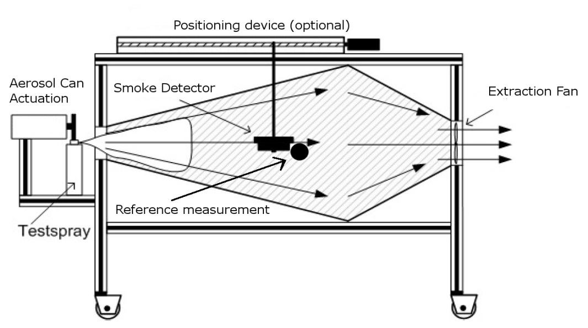
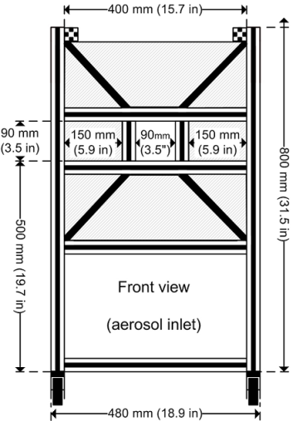
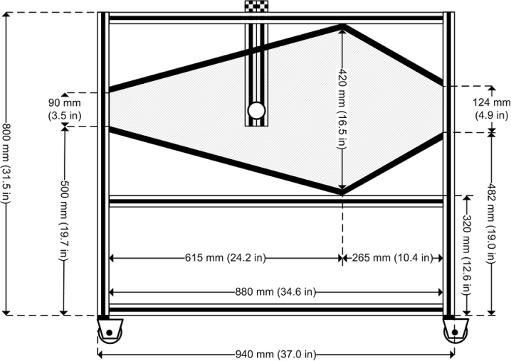
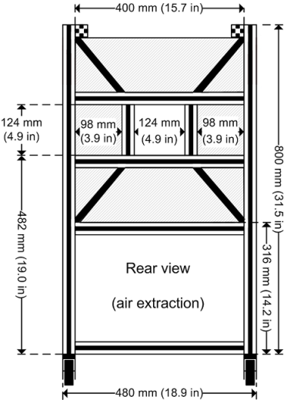
INSECTICIDE TESTING APPARATUS

Slide 12
AMBIENT LIGHT TESTING
No alarm shall occur as a result of ambient light being directed at the detector
The detector shall be subjected to a dazzle test using a cube of side approximately 13.8” (350mm)
The internal surfaces of the cube shall be lined with high gloss aluminum foil
Five 32W circular fluorescent lamps of diameter approximately 12.3” (312mm) are fixed to the bottom face and the sides
With the test unit operating and mounted to the inside of the top face, no false alarms shall be reported when all lamps are activated
An alternate test would be the EN54-7 paragraph 5.7 dazzle test

Slide 13
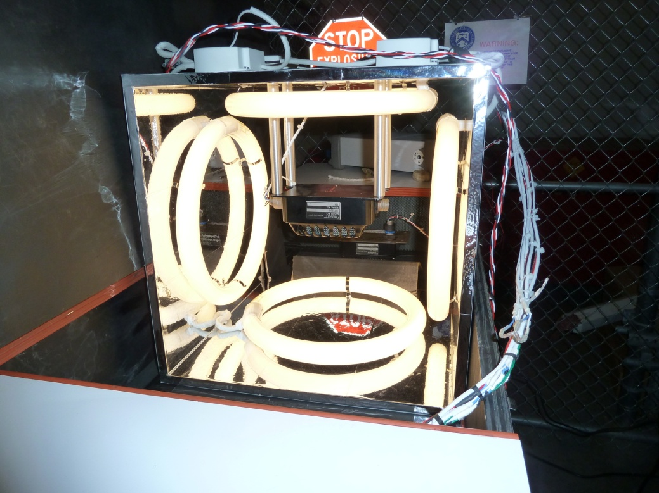
AMBIENT LIGHT TESTING APPARATUS

Slide 14
COMBINED ENVIRONMENTS TEST
Designed to simulate cycling between hot humid airports and cold dry cruise
Bring the environment to Warm/Moist. With the test item operating, ramp the humidity to 95 percent relative humidity (RH) at an average 6%/min. Ramp the temperature to 50ºC at a rate of 5ºC per minute
Warm/Moist Dwell. Maintain 50°C, site pressure, and 95 percent relative humidity for 30 minutes
Ramp to Cold Altitude. With the test item operating, ramp the temperature to 0ºC at a rate of 5ºC per minute. Ramp the humidity to ambient conditions at an average ramp rate of 6% RH/min. Ramp the chamber from the test site pressure to 15000ft pressure altitude
Cold Soak. Allow the test item to soak at 0ºC, 15000ft and uncontrolled humidity for 1 hour
Repeat the cycle (steps 1 to 4) two (2) times
Bring to ambient conditions

Slide 15
COMBINED ENVIRONMENTS T, P & RH TEST PROFILES

Slide 16
SUMMARY
AS8036 updated and new Revision agreed by the AS8036 working group
Document is with the SAE Aerospace Council for review and 28 day ballot
If no disapprovals it will be sent to publish
TSO C1e will subsequently be updated to call out the new standard

