Slide 1
Escape Slide Performance
Altitude Effects
By Mike Kret
Technical Support Manager
Air Cruisers - Doing business as (DBA):
Zodiac Aerospace Evacuation Systems America (ZAESA)

Slide 2
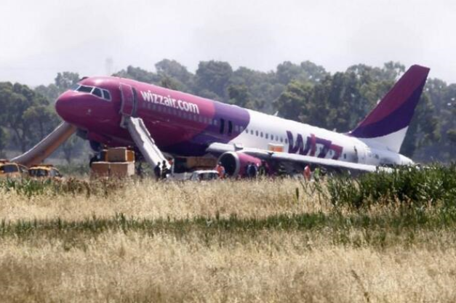
Do Evacuation Systems Perform Adequately at High Altitudes?
Evacuation systems must perform at altitudes up to 15,000 ft

Slide 3
Background Information
History
Several years ago Air Cruisers moved part of the manufacturing process from a facility close to “sea-level” to a facility residing near 5,000 ft.
SPC deployment records are maintained by these facilities.
  A final tube pressure differential was noted to be approximately .30-.40 psig. higher

Slide 4
Background Information
History
While this phenomenon was already known in the industry, these occurrences again brought to light the potential impact of altitude on tube pressures
Prior/similar studies have been performed however several of our systems were questioned since they do not utilize pressure relief devices
How will these evacuation systems perform at 15,000 ft?

Slide 5
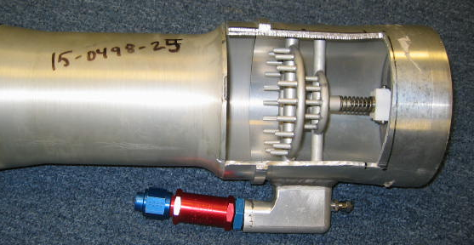
Background Information
How Do Slides Inflate?
The aspirators are composed of several key parts:
Nozzle Array
Ambient Inlet / Flapper Valve
Mixing Tube
Pressurized Gas Inlet

Slide 6
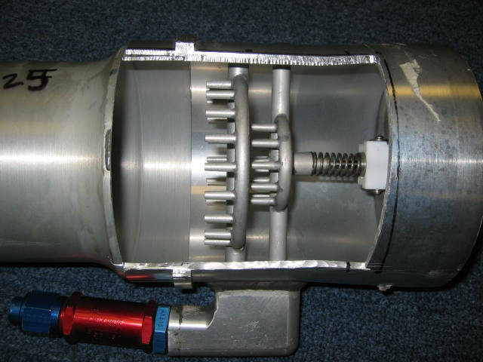
Background Information
How Do Slides Inflate?
The released gas flows through the hoses to the aspirators and a partial vacuum is created in the inlet section of the aspirators by the high-velocity gas as it leaves the nozzles.
As a result, ambient air enters through the flapper valves and combines with the high velocity gas in the venturi to provide for rapid inflation.
Ambient Air Inlet
Combined Exit Gas
Pressurized Gas Inlet

Slide 7
Background Information
Requirements
Evacuation system performance is governed by FAA TSO-C69
Normal conditions pressure range – range of pressures attained during typical deployments
Minimum operating pressure – the minimum pressure at which the evacuation rate can be met
Maximum operating pressure – that which may be reached after the device has reached a usable attitude
The device structure must withstand a pressure of 1.5 times the maximum operating pressure for five minutes without damage and at least 2 times the maximum operating pressure without failure for at least one minute

Slide 8
Do Evacuation Systems Perform Adequately at High Altitudes?
Calculations can be performed to analyze the expected performance at altitude
ACC was interested in obtaining empirical data
Two options were considered:
  A - Fly Engineers and equipment to Daocheng Airport in Tibet (14,500 ft)
  B – Send Engineers and equipment to the altitude chamber at FAA CAMI facility in Oklahoma City
    Option worked out great – Helpful and knowledgeable support team
    Really good barbeque nearby

Slide 9
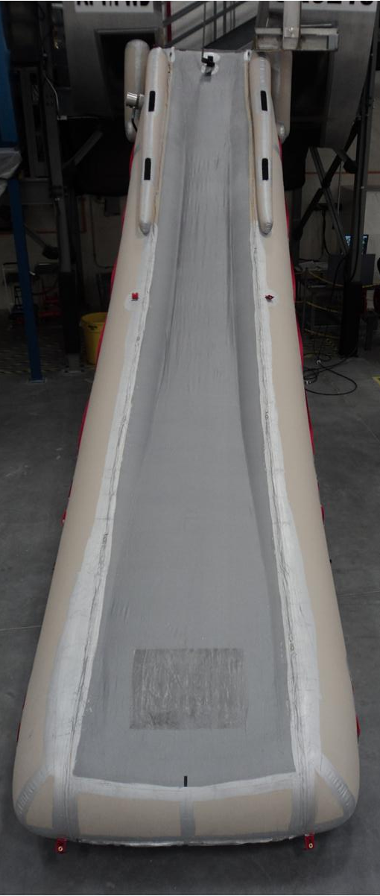
Testing
Two evacuation slide systems were tested:
  A320 slide – 22.5’Lg X 5.0’Wd
Maximum Operating Pressure: 3.55 psig
Overpressure Test: 5.33 psig
Minimum burst value: 7.1 psig

Slide 10
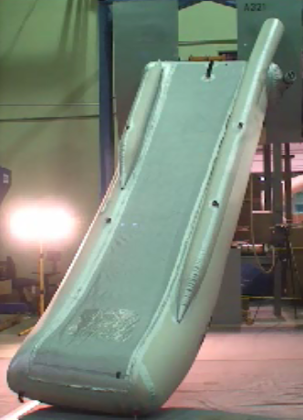
Testing
Two evacuation slide systems were tested:
  A321 slide – 17.4’Lg X 5.5’ Wd
Maximum Operating Pressure: 3.50 psig
Overpressure Test: 5.25 psig
Minimum burst value: 7.00 psig

Slide 11
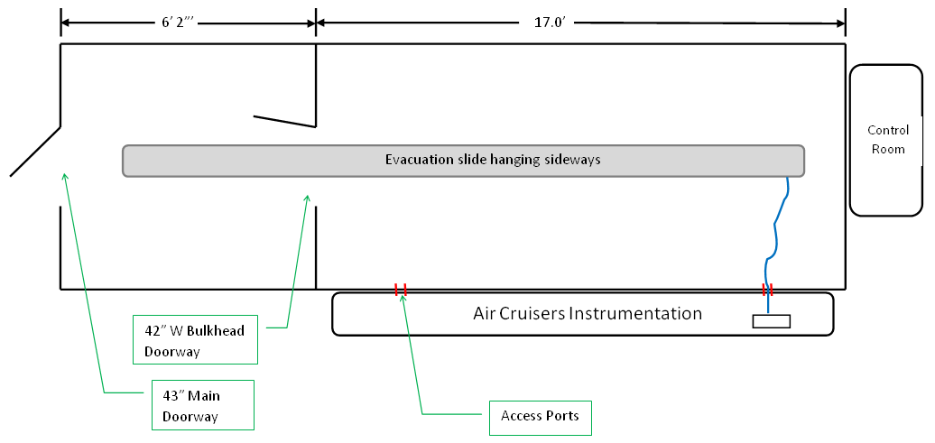
Testing
Systems were “flat” fired – Inflation systems were actuated with the slides completely unfolded
  This was necessary due to the volume constraints of the altitude chamber
  This provides the worst case (highest pressure) scenario since no energy is expended unfolding the slide

Slide 12
Test Data
A320 Slide Run # | Reservoir Pressure (PSIG) | Altitude (ft) | Ambient (Chamber) Pressure (PSIA) | Tube Pressure at 1 Min (PSIG) | Tube Pressure at 5 Min (PSIG) | Notes
1 | 3180 | 15,000
2 | 3180 | 15,000
3 | 3140 | 8,150
4 | 3060 | 1,295
5 | 3220 | 1,295

Slide 13
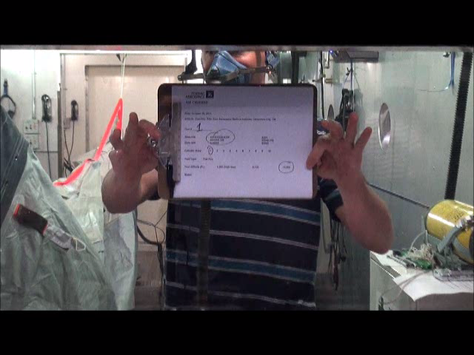
Testing
A320 Deployment:

Slide 14
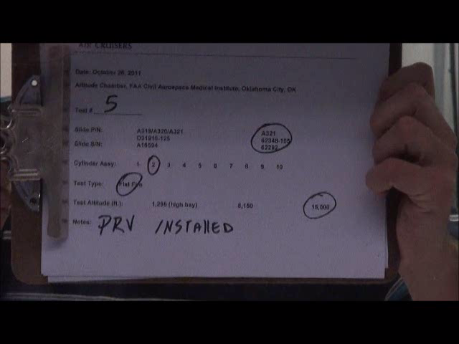
Testing
A321 Deployment:

Slide 15
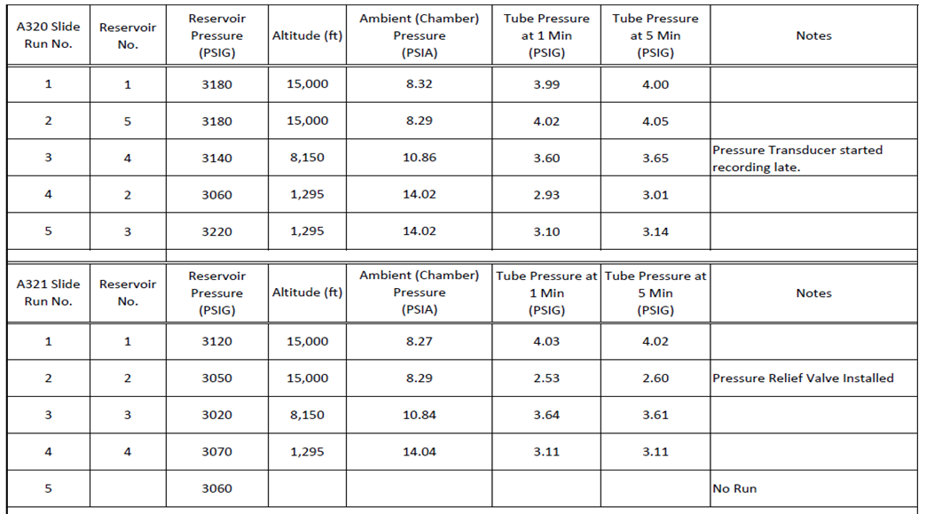
Test Results
Test Location: Oklahoma City, OK
Test Date: 26 Oct. 2011
Barometric Pressure: 29.89”

Slide 16
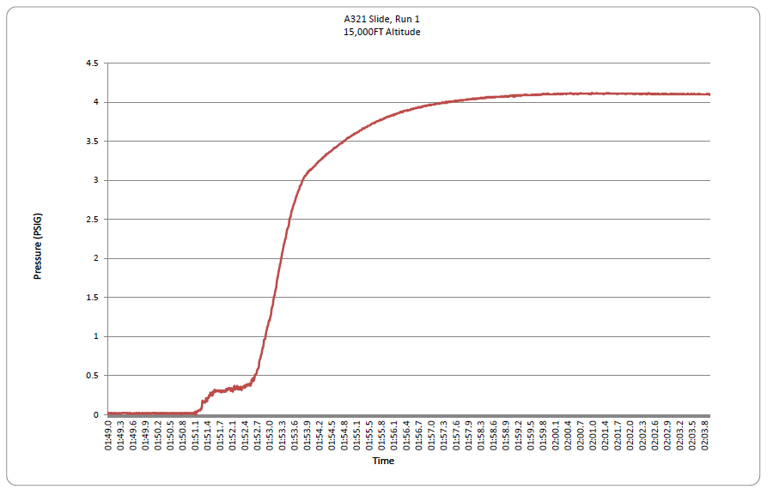
Test Results
4.02 psig @ 1 min.

Slide 17
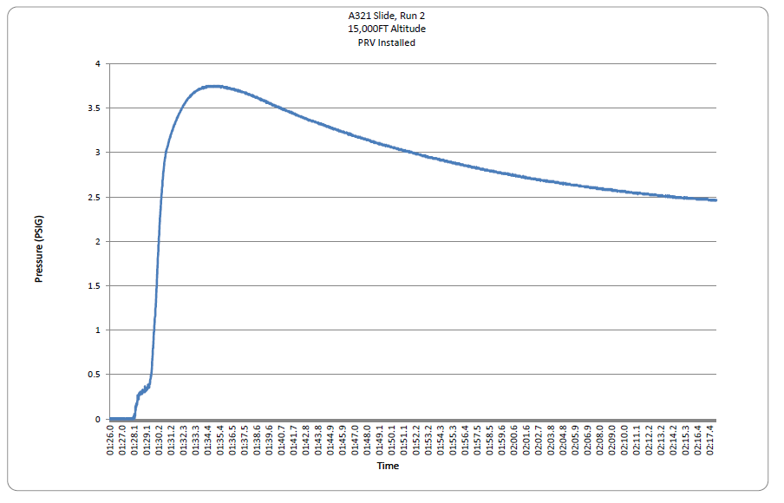
Test Results
2.53 psig @ 1 min.

Slide 18

Conclusion
The pressure values experienced at 15,000 ft (4.02) remain well below the overpressure test pressures (5.25-5.33)
Evacuation slides without pressure relief devices can provide a safe operation at altitudes up to 15,000 ft

Slide 19

Any Questions??

