Slide 1
Where the wind blows…
And the waves crash!
7th Triennial International Aircraft Fire and Cabin Safety Research Conference
Cynthia L. Corbett
December 5, 2013

Slide 2
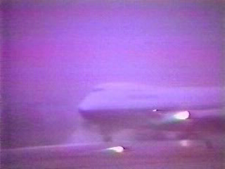

Slide 3
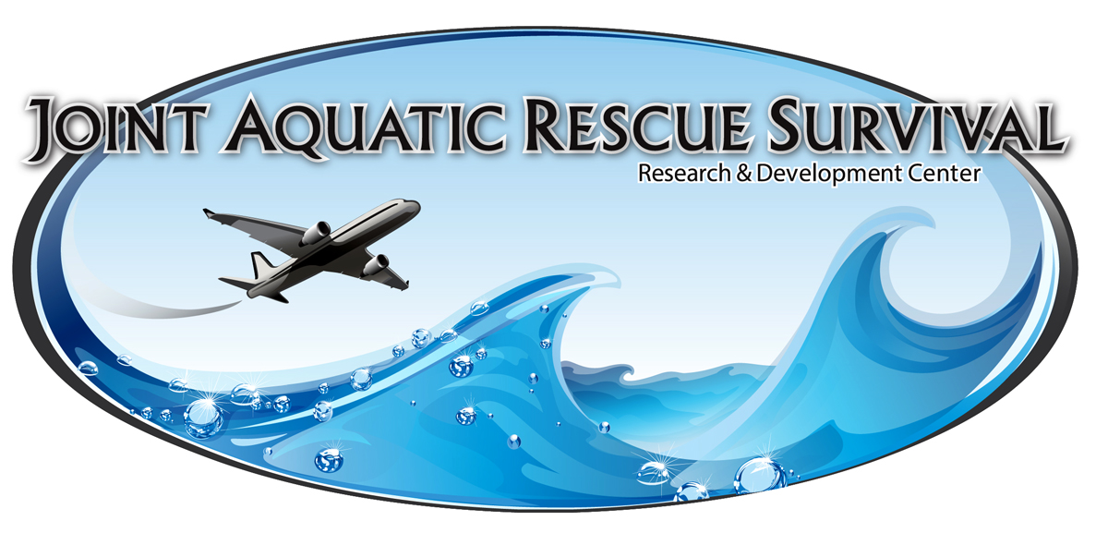

Slide 4
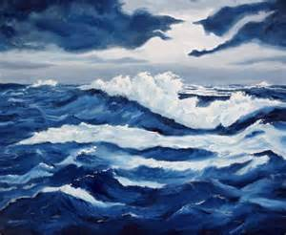

JARS
Capital Investment Program in partnership with industry, military, and other federal agencies
Projected start date: March 2017
Wind/wave capabilities similar to Louisiana Wave Studio
Facility similar to USCG Rescue Swimmer Training Facility, Elizabeth City, NC

Slide 5

Wind and Waves Industry

Slide 6
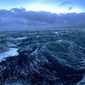
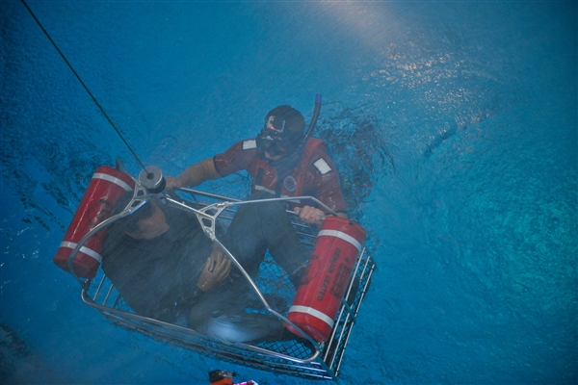
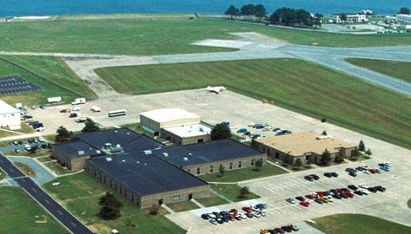
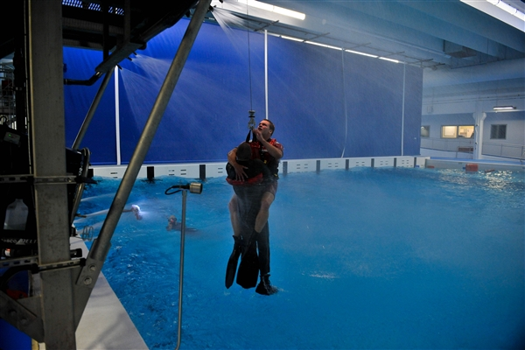
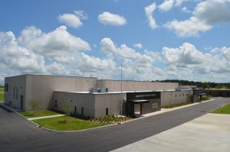

Slide 7
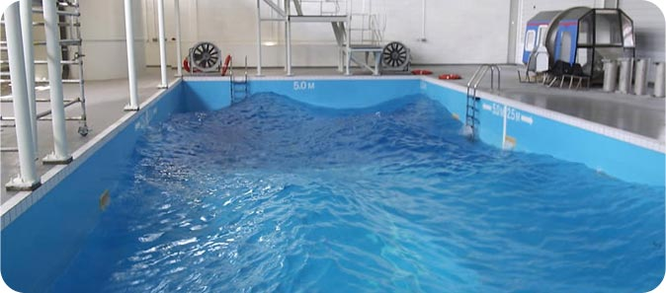
Features
50,000 sq. ft. facility
100’ x 80’ x 12’ water tank
  Computer controlled wave generator
  10’ waves
  Moveable bulkheads and overflow troughs
  Full tank cover to allow for testing in wind-only conditions

Slide 8
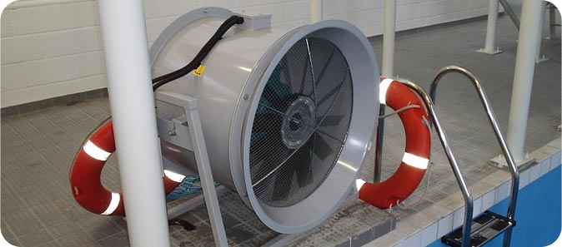
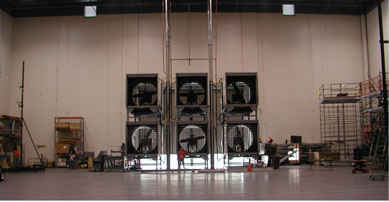
Wind generating fans
  35-knot sustained wind
  52-knot gusts

Slide 9
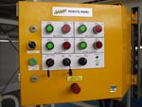
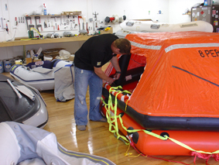
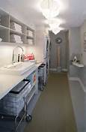
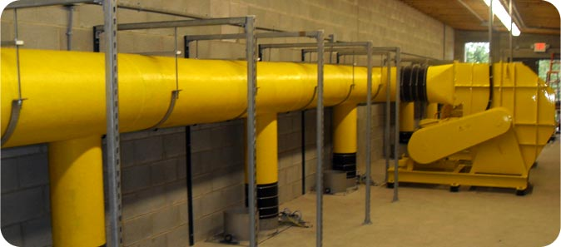
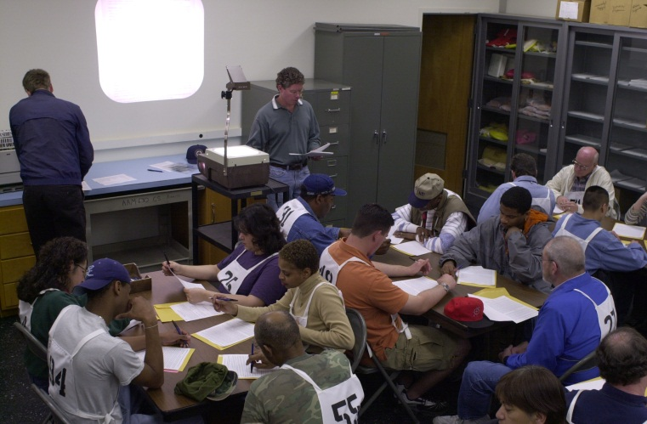
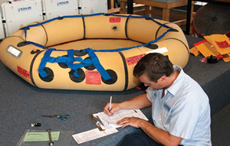
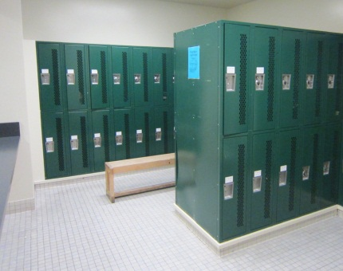
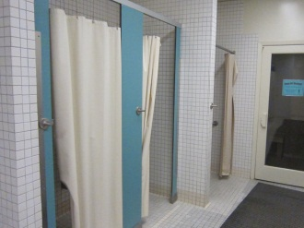
Inflatables lab, equipment lab/storage, pump shop, facility support, master control rooms
Research participant processing room
Public and Staff locker rooms
Laundry room

Slide 10
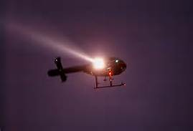
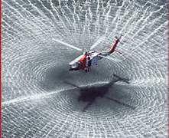
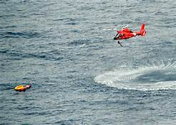
Day, dusk, night simulation
Helicopter search light, rotor wash simulator, rescue basket/equipment

Slide 11
Bridge crane, winch lift
Sound system
Video recording equipment
Rain nozzles, anemometers
Multi-level “mezzanine” where escape slides can be mounted/boarded for testing

Slide 12
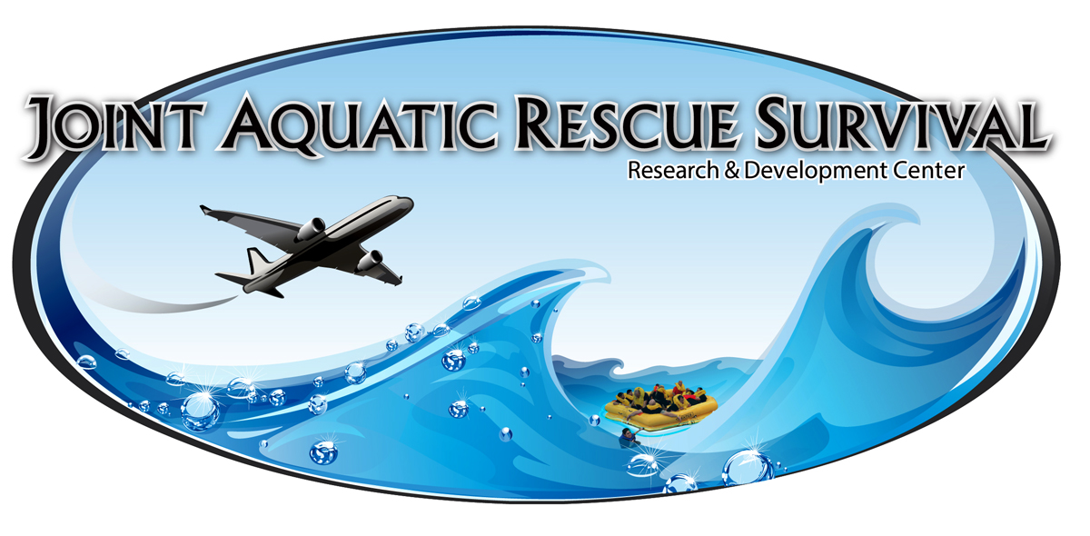

Slide 13
If you are interested in a partnership
Cynthia.corbett@faa.gov
Racquel.crisp@faa.gov
Diana.ctr.houck@faa.gov

