Slide 1
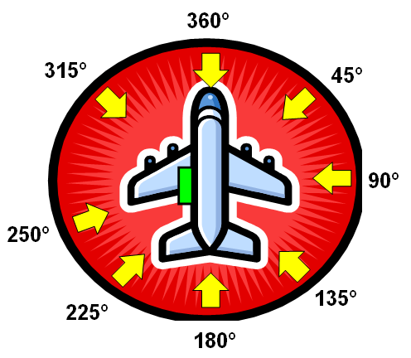
Wind and Emergency Evacuation Devices
The Seventh Triennial International Aircraft Fire and Cabin Safety Research Conference
Philadelphia, PA
December 2-5, 2013
Presented By: Tom Anderson
Goodrich Interiors – Evacuation Systems

Slide 2
Wind?
Why are we interested?
  Wind can have significant effects on cabin safety provisions:
    Exit opening
    Evacuation
    Use of Emergency Equipment such as life rafts

Slide 3
Wind – Historical References
The origin of a wind requirement dates back to (at least) the 1960’s where SAE published Aerospace Recommended Practice (ARP) 495A for escape devices which said (3.1.11): “The device should not be adversely affected by winds of up to 30 knots.”
At least one major airplane manufacturer adopted this recommendation and included it in their specifications for evacuation devices.
One slide manufacturer advertised slides which achieved “perfect ground anchoring despite 50-knot gusts.”

Slide 4
Wind and FAA Regulations
FAA did not incorporate a wind requirement into the regulations until Amendment 46 (12/1/1978) where 14 CFR part 25 §25.809 (f)(1)(iv) required the evacuation assist means to “have the capability, in 25-knot winds directed from the most critical angle, to deploy and, with the assistance of only one person, to remain usable after full deployment to evacuate occupants safely to the ground.”
Subsequently (6/3/1983), this requirement was incorporated into Technical Standard Order (TSO) C69a “Emergency Evacuation Slides, Ramps, and Slide/Raft Combinations”.
Wind requirements (35-knots steady/52-knot gusts) were also applied to the canopies used to protect evacuees in life rafts (TSO-C70) and evacuation slide/rafts.

Slide 5
FAA Guidance for §25.809 Wind
(From FAA Advisory Circular AC 25-17A at Amendment 25-46)
In guidance for paragraph (f)(1)(iv), FAA offered:
“(i) The person who assists should come from the airplane. This capability should be demonstrated by test.”
“(ii) Escape slides that deploy in front of an engine inlet may need to be assessed for the effect of the inlet airflow on the acceptable deployment of the escape slide. Since the wind condition is assumed, the effect for the inlet airflow should be considered in combination with the 25-knot wind. The effect of the engine is non-linear with respect to the distance from the inlet, so that tests that do not use an actual running engine should contain conservative conditions or assumptions to ensure that the installation is acceptable. For example, adding the effect of the engine (at specific distance from the inlet) to the wind velocity, and then verifying that the slide will come no closer to the engine than that distance is an acceptable method.”

Slide 6
FAA Guidance for Wind (Cont’d)
(From FAA Advisory Circular AC 25-17A at Amendment 25-46)
Further, for Paragraph (f)(1)(iv) and (v), FAA offered:
“For wind or repeatability tests, as many deployments as possible should be done on an airplane. When using a mockup (also known as a module) for these tests, the following items, as a minimum, should be satisfactorily addressed:
(i) The door on the mockup should be a full-size door built as close to a production door as possible, using production hardware or prototype equivalents. This is especially critical with respect to the girt bar, floor fittings, packboard, bustle, the door motion, door velocity throughout the range of travel, and the manner in which the slide drops.
(ii) The fuselage contour and skin surface of the mockup which might be contacted by the slide, under any normal or adverse attitude or wind conditions, should be the same as the airplane contour. Additionally, fuselage protuberances such as pitot-static tubes and outflow valves should be accurately represented.
(iii) The impingement of the wind on the slide should be shown by aerodynamic analysis to be equal or greater than that on the airplane.”

Slide 7
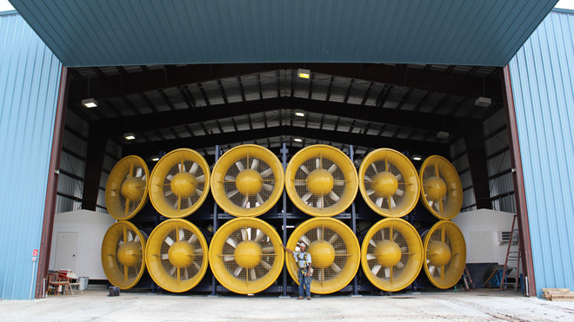
Creating Wind
Artificially creating a wind “field” is not a trivial task. Typically a wind machine consists of an engine or motor driving a propeller in a “pusher” type configuration. The wind produced will vary according to the distance from the center of the machine, the speed of the propeller, and any flow straightening devices, among other factors.
The Wall of Wind (WoW) facility at Florida International University (FIU) (Photo courtesy of FIU, A. Gonzalez/E. Salna)

Slide 8
Wind Measurement
Wind measurement is commonly done with a cup-type anemometer, which is a miniature DC generator. It produces a discrete amount of electricity according to the speed of the spinning cup assembly. This is translated into knots.
Hand-held anemometers are notoriously inaccurate and should not be used.
Hot wire anemometers are, generally, too sensitive and require too much filtering to achieve reasonable results.

Slide 9
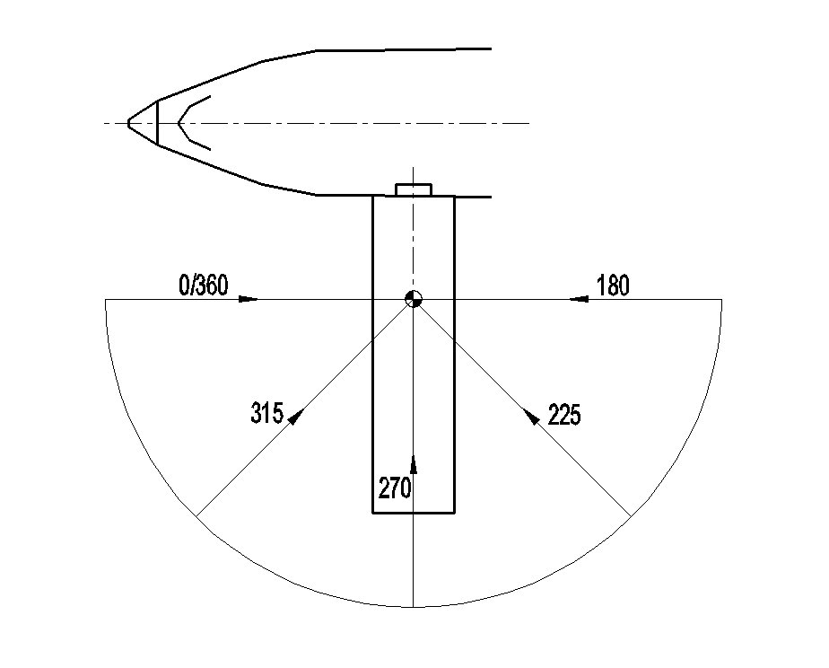
Applying the Wind
Wind measurements are made at a distance in front of the wind machine(s) in a pattern which represents the slide profile from all angles. If the slide extends out from the fuselage at an angle (canted), it may be necessary to apply the wind from a slightly different set of angles.

Slide 10
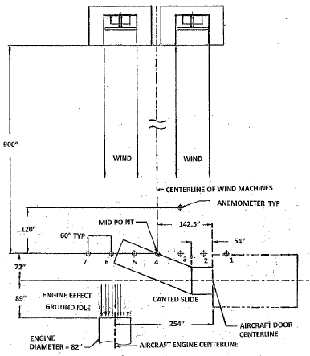
Applying Wind (Cont’d)
Example of wind layout with aircraft engine inlet and canted slide
Wind profile is checked at points 1-7 prior to test and monitored at a single point upstream of the slide during the deployment
Wind speed is adjusted to account for the effects of engine ground idle as required by FAA

Slide 11
Wind Profiles
To achieve suitable application of wind, it is necessary first to “map” the wind field.
Mapping is typically done with series of anemometers mounted at several heights and at multiple locations across the projected deployment area.

Slide 12
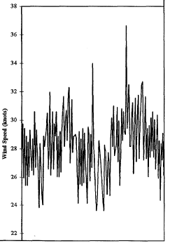
Typical Anemometer Output
It may be necessary to filter the anemometer output to determine the average wind speeds.

Slide 13
Typical Wind Profile with One Wind Machine

Slide 14
Typical Wind Profile with Two Wind Machines

Slide 15
Typical Wind Profile with Three or More Wind Machines

Slide 16
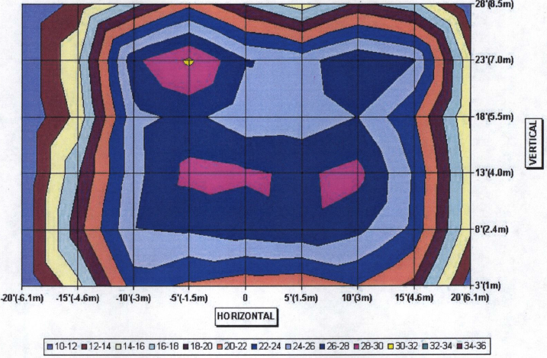
Typical Wind Profile with More Than Three Wind Machines

Slide 17
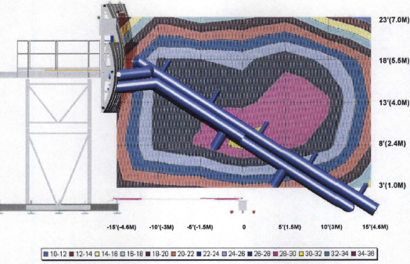
Wind Applied to Side of Slide
(O/360 or 180 Degrees to Airplane)

Slide 18
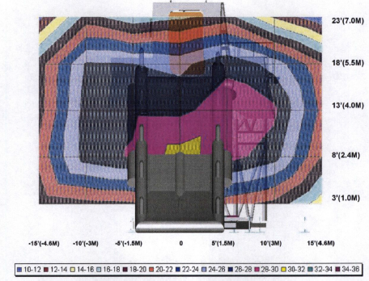
Wind Applied to Face of Slide
(90 or 270 Degrees to Airplane)

Slide 19
Defining Coverage
The Regulations specify that the slide “have the capability, in 25-knot winds directed from the most critical angle, to deploy...”
There is no tolerance given nor is there a suggestion that less than full 25-knot coverage from top to toe is acceptable.

Slide 20
Defining Coverage (Cont’d)
The previously shown wind profiles suggest the difficulty in achieving uniform wind application over the entire length of the slide. While this might be more easily achieved for some angles, others such as 0/360º or 180º are more problematic.
Thus, one approach to attaining full effect considering the variations might be to use test and analysis.

Slide 21
Defining Analysis
An analytical approach could consider breaking the slide into sections and determining the wind coverage at each section. Then, the areas of coverage (times the wind speed for that area) could be summed to verify that the total meets or exceeds the 25-knot requirement. Using the wind profile and a slide profile overlay, the coverage may be calculated:

Slide 22
Sample “Area – Wind” Calculations
28-30 knots – 4% = .04 x 29 = 1.16
26-28 knots – 55% = .55 x 27 = 14.85
24-26 knots – 15% = .15 x 25 = 3.75
22-24 knots – 15% = .15 x 23 = 3.45
20-22 knots – 5% = .05 x 21 = 1.05
18-20 knots – 4% = .04 x 19 = 0.76
16-18 knots – 1% = .01 x 17 = 0.17
14-16 knots – 1% = .01 x 15 = 0.25
Sum = 25.34, which is >/= 25 knots

Slide 23
More Analysis?
This has been a rather simple exercise to show how wind effects may be considered. We could further complicate life by considering:
Wind application during deployment, which will involve changes of shape
Moment arms during and after deployment
Different wind application angles
The opportunities for analysis are endless!

Slide 24
Questions?

