Slide 1
Cabin Safety Research Resources for the 21st Century: A New CAMI Emerges
Estrella Forster, Ph.D., PMP
Civil Aerospace Medical Institute
Oklahoma City, OK

Slide 3
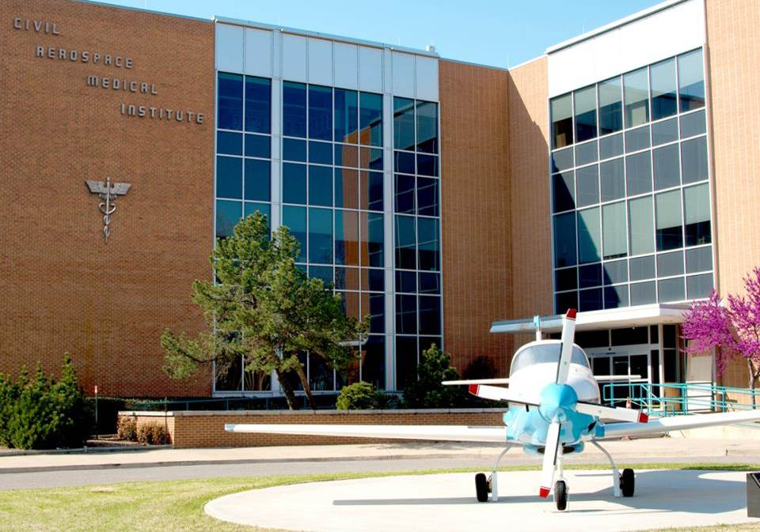

Slide 4
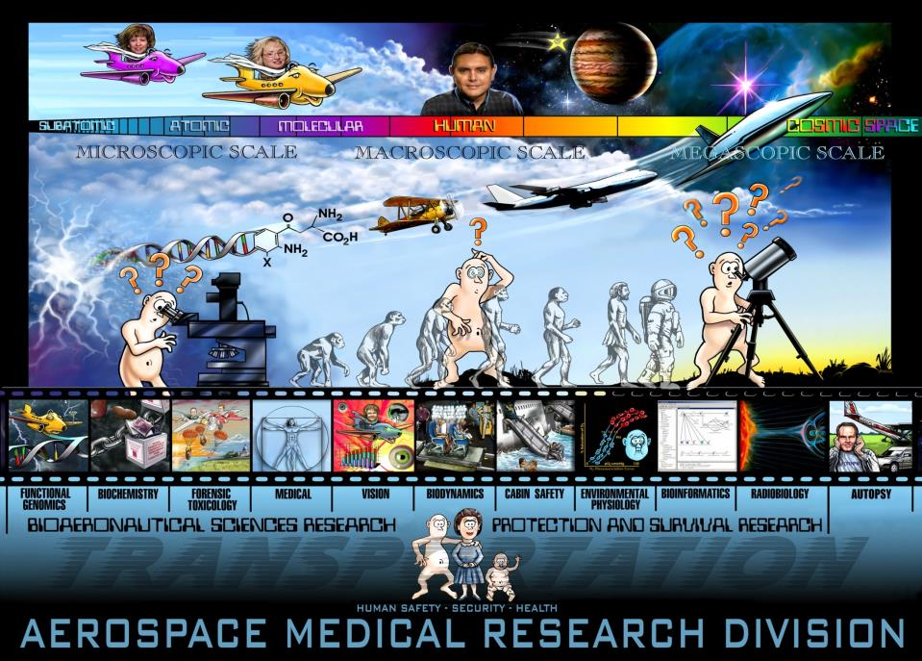

Slide 5
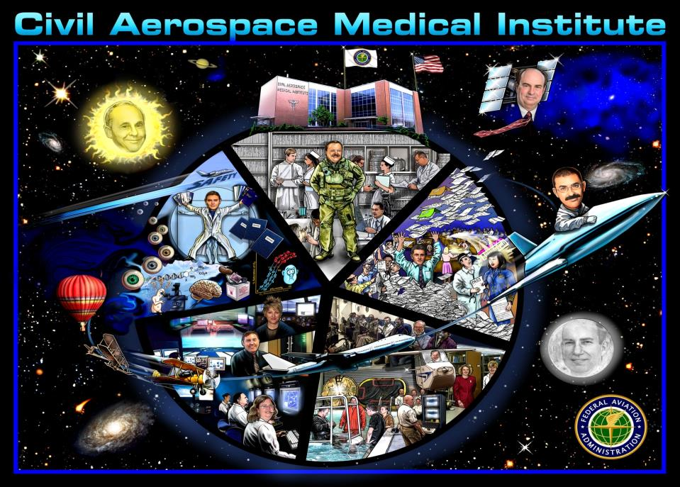

Slide 6
Research Arm of a Regulatory Agency

Slide 7
MISSION
Develop new and innovative ways to support FAA regulatory and advisory missions to improve the safety of humans in civilian aerospace operations.

Slide 8
CONTRIBUTION
Our research knowledge is the basis for proposed rules, advisory circulars, and technical standards orders that the FAA uses in its regulation of the civil aviation industry.

Slide 9
International Organization for Standardization (ISO)
ISO 9001:2008 CERTIFIED
Quality Management Systems
ISO 14001:2004 CERTIFIED
Environmental Management Systems

Slide 10
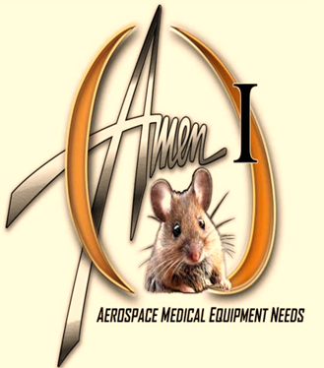
FAA Acquisition Management System
Facilities & Equipment
Technology Refresh
ACAT V
>100 Research Assets
2012 - 2014

Slide 11
OBJECTIVES
Aerospace Medical Research Division
Protection & Survival Labs
Cabin Safety Research Team
Biodynamics Research Team
IMPACT SLED
AIRCRAFT CABIN RESEARCH FACILITY
AIRCRAFT
ENVIRONMENT
RESEARCH FACILITY

Slide 12
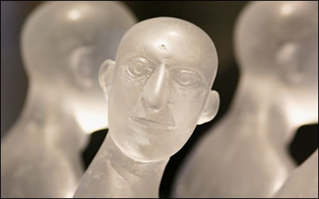
PROTECTION & SURVIVAL LABS

Slide 14
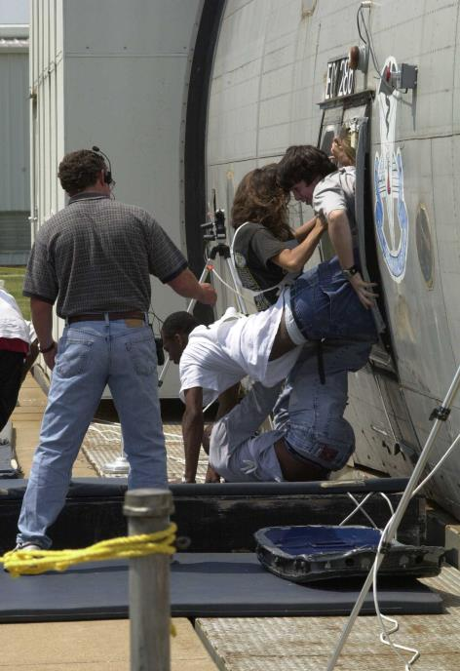
Aircraft Evacuation
“How tragic to have survived an accident and to be killed while trying to get out of the airplane.”
George Black, member, NTSB
Modeling & Simulation

Slide 15
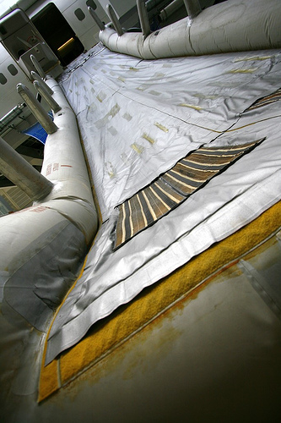
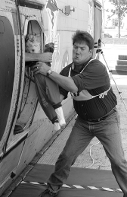
Slide Testing & Precious Cargo Studies

Slide 16
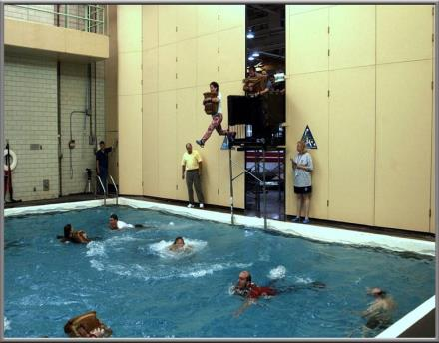
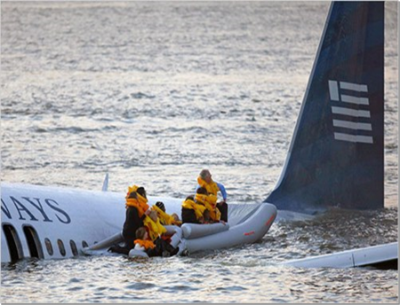
Water Survival

Slide 17
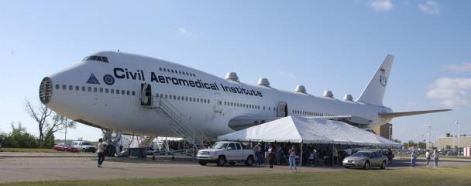
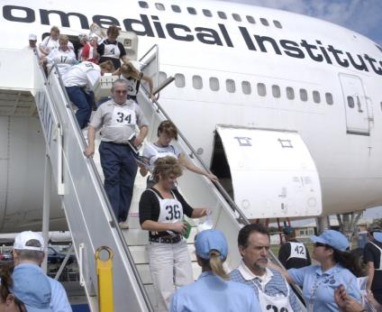
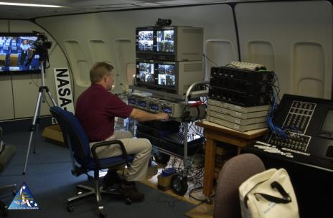
Aircraft Environment Research Facility

Slide 18
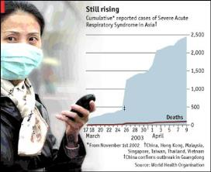
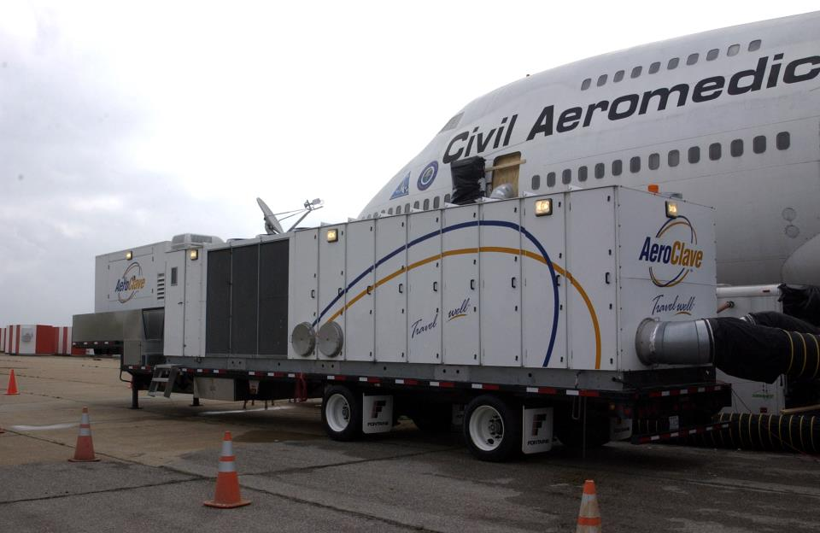
Decontamination Technology

Slide 19
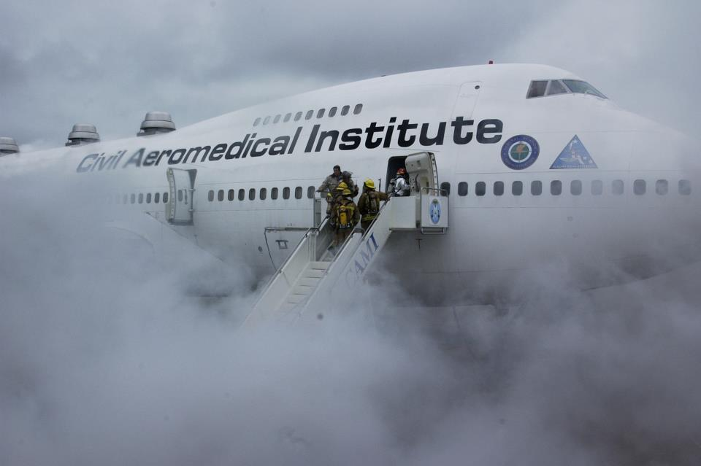
Collaboration With Other Agencies
14

Slide 20
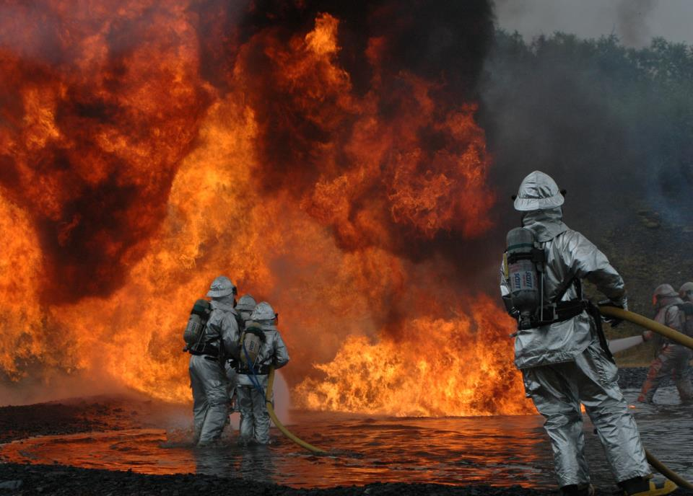
Fire Safety
Of those who survive an aviation crash, 40% will die as a result of the ensuing fire

Slide 21
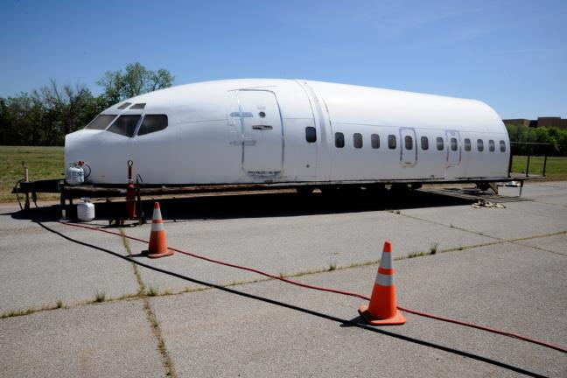
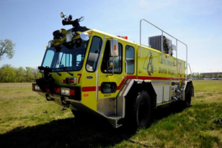
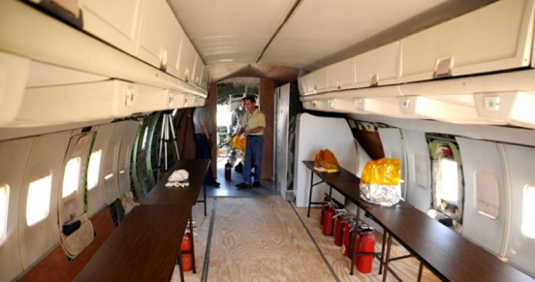
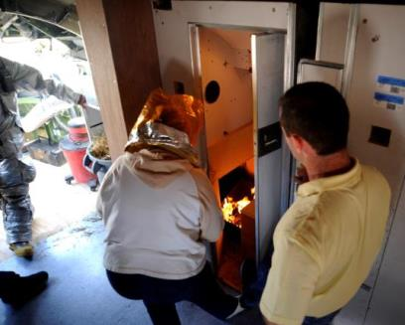
Fire Fighting Lab

Slide 22
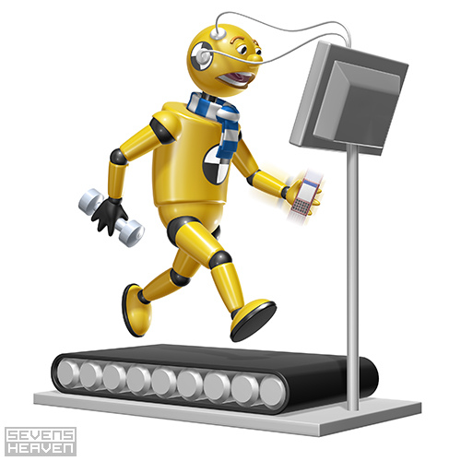
B-747 refurbish

Slide 23
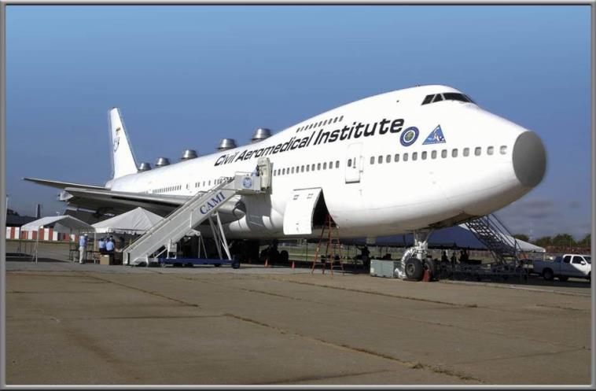

Slide 24
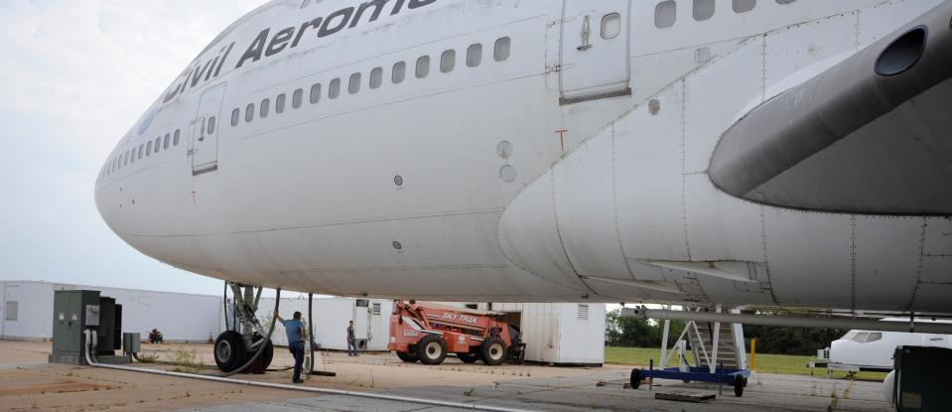
HVAC & Configuration
Slide Rafts
Universal Inflation System
Communication System
Pathway Marking
Interiors
Equipment Sheds
B-747 Updates

Slide 25
Aircraft Cabin Research Facility replacement

Slide 26
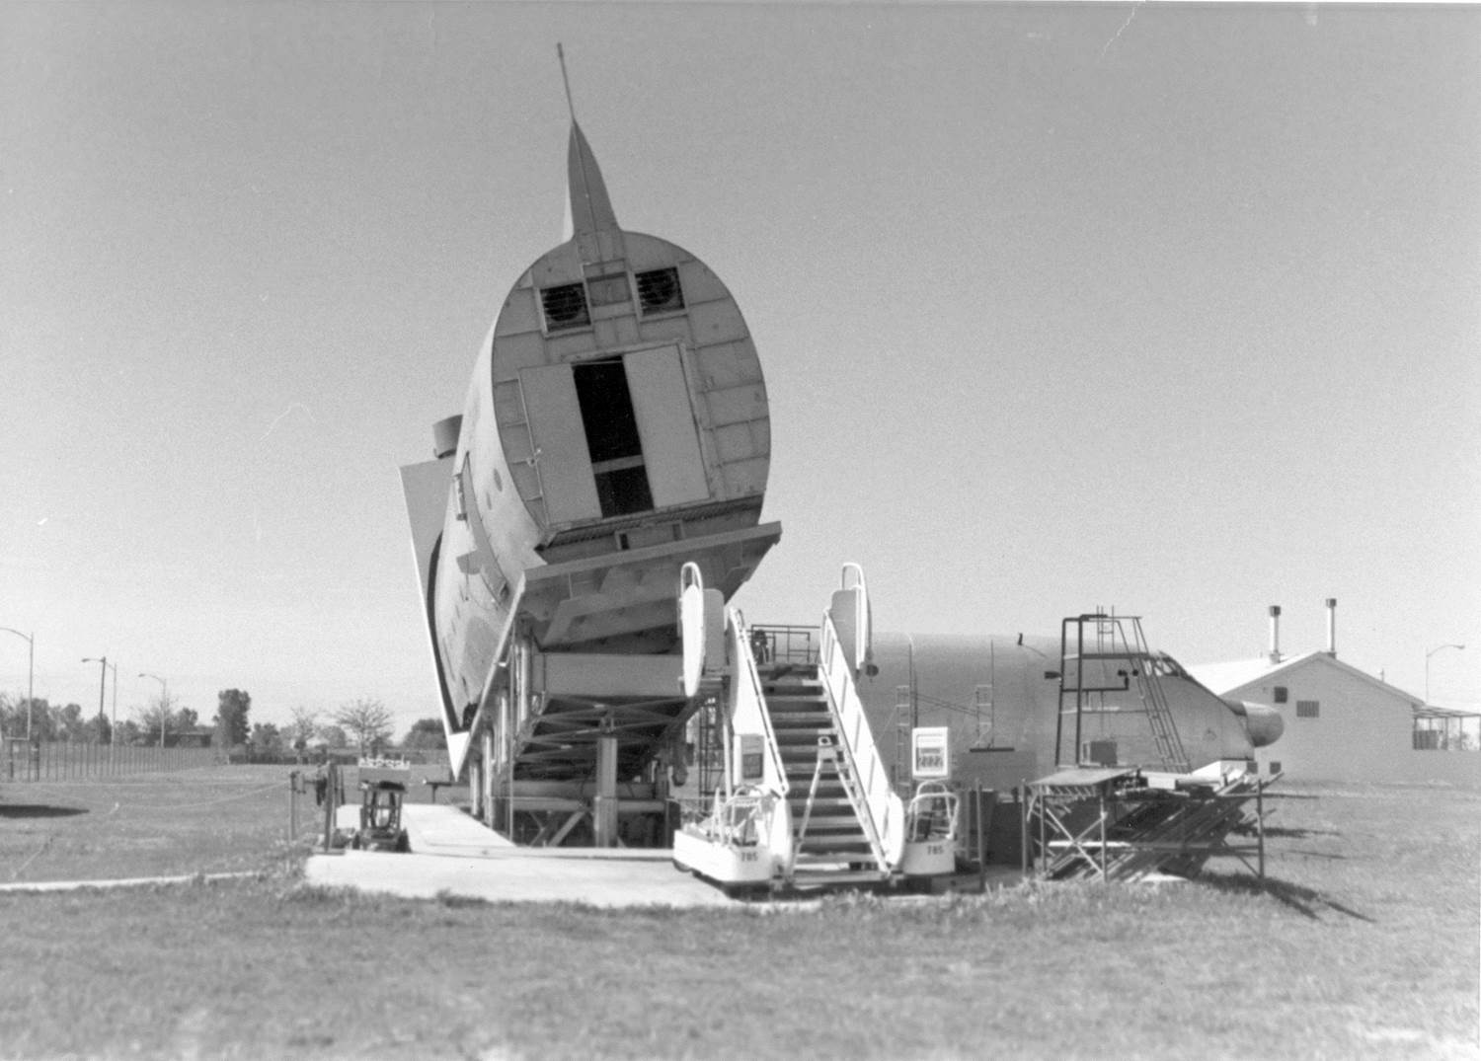
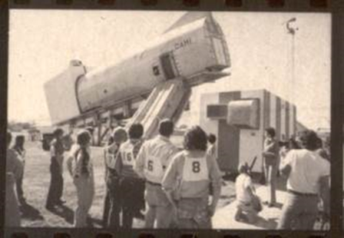

Slide 27
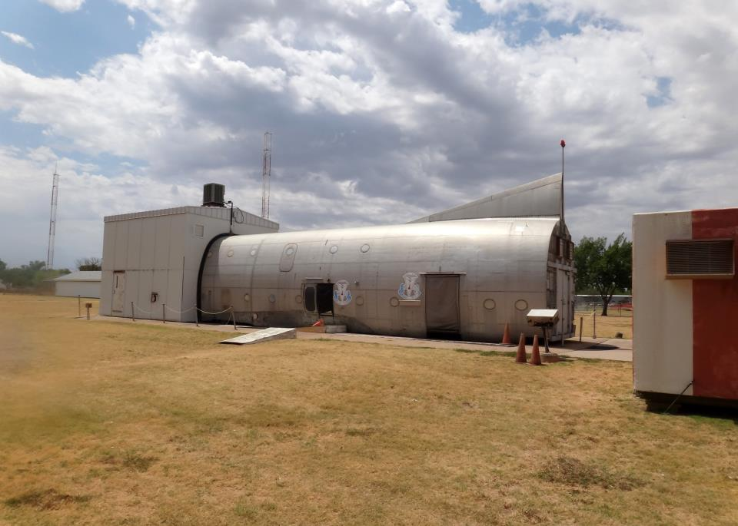

Slide 28
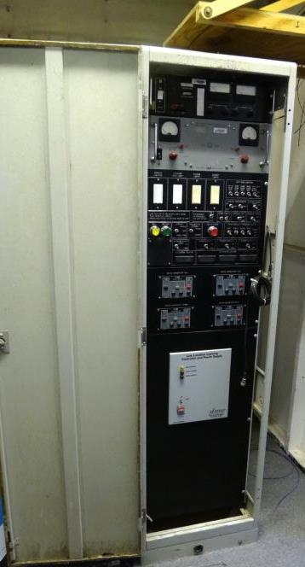
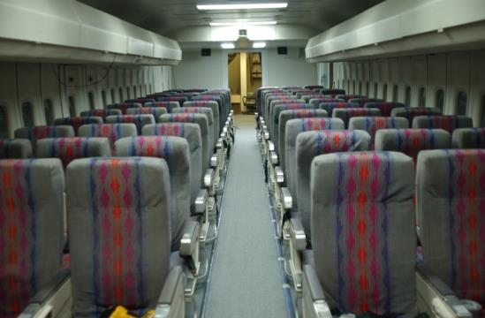

Slide 29
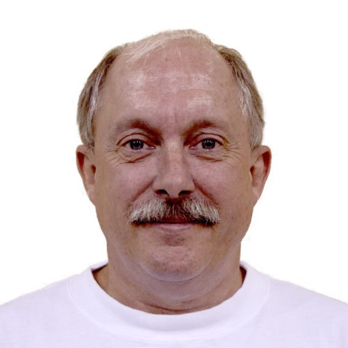
Dr. Mac McLean
Project Lead

Slide 30
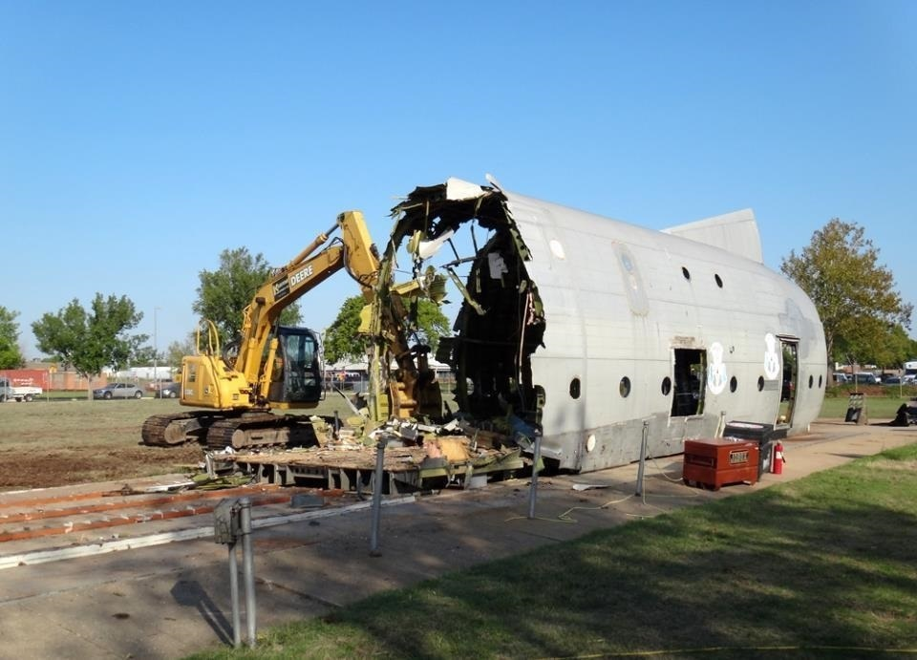

Slide 31
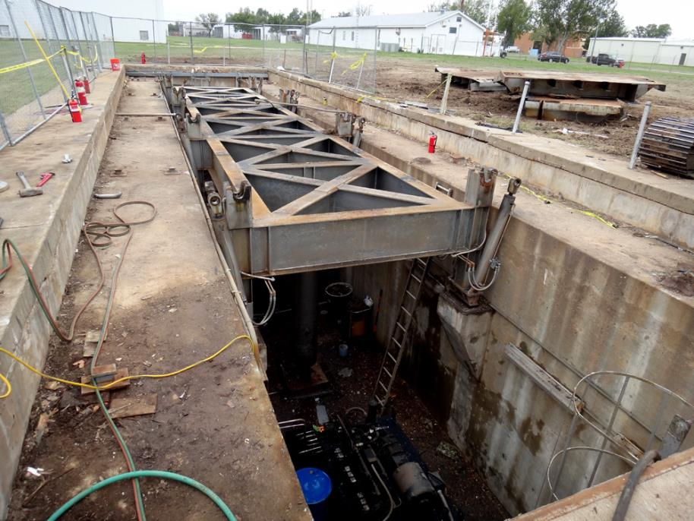

Slide 32
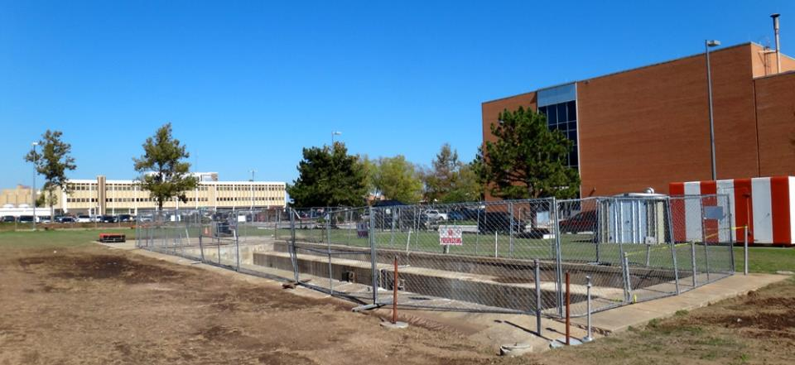

Slide 33
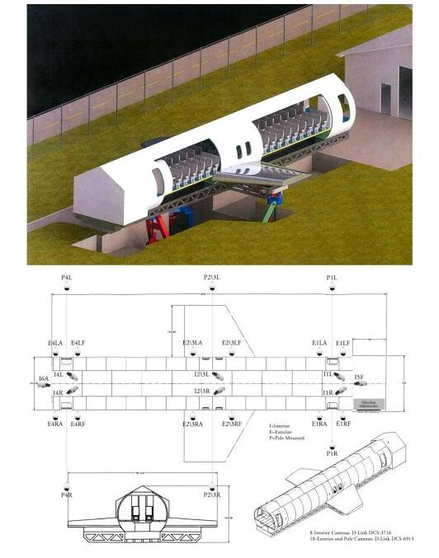

Slide 34
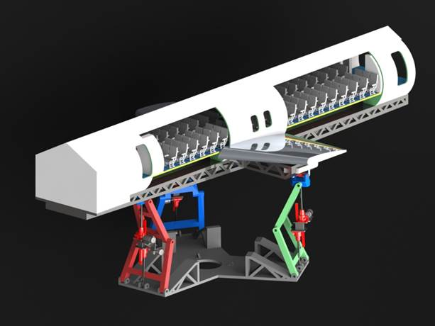

Slide 35
Flexible Aircraft Cabin Simulator Characteristics
Reconfigurable as multiple narrow-body transport category aircraft, (A320, B737, CRJ-700, ERJ170, MD80)
High-Fidelity Type C, I, and III exits
Landing gear out pitch-and-roll attitudes
Emergency scenario management computer system
Out the window views throughout cabin
Audio/Video communication
Environmental control with theatrical smoke
Staging and storage areas
Exterior stadium lighting for night time work

Slide 36
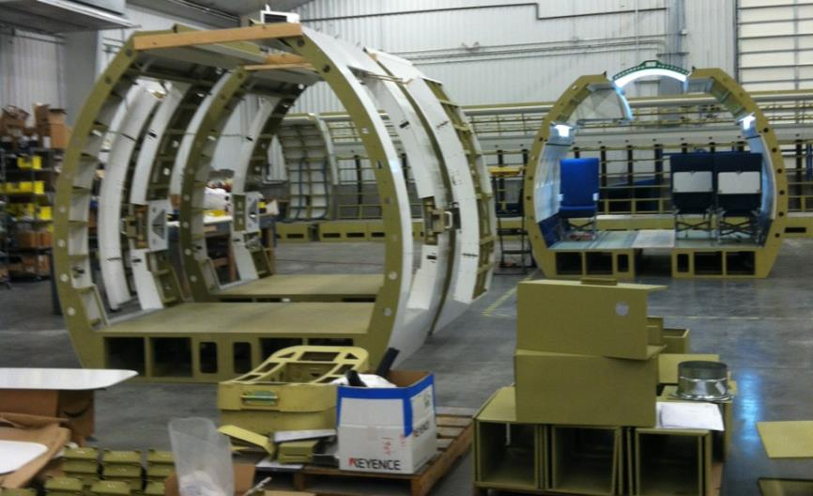

Slide 37
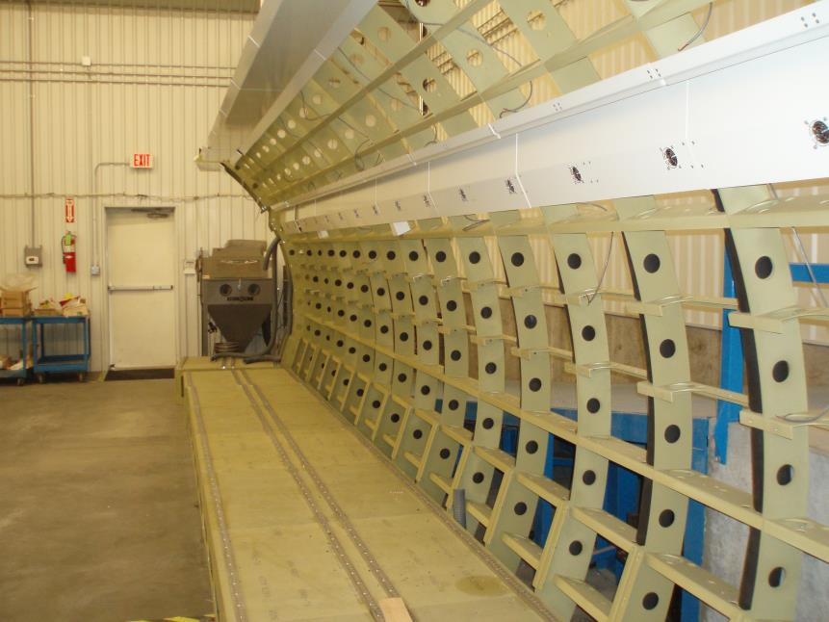

Slide 38
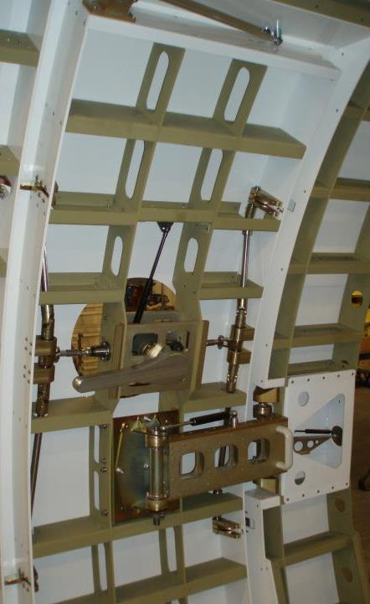
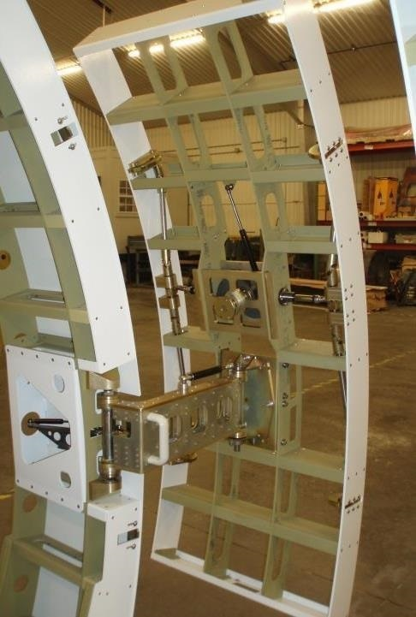

Slide 39
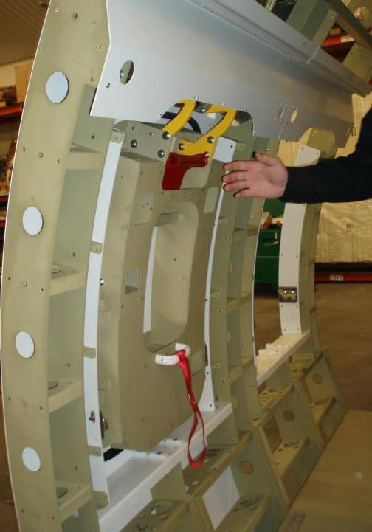
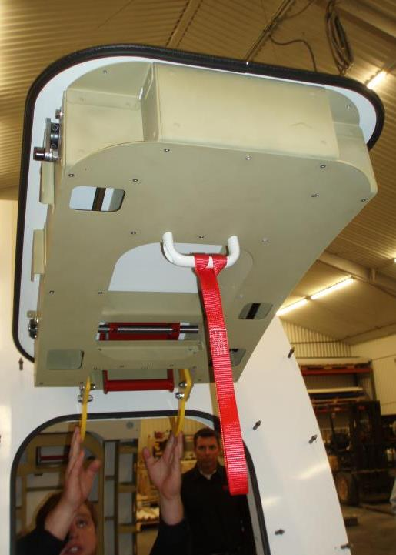

Slide 40
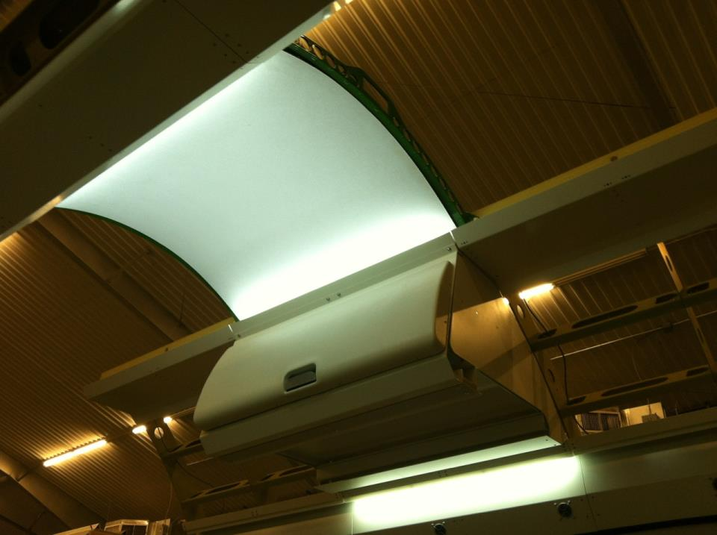

Slide 41
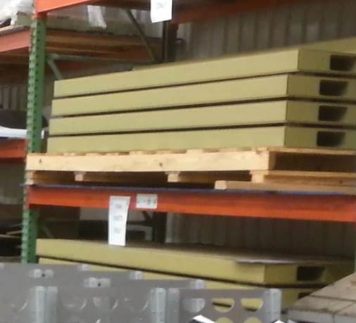
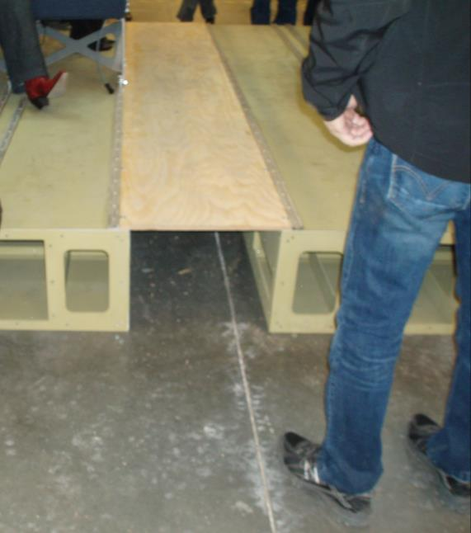

Slide 42
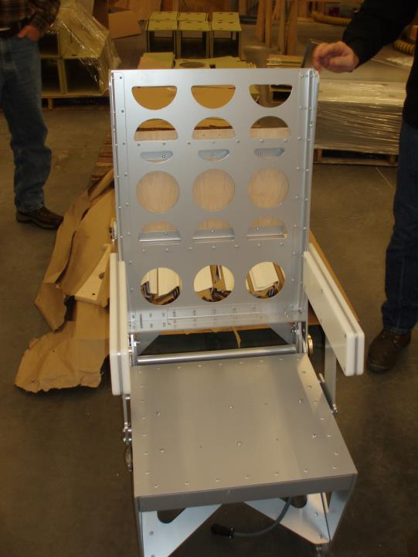
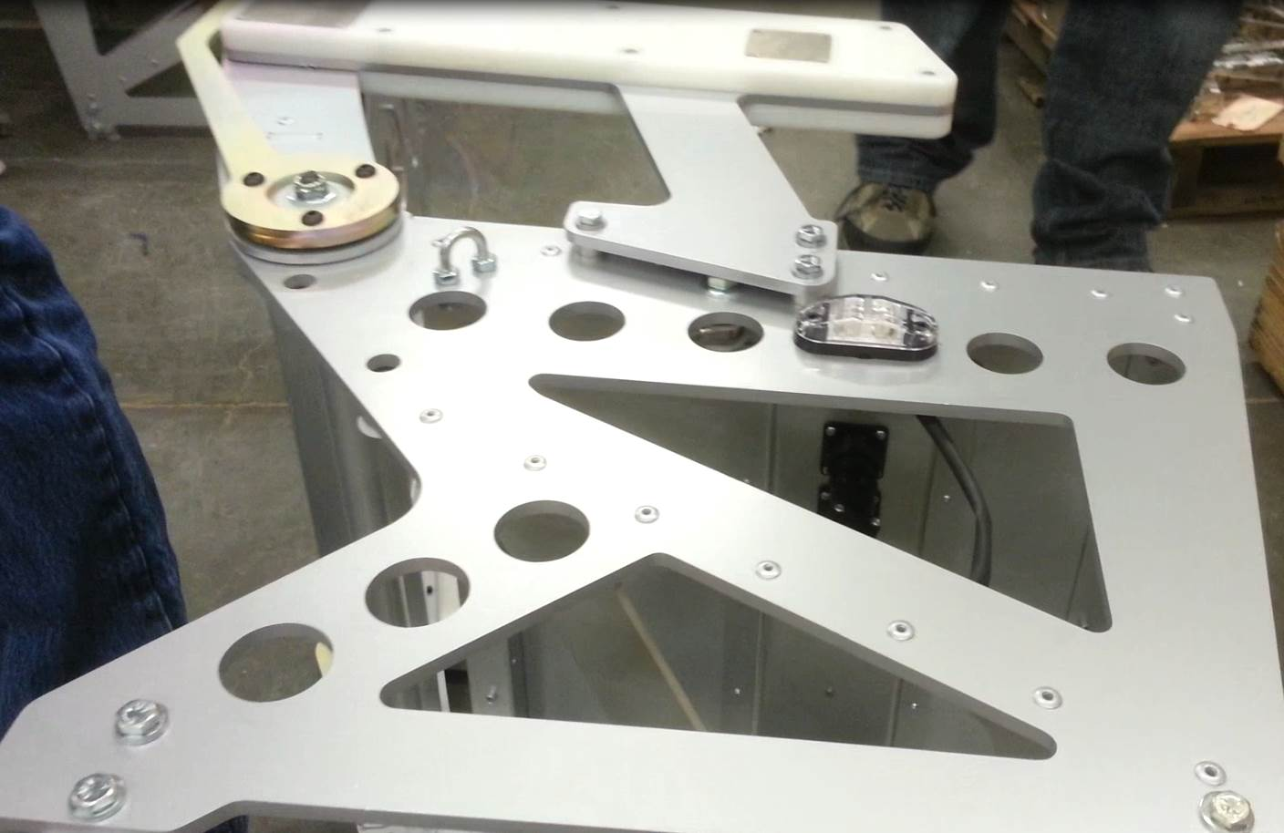
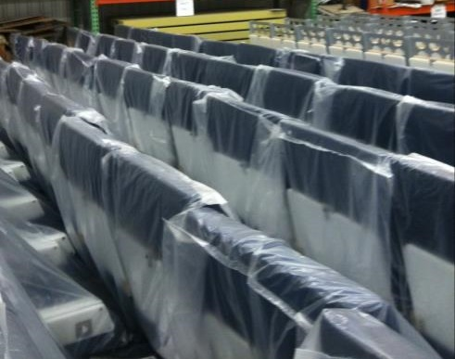

Slide 43
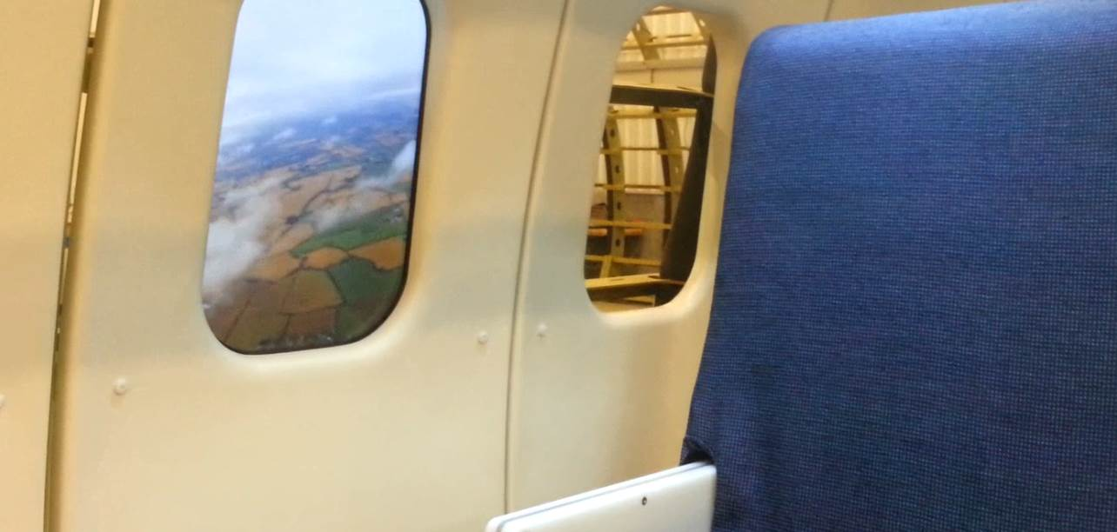

Slide 44
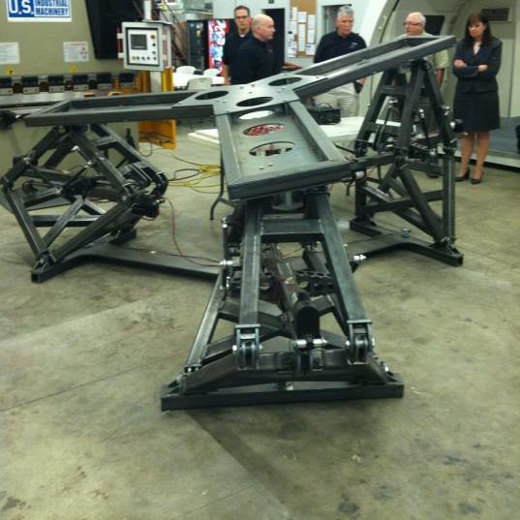
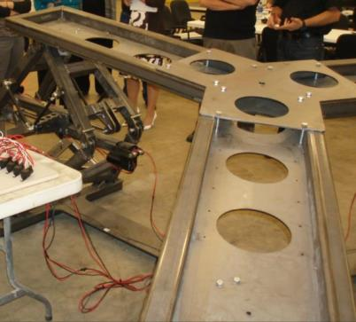

Slide 46
Gear Box, Motor, Actuator

Slide 47
superstructure

Slide 51
Impact Tests
AIRLINER
BUSINESS JETS
Air Bags
Seat Configuration
Seat Cushions
Restraint Systems
Life Preservers
Injury Mechanisms

Slide 52
The Aircraft Occupant
SMALL LADY
Anthropomorphic Test Dummies (ATD's)
NFL TEAM

Slide 53
Design & Fabrication
ATD
SHOP
MACHINE SHOP

Slide 54
Modeling & Simulation
Mathematical Dynamic MOdeling
MADYMO is an engineering software tool that allows users to design and optimize occupant safety systems efficiently, quickly, and cost-effectively.
Using software simulation can predict impact test results as well as save money by simulating different test scenarios, thus reducing the number of actual impact test experiments that consume resources.

Slide 59
IMPACT SLED
replacement

Slide 60
Rick DeWeese
Project Lead

Slide 61
SLED Characteristics
ServoSled System
Force Capacity >= 450,000 lb.
Maximum required Payload 6,600 lb.
Maximum empty sled weight is 2,700 lb.
Maximum required acceleration with a 2,500 lb. payload, 65 G
Maximum required velocity with a 2,500 lb. payload, 70 ft/s
Distance over which acceleration is precisely controlled is at least 6.5 feet from starting point

Slide 64
Clip SLED Construction

Slide 68
Length: 150 ft.
Travel: 110 ft.

Slide 70
REQUIREMENTS
COORDINATION
SCHEDULE
BUDGET

Slide 72
Next: the pool
Art: Dave Nitsche

Slide 73
REPLACE WATER RESEARCH TANK
WIND & WAVE Facility: 100 x 80 x 12 ft.
FY 2017 ACQUISITION CATEGORY IV
Potential partnership with
industry, academia, military, and government agencies
Program Manager: Racquel.Crisp@faa.gov

Slide 74
THANK YOU
Estrella.Forster@faa.gov

