Slide 1
Inflatable Emergency Equipment:
Evaluation of Individual Inflatable Life Preserver Retention
7th Triennial International Aircraft Fire and Cabin Safety Research Conference
Cynthia L. Corbett, MA
December 4, 2013

Slide 2
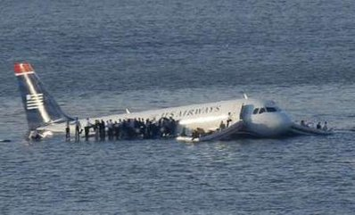
Introduction
US Airways Flight 1549 emergency landing in the Hudson River, Weehawken, NJ, January 2009

Slide 3

Technical Standard Order (TSO) C13f Retention/Jump Test
  Means for retention (excluding infant/small child)
    One attachment
    One adjustment for fit
  Must remain attached when wearer
    Jumps into water at any attitude
    From at least 5 feet above water
  No damage to life preserver
  No injury to wearer (except minor skin chafing)
  No reference to whether or not the wearer can hold onto the life preserver, which would affect retention

Slide 4
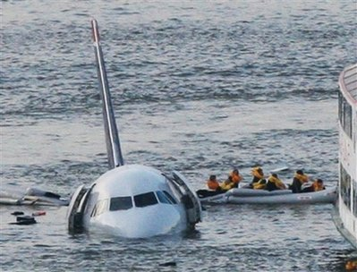
SAE Aerospace Standard (AS) 1354 – Individual Inflatable Life Preservers
  SAE S-9 Cabin Safety Provisions Technical Committee
  Request by FAA to support TSO revision
  Retention/Jump test mirrors TSO C-13f
    Except retention means shall not make use of knots

Slide 5
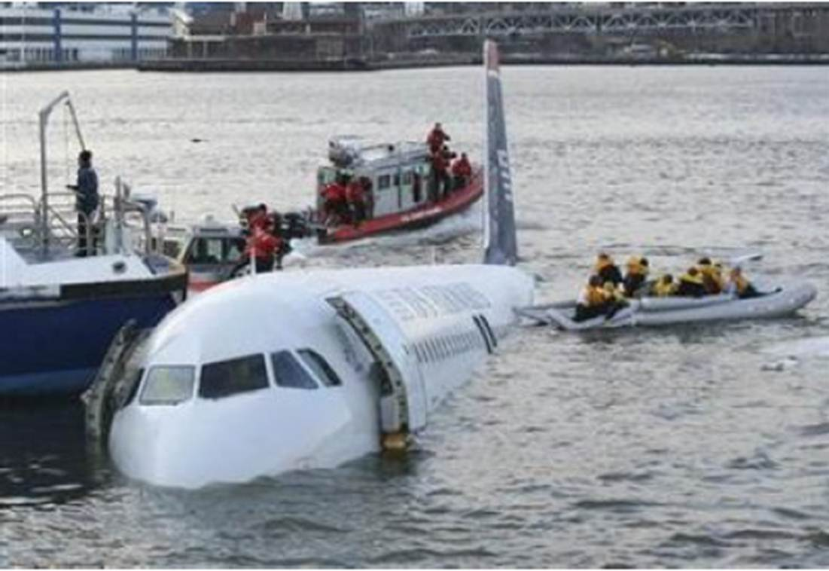
Evaluation of Retention Characteristics of Inflatable Life Preservers
Higgins and Funkhouser, 1986 (AAM-119-86-7)
Do certain design features affect the retention characteristics of inflatable life preservers?
Tested 8 different models of inflatable life preservers worn by 10 participants
All participants jumped from a standing upright position and entered water with arms extended over head
Participants jumped from platform located 5 feet above water level
Retention
  Life Preserver in proper position after test
  Partial retention: Life Preserver raised partially over head
  Not retained: Life Preserver came completely over head, held on only by waist strap

Slide 6
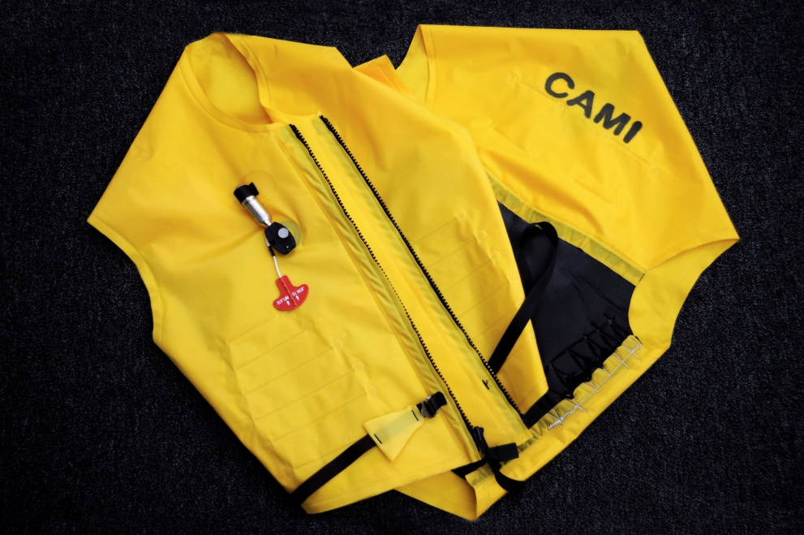
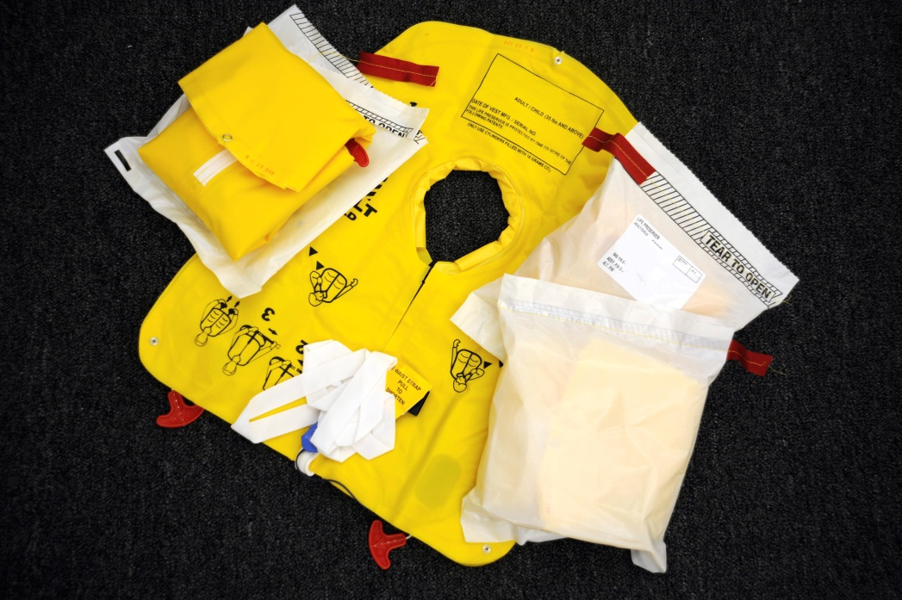
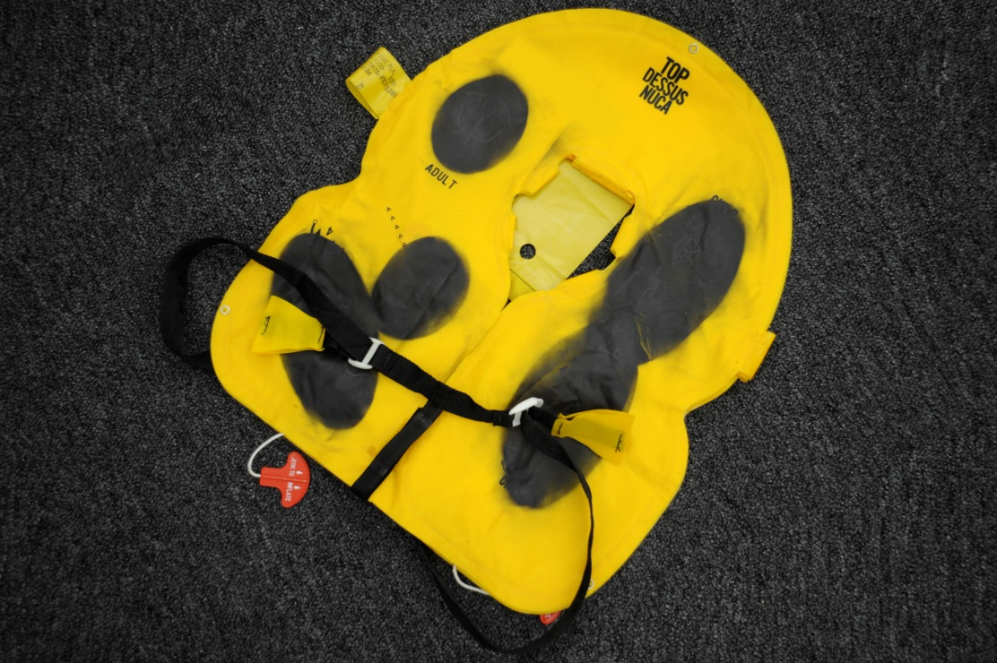
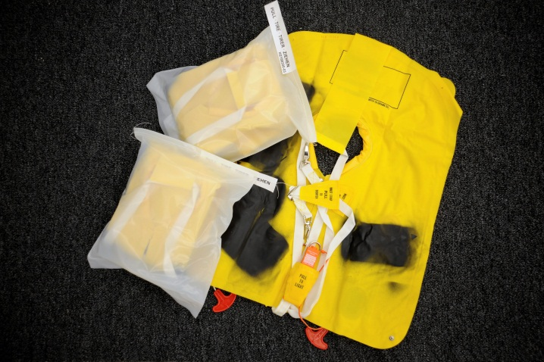
Life Preservers

Slide 7
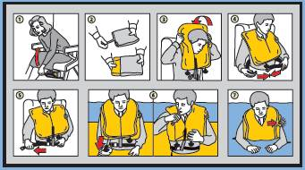
Results
Only 2 life preservers retained by all 10 participants
  The CAMI Experimental Zipper-Front Vest
  Dual Chamber with backstrap, permanently affixed single closure, dual adjustment
    Other life preservers with backstraps failed
    Other life preservers with single closures failed
    Other life preservers with dual adjustments failed
Did not measure neck opening or amount of inflation, which they determined to be important considerations

Slide 8
Life Preserver Retention 2013
Assessed videos of CAMI Cabin Safety Workshop water survival activities
Apparatus:
  Platform/airplane “winglet” 1 meter above water
  Springboard 3 meters above water
6 different models of inflatable life preservers (single and double inflation chambers)
Wearers entered water in upright position with arms straight down at sides

Slide 9
Results
At 1-meter height, 17% of life preservers were not retained.
  Not in proper position after the jump
  Did not differentiate “partial” retention

Slide 10
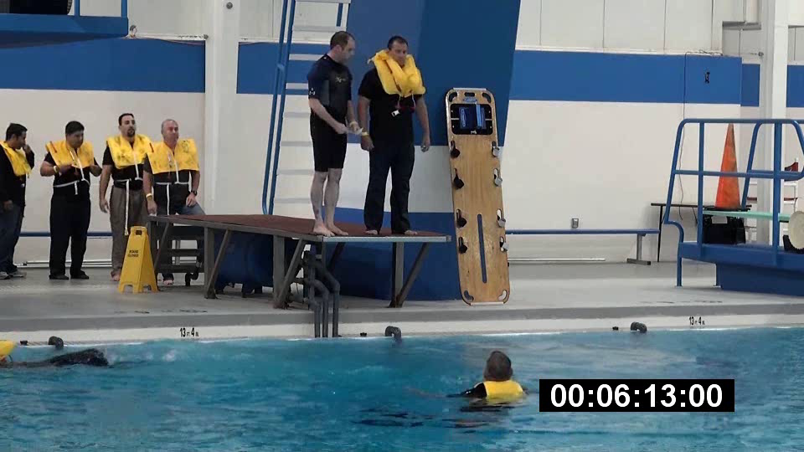

Slide 11
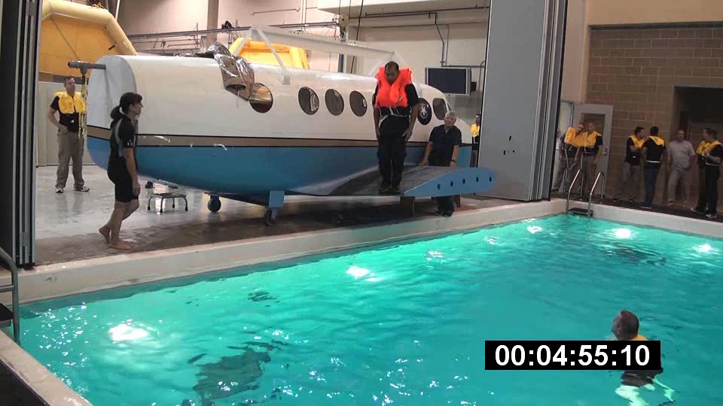

Slide 12
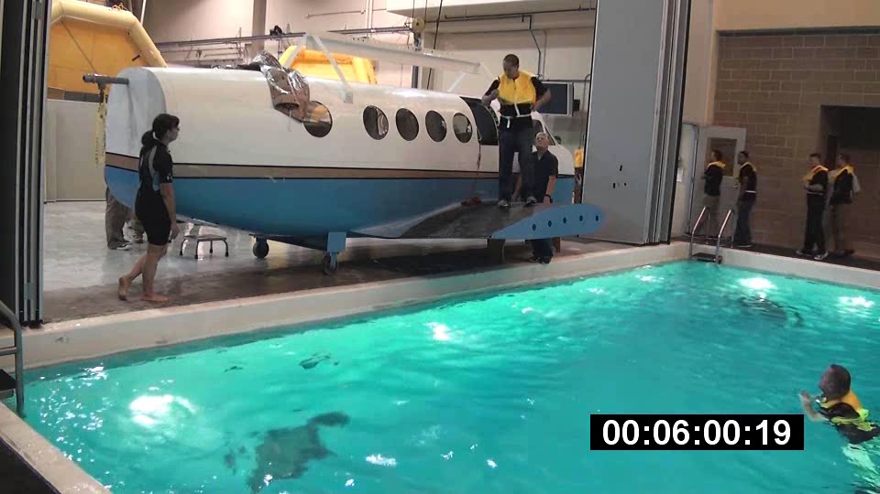

Slide 13
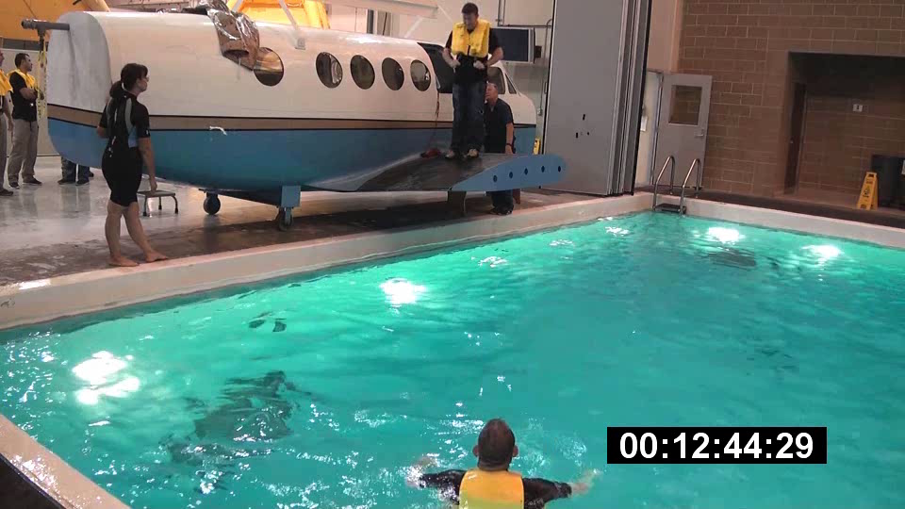

Slide 14
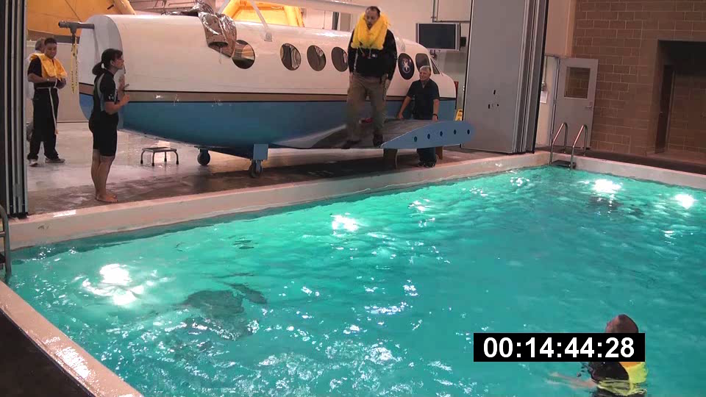

Slide 15
Results
At 3-meter height, 29% of life preservers not retained.
  Not in proper position after the jump
  Did not differentiate “partial” retention

Slide 16
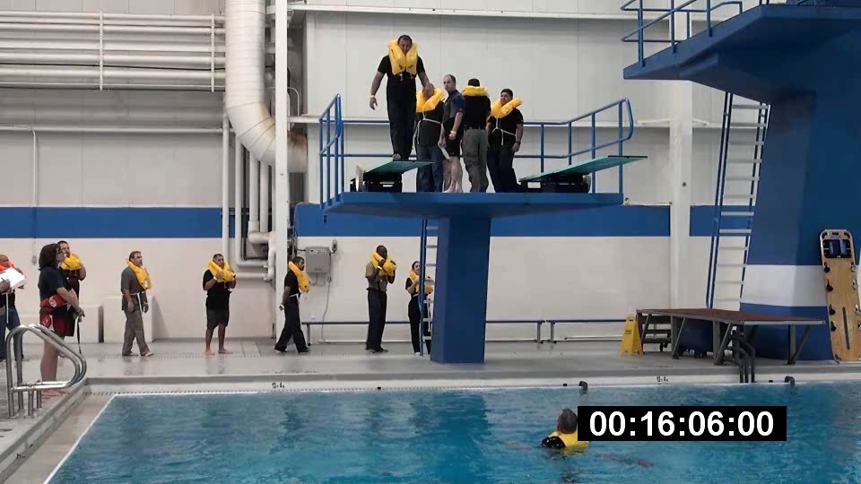

Slide 17
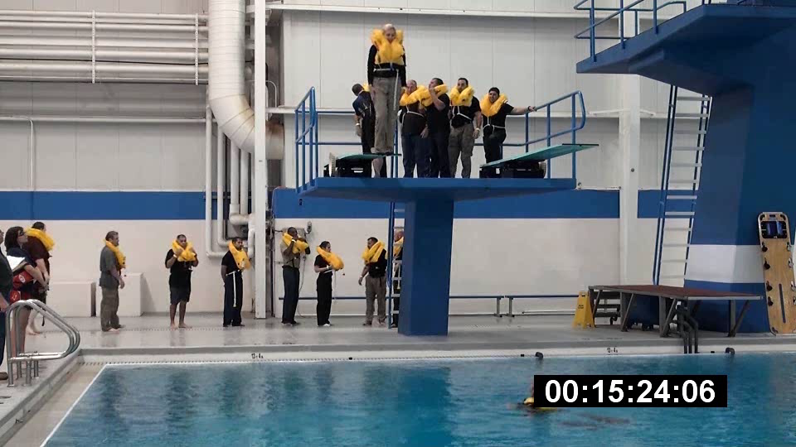

Slide 18
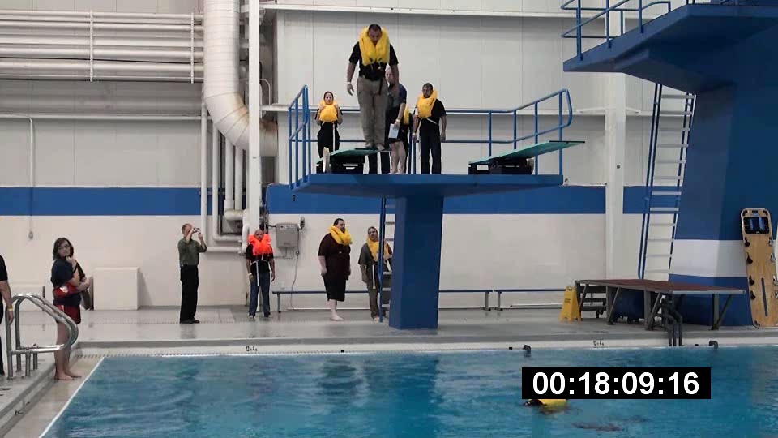

Slide 19
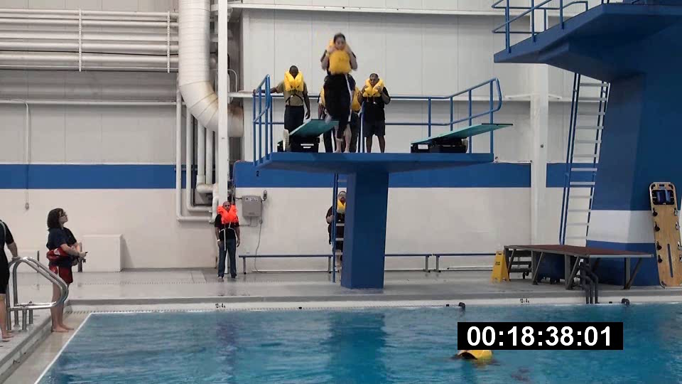

Slide 20
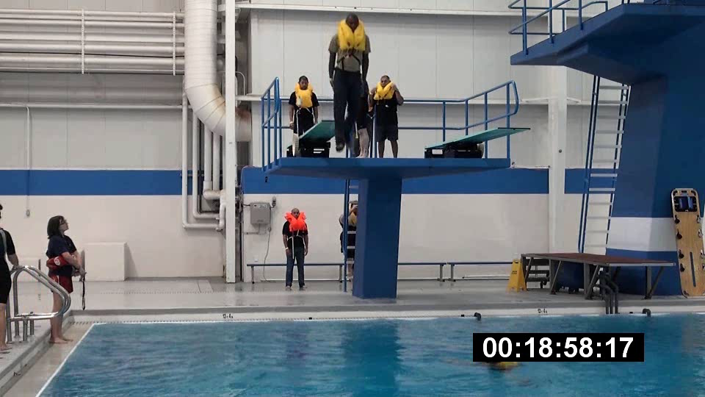

Slide 21
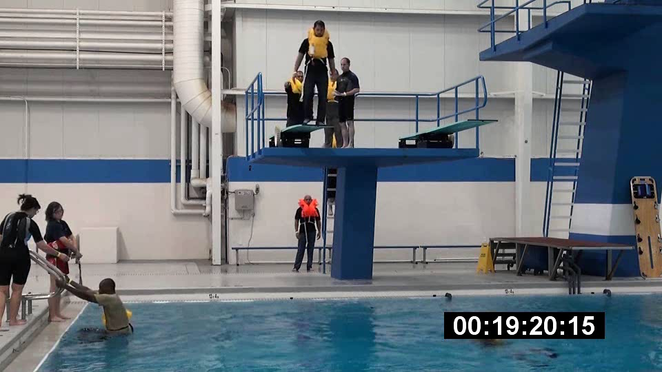

Slide 22
Results
Number of inflatable cells was not significantly associated with retention.
The size of the neck opening was not significantly associated with retention, however, those NOT retained had the largest neck openings.
BMI was not significantly associated with retention.
Height above the water was not significantly associated with retention, but more life preservers were not retained when the wearer jumped from the higher platform.

Slide 23
Conclusions
Proceed with balanced-design experiment to confirm “observational” findings.
  Participants were instructed to “Enter water at attention, arms down at yours sides.”
  Some jumped at attention, but held onto the life preserver as they entered the water.
  No follow-up questions regarding how the life preserver “performed.”
  Some may have pulled the life preserver down while in the water where the researchers couldn’t identify “partial” retention.

Slide 24
Test methods should be more explicit to better control the test environment.
  Test with wearer NOT holding onto the life preserver.
  Confirm “any attitude” includes most adverse for life preserver retention.

Slide 25
Publications available from: http://www.faa.gov/data_research/research/med_humanfacs/oamtechreports/

