Slide 1
Inflatable Emergency Equipment:
Evaluation of Individual Inflatable Life Preserver Donning Tests, Part 1
7th Triennial International Aircraft Fire and Cabin Safety Research Conference
Cynthia L. Corbett, MA
December 4, 2013

Slide 2
Thank You to
Cabin Safety Research Team
  David B. Weed, MA
  David J. Ruppel,
  Ken Larcher, MAS
  G. A. McLean, PhD

Slide 3
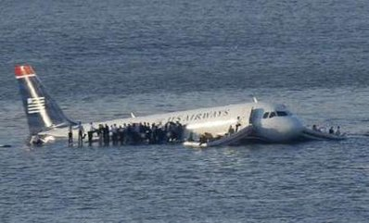
Background
US Airways Flight 1549 emergency landing in the Hudson River, Weehawken, NJ, January 2009
  Most of the passengers did not pay attention to the oral preflight safety briefing or read the safety information card, indicating that more creative and effective methods of conveying safety information to passengers are needed (A-10-86).
  Of the estimated 33 passengers (N = 150) who reported eventually having a life preserver, only 4 confirmed that they were able to complete the donning process by securing the waist strap themselves. Current design standards in TSO-C13f do not ensure that passengers can quickly or correctly don life preservers (A-10-85).

Slide 4
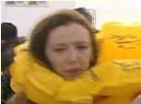
Technical Standard Order (TSO) C13f Donning Test
  Actual/simulated coach class seating with row in front of subjects creating maximum 31” seat pitch
  Subject must begin with seat belt fastened and may release and rise from seat but must remain in front of seat
  No donning information other than typical preflight briefing and donning demonstration
  25-second time limit
    Starts when subject has both hands on packaged life preserver
    Stops when life preserver is properly donned, secured, adjusted for fit
  75% of total number of test subjects must “pass”

Slide 5
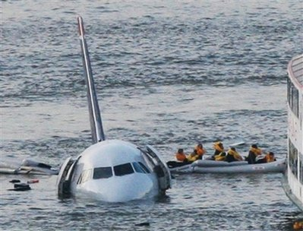
SAE Aerospace Standard (AS) 1354 – Individual Inflatable Life Preservers
  SAE S-9 Cabin Safety Provisions Technical Committee
  Request by FAA to support TSO revision
  Process began in 2004
  “No donning information other than typical preflight briefing and donning demonstration”
  If passengers are not going to pay attention to a preflight briefing in actuality, then it should not be included in the donning test method…

Slide 6
Research Design

Slide 7
Research Design
Total N = 156

Slide 8
Briefing Card Illustration for Condition C
Airline Name: USA 3000 Airlines
Equipment: A320
Designer: Interaction Research Corporation
Date of Copyright: 2005

Slide 9
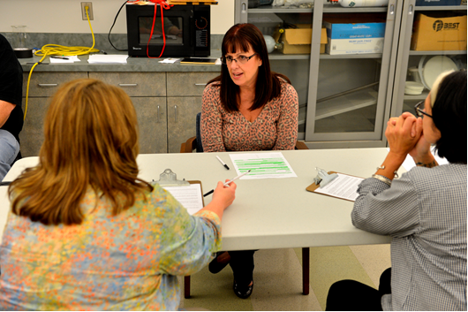
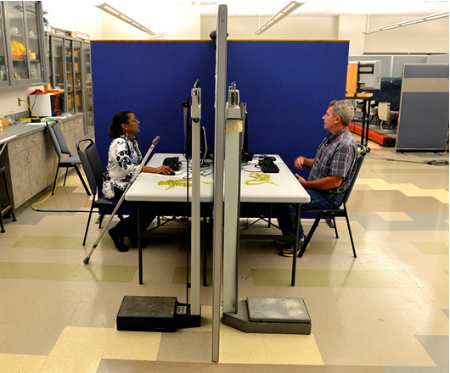
Procedure

Slide 10
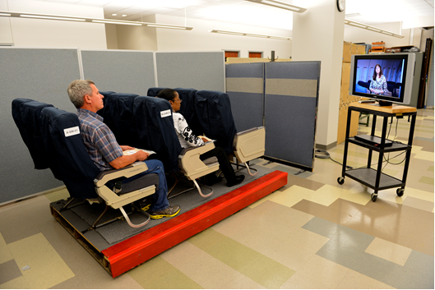

Slide 11
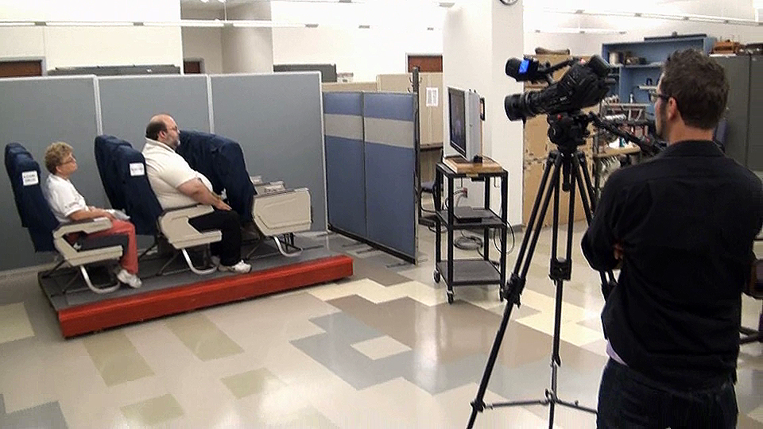

Slide 12
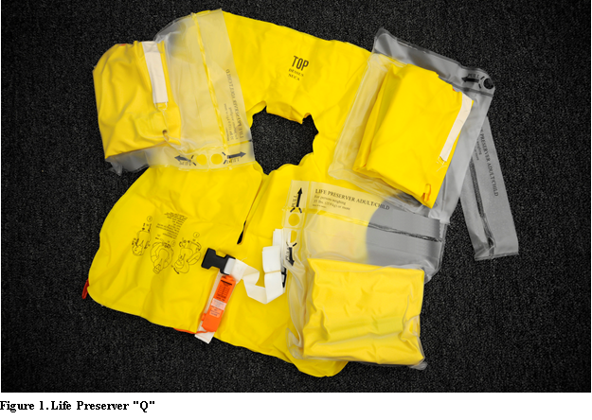
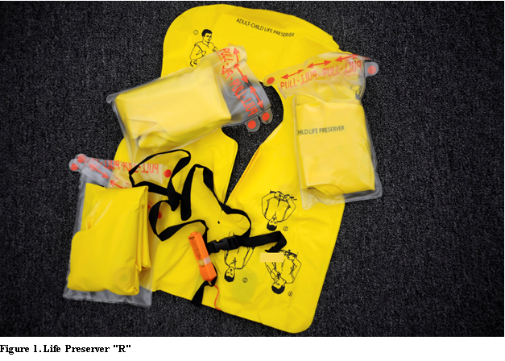
Life Preservers
Life Preserver “Q”
Life Preserver “R”

Slide 13
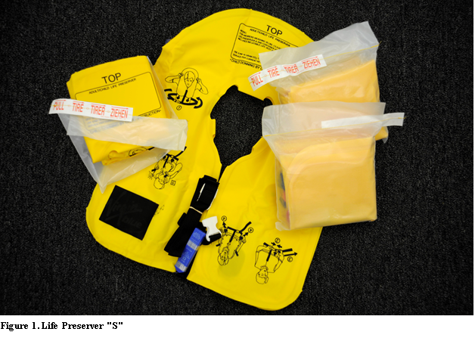
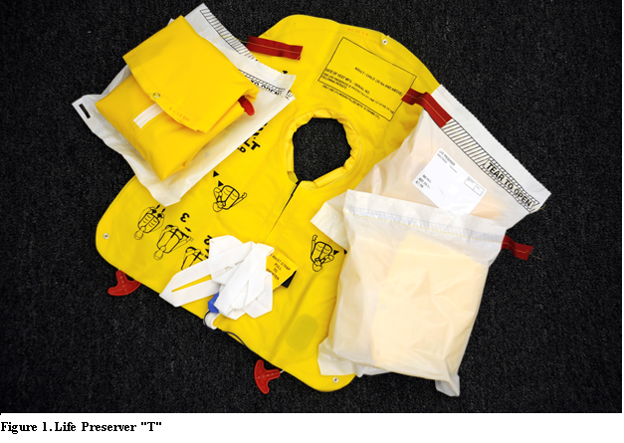
Life Preservers
Life Preserver “S”
Life Preserver “T”

Slide 14
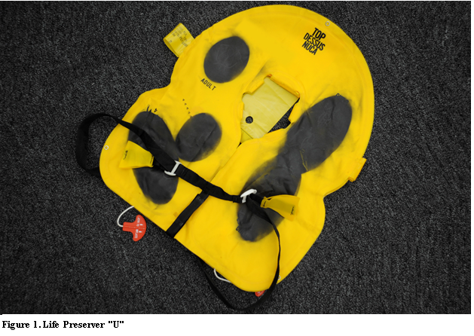
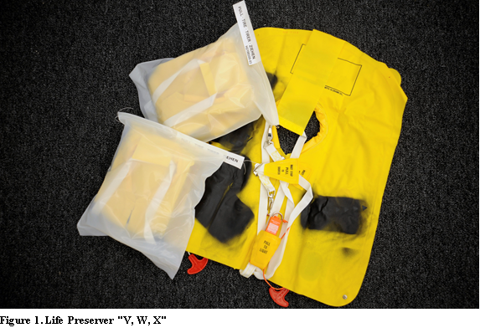
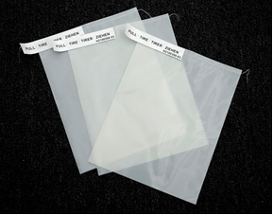
Life Preservers
Life Preserver “U”
Life Preservers “V, W, X”

Slide 15
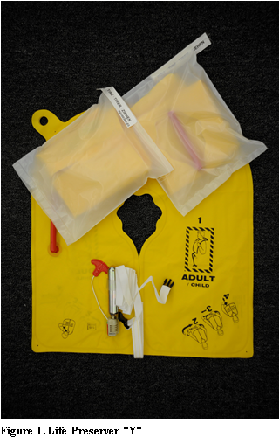
Life Preservers
Life Preserver “Z”
Life Preserver “Y”

Slide 16
Participants
 | Donning Instruction Condition
 | A* | BA* | B* | C* | D* | Overall
Gender | 54 | 30 | 24 | 24 | 24 | 156
Male | 57.4% | 60.0% | 12.5% | 37.5% | 33.3% | 44.2%
Female | 42.6% | 40.0% | 87.5% | 62.5% | 66.7% | 55.8%
Mean Age in Years | 46.7 | 50.2 | 48.3 | 47.5 | 41.3 | 46.9
Minimum | 25 | 24 | 23 | 28 | 26 | 23
Maximum | 75 | 66 | 68 | 62 | 61 | 75
Mean Girth in Inches | 34.8 | 37.7 | 36.5 | 38.5 | 36.4 | 36.4
Minimum | 20 | 29 | 27 | 31 | 27 | 20
Maximum | 50 | 47 | 49 | 50 | 49 | 50
Mean Height in Inches | 67.8 | 68.0 | 64.8 | 66.3 | 67.9 | 67.2
Minimum | 59 | 59 | 59 | 60 | 63 | 59
Maximum | 76 | 76 | 73 | 71 | 74 | 76
Mean Weight in Pounds | 183.5 | 201.6 | 172.9 | 188.8 | 183.0 | 186.1
Minimum | 115 | 139 | 124 | 128 | 110 | 110
Maximum | 356 | 300 | 246 | 319 | 282 | 356
*A: No instructions
*BA: Instructions on Life Preserver with no direction
*B: Instructions on Life Preserver with direction
*C: Instructions on Life Preserver and Briefing Card
*D: Instructions on Life Preserver with Briefing/Demonstration

Slide 17
Life Preserver Experience (Pre-Test)
81.4% had traveled on a plane where the use of life preservers were explained or demonstrated
Of those, 76.9% said they DID pay attention to the explanation/demo
66% considered the explanation/demo to be adequate should they have needed to use the life preserver
85.9% had used a life preserver in connection with water activities like water skiing or boating
Of those, time since last use ranged from 1 week to 20 years or more
Most often used: Non-inflatable 74%, Auto-inflate 6%

Slide 18
Time Measurement
TSO Time – Both hands on package, ready to open, to final adjustment
  102/156 (65.4%) Correct dons
  13/156 (8.3%) Correct don AND passed TSO Time requirement of 25 seconds

Slide 19
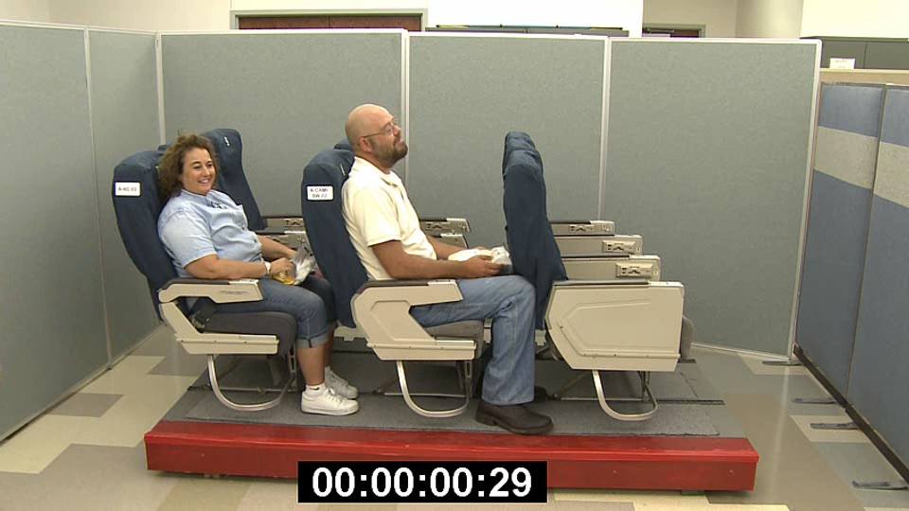

Slide 20
Time Measurement
TSO Time – Both hands on package, ready to open, to final adjustment
Package Opening Time – Both hands on package, ready to open, to hand entering package
Donning Time – Both hands on life preserver to final adjustment

Slide 21
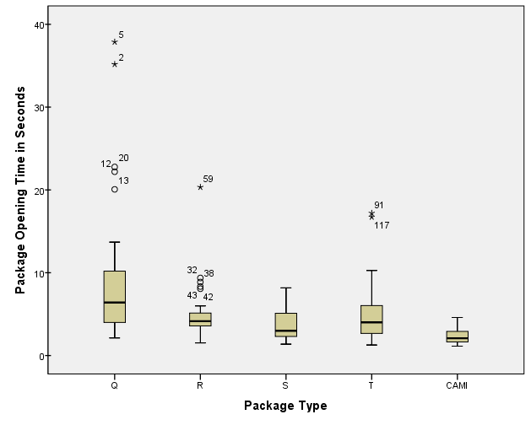
Package Opening
Notes:
Boxplot: Median, box (hinges) bracket the middle 50% of the scores
Whiskers contain adjacent values +/- 1.5 (hinge spread)
Outliers or extreme values

Slide 22
Donning Time without Package Opening

Slide 23
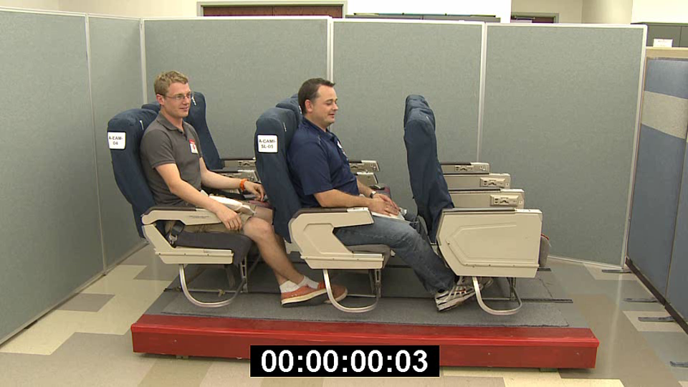
A: No Instruction Condition; Type S and U

Slide 26
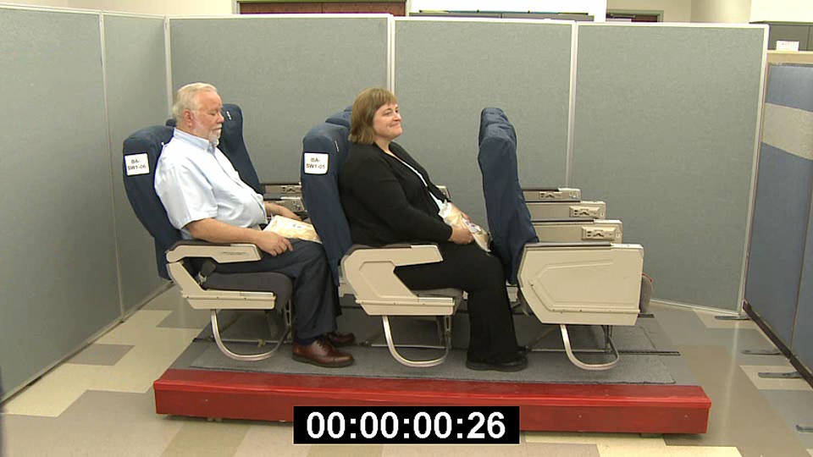
BA: Vest Only Instruction Condition; Type Y

Slide 28
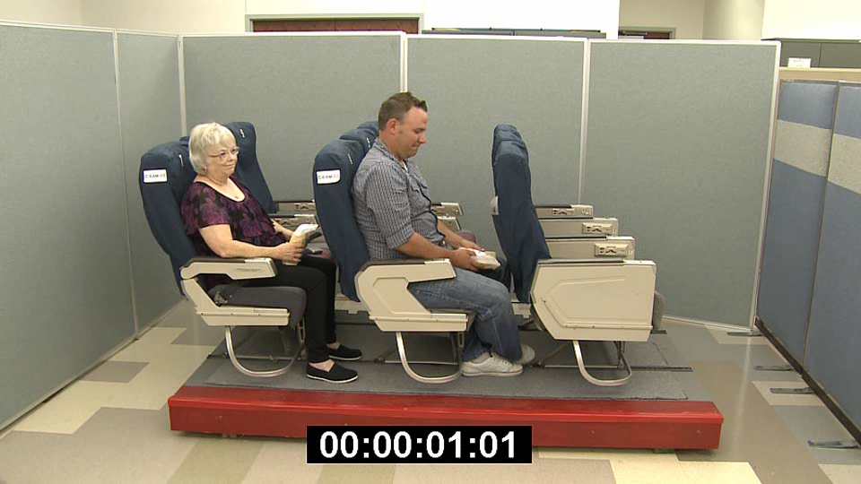
C: Vest and Briefing Card Instruction Condition; Type S

Slide 30
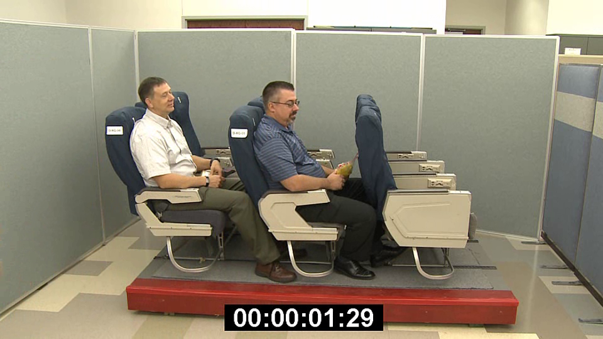
D: Vest and Briefing/Demo Instruction Condition; Type R

Slide 31
Overall

Slide 33
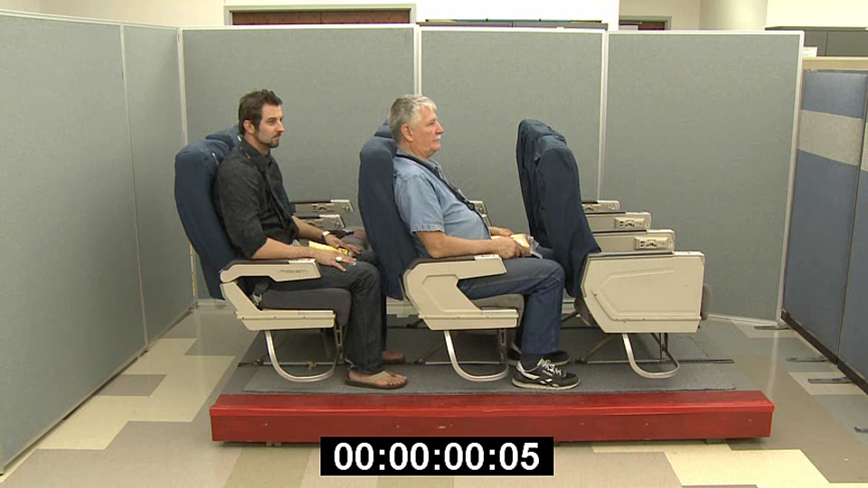

Slide 34
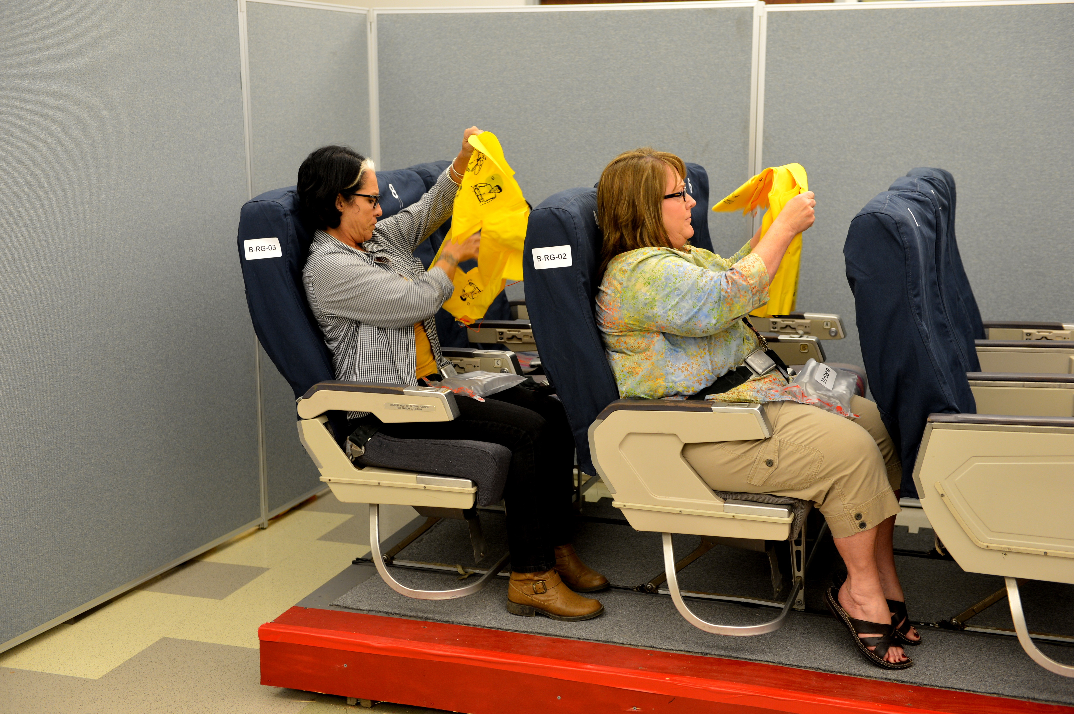
All Instruction Conditions Follow-Up Questions
51.9% said they experienced difficulties in donning the life preserver
Primary Sources of Difficulty
  Opening the package
  Determining front and back
  Fastening/Unfastening/Adjusting waist strap (rubber band)
  Upside-down instructions on life preserver
  Neck opening too small

Slide 35
Conclusion & Recommendations
None of the life preservers tested passed the certification criteria.
Test methods should be more explicit to better control the test environment.
Package opening should be a separate test with participants having cold/gloved hands.
A “critical” donning time should be determined.
Standards should be improved to address the difficulties identified.
Improve Passenger Safety Awareness!

Slide 36
Publications available from: http://www.faa.gov/data_research/research/med_humanfacs/oamtechreports/

Slide 37
Inflatable Emergency Equipment:
Evaluation of Individual Inflatable Life Preserver Donning Tests, Part 2
7th Triennial International Aircraft Fire and Cabin Safety Research Conference
Cynthia L. Corbett, MA
December 4, 2013

Slide 38
Life Preservers
Life Preserver “Q”
Life Preserver “R”

Slide 39
Life Preservers
Life Preserver “S”
Life Preserver “T”

Slide 40
Life Preservers
Life Preserver “U”
Life Preservers “V, W, X”

Slide 41
Life Preservers
Life Preserver “Z”
Life Preserver “Y”

Slide 42
The Details…

Slide 43
Life Preserver Donning
Correct Dons was significantly associated with Type of Life Preserver: Χ² (7, N = 156) = 16.05, p = .025
  Type A and Z each had the highest percentage of Correct Dons (83%) followed by Type T (80%)
  Type U had the lowest percentage of Correct Dons (33%)
Pass/Fail was not significantly associated with the Type of Life Preserver
  BUT Type Y had the highest percentage of Passes (25%) followed by Type T (17%)

Slide 44
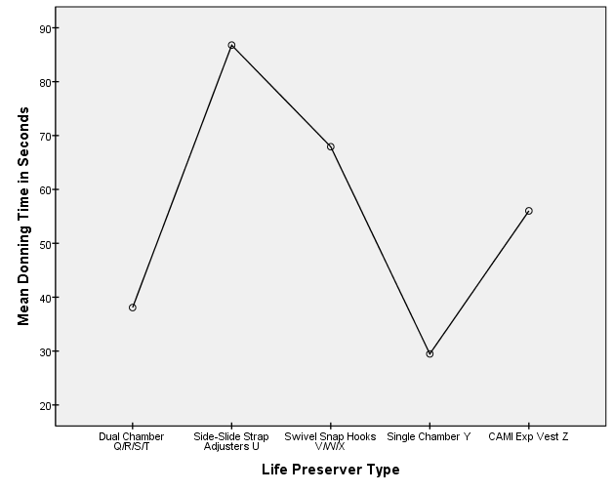
Instruction Condition A: No Instructions/No Markings
F (4, 49) = 6.46, p < .01

Slide 45
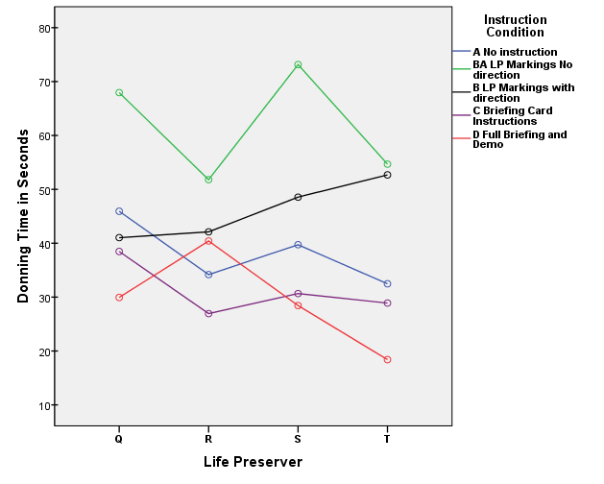
Instruction Condition (A/BA/B/C/D) X
Life Preserver (Q/R/S/T)
No significant differences among life preservers
No significant interaction of main effects
P < .01

Slide 46
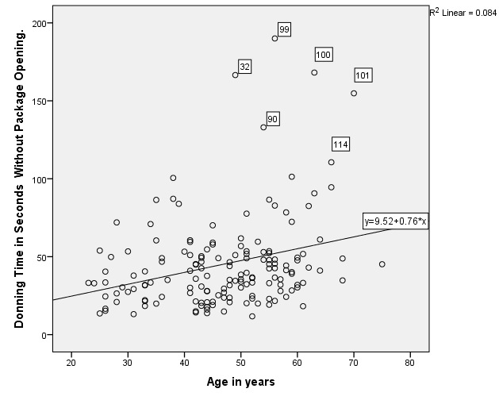
Participants
Age was significantly correlated with both TSO Time and Donning Time (with/without package opening), but…r = .289, p < .001
No other participant physical characteristics were significantly associated with Donning Time

Slide 47
Flight Experience
Number of Flights taken in the past year was significantly correlated with TSO Time and Donning Time
  r = -.20, p = .02
  r = -.18, p = .04
Within 25 seconds
  Pass average 14.3 flights
  No Pass average 3.9 flights

Slide 48
Time spent reading markings
No significant difference in mean time reading markings on Life Preserver between B (with direction) and BA (without direction)
  B: 1.43 to 34.03 seconds, M = 13.32
  BA: 0 to 39.73 seconds, M = 10.51
    Years of education significantly correlated with Total Time Spent Reading Markings, r = -.391, p = .03
No significant difference among Life Preservers
  Q: 8.54
  R: 12.64
  S: 15.08
  T: 13.85
  Y: 5.63 (BA Condition Only)

Slide 49
All Instruction Conditions Follow-Up Questions
51.9% said they experienced difficulties in donning the life preserver
28.2% reported they would have done worse, and 64.7% reported they would have done about the same if this had been an actual emergency aboard an airplane
36.5% said they would not have felt confident in their preparedness for an actual over-water evacuation

Slide 50
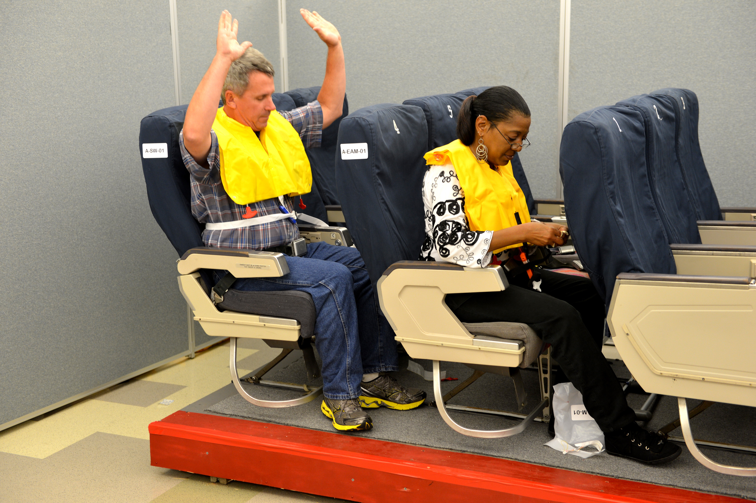
Primary Sources of Difficulty
Opening the package
Determining front and back
Fastening/Unfastening/Adjusting waist strap (rubber band)
Upside-down instructions on life preserver
Neck opening too small

Slide 51
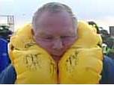
Instruction Conditions
47% said they read the instructions on the equipment or package
48% stated that they experienced confusion or uncertainty in following the instructions
How useful were instructions in helping you don the life preserver?
  BA 30% Adequate, 37% Marginal, 30% Inadequate
  B 63% Adequate, 29% Marginal, 8% Inadequate
  C 75% Adequate, 25% Marginal
  D 83% Adequate, 13% Marginal, 4% Inadequate
**May not total 100% due to rounding or no response

Slide 52
How well do you think you would have done if no information had been given?
  BA 7% Better, 57% About same, 33% Worse
  B 4% Better, 50% About same, 46% Worse
  C 0% Better, 58% About same, 42% Worse
  D 4% Better, 29% About same, 67% Worse
**May not total 100% due to rounding or no response

Slide 53
Recommendation
“If passenger safety is to be improved through the use of existing TSO devices, it will probably have to be achieved through a stronger than usual emphasis on correct usage during passenger briefings and require more than passive or elective attention by the passengers.”
      Rasmussen and Steen (1983)

Slide 54
Publications available from: http://www.faa.gov/data_research/research/med_humanfacs/oamtechreports/

