Slide 1
Implementing Crew Redirection Algorithm into Airplane Evacuation Computer Simulation
Hae Chang Gea
Department of Mechanical and Aerospace Engineering
Rutgers University, New Jersey, USA
Program Manager: Dr. Mac McLean, FAA, CAMI

Slide 2
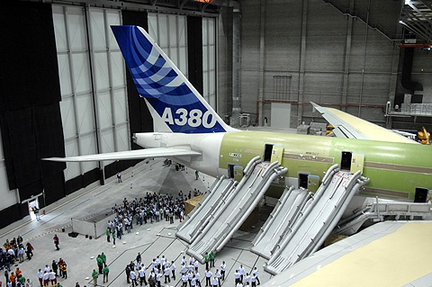
Aircraft Emergency Evacuation
A full scale test is…
  risky;
  costly;
  time consuming;
  inconsistent.
Simulations can…
  study many what-if scenarios;
  incorporate various hazardous conditions;
  evaluate the impact of new devices;
  better understanding of the entire evacuation process.

Slide 3
Aircraft Emergency Evacuation
Simulations can…
  study many what-if scenarios;
  incorporate various hazardous conditions;
  evaluate the impact of new devices;
  better understanding of the entire evacuation process.
Crew Redirection Algorithm
Crew Redirection with Interior Access Vehicles for Emergency Evacuation
Crew Redirection with Injured Passenger for Emergency Evacuation

Slide 4
Aircraft Emergency Evacuation
Simulations can…
  study many what-if scenarios;
  incorporate various hazardous conditions;
  evaluate the impact of new devices;
  better understanding of the entire evacuation process.
Crew Redirection Algorithm (Cabin Safety I: 10:30-11:00AM)
Crew Redirection with Interior Access Vehicles for Emergency Evacuation (Cabin Safety II: 2:30-3:00PM)
Crew Redirection with Injured Passenger for Emergency Evacuation (Cabin Safety II: 4:30-5:00PM)

Slide 5
Limitation of Airplane Evacuation
Narrow Aisle
Limited Exits
Tendency to use closest exit
Congestion of Passengers
In efficient evacuation flow

Slide 6

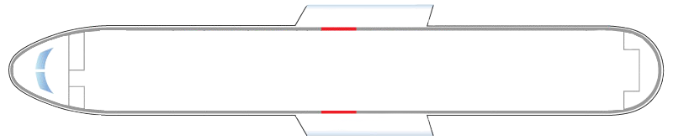
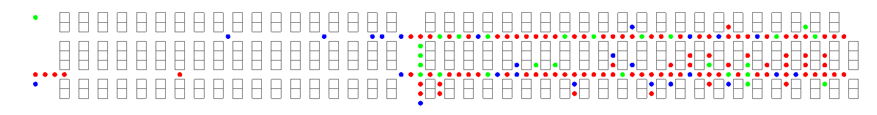
Evacuation Flow Study
From observation of evacuation flow
- Heavy congestion at the mid section exits were commonly observed.
- Some of the exits are not fully utilized when both side of exits are available.
Redirect Passengers evacuation path is required to have more efficient flow.
Not Fully Utilized
Heavy Congestions
Crew Redirection Algorithm

Slide 7
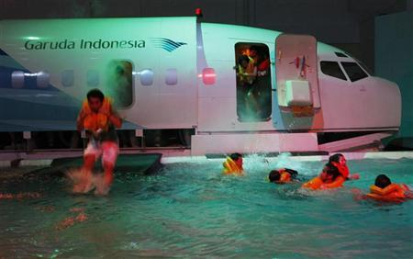
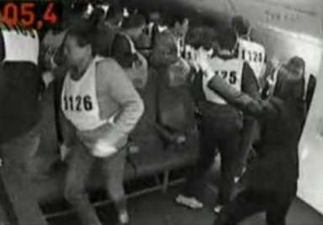
Crew Redirection Simulation
Crew Redirection algorithm can be used to develop more efficient evacuation procedure for emergency evacuation situation
The crew redirection algorithm can be applied differently depending on available exits

Slide 8
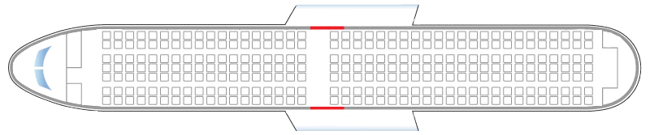

Crew Redirection Principles
Redirecting entire section
- send entire section passengers which are connected to the a pair of opened exit.
Redirect To the Front
Increase congestions
at the mid exits

Slide 9

Crew Redirection Principles
Redirecting at the intersection
- redirecting passenger to the further exit when closest exit is congested

Slide 10
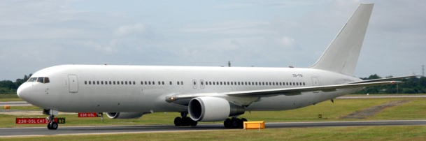
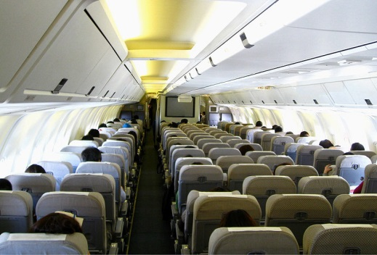
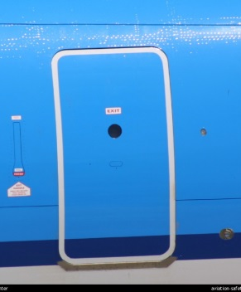
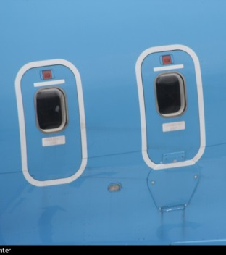
Simulation Model: B 767-300
Seat Number: 285
Seat Layout: 2-3-2
Exit Number: 8 Pairs
Exit Type: 4 Type A
4 Type III
Type A
2: Type III
Type A
Type A
2: Type III
Type A

Slide 11
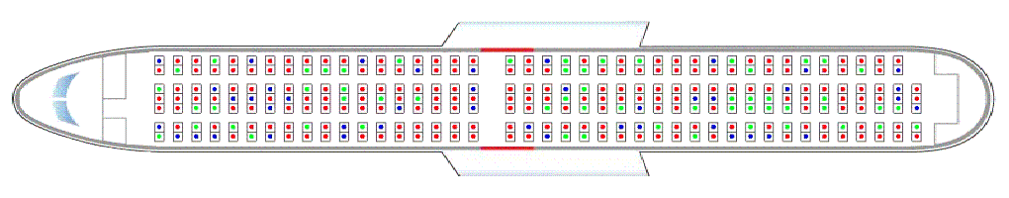
B 767-300: No Crew
154.74sec

Slide 12
B 767-300: No Crew
1
2
4
3
Notes:
ans =
154.7415
passengers =
52.0850 54.7350 88.8530 89.3270
passenger_std =
3.2274 3.0063 2.4485 2.2903
times =
42.1203 44.4251 154.2205 154.0146
times_std =
7.4078 7.2117 2.8610 2.8148

Slide 13
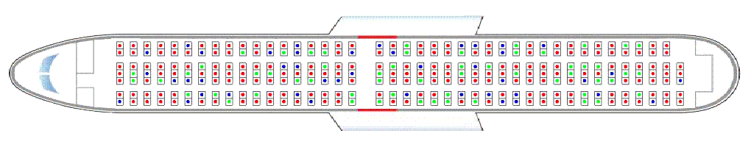
B 767-300: Crew
89.23sec
Notes:
ans =
89.2333
passengers =
100.4210 90.9060 43.0210 50.6520
passenger_std =
3.6638 3.4033 2.3008 3.3154
times =
85.4162 83.1100 88.2613 87.9087
times_std =
4.3673 4.7597 4.6374 4.6620

Slide 14
B 767-300: Crew
1
2
4
3
Notes:
ans =
89.2333
passengers =
100.4210 90.9060 43.0210 50.6520
passenger_std =
3.6638 3.4033 2.3008 3.3154
times =
85.4162 83.1100 88.2613 87.9087
times_std =
4.3673 4.7597 4.6374 4.6620

Slide 15
B 767-300: Comparison
1
2
4
89.23sec
3
154.74sec
65.51sec

Slide 16
B 767-300: Comparison
1
2
4
3

Slide 17
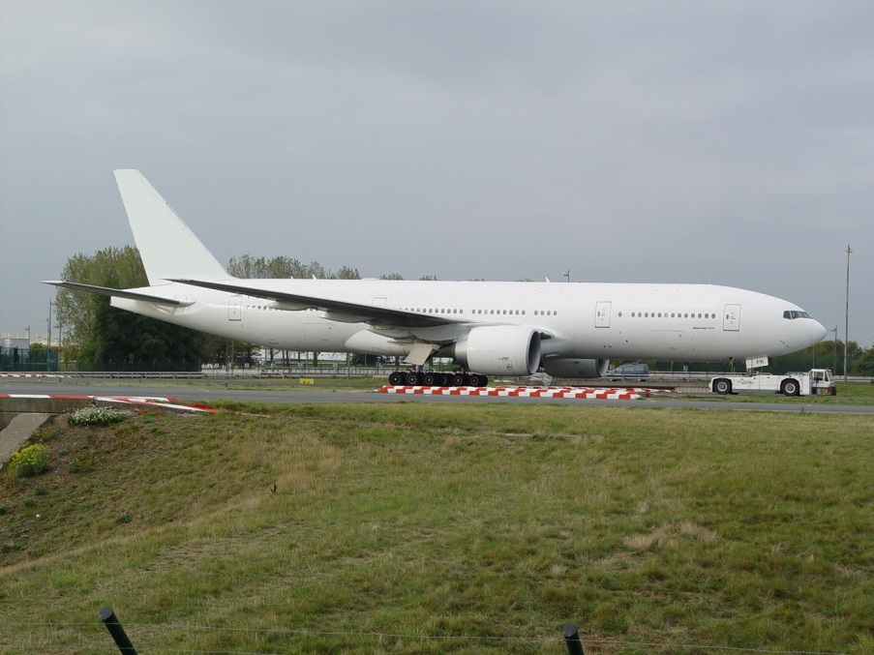
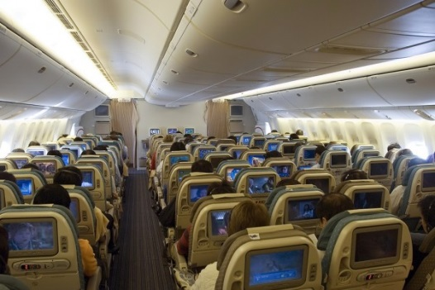
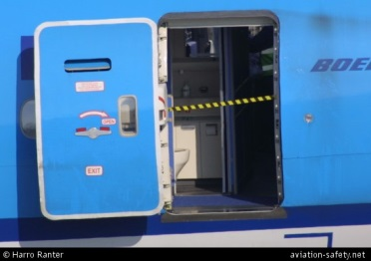
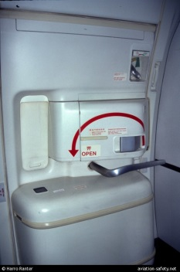
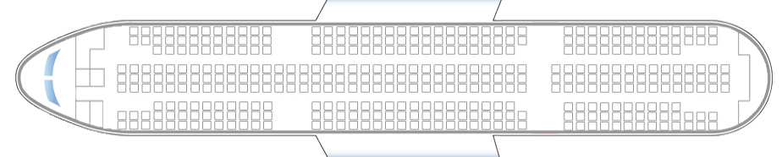
Simulation Model: B 777-200
Seat Number: 440
Seat Layout: 3-3-3
Exit Number: 4 Pairs
Exit Type: 8 Type A
Type A
Type A
Type A
Type A
Type A
Type A
Type A
Type A

Slide 18

Simulation Model: B 777-300
Half number of exits are fully available during evacuation
5 different sets of usable exit combinations are simulated by Monte Carlo Test
Conf. A
Conf. B
Conf. D
Conf. C
Conf. E

Slide 19
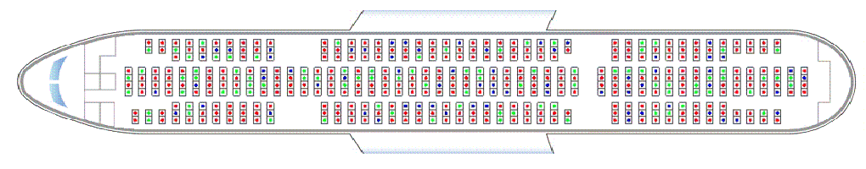
B 777-300: Conf. A-No Crew
84.10sec
Notes:
ans =
84.1028
passengers =
74.6570 139.9060 140.9390 84.4980
passenger_std =
2.7920 4.3852 4.5102 2.7917
times =
45.8379 82.5067 83.1167 52.7179
times_std =
2.5550 2.1488 2.0893 2.6389

Slide 20
B 777-300: Conf. A-No Crew
1
2
3
4

Slide 21
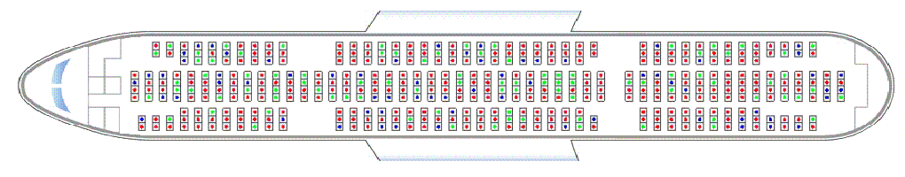
B 777-300: Conf. A- Crew
69.33sec
Notes:
ans =
69.3272
passengers =
102.0000 113.5290 114.4450 110.0260
passenger_std =
0 3.9422 3.9513 0.1771
times =
59.7364 67.2687 67.8418 66.0346
times_std =
2.3310 2.2130 2.2495 2.6083

Slide 22
B 777-300: Conf. A- Crew
1
2
3
4

Slide 23
B 777-300: Conf. A
1
2
3
4
1
2
69.33sec
84.10sec
3
4
14.77
Notes:
Reduce 14.77sec

Slide 24
B 777-300: Conf. A
1
2
3
4

Slide 25
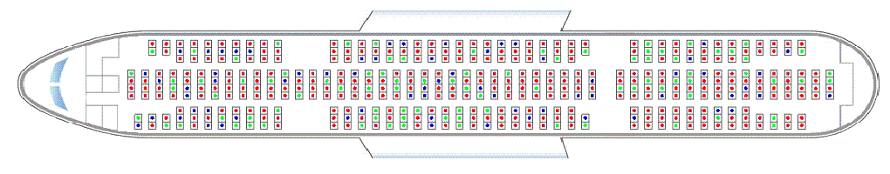
B 777-300: Conf. B- No Crew
153.53sec
Notes:
ans =
123.5318
passengers =
32.8430 31.9810 192.3660 182.8100
passenger_std =
2.6343 2.6400 6.0736 6.0442
times =
23.2387 23.1582 122.9764 121.5956
times_std =
2.0954 1.9978 2.8126 2.8388
>>

Slide 26
B 777-300: Conf. B- No Crew
3
4
1
2

Slide 27
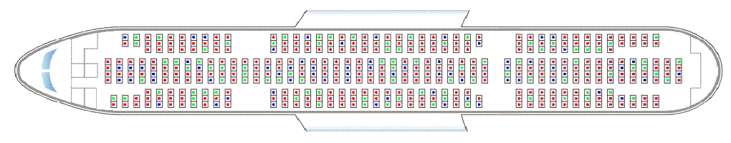
B 777-300: Conf. B- Crew
79.58sec
Notes:
ans =
79.5800
passengers =
105.4590 102.3250 119.5020 112.7140
passenger_std =
4.4283 4.2456 3.4293 3.2531
times =
73.8054 73.4228 79.5226 76.0474
times_std =
1.8628 1.9735 1.8665 2.2157

Slide 28
B 777-300: Conf. B- Crew
3
4
1
2

Slide 29
B 777-300: Conf. B
3
4
1
2
79.58sec
153.53sec
73.95 sec

Slide 30
B 777-300: Conf. B
3
4
1
2

Slide 31
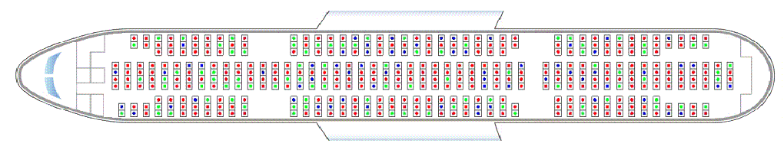
B 777-300: Conf. C- No Crew
118.26sec
Notes:
ans =
118.2623
passengers =
63.1680 89.1750 202.8280 84.8290
passenger_std =
3.0921 4.4874 4.1725 4.2647
times =
40.3426 59.3879 118.2623 58.3918
times_std =
3.8684 6.5901 2.9205 6.1939

Slide 32
B 777-300: Conf. C- No Crew
4
1
2
3

Slide 33
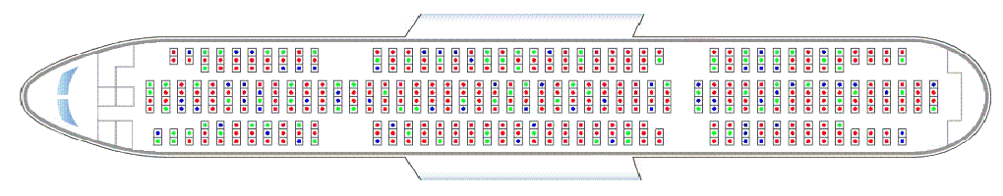
B 777-300: Conf. C- Crew
79.58sec
Notes:
ans =
79.5800
passengers =
105.4590 102.3250 119.5020 112.7140
passenger_std =
4.4283 4.2456 3.4293 3.2531
times =
73.8054 73.4228 79.5226 76.0474
times_std =
1.8628 1.9735 1.8665 2.2157

Slide 34
B 777-300: Conf. C- Crew
4
1
2
3

Slide 35
B 777-300: Conf. C
4
1
2
79.58sec
118.26sec
3
38.68 sec

Slide 36
B 777-300: Conf. C
4
1
2
3

Slide 37
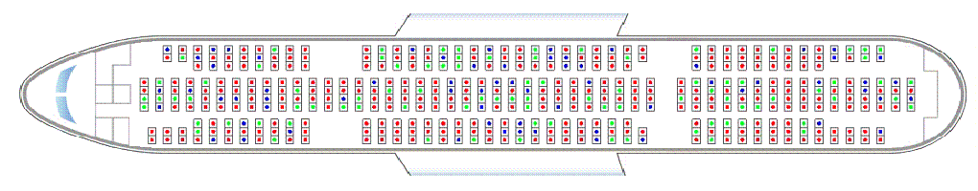
B 777-300: Conf. D- No Crew
127.09sec
Notes:
ans =
127.0928
passengers =
42.4310 138.1220 218.3080 41.1390
passenger_std =
2.6123 4.5345 3.8007 2.5804
times =
30.0418 83.3156 127.0928 29.5185
times_std =
2.5668 4.8325 2.6790 2.3211

Slide 38
B 777-300: Conf. D- No Crew
4
1
2
3

Slide 39
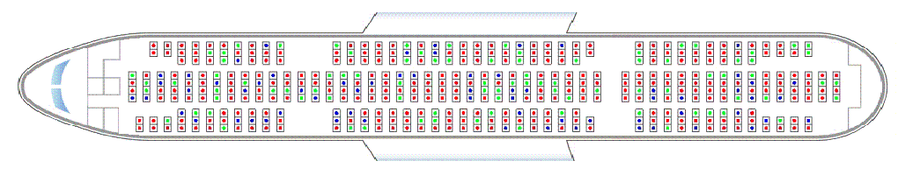
B 777-300: Conf. D- Crew
79.54sec
Notes:
ans =
79.5351
passengers =
97.1380 115.0450 134.0000 93.8170
passenger_std =
4.2048 5.0611 0 3.8260
times =
72.2782 78.0251 76.8623 73.4859
times_std =
2.1660 3.4426 2.4568 2.1074

Slide 40
B 777-300: Conf. D- Crew
4
1
2
3

Slide 41
B 777-300: Conf. D- Crew
4
1
2
3
79.54sec
127.09sec
47.55 sec

Slide 42
B 777-300: Conf. D- Crew
4
1
2
3

Slide 43
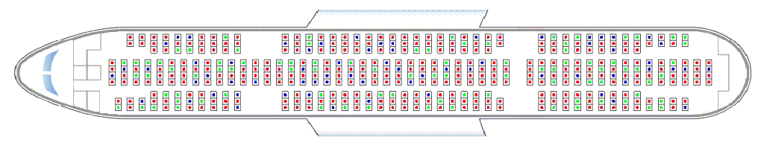
B 777-300: Conf. E- No Crew
106.23sec
Notes:
ans =
106.2038
passengers =
42.4610 178.6750 177.6850 41.1790
passenger_std =
2.6851 5.6168 5.2277 2.7075
times =
29.9836 104.8492 103.9477 29.4695
times_std =
2.5406 2.8686 2.7959 2.4099

Slide 44
B 777-300: Conf. E- No Crew
4
1
2
3

Slide 45
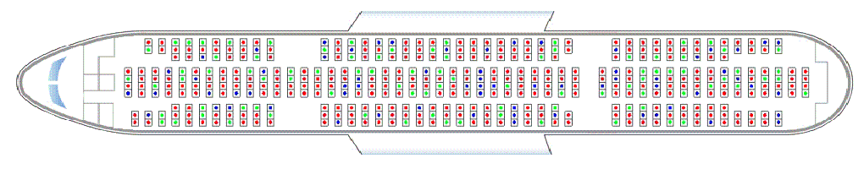
B 777-300: Conf. E- Crew
80.01sec
Notes:
ans =
88.0077
passengers =
94.6290 104.1590 148.0780 93.1340
passenger_std =
4.0632 3.7263 5.3371 3.7932
times =
72.8246 73.1779 87.9864 72.5351
times_std =
2.1763 3.2725 2.7297 2.3685

Slide 46
B 777-300: Conf. E- Crew
4
1
2
3

Slide 47
B 777-300: Conf. E
4
1
2
80.01sec
106.23sec
3
26.22

Slide 48
B 777-300: Conf. E
4
1
2
3

Slide 49
Conclusion
Crew redirection algorithm and results are presented based on 2 types of double aisle airplane
Crew redirection reduce significant amount of time if either front or rear section is completely block
B 777-300: Conf. B shows worst evacuation time without crew redirection. However, crew redirection algorithm reduced about 74 second evacuation time which can meet the 90 second evacuation rule.
Different types of airplane can be studied to apply the crew redirection algorithm

