Slide 1
Simulated Effectiveness of Crew Redirection with Interior Access Vehicle
Hae Chang Gea
Department of Mechanical and Aerospace Engineering
Rutgers University, New Jersey, USA
Program Manager: Dr. Mac McLean, FAA, CAMI

Slide 2
Aircraft Emergency Evacuation
Simulations can…
  study many what-if scenarios;
  incorporate various hazardous conditions;
  evaluate the impact of new devices;
  better understanding of the entire evacuation process.
Crew Redirection Algorithm
Crew Redirection with Interior Access Vehicles for Emergency Evacuation
Crew Redirection with Injured Passenger for Emergency Evacuation

Slide 3
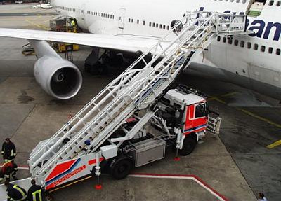
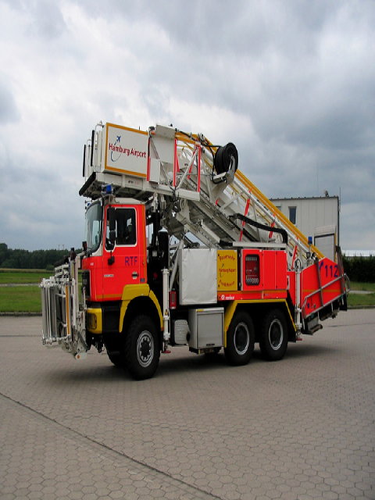
Interior Access Vehicle
Objective
  To aid in passenger evacuation;
  To initiate an effective rescue and fire suppression.

Slide 4


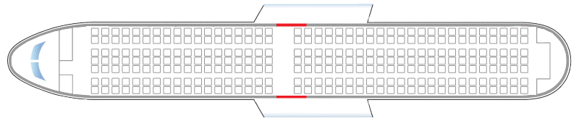
IAV Deployment Simulation
Half of exits are available at the beginning
IAV is deployed with time delay: 0sec to 80 sec
Different exit availability configurations are simulated

Slide 5

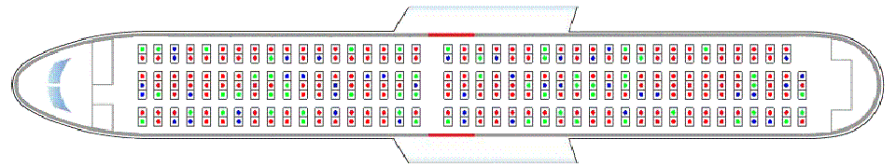

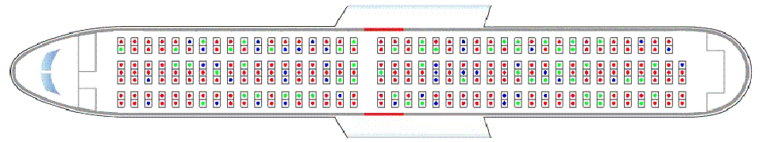
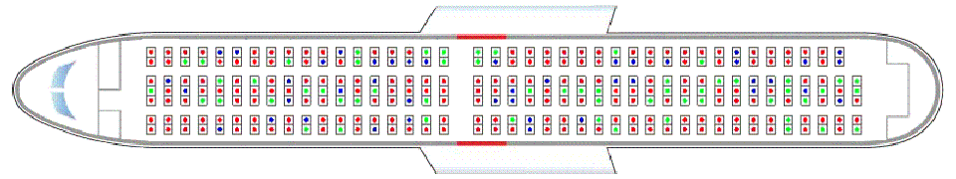
IAV Opens at 0 sec. (68sec)
IAV Opens at 30 sec. (71sec)
IAV Opens at 60 sec. (74sec)
Type C Type 3 Type C

Slide 6
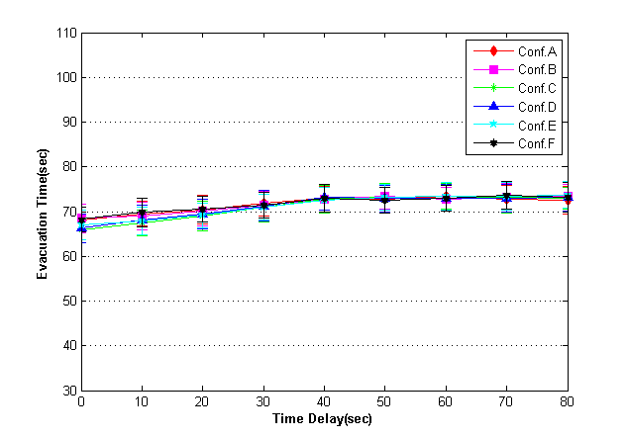
Review of IAV without Crew Redirection
Evenly placed exits
Conf. A
Conf. B
Conf. C
Conf. D
Early IAV deployment reduce about 7 sec for total evacuation time
Conf. E
Conf. F

Slide 7

Summary of IAV without Crew Redirection
1
5
3
2
4

Slide 8
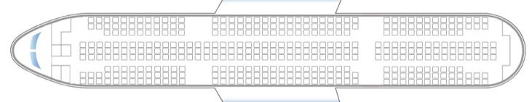
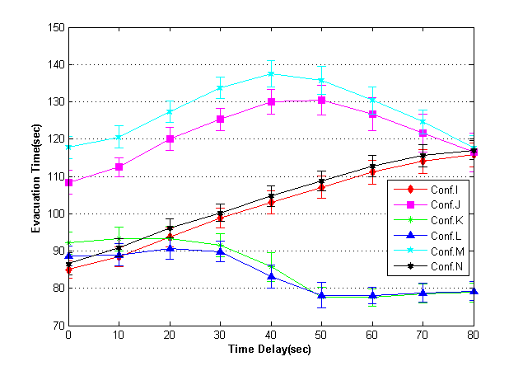
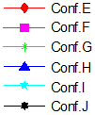
Review of IAV without Crew Redirection
After certain time late IAV deployment reduce about for total evacuation time
Conf. E
Conf. F
Conf. G
Conf. H
Conf. I
Conf. J

Slide 9
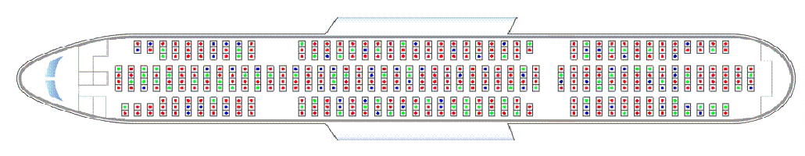
Configuration I
IAV deployed at 40 sec
Fig9M5 no crew Animation
IAV deployed at 80 sec

Slide 10
Review of IAV without Crew Redirection
When IAV deployed the other side of available exits, the exits are not fully utilized.
Depending on available exit locations, the early IAV deployment cannot help to reduce overall evacuation time because of inefficient egress flow
Crew Redirection

Slide 11
Crew Redirection for IAV deployment
Crew redirection algorithm is activate when a pair of same section’s exits is available.
Redirecting at the mid-cabin intersection also activate depending on the criteria which was defined in the Crew Redirection Algorithm presentation
Crew redirection algorithm is revised depending on exits
Redirect To
the Front

Slide 12
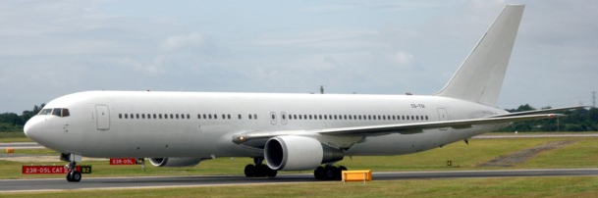
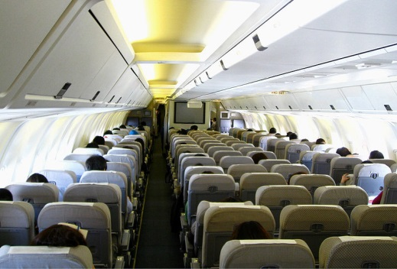
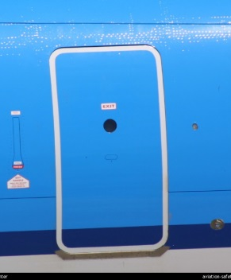
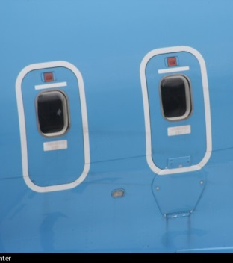
Simulation Model: B 767-300
Seat Number: 285
Seat Layout: 2-3-2
Exit Number: 8 Pairs
Exit Type: 4 Type A
4 Type III
Type A
2: Type III
Type A
Type A
2: Type III
Type A

Slide 13

Simulation Model: B 767-300 / Group 1
Four fully usable exits were evenly placed along the fuselage (front, middle, rear)
IAV deployed either front or rear exit of the cabin
Conf. A
Conf. D
Conf. B
Conf. E
Conf. C
Conf. F

Slide 14
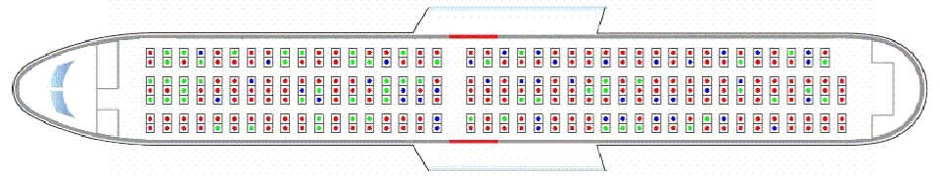
B 767-300 / Group 1-Conf.A
0 second IAV deployment

Slide 15
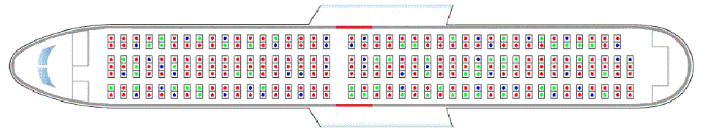
B 767-300 / Group 1-Conf.A
30 second IAV deployment

Slide 16
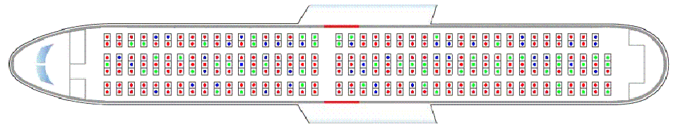
B 767-300 / Group 1-Conf.A
60 second IAV deployment

Slide 17


B 767-300 / Group 1-Conf.A
Early IAV deployment reduce about 5 sec for total evacuation time
Early IAV deployment with Crew redirection reduce about 14 sec for total evacuation time

Slide 18


B 767-300 / Group 1-Conf.D
Early IAV deployment reduce about 7 sec for total evacuation time
Early IAV deployment with Crew redirection reduce about 17 sec for total evacuation time

Slide 19
B 767-300 / Group 1
Conf. A
Conf. B
Conf. C
Conf. D
Conf. E
Conf. F

Slide 20
Simulation Model: B 767-300 / Group 2
Either front or rear exits are initially blocked and IAV deployed one of the blocked exit depending on the time
Deployment of IAV restored egress to all three cabin sections
Crew redirection will be applied form the beginning of the evacuation
Conf. G
Conf. J
Conf. H
Conf. I

Slide 21
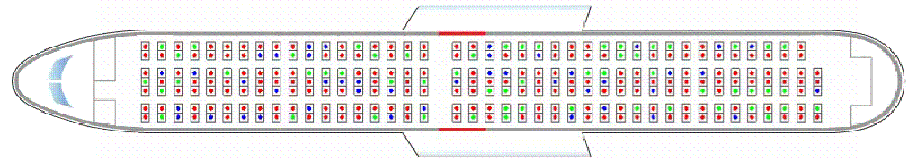
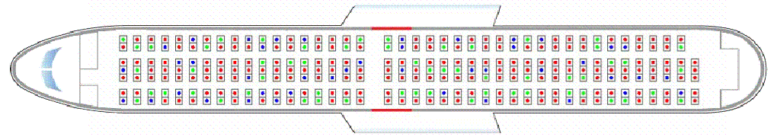
B 767-300 / Group 2-Conf.G
0 second IAV deployment

Slide 22
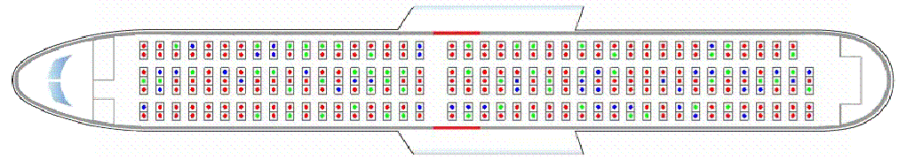
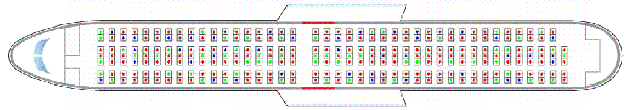
B 767-300 / Group 2-Conf.G
30 second IAV deployment
Fig5G_30 No crew Animation
Fig5G_30 crew Animation

Slide 23
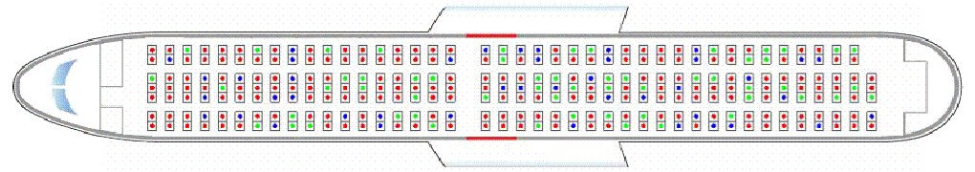
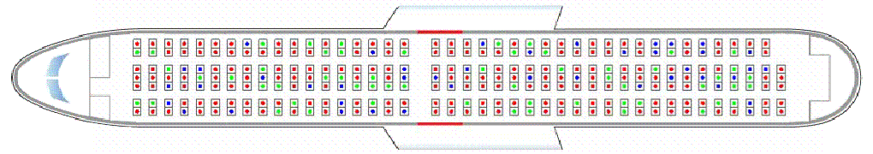
B 767-300 / Group 2-Conf.G
60 second IAV deployment
Fig5G_60 No crew Animation
Fig5G_60 crew Animation

Slide 24
B 767-300 / Group 2
Early IAV deployment with Crew redirection reduce about 10 sec compare with no crew redirection
Conf. G
Conf. H
Conf. J
Conf. I

Slide 25
Simulation Model: B 767-300 / Group 3
Both mid-cabin Type-III exits and one of the end cabin exit are usable
IAV deployed at the other side of usable Type A door
One section exits are completely blocked for entire evacuation process
Conf. K
Conf. L

Slide 26
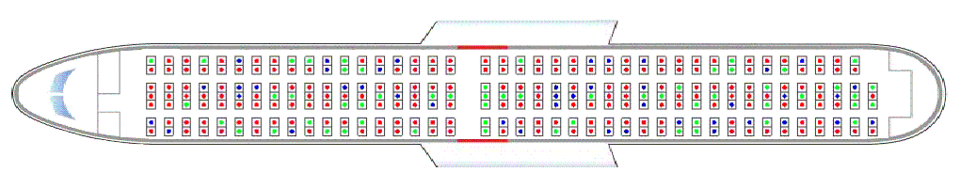
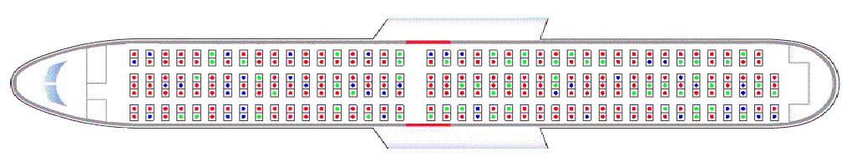
B 767-300 / Group 3-Conf.K
0 second IAV deployment
Fig5K crew Animation

Slide 27
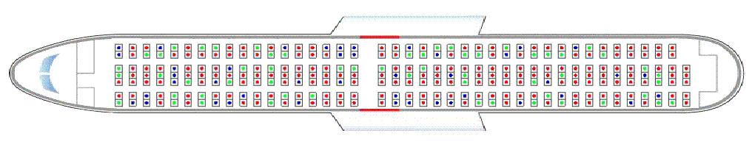
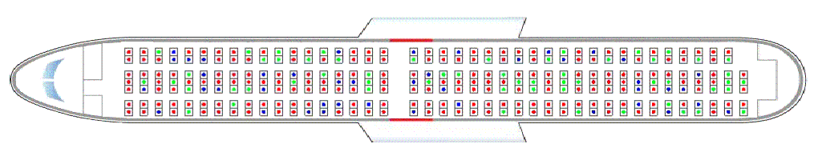
B 767-300 / Group 3-Conf.K
30 second IAV deployment

Slide 28
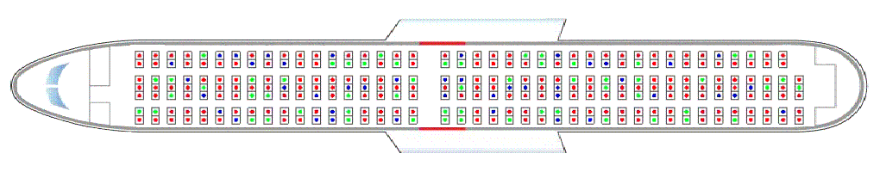
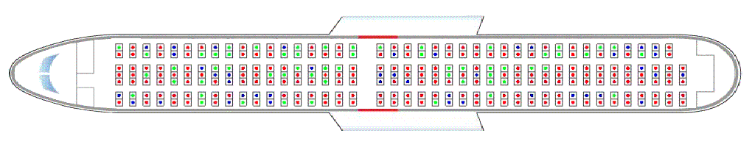
B 767-300 / Group 3-Conf.K
60 second IAV deployment

Slide 29
B 767-300 / Group 3
Conf. K
Early IAV deployment with Crew redirection reduce about 20 sec compare with no crew redirection
Conf. L

Slide 30
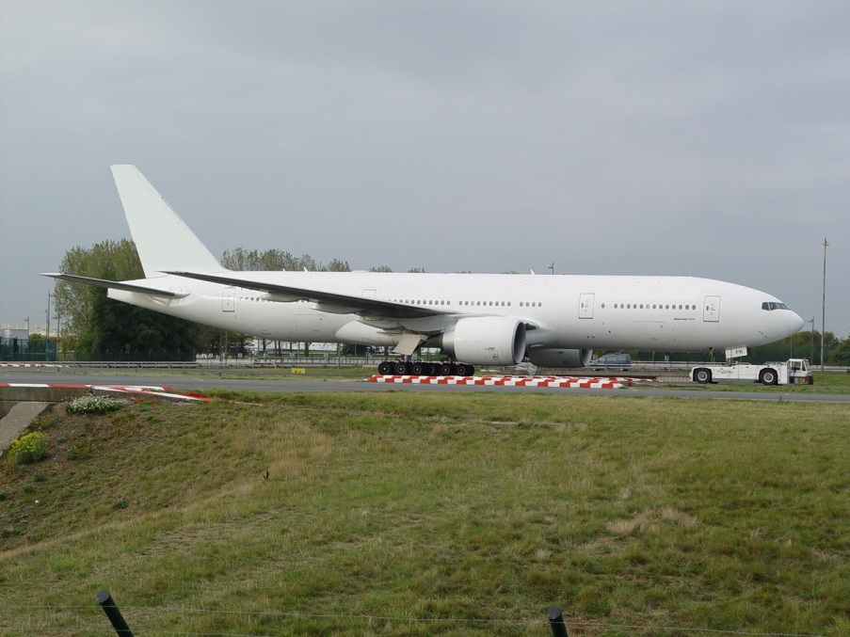
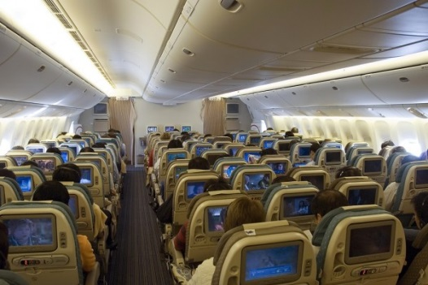
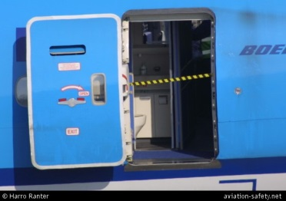
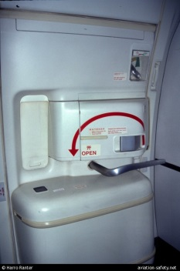
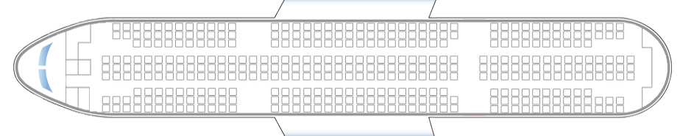
Simulation Model: B 777-200
Seat Number: 440
Seat Layout: 3-3-3
Exit Number: 4 Pairs
Exit Type: 8 Type A
Type A
Type A
Type A
Type A
Type A
Type A
Type A
Type A

Slide 31
Simulation Model: B 777-200 / Group 1
The four fully usable exits were distributed evenly along the one side of fuselage and the opposite side of exits were blocked.
IAV deployed one of the blocked exits
Conf. A
Conf. C
Conf. B
Conf. D

Slide 32
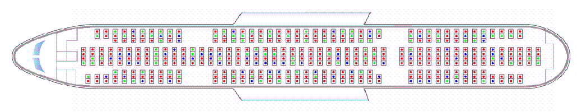
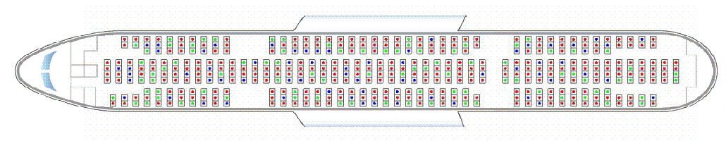
B 777-200 / Group 1-Conf.B
0 second IAV deployment

Slide 33
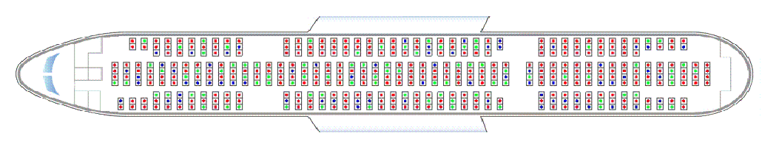
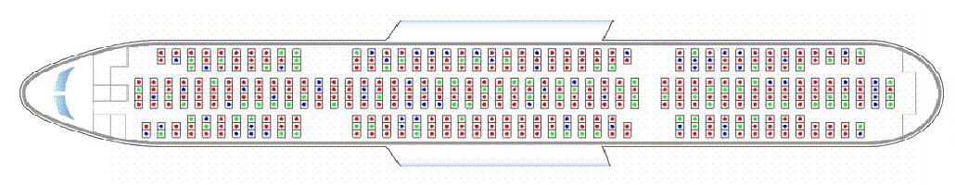
B 777-200 / Group 1-Conf.B
30 second IAV deployment

Slide 34
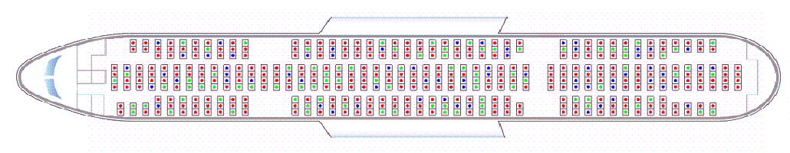
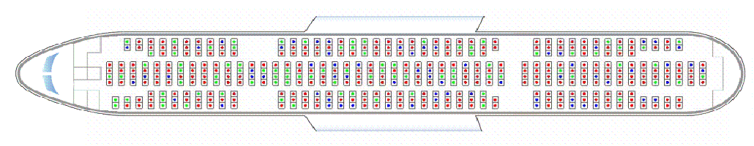
B 777-200 / Group 1-Conf.B
60 second IAV deployment

Slide 35
Simulation Model: B 777-200 / Group 1
Conf. A
Conf. B
Early IAV deployment with Crew redirection reduce about 7~19 sec compare with no crew redirection
Conf. C
Conf. D

Slide 36
Simulation Model: B 777-200 / Group 2
Each section of the fuselage-front, middle or rear section- was fully blocked
IAV deployed one of the blocked exit.
Conf. E
Conf. H
Conf. F
Conf. I
Conf. G
Conf. J

Slide 37
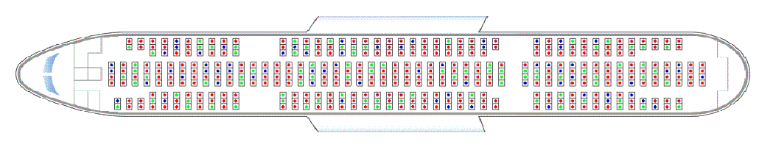
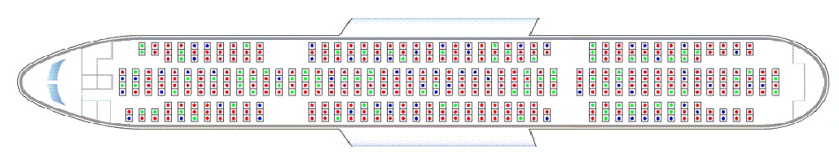
B 777-200 / Group 2-Conf.I
0 second IAV deployment

Slide 38
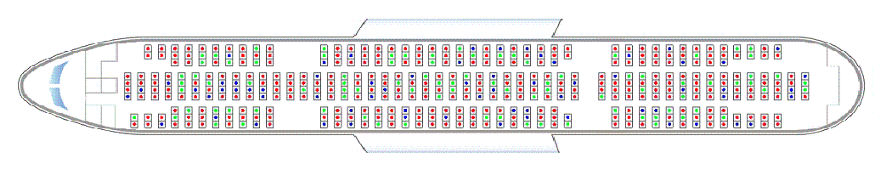
B 777-200 / Group 2-Conf.I
40 second IAV deployment

Slide 39
Simulation Model: B 777-200 / Group 2
Conf. E
Early IAV deployment with Crew redirection reduce about 30~58 sec compare with no crew redirection
Conf. F
Conf. G
Conf. H
Conf. I
Conf. J

Slide 40
Conclusion
Crew redirection with IAV deployment situations were simulated
Early IAV deployment reduced evacuation time. However, early IAV deployment with crew redirection reduced the evacuation time significantly.
Crew redirection can reduce evacuation time even with late IAV deployment.
Even in worst case (B767-300/Group2) crew redirection with IAV provide 10 more second to meet 90 sec. rule than without crew redirection.

