Slide 1
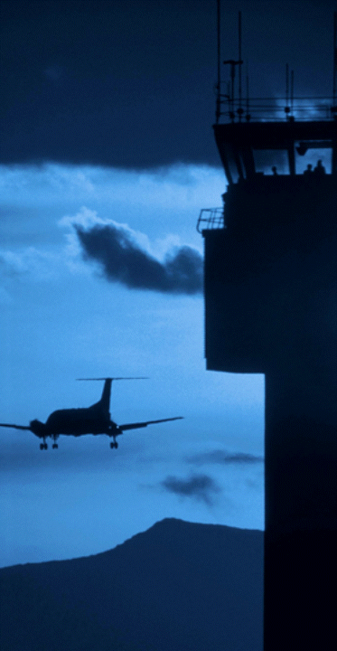

Federal Aviation
Administration
Identification and Comprehension of Symbolic Exit Signs for Small Transport Category Airplanes
G. A. ‘Mac’ McLean, Ph.D.
David B. Weed, M.A.
Protection and Survival Research Laboratory
FAA Civil Aerospace Medical Institute
Oklahoma City, OK 73125

Slide 2

Required Emergency Exit Sign
14CFR 25.811 – Emergency Exit Marking
(d) (1) A sign located above the aisle
(2) Next to each exit
(3) On each obstructing bulkhead or divider
14CFR 25.812 – Emergency Lighting
(a) (1) Illuminated emergency exit marking and locating signs
(b)(1) (i) Red letters 1.5” high on white background, 21 sq in., stroke width between 6 and 7:1 contrast ratio 10:1, 25 ft. Lamberts,
internally illuminated w/high to low background contrast < 3:1.

Slide 3

Symbolic Exit Sign
14CFR 21.21- Issue of Type Certificate
(b)(1) the type design and product [must] meet the applicable airworthiness requirements of the Federal Aviation Regulations or… any provisions not complied with [must be] compensated for by factors that provide an equivalent level of safety.

Slide 4
Non-Contextual Symbols

Slide 5
Comprehension Response Categories & Weights
Category | Response Type | Weight
0 | No response
1 | Don’t Know
2 | Opposite to the intended meaning | - 1.00
3 | Wrong | 0.00
4 | Related but understanding is doubtful / suspect | 0.25
5 | Related but understanding is arguable | 0.50
6 | Understanding is likely | 0.75
7 | Understanding is certain | 1.00

Slide 6
Exit Here

Slide 7
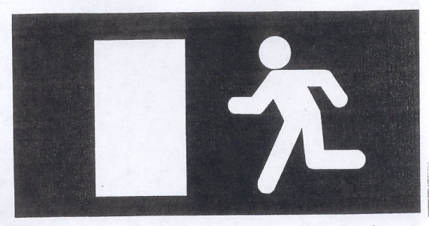
Exit Here

Slide 8
Exit Here

Slide 9

Exit Straight Ahead

Slide 10
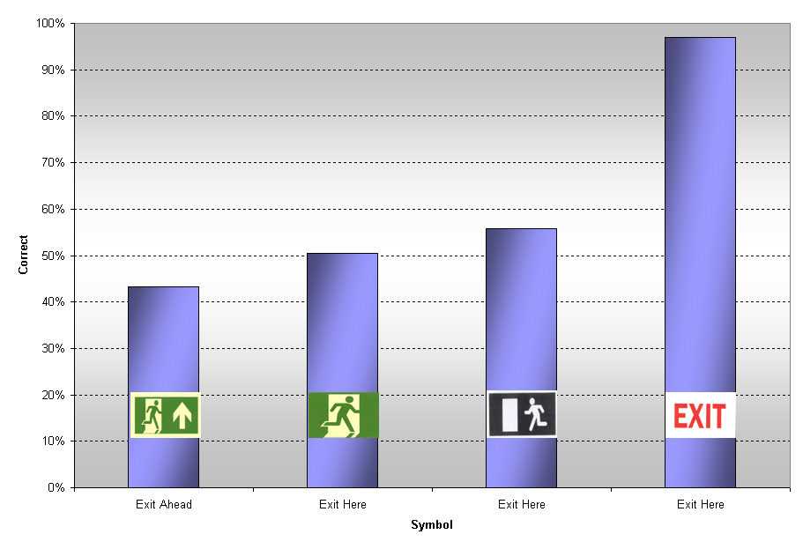
Non-Contextual Comprehension Score Comparison

Slide 11
Contextual Symbols

Slide 12
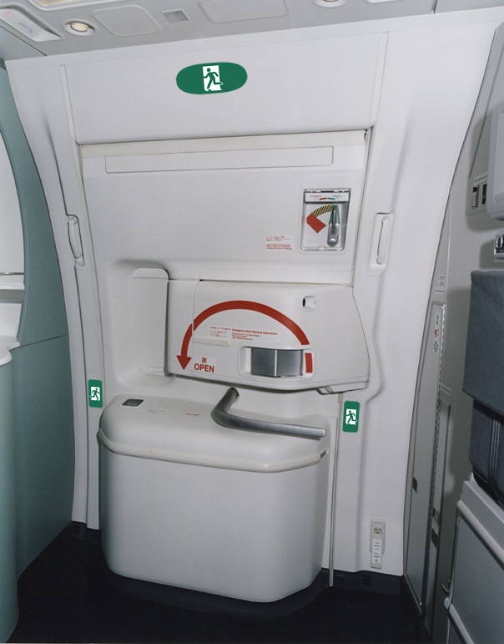
Exit Here

Slide 13
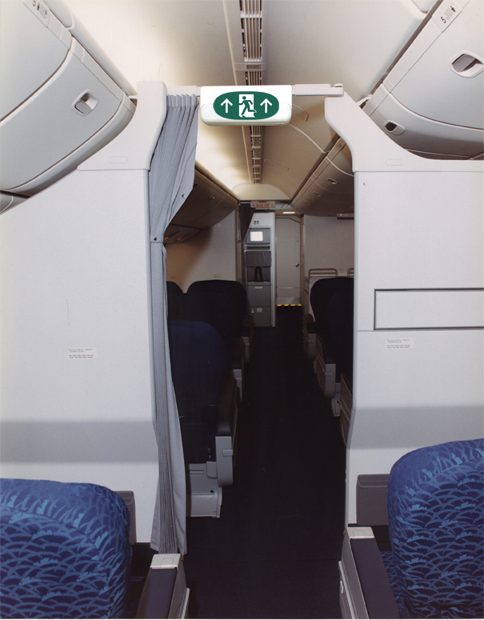
Exit Straight Ahead

Slide 14
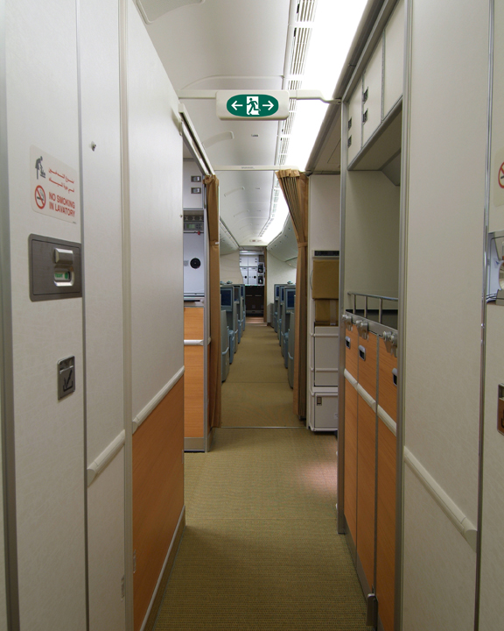
Exit Both Sides

Slide 15
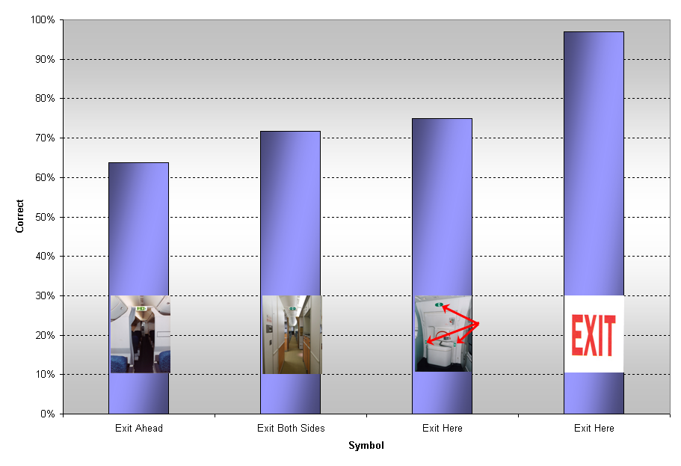
Contextual Comprehension Score Comparison

Slide 16
Context-Based Conclusions
Traditional Part 25.811 / .812 EXIT Sign Universally Understood
Symbolic Signs Without Context Had Mean Comprehension of About 50%
Addition of Contextual Cues Improved Mean Comprehension to About 70%
Symbolic Signs Were Shown NOT to be Equivalent to Traditional EXIT Sign
Additional Compensating Factors Would be Required to Establish an
Equivalent Level of Safety

Slide 17
Signs for Small Transport Category Airplanes

Slide 18
Required Emergency Exit Sign
14CFR 25.811 – Emergency Exit Marking
(d) (1) A sign located above the aisle
(2) Next to each exit
(3) On each obstructing bulkhead or divider
14CFR 25.812 – Emergency Lighting
(a) (1) Illuminated emergency exit marking and locating signs
(b)(2) Red letters 1.0” high on white background at least 2.0” high, internally or self illuminated at an initial minimum of at least 160 microlamberts.

Slide 19
Paper Booklet Exit Sign Test

Slide 20
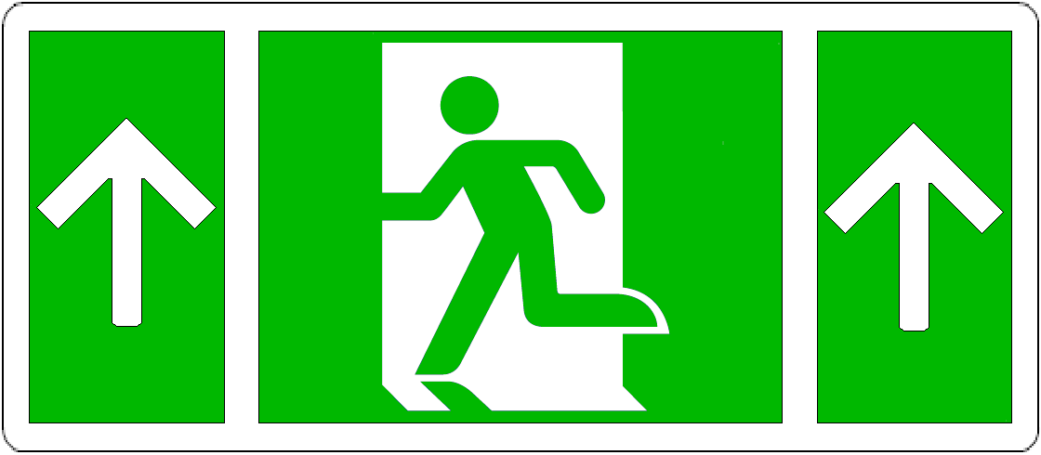
Approved Symbolic Exit Sign Featuring the ISO 7010:2011 Running Man with Narrow Arrows

Slide 21

Proposed Symbolic Exit Sign Featuring a Modified ISO 7010:2011
Running Man with ISO 3864-3:2012 (E) Wide Arrows

Slide 22
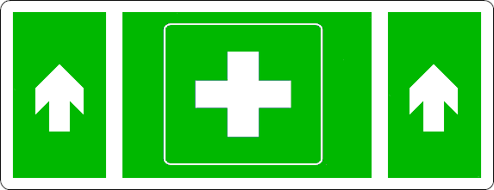



Alternate Signs
First Aid Kit Ahead
Do Not Enter: Biohazard
Caution / Attention: Radiation
Gas Mask Must Be Worn

Slide 23
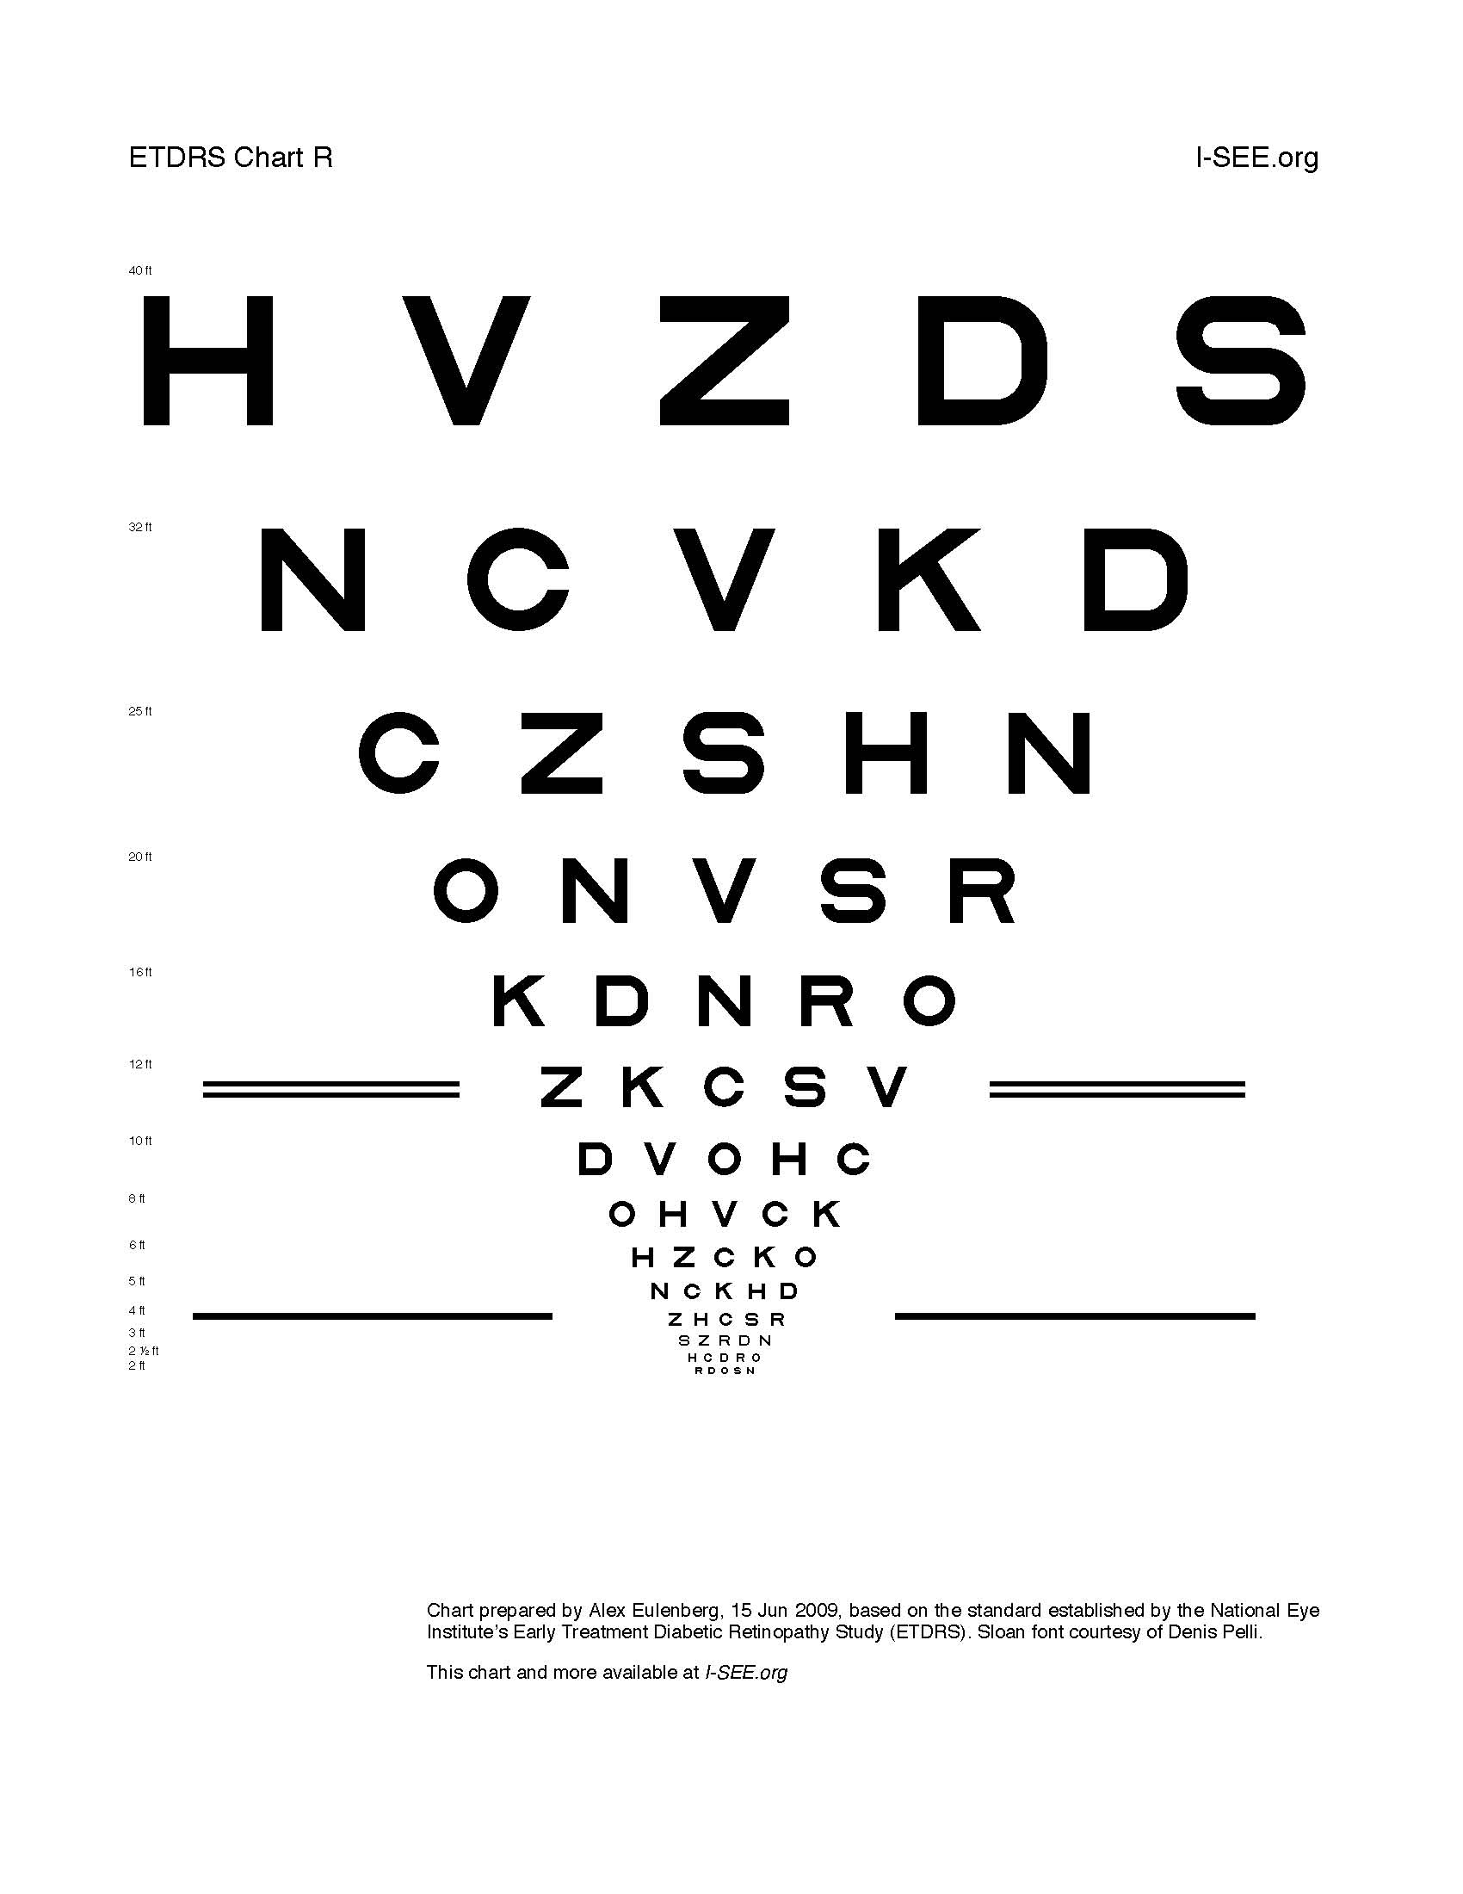
Visual Acuity Chart

Slide 24
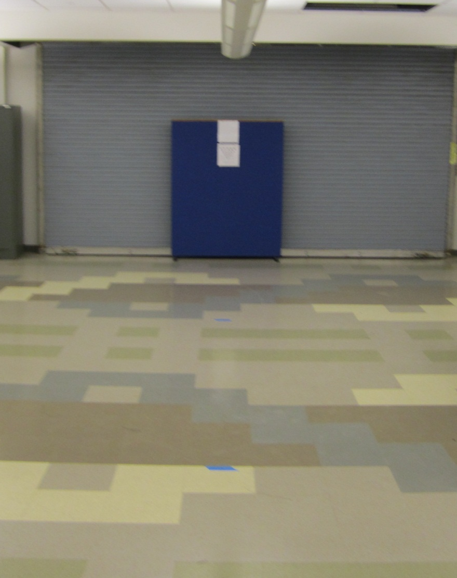
Test Area and Booklet Viewed from 32 Feet

Slide 25

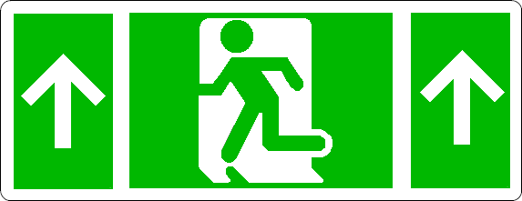
Test Booklet B
Gas Mask Must Be Worn
Do Not Enter: Biohazard
Modified Green Man with Narrow Arrows
Attention / Caution: Radiation
First-Aid Kit with Wide Arrows

Slide 26
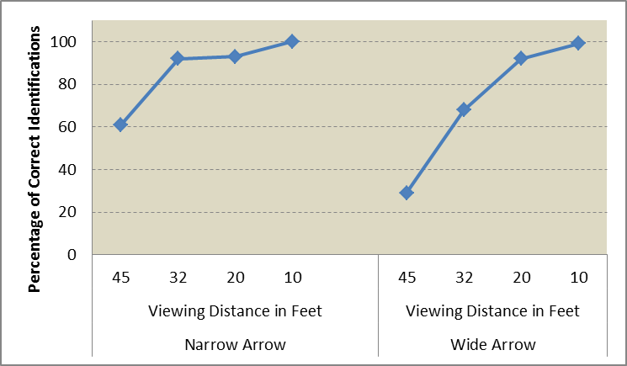
Cumulative Identification of Arrow Elements

Slide 27
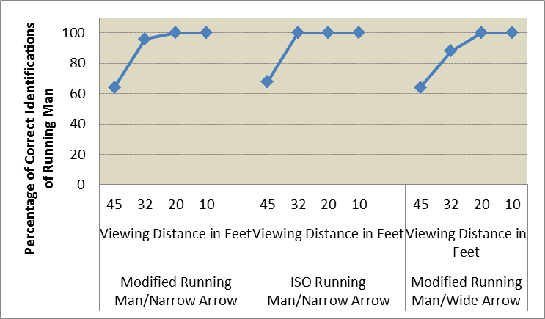
Cumulative Identification of Running Man Elements

Slide 28
Comprehension Response Categories & Weights
Category | Response Type | Weight
0 | No response
1 | Don’t Know
2 | Opposite to the intended meaning | - 1.00
3 | Wrong | 0.00
4 | Related but understanding is doubtful / suspect | 0.25
5 | Related but understanding is arguable | 0.50
6 | Understanding is likely | 0.75
7 | Understanding is certain | 1.00

Slide 29
Comprehension of ISO Running Man with Narrow Arrow Elements
Comprehension Category | Frequency | Percent | Weight | Comprehension Score
Certain | 1 | 4.00 | 1.00 | 4.00
Likely | 8 | 32.00 | 0.75 | 24.00
Arguable | 5 | 20.00 | 0.50 | 10.00
Suspect | 4 | 16.00 | 0.25 | 4.00
Opposite | 0 | 0.00 | -1.00 | 0.00
Wrong | 7 | 28.00 | 0.00 | 0.00
Total | 25 | 100.00 |  | 42.00

Slide 30
Comprehension of Modified Running Man with Wide Arrow Elements
Comprehension Category | Frequency | Percent | Weight | Comprehension Score
Certain | 0 | 0.00 | 1.00 | 0.00
Likely | 9 | 36.00 | 0.75 | 27.00
Arguable | 5 | 20.00 | 0.50 | 10.00
Suspect | 5 | 20.00 | 0.25 | 5.00
Opposite | 1 | 4.00 | -1.00 | -4.00
Wrong | 5 | 20.00 | 0.00 | 0.00
Total | 25 | 100.00 |  | 38.00

Slide 31
Comprehension of Modified Running Man with Narrow Arrows
Comprehension Category | Frequency | Percent | Weight | Comprehension Score
Certain | 0 | 0.00 | 1.00 | 0.00
Likely | 7 | 28.00 | 0.75 | 21.00
Arguable | 5 | 20.00 | 0.50 | 10.00
Suspect | 6 | 24.00 | 0.25 | 6.00
Opposite | 0 | 0.00 | -1.00 | 0.00
Wrong | 7 | 28.00 | 0.00 | 0.00
Total | 25 | 100.00 |  | 37.00

Slide 32
First Aid Kit Ahead
Comprehension Category | Frequency | Percent | Weight | Comprehension Score
Certain | 0 | 0.00 | 1.00 | 0.00
Likely | 22 | 29.33 | 0.75 | 22.00
Arguable | 18 | 24.00 | 0.50 | 12.00
Suspect | 15 | 20.00 | 0.25 | 5.00
Opposite | 0 | 0.00 | -1.00 | 0.00
Wrong | 17 | 22.67 | 0.00 | 0.00
None | 3 | 4.00 | 0.00 | 0.00
Blank | 0 | - | - | 0.00
Total | 75 | 100.0 |  | 39.00

Slide 33
Caution / Attention: Radiation
Comprehension Category | Frequency | Percent | Weight | Comprehension Score
Certain | 8 | 10.67 | 1.00 | 10.67
Likely | 18 | 24.00 | 0.75 | 18.00
Arguable | 7 | 9.33 | 0.50 | 4.67
Suspect | 16 | 21.33 | 0.25 | 5.33
Opposite | 0 | 0.00 | -1.00 | 0.00
Wrong | 19 | 25.33 | 0.00 | 0.00
None | 7 | 9.33 | 0.00 | 0.00
Blank | 0 | - | - | 0.00
Total | 75 | 100.0 |  | 38.67

Slide 34
Gas Mask Must Be Worn
Comprehension Category | Frequency | Percent | Weight | Comprehension Score
Certain | 5 | 10.00 | 1.00 | 10.00
Likely | 4 | 8.00 | 0.75 | 6.00
Arguable | 7 | 14.00 | 0.50 | 7.00
Suspect | 18 | 36.00 | 0.25 | 9.00
Opposite | 0 | 0.00 | -1.00 | 0.00
Wrong | 6 | 12.00 | 0.00 | 0.00
None | 10 | 20.00 | 0.00 | 0.00
Blank | 0 | - | - | 0.00
Total | 50 | 100.0 |  | 32.00

Slide 35
Do Not Enter: Biohazard
Comprehension Category | Frequency | Percent | Weight | Comprehension Score
Certain | 5 | 6.67 | 1.00 | 6.67
Likely | 6 | 8.00 | 0.75 | 6.00
Arguable | 12 | 16.00 | 0.50 | 8.00
Suspect | 21 | 28.00 | 0.25 | 7.00
Opposite | 0 | 0.00 | -1.00 | 0.00
Wrong | 20 | 26.67 | 0.00 | 0.00
None | 11 | 14.67 | 0.00 | 0.00
Blank | 0 | - | - | 0.00
Total | 75 | 100.0 |  | 27.67

Slide 36
Self-Illuminated Exit Sign Test

Slide 37
Proposed Symbolic Exit Sign Featuring a Modified ISO 7010:2011
Running Man with ISO 3864-3:2012 (E) Wide Vertical Arrows

Slide 38

Proposed Symbolic Exit Sign Featuring a Modified ISO 7010:2011
Running Man with ISO 3864-3:2012 (E) Wide Horizontal Arrows

Slide 39

ISO 7010:2011 Automatic External Defibrillator and
Narrow ISO 3864-3:2012 (E), Type D Arrows

Slide 40
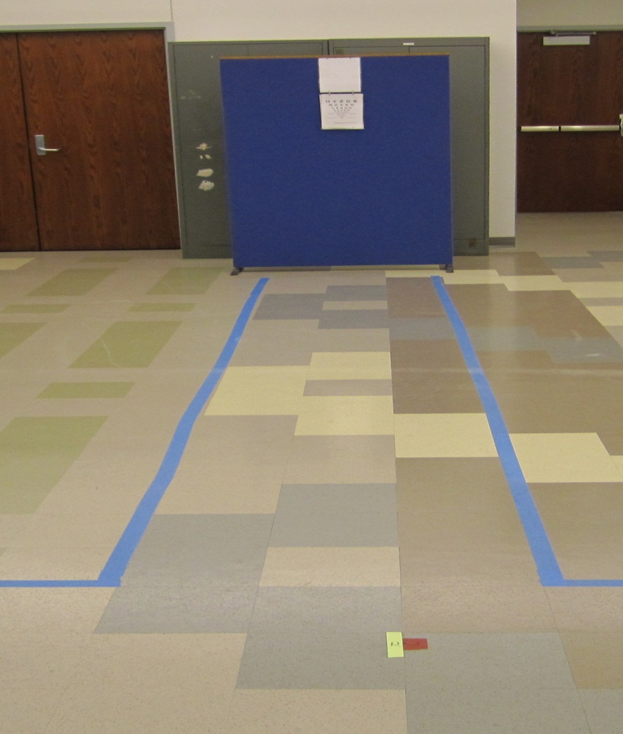
Visual Acuity Charts Displayed on Side Test Track

Slide 41
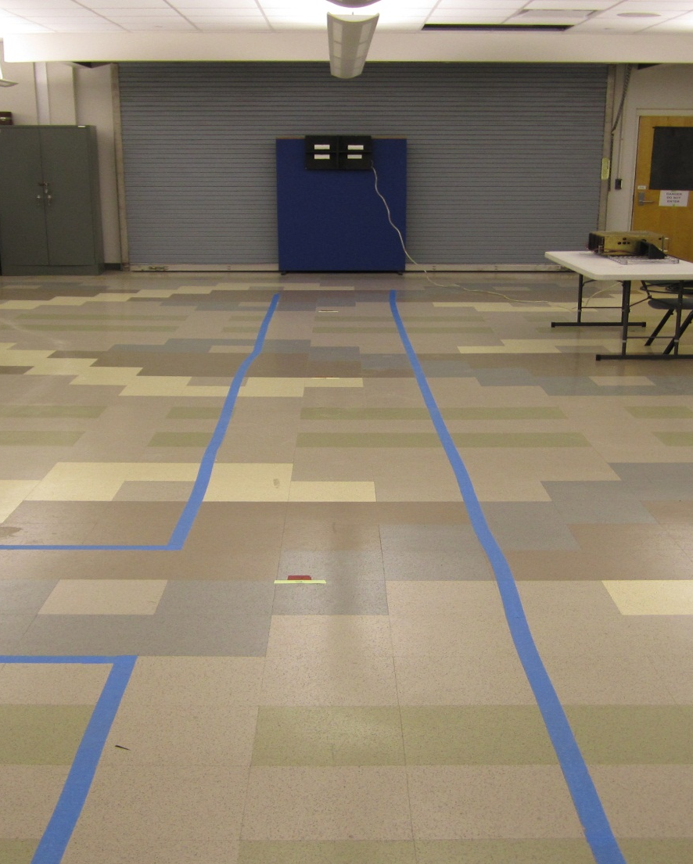
Test Track and Signs Viewed From 45 Feet

Slide 42
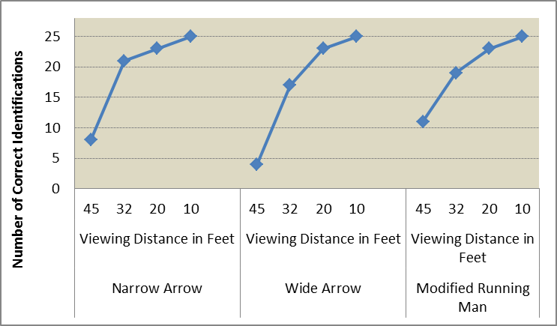
Cumulative Identification of Sign Elements in the Dark (0.00 fc)

Slide 43
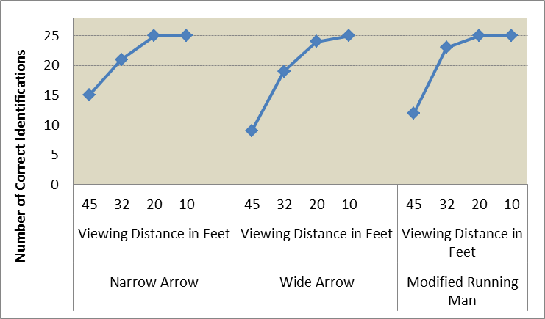
Cumulative Identification of Sign Elements in Emergency (0.05 fc) Lighting

Slide 44

Cumulative Identification of Sign Elements in Low (0.50 fc) Lighting

Slide 45
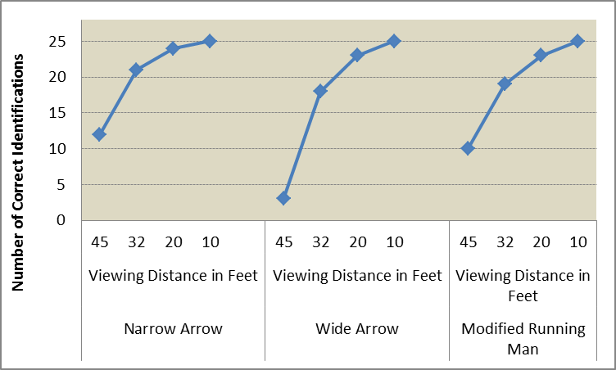
Cumulative Identification of Sign Elements in High (45 fc) Lighting

Slide 46
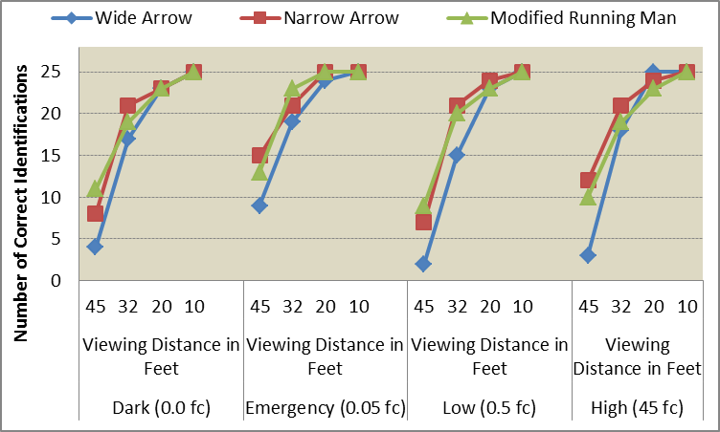
Cumulative Identification of Sign Elements in All Lighting Conditions

Slide 47
Comprehension of Exit Signs In Dark (0.00 fc) Lighting
Comprehension Category | Frequency | Percent | Weight | Comprehension Score
Certain | 10 | 40.00 | 1.00 | 40.00
Likely | 3 | 12.00 | 0.75 | 9.00
Arguable | 2 | 8.00 | 0.50 | 4.00
Suspect | 4 | 16.00 | 0.25 | 4.00
Opposite | 0 | 0.00 | -1.00 | 0.00
Wrong | 6 | 24.00 | 0.00 | 0.00
None | 0 | 0.00 | 0.00 | 0.00
Total | 25 | 100.0 |  | 57.00

Slide 48
Comprehension of Exit Signs In Emergency (0.05) fc Lighting
Comprehension Category | Frequency | Percent | Weight | Comprehension Score
Certain | 14 | 56.00 | 1.00 | 56.00
Likely | 1 | 4.00 | 0.75 | 3.00
Arguable | 5 | 20.00 | 0.50 | 10.00
Suspect | 4 | 16.00 | 0.25 | 4.00
Opposite | 0 | 0.00 | -1.00 | 0.00
Wrong | 1 | 4.00 | 0.00 | 0.00
None | 0 | 0.00 | 0.00 | 0.00
Total | 25 | 100.0 |  | 73.00

Slide 49
Comprehension of Exit Signs In Low (0.50) fc Lighting
Comprehension Category | Frequency | Percent | Weight | Comprehension Score
Certain | 4 | 16.00 | 1.00 | 16.00
Likely | 5 | 20.00 | 0.75 | 15.00
Arguable | 7 | 28.00 | 0.50 | 14.00
Suspect | 2 | 8.00 | 0.25 | 2.00
Opposite | 0 | 0.00 | -1.00 | 0.00
Wrong | 6 | 24.00 | 0.00 | 0.00
None | 1 | 4.00 | 0.00 | 0.00
Total | 25 | 100.0 |  | 47.00

Slide 50
Comprehension of Exit Signs In High (45 fc) Lighting
Comprehension Category | Frequency | Percent | Weight | Comprehension Score
Certain | 4 | 16.00 | 1.00 | 16.00
Likely | 3 | 12.00 | 0.75 | 9.00
Arguable | 9 | 36.00 | 0.50 | 18.00
Suspect | 6 | 24.00 | 0.25 | 6.00
Opposite | 0 | 0.00 | -1.00 | 0.00
Wrong | 2 | 8.00 | 0.00 | 0.00
None | 1 | 4.00 | 0.00 | 0.00
Total | 25 | 100.0 |  | 49.00

Slide 51
Overall Comprehension of Self-Illuminated Exit Signs
Comprehension Category | Frequency | Percent | Weight | Comprehension Score
Certain | 32 | 32.00 | 1.00 | 32.00
Likely | 12 | 12.00 | 0.75 | 9.00
Arguable | 23 | 23.00 | 0.50 | 11.50
Suspect | 16 | 16.00 | 0.25 | 4.00
Opposite | 0 | 0.00 | -1.00 | 0.00
Wrong | 15 | 15.00 | 0.00 | 0.00
None | 2 | 2.00 | 0.00 | 0.00
Total | 100 | 100.00 |  | 56.50

Slide 52
Automatic External Defibrillator Comprehension
Comprehension Category | Frequency | Percent | Weight | Comprehension Score
Certain | 19 | 19.00 | 1.00 | 19.00
Likely | 17 | 17.00 | 0.75 | 12.75
Arguable | 19 | 19.00 | 0.50 | 9.50
Suspect | 9 | 9.00 | 0.25 | 2.25
Opposite | 0 | 0.00 | -1.00 | 0.00
Wrong | 16 | 16.00 | 0.00 | 0.00
None | 20 | 20.00 | 0.00 | 0.00
Total | 100 | 100.0 |  | 43.50

Slide 53
Conclusions
Comprehension of small symbolic exit signs equivalent to that of signs tested for larger transport category airplanes
Use the ISO 7010:2011 running man element combined with the narrow arrows (same as approved for large transport airplanes)
The distance between any viewer inside the transport airplane cabin and these smaller exit signs should not exceed 20 feet
Standardization of symbolic exit signs for all transport airplanes will produce better comprehension by passengers

