Slide 1
Simulating the Impact Response of Full-Scale
Composite Airframe Structures
Edwin L. Fasanella, Senior Research Fellow
National Institute of Aeronautics (NIA)
Hampton, VA

Slide 2
Outline
Objectives
Experimental Program
-Component testing - Fuselage and Subfloor Sections
• Finite Element Models - Development and Calibration
• Conclusions
• Acknowledgements

Slide 3
Objectives
• Assess the capabilities of LS-DYNA to predict the structural
response of a SARAP composite airframe structures subjected
to impact loads, including damage initiation and progressive
failure using two different material models:
-Progressive damage model
(Mat 54): Mat_Enhanced_Composite_Damage
-Continuum damage mechanics model
(Mat 58): Mat_Laminated_Composite_Fabric

Slide 4
Approach (SARAP TVA Hardware)
Roof – Damaged, unused
Front Frame
Drop test:249 in/s
Rear Frame –
Partially damaged
In 2008 drop test
Front Subfloor –Drop test:
Longitudinal 264 in/s
Rear Subfloor –
Cut into cruciforms, I-beams,T-sections, and material coupons

Slide 5
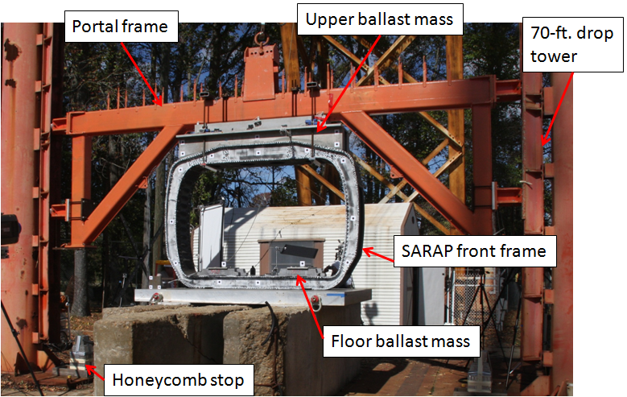
Experimental Program: Component Testing
(Fuselage Section)
Total weight=
5,884-lb.
Impact velocity=
249-in/s

Slide 6
Experimental Program: Fuselage Section Drop Test Movie

Slide 7
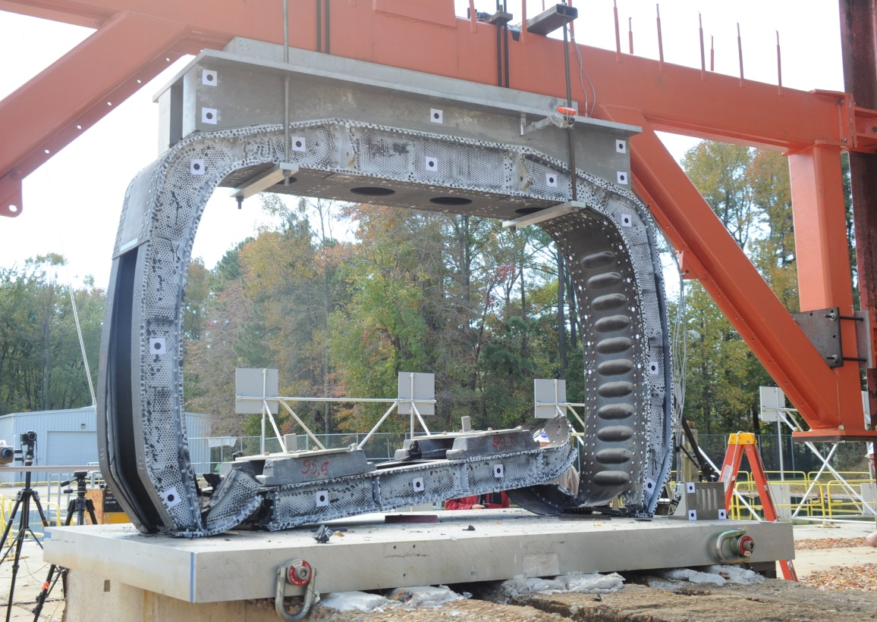
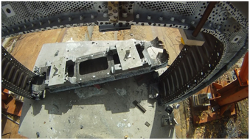
Experimental Program: Component Testing
(Fuselage Section)
Post-test Photographs
Three-quarter view
View from top

Slide 8
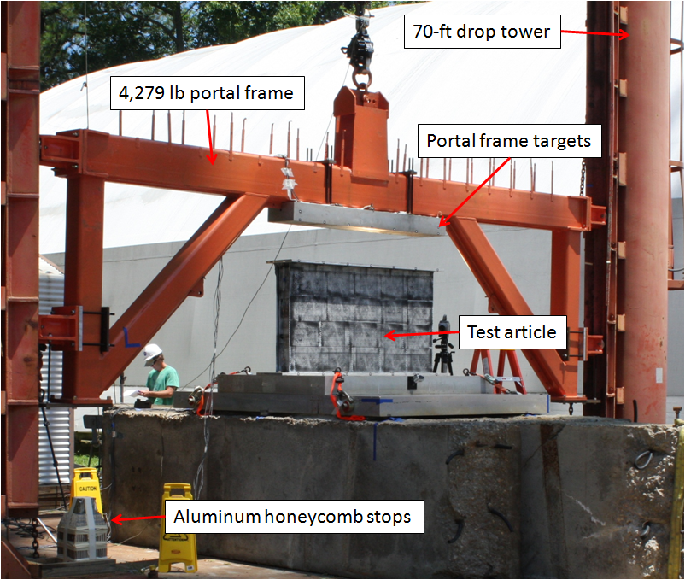
Experimental Program: Component Testing
(Subfloor)
Subfloor test set-up

Slide 9
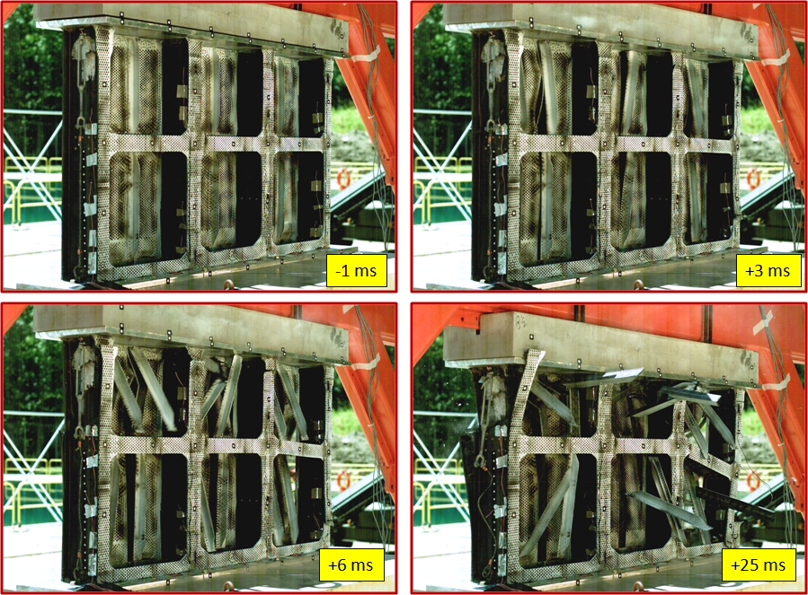
Experimental Program: Component Testing
(Subfloor)
Film sequence of open side

Slide 10
Experimental Program: Component Testing
(Subfloor)
Movie

Slide 11
Experimental Program: Component Testing
(Subfloor)
Post-Test Photographs
Open subfloor deformation
Base (skinned) side deformation

Slide 12
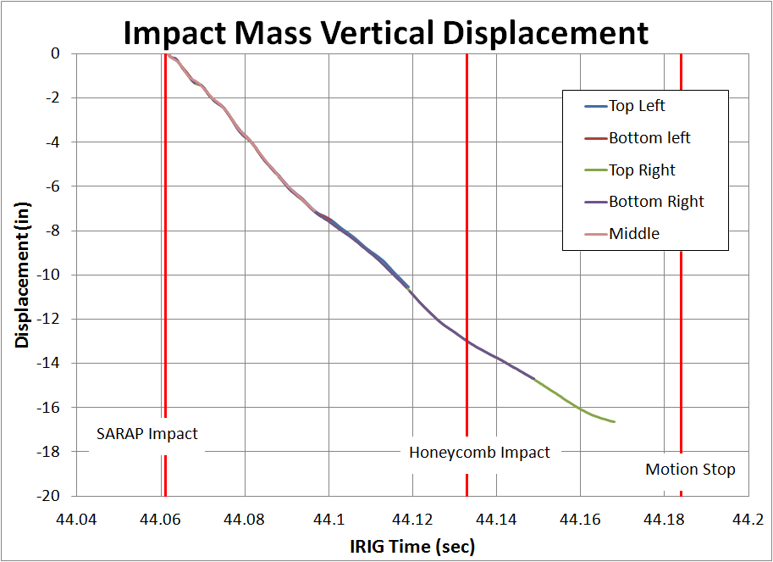
Experimental Program: Component Testing
Photogrammetric Displacement (Subfloor)
NOTE: All Impact Mass Accelerometers Fail or Over-Range

Slide 13
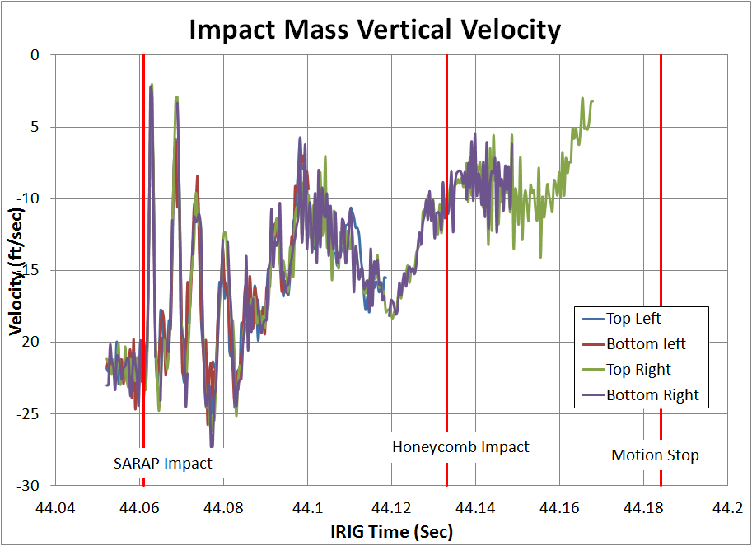
Experimental Program: Component Testing
Differentiated Photogrammetric Displacement (Subfloor)

Slide 14
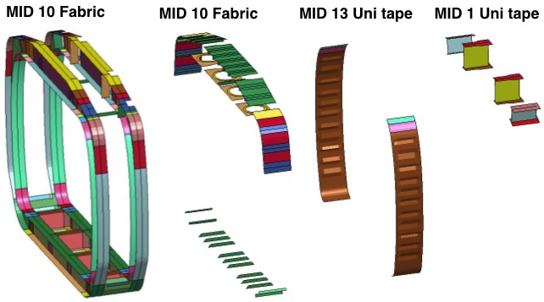
Finite Element Model Development and
Calibration: Fuselage Section
Fuselage Section was constructed of BOTH Unidirectional tape and
fabric laminates

Slide 15
Finite Element Model Development and
Calibration: Fuselage Section
Model contained:
- 37,100 nodes
- 17,216 shells
- 8,300 solids
- 2,200 mass elements
- 1 automatic single surface
contact
- 16 Part Composite cards
- Initial velocity = 249-in/s
- Portal mass = 5,100-lb
- Floor mass = 400-lb.
- SPC used to fix nodes in
the impact surface

Slide 16
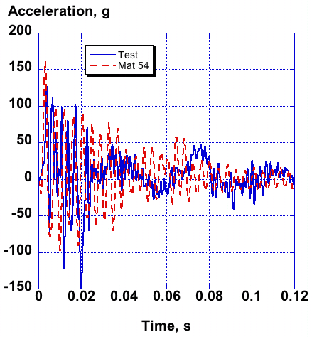
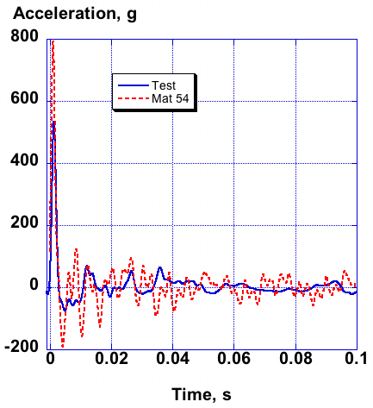
Finite Element Model Development and
Calibration: Fuselage Section (Mat 54)
Test-Analysis Comparisons for Mat 54 Model
Portal mass responses
Floor responses

Slide 17
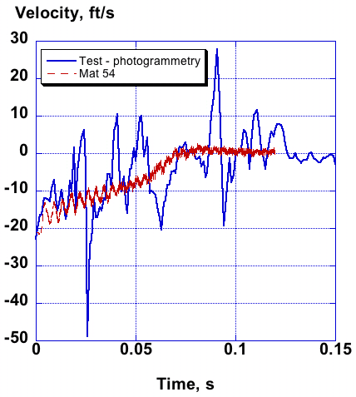
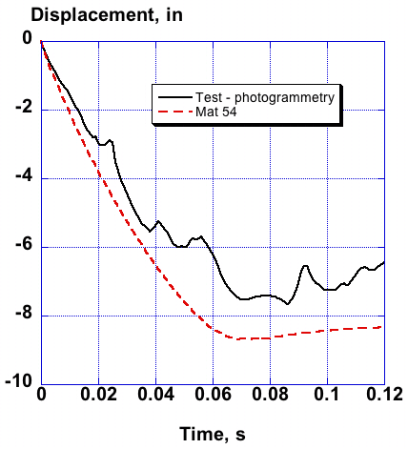
Finite Element Model Development and
Calibration: Fuselage Section (Mat 54)
Test-Analysis Comparisons for Mat 54 Model
Portal mass velocity responses
Portal mass displacement responses

Slide 18
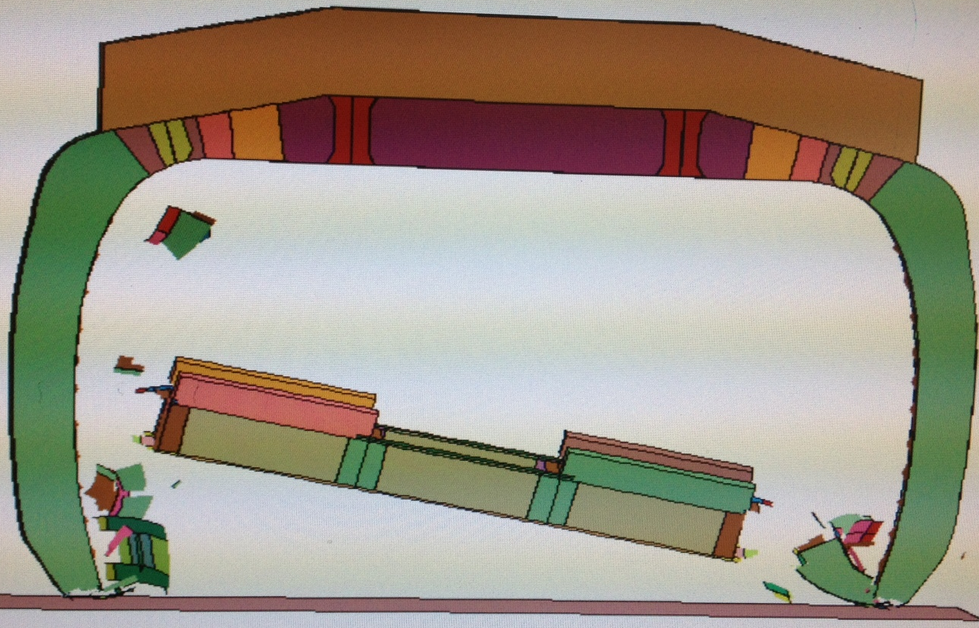
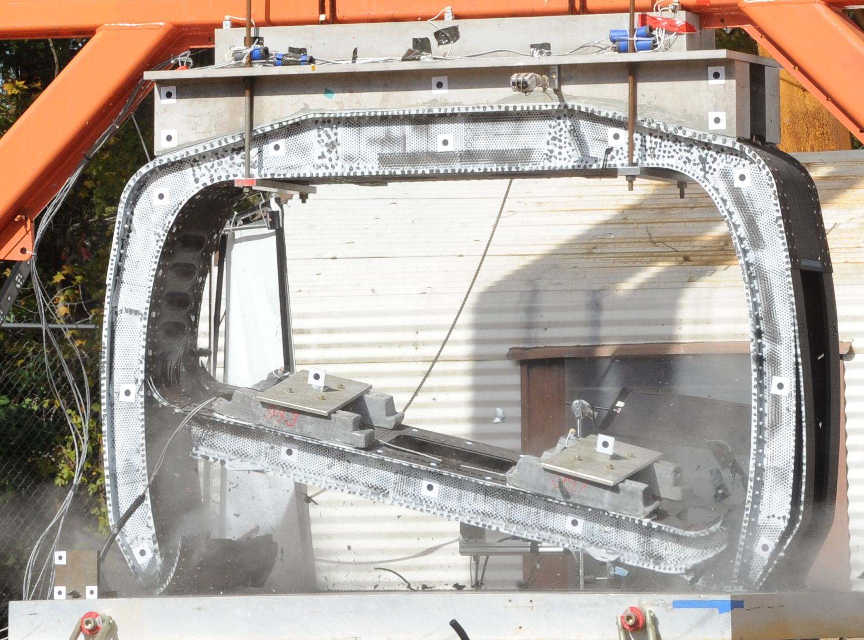
Finite Element Model Development and
Calibration: Fuselage Section (Mat 54)
Deformation Comparison: Test and Mat 54 Model
Mat 54 model prediction at 0.1-s
Film-capture photo at 0.1-s

Slide 19
Finite Element Model Development and
Calibration: Fuselage Section (Mat 58)
Deformation Comparison: Test and Mat 58 Model
Mat 58 model (ERODS=0.06) at 0.1-s
Film-capture photo at 0.1-s
Note: Baseline model was executed with ERODS=0.06

Slide 20
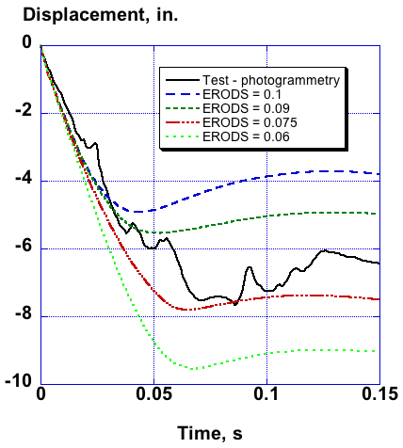
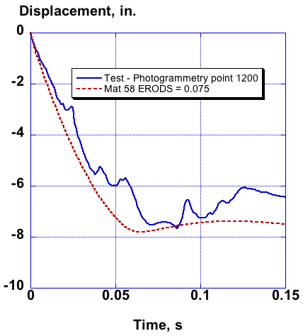
Finite Element Model Development and
Calibration: Fuselage Section (Mat 58)
Mat 58 ERODS Parameters Study
Best comparison with test displacement is shown for ERODS=0.075

Slide 21
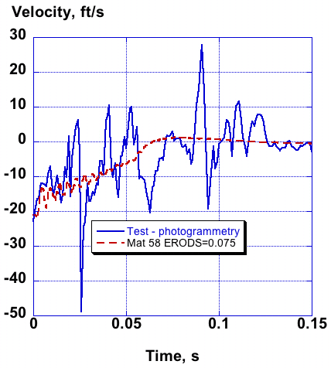
Finite Element Model Development and
Calibration: Fuselage Section (Mat 58)
Test-Analysis Comparisons for Mat 58 Model (ERODS=0.075)
Best comparison with photogrammetry results is for ERODS=0.075

Slide 22
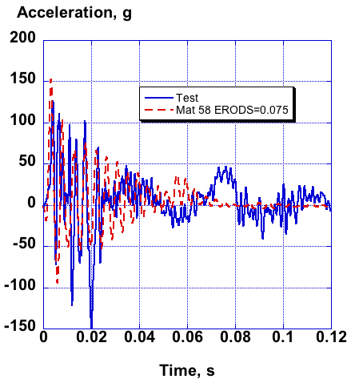
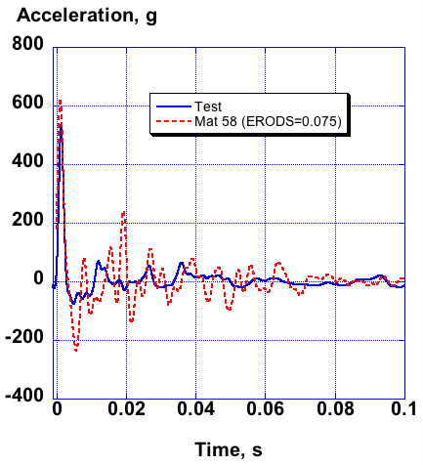
Finite Element Model Development and
Calibration: Fuselage Section (Mat 58)
Test-Analysis Comparisons for Mat 58 Model (ERODS=0.075)
Portal mass responses
Floor responses

Slide 23
Finite Element Model Development and
Calibration: Fuselage Section (Mat 58)
Deformation Comparison: Mat 58 Model (ERODS=0.075) & Test
Mat 58 model (ERODS=0.075) at 0.1-s
Film-capture photo at 0.1-s
Even though the Mat 58 model with ERODS=0.075 shows the best
comparison with time history response data, the model with ERODS=0.06
best matches the deformation response

Slide 24
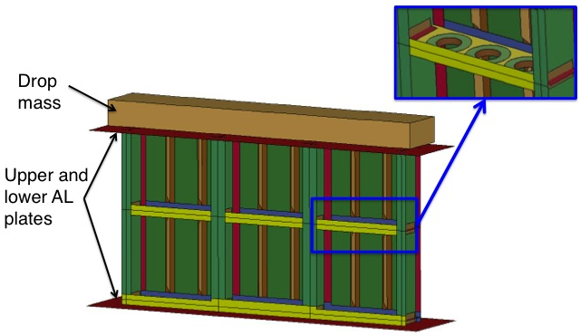
Finite Element Model Development and
Calibration: Subfloor Section
• Model contains: 111,600 nodes; 109,000 shells;
1,500 solids; 15 parts; and 5 material cards
• One automatic single surface contact defined
• Bottom nodes fixed, initial velocity= 264-in/s

Slide 25
Finite Element Model Development and
Calibration: Subfloor Section (Mat 54)
T=0.018-s
T=0.036-s
T=0.072-s
T=0.054-s
T=0.09-s

Slide 26
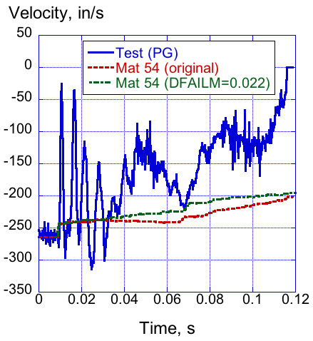
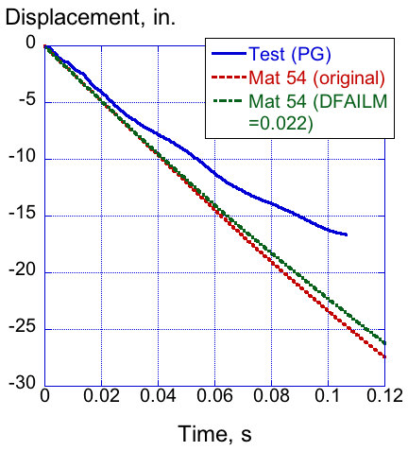
Finite Element Model Development and
Calibration: Subfloor Section
Test-Analysis Comparisons for Mat 54 Model
Accelerometers failed or over-ranged due to metal on metal contact
Test and analysis agreement for Mat 54 is poor due to complete model collapse
Velocity response indicates that model dissipates too little kinetic energy

Slide 27
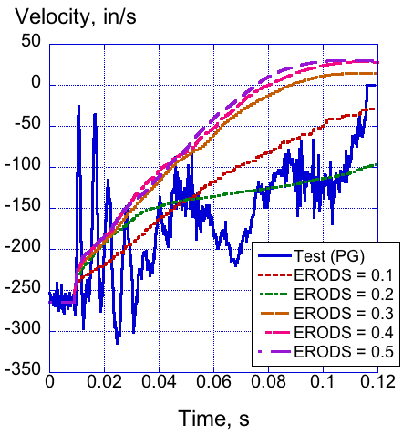
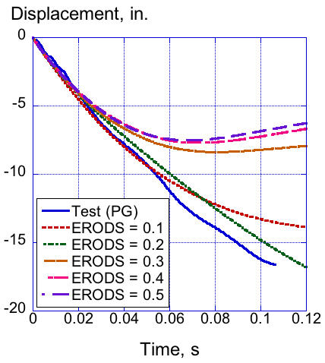
Finite Element Model Development and
Calibration: Subfloor Section (Mat 58)
Mat 58 ERODS Parameter Study
ERODS = 0.1 demonstrates excellent agreement with test displacement
up to 10-in. of displacement. However, delamination was not considered.

Slide 28
Conclusions
Finite element models were developed and simulations were
executed using LS-DYNA V971R6.0.0 on Linux workstations.
• Two LS-DYNA material models (Mat 54, a progressive
damage model based on the Chang-Chang failure criterion,
and Mat 58, a continuum damage mechanics model) were
evaluated to assess their capability in predicting the
structural response of the composite airframe impact loads,
including damage initiation and progressive failure.
Both the Mat 54 and Mat 58 pre-test models of the fuselage
test correlated well with the test response. However, the Mat 54
model of the subfloor disintegrated. The Mat 58 model gave
reasonable results for both tests for an element erosion value
(ERODS) of from 0.06 to 0.1. An ERODS value of 0.1 has
been found to be reasonable for many dynamic models.

Slide 29
Conclusions
None of the models were set up to predicting the massive
delamination that occurred in the highly destructive subfloor test.
A much more complex model would be required to predict
delamination with ply-by-ply peel strengths captured in the
material model, or with spot-welds with tie-breaks at each node.
Fortunately, delamination does not play a major role for many
impact scenarios.

Slide 30
Acknowledgements
We would like to thank:
- US Army Aviation Applied Technology Directorate (AATD) for
providing the SARAP TVA
- Charles Clarke, Brian Wilson, and Joe Shen of Sikorsky for
providing baseline finite element models, and for many helpful
conversations related to testing and simulation
- NASA technicians for assistance in conducting impact
testing, including instrumentation and test set-up
- Members of the NASA Nondestructive Evaluation Services
Branch who performed the NDE assessment

