Slide 1
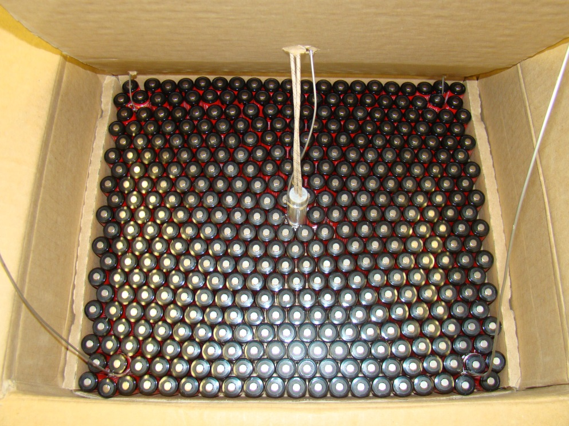
SAE G27 Packaging Tests
Systems Meeting
FAA Fire Safety
11/2017

Slide 2
Background
SAE G-27 is creating a packaging standard for air shipment of lithium batteries and cells.
Standard includes tests that must be conducted.
The FAA and others are performing experiments to answer questions that arise in the writing process.

Slide 3
Introduction
Main Test:
Initiate thermal runaway in the cell most likely to cause propagation.
Battery box is unsafe if any of the following:
A spark igniter ignites off-gasses
Temperatures in certain places get too high.
The package comes apart.
Hazardous particles exit the package.
Hazardous flames exit the package.
Many sub-tests were examined:
Certain cells or batteries may be intrinsically safe and the main test may not be necessary.
External Fire

Slide 4
Introduction (in-depth version of previous slide)
Off-gasses are ignited:
If gasses build up in the entire chamber and exceed the lower flammability limit in the chamber they will ignite. Rationale for this is in the standard.
Temperatures:
Self-explanatory. Positions and temperature values can be found in the standard.
Package comes apart:
Criteria can be found in standard. (may not be there yet)
Hazardous Particles/Flame possibilities:
No particle/flame (all are hazardous)
If certain particles or flames are safe then what size and what duration?
Flame size can be no greater than the separation between packages in a cargo compartment.
Flame duration can be no longer than what would ignite the most flammable packaging in a compartment (shrink wrap maybe).
Sub-tests
For cells: 3 cells are placed together in a configuration with the greatest likelihood of propagation.
For batteries: thermal runaway is initiated in the cell with the greatest likelihood of propagation.
External Fire: Will mitigations for main test be enough to sufficiently mitigate the risk for external fires also or is an additional test needed?

Slide 5
Background video (failure example)

Slide 6
FAA Work
Most Current FAA Tests:
What would be the most suitable external fire tests?
Additional things the FAA looked at:
Worst case packaging.
Flame exiting the package (cheese cloth, shrink wrap).
What position in a box is most likely to cause propagation?
Approximately how many cells at what SOC are necessary for ignition?
Propagation in COTS (off-the-shelf) battery packs
Propagation with safer li-ion cell chemistries
Propagation and testing with li-metal cells
Testing with lithium-pouch cells.
Cell packaging exposed to an external oil burner flame
Battery packaging soaked in an oven

Slide 7
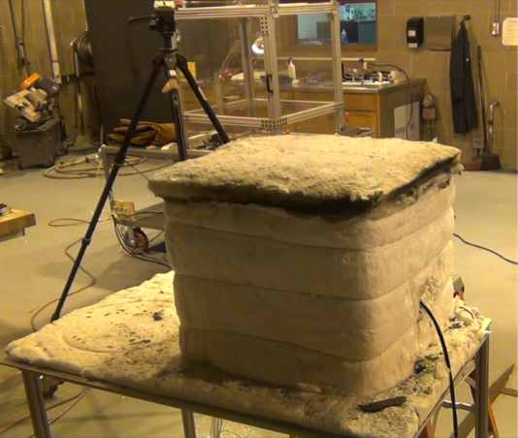
Experimental setup for external fire tests
Tests were set up and conducted to be similar to the oxygen cylinder tests.
Oven: 200C for 3 hours.
Burner: Sample 8 inches away for 5 minutes.

Slide 8
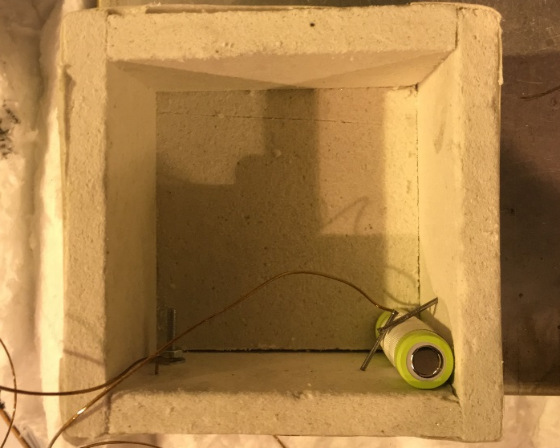
External Fire – Oven Tests (how we did it)
Place single cell in worst case position in box (corner of box) and instrument with thermocouples
Preheat oven to 200C and place single cell and box in oven.
Tests Performed:
Single cell in 9cell cardboard box
Single cell in 36cell cardboard box
Single cell in 100cell cardboard box
Single cell in insulated 36cell box
Single cell in specially made water filled insulated box.

Slide 9
Oven Test – Insulated Plastic Box
Cell goes into TR
3 hours

Slide 10
Results Oven test
Thermal runaway occurred in each test when thermocouple in center of box reached 190C or greater.
Size of box (with 1 cell) had little effect on time to runaway.

Slide 11
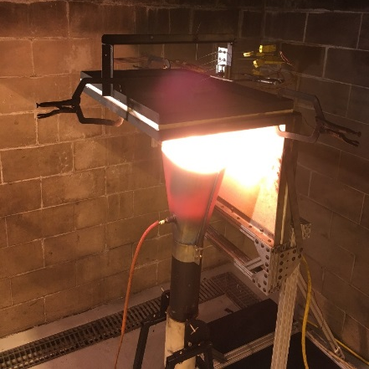
External Fire – Burner Tests
Place single cell on top of material
Record temperatures above sample when cell goes into runaway.
So far only kaowool was tested and cell didn’t overheat after 45 minutes.
Single cell

Slide 12
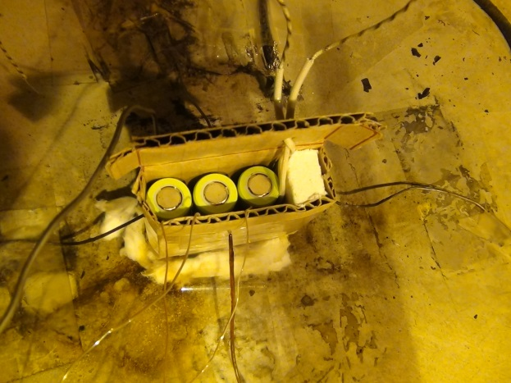
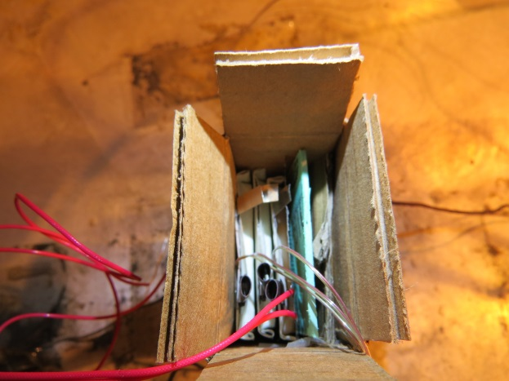
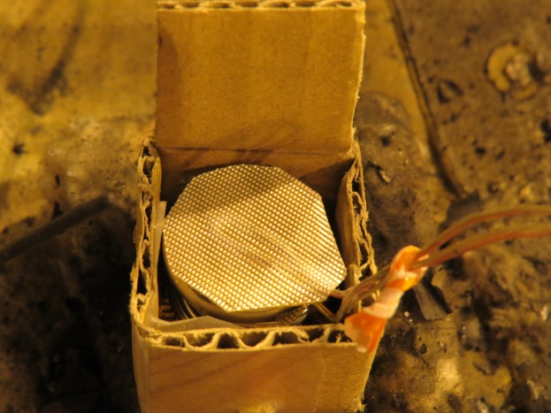
Misc. images
Various other types of cells
Cylindrical cells
Pouch cells
Button cells

Slide 13
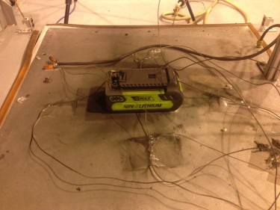
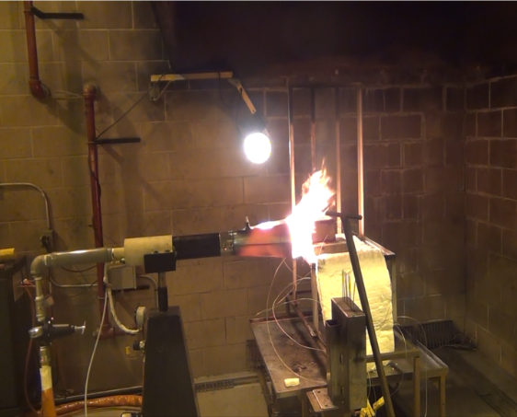
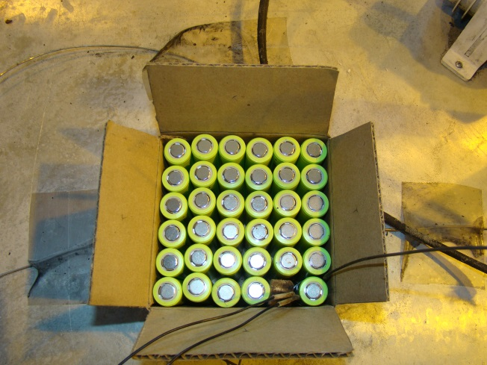
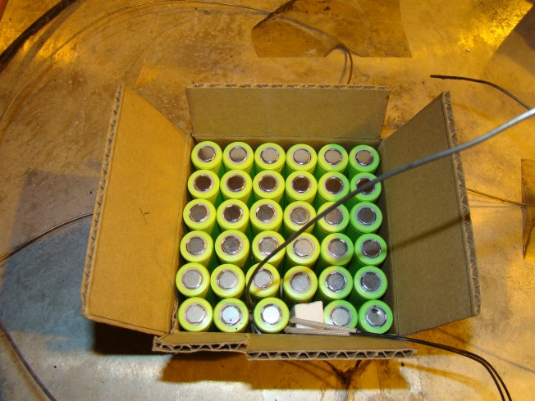
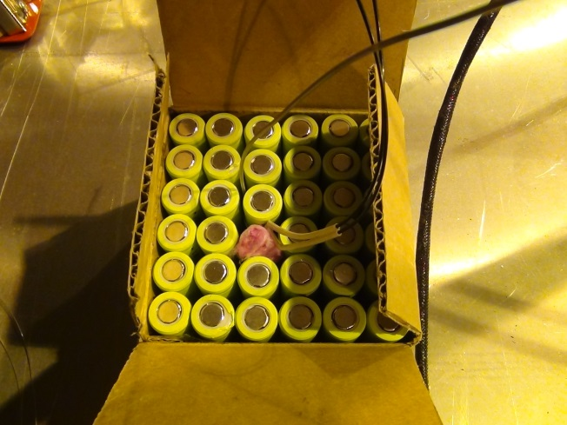
Misc. images
Battery pack
External Fire (horizontal)
Cheese Cloth
Corner Initiation
Edge Initiation
Center Initiation

Slide 14
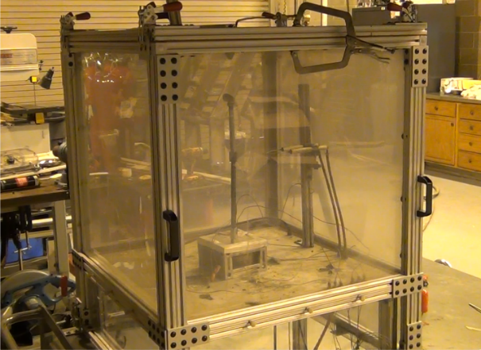
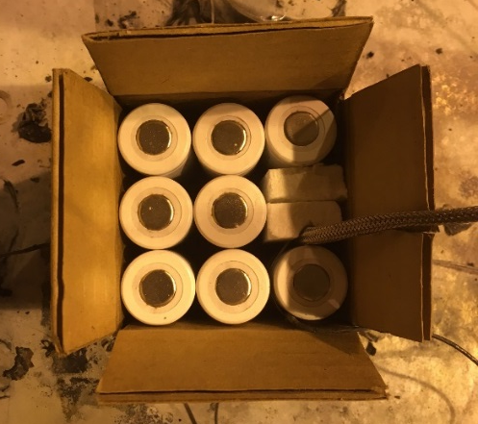
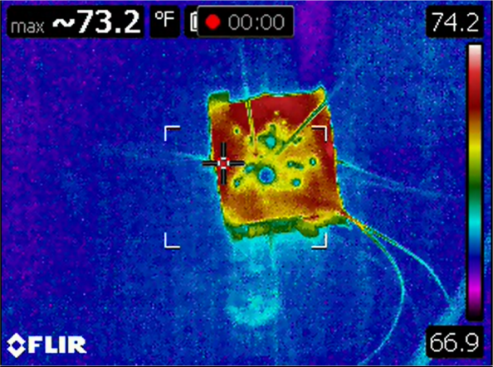
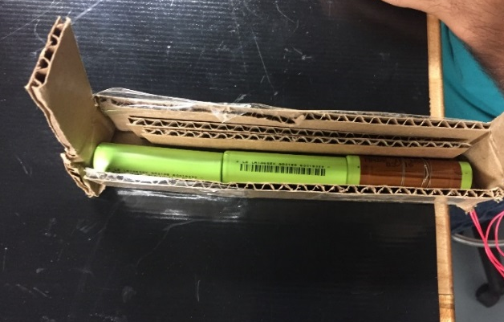
Misc. images
Metal cells
Safer li-ion chemistry
IR video tests
Alternative Configurations

Slide 15
Summary
With adequate packaging, external fire battery tests could be “dropped-in” to the oxygen cylinder test method.
Testing is ongoing

Slide 16
Questions?
Contact information:
Thomas.Maloney@faa.gov
1-609-485-7542

