Slide 1
Fire Safety
Implications
from the use,
storage and
Charging of
Tablets Onboard
Transport Aircraft

Slide 2
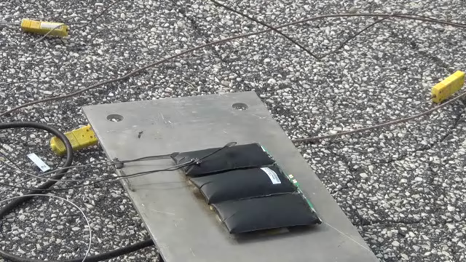
IPAD Battery Overheating

