Slide 1
RTCA Development of a New Flammability Test for Electronic Equipment
Section 26, Category C
Programmable Line Burner Method
October 2023 Update
Produced by: Lindsey Anaya, FAA
Lindsey.p.Anaya@faa.gov Steve Rehn, FAA Steven.rehn@faa.gov
Notes:
Radio Technical Commission for Aeronautics

Slide 2
RTCA DO-160G » DO-160H
DO-160 contains the international standard for environmental testing of commercial avionics
Section 26, Category C defines the flammability testing requirements for electronic housings and component parts
The goal is to create a new test method that will be simpler and require less total testing while maintaining or improving the level of safety
6/13/2023

Slide 3
Current Standards
Electronic equipment must be broken down into its individual parts and tested using the various Bunsen Burner tests
Small part exemptions
6/13/2023

Slide 4
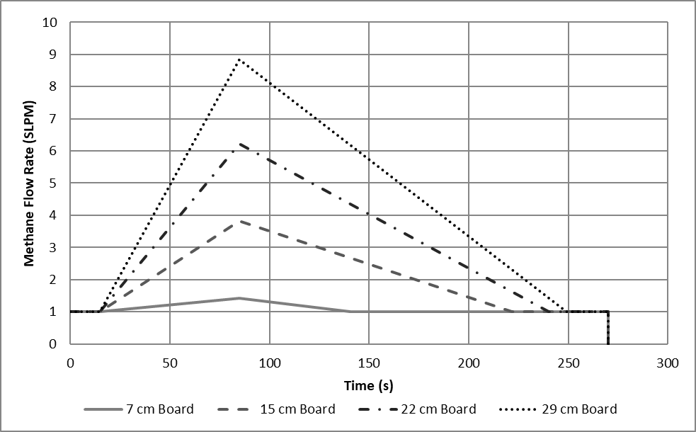
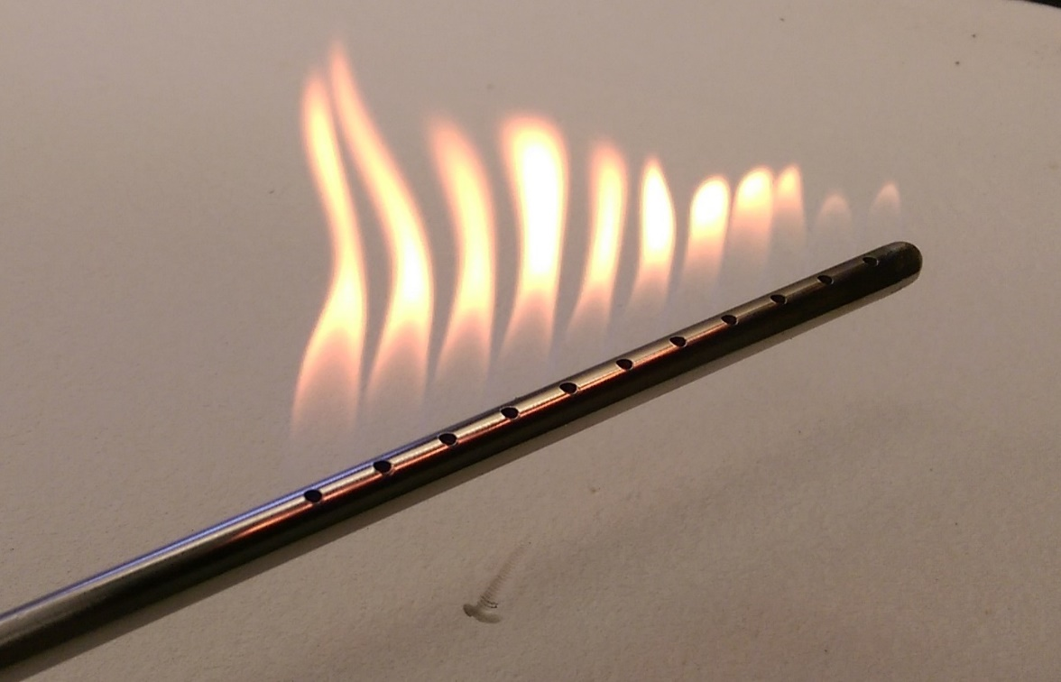
New Test Method: Programmable Line Burner
Based on telecom industry test ANSI T1.319
3/8” stainless steel tube with (11) 7/64” holes places 1/2” apart
Methane Fuel with variable flow rate controlled by computer program
Flow rate based on circuit board of certain size burning to completion
Burner holes can be covered for smaller box or lower flow rates
6/13/2023

Slide 5
Non-Vented Exemption
No Test Required if:
The enclosure is constructed of metal (metal finish that is non-flammable), on all sides, and is non-ventilated.
The enclosure is constructed of metal (metal finish that is non-flammable) on five sides and one side is constructed of glass polycarbonate(display) that has met the 12 second vertical test and has no ventilation.
6/13/2023

Slide 6
“Non-Vented” Defined
Based on testing, an enclosure is considered to have no ventilation if the total open area, A (in mm²), is less than 4 times the longest outside dimension, L (in mm), (A < 4 × L) up to a maximum of 700 mm². Total open area is any open area on the enclosure that air can flow through, including but not limited to vent holes and worse-case scenario design tolerance gaps.
6/13/2023

Slide 7
Test Procedure
Identify printed circuit board (PCB) or other part with the highest fuel load
Remove adjacent PCB and the burner is to be placed in the same general location aimed 45° towards PCB to be tested
Drill 0.75” hole to insert burner
Insert lit burner into enclosure and immediately start 270s burner program
Evaluate based on pass/fail criteria (maximum 12 second flame outside enclosure)
Certain equipment may require more than one test depending on potential fuel load inside box
6/13/2023

Slide 8
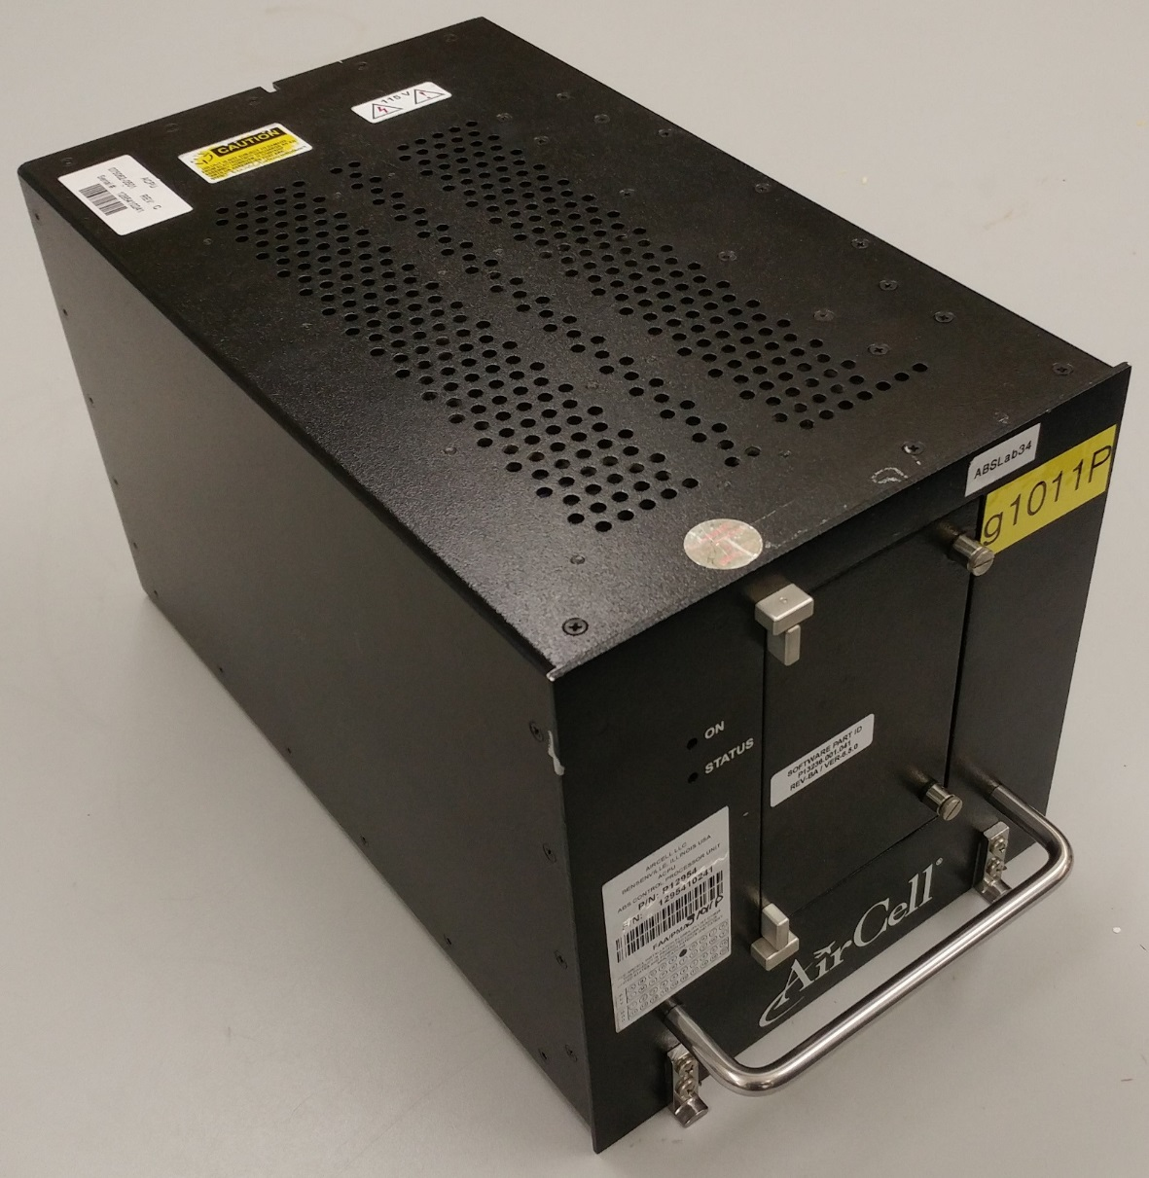
Test Example
12.5” × 7.5” × 7.5” box
Ventilation on top and bottom only
18.6 cm PCB height
1 SLPM initial flow rate, 5.02 SLPM max
Tested as part of a round robin with 4 labs
6/13/2023

Slide 9
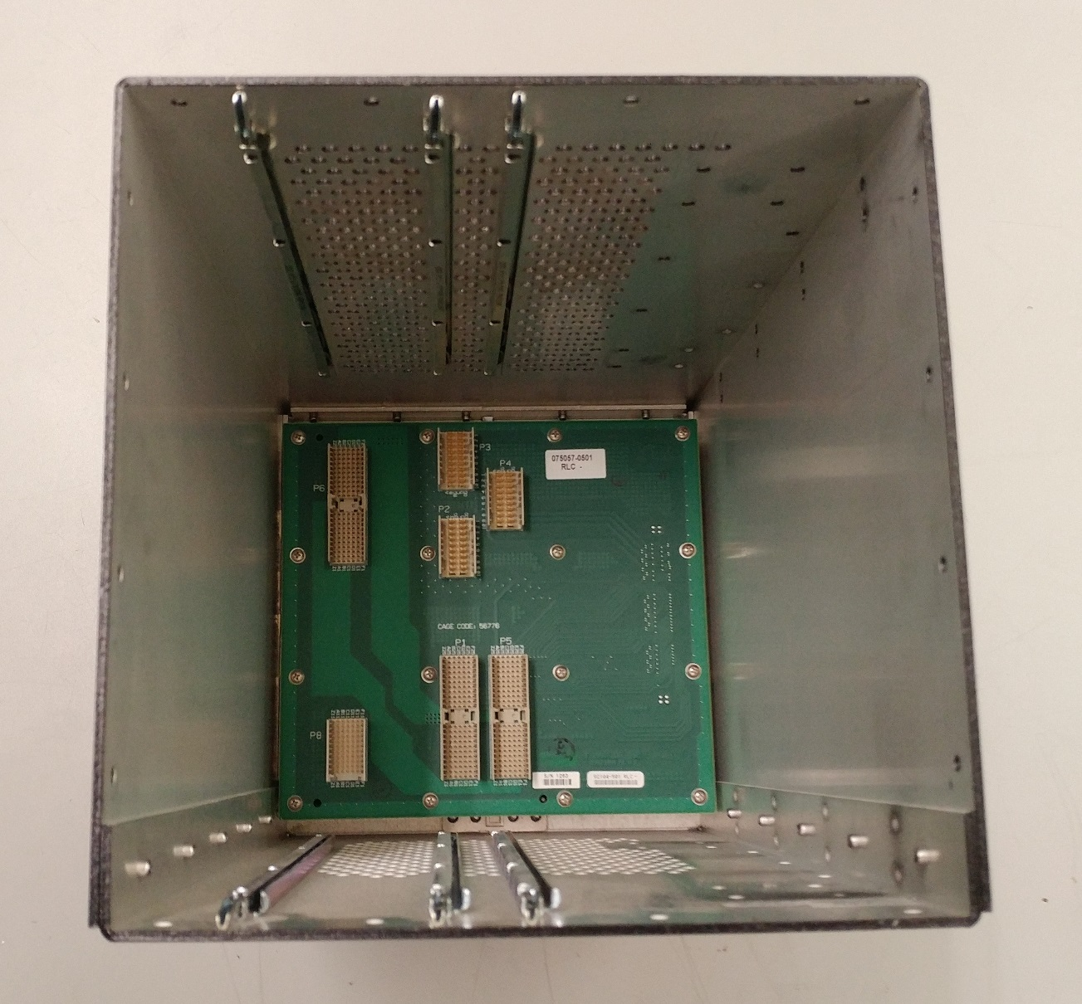
Test Example
PCB 1
PCB 3
PCB 2
PCB 4
6/13/2023

Slide 10
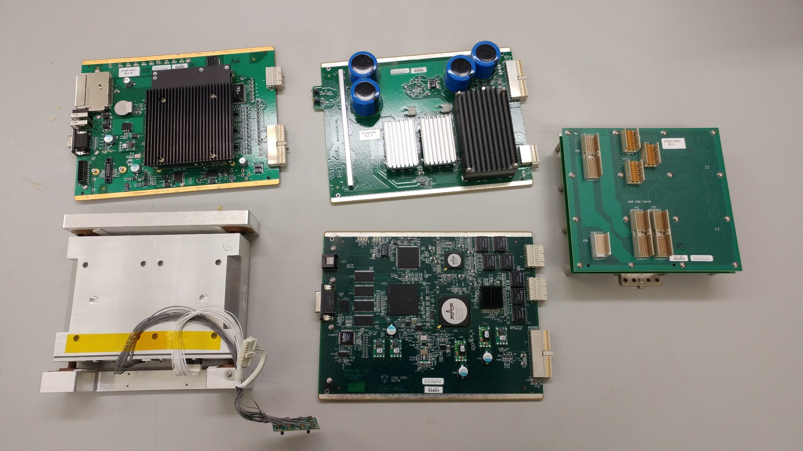
Test Example
PCB 3
PCB 1
PCB 4
PCB 2
6/13/2023

Slide 11
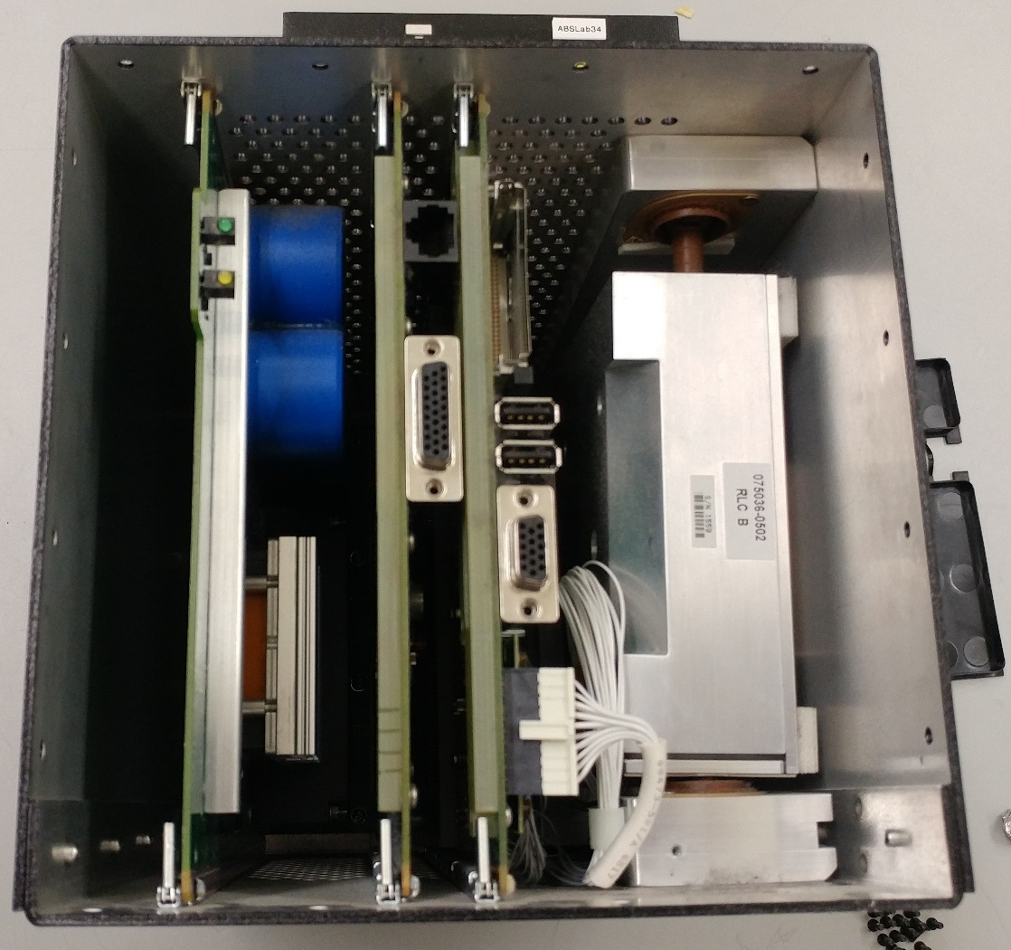
Burner Placement
Likely need two burns to substantiate this equipment
PCBs are made of same base material, so need to test based on features on PCBs
Burn 1: PCB 1 due to large capacitors
Burn 2: PCB 3 due to lithium battery and wire bundle
PCB 1
PCB 2
PCB 3
6/13/2023

Slide 12
Pass/Fail Criteria
The equipment shall not pose a risk of propagating a fire to other adjacent equipment or cabling, as defined in the following criteria:
Any flames* shall not exit the enclosure for a cumulative duration of 12 seconds or more.
*What is a “flame”? Proposed definition based on test observations:
Flames/Flaming Outside of Enclosure
Acceptable flame height minimum should be similar in size to a plume of a handheld lighter, but does not necessarily have to be as dense/fuel-rich as such. Flame wisps and intermittent flashing can and should be counted as flame. Stray embers emitted from the enclosure are not considered flames. Flamelet tips peeking through the ventilation holes should not be counted towards the pass-fail criteria.
6/13/2023

Slide 13
P/F Criteria – Flame Observation/Detection
Method Attempted | Did it work? | Notes
Live/Real-Time Visual observation with manual stop watch | No | Flashes/unknown behavior of burn made it difficult to accurately react with stopwatch live; can’t see all sides at once.
Indicator material placed above box | No | Indicator material suppressed flame by changing the airflow profile. Also standardizing an indicator material is difficult. Captures top of the enclosure only.
Thermocouple rake | No | TCs had slow response time; flames can miss contact with TC; captures top of the enclosure only.
Infrared camera | No | Only produced heat signatures; didn’t help detect flame any more than a regular camera
Photodiode #1 w/ 825 – 875 nm band pass filter | No | Output values of sensor could not differentiate between flame and smoke; sees flaming inside of enclosure
Photodiode #2 (800-1800nm range/IR) | No | Output values of sensor could not differentiate between flame and smoke; sees flaming inside of enclosure
Traditional flame tests
Optical Instrumentation
6/13/2023

Slide 14
P/F Criteria – Flame Observation/Detection
Method Attempted | Did it work? | Notes
300/600/900lm Blue LED for smoke attenuation + PD#2 combination *windows blocked/room lights OFF | Ultimately, no, but the blue light enhanced visual of flame vs. smoke; great color contrast | Firefighters use blue LEDs to help them locate source of fire in a tunnel (car accident) + other studies have shown smoke attenuation benefits
300 lm Red LED for smoke attenuation + PD#2 combination *windows blocked/room lights OFF | Ultimately, no, enhanced visual of flame vs. smoke, but not as well as blue LED | Inspired by amber fog lights in cars + other studies have shown smoke attenuation benefits
Photodiode #3 (350+nm/visible range) + orange/red wavelength BP filter + 900 lm Blue LED combination *windows blocked/room lights OFF | No | Idea here was to capitalize on the contrast of color offered by blue LED and focus the PD on the flame color. From previous trials, brighter blue light is better at attenuating smoke
Dual Camera System + 900 lm Blue LED combination *windows blocked/room lights OFF | Sort of | This method in general worked, but kept seeing glowing/reflective smoke phenomenon and was hard to differentiate glowing vs real flame. Next step is to try brighter LED.
Dual Camera System + 2025lm Blue LED combination *windows blocked/room lights OFF + Blackout Curtain Back Drop | Yes | The glowing/reflective smoke phenomenon practically vanished with the super bright LED.
Lights + Optical Instrumentation
Bright Blue LED + Video Camera Recording
6/13/2023

Slide 15
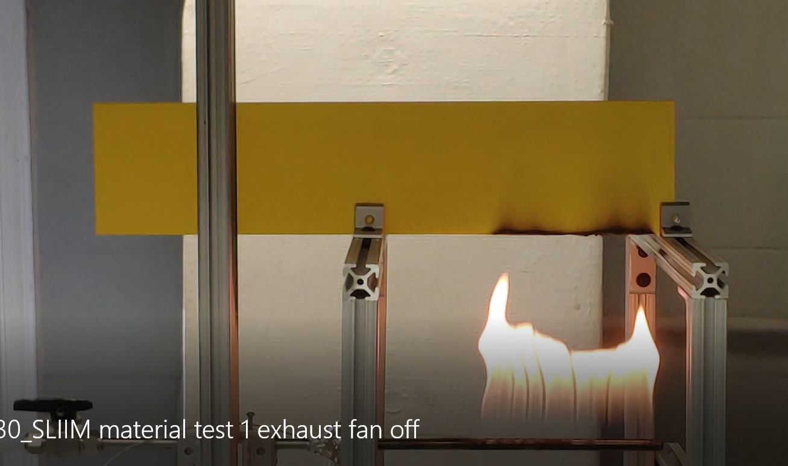
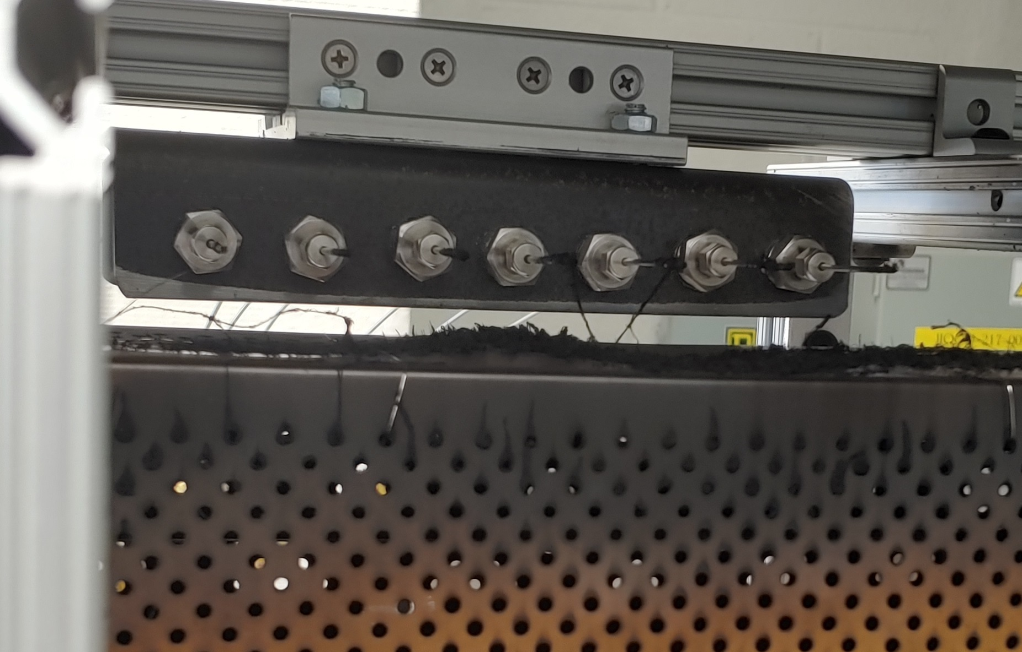
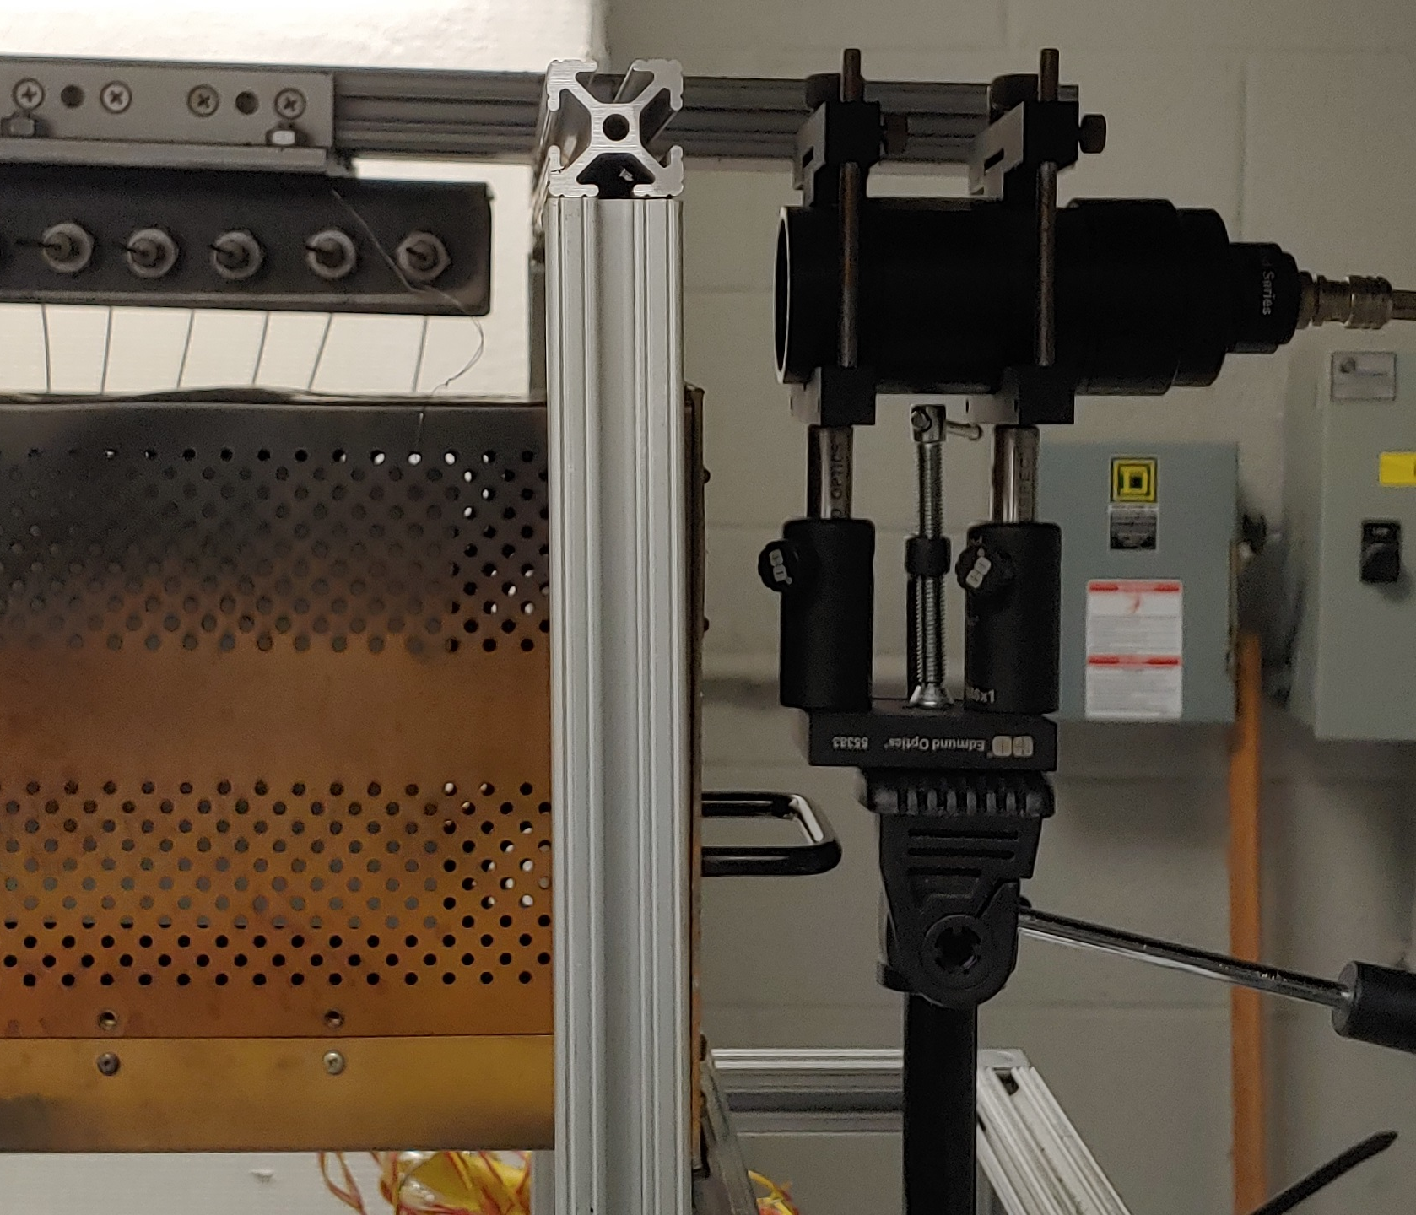
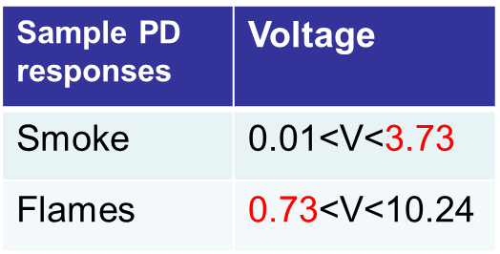
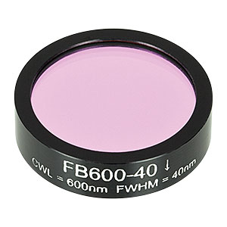
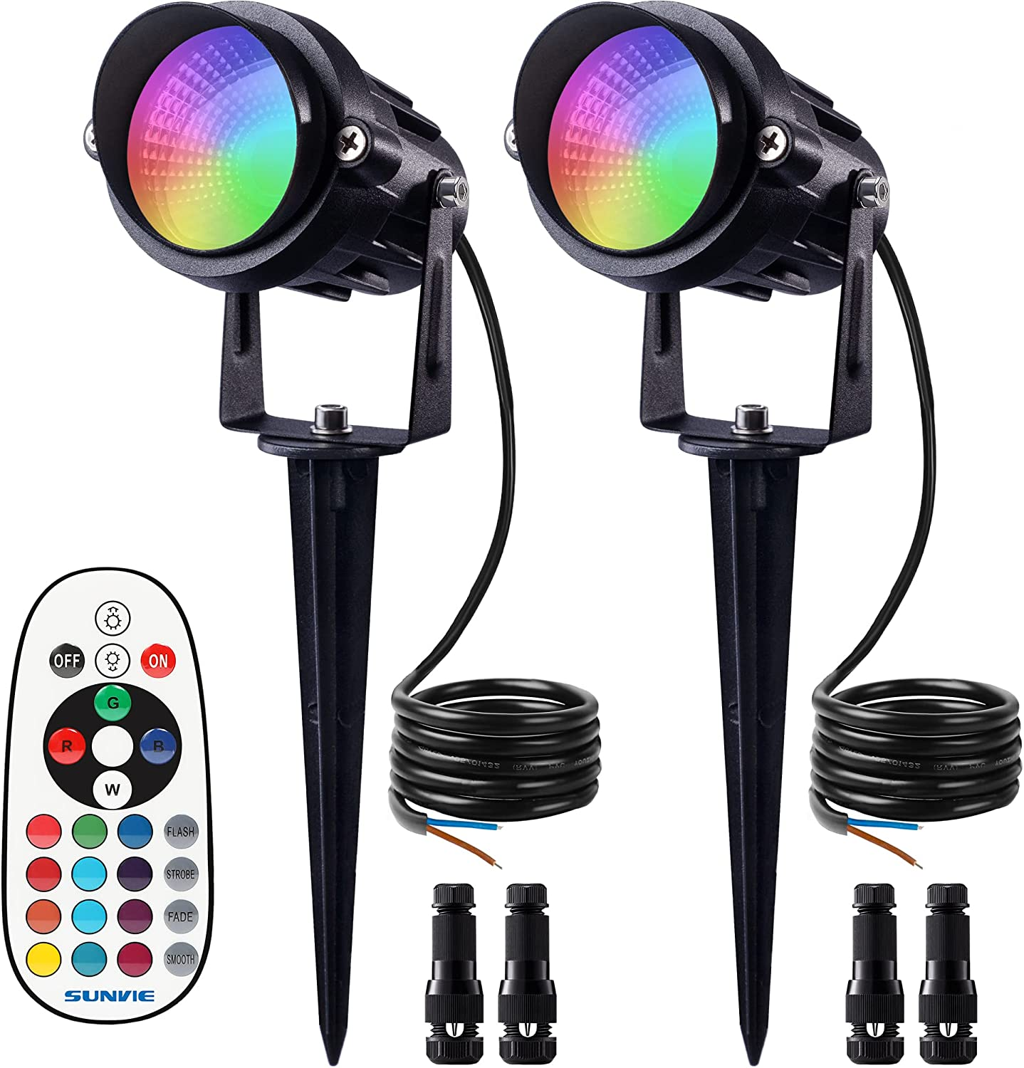
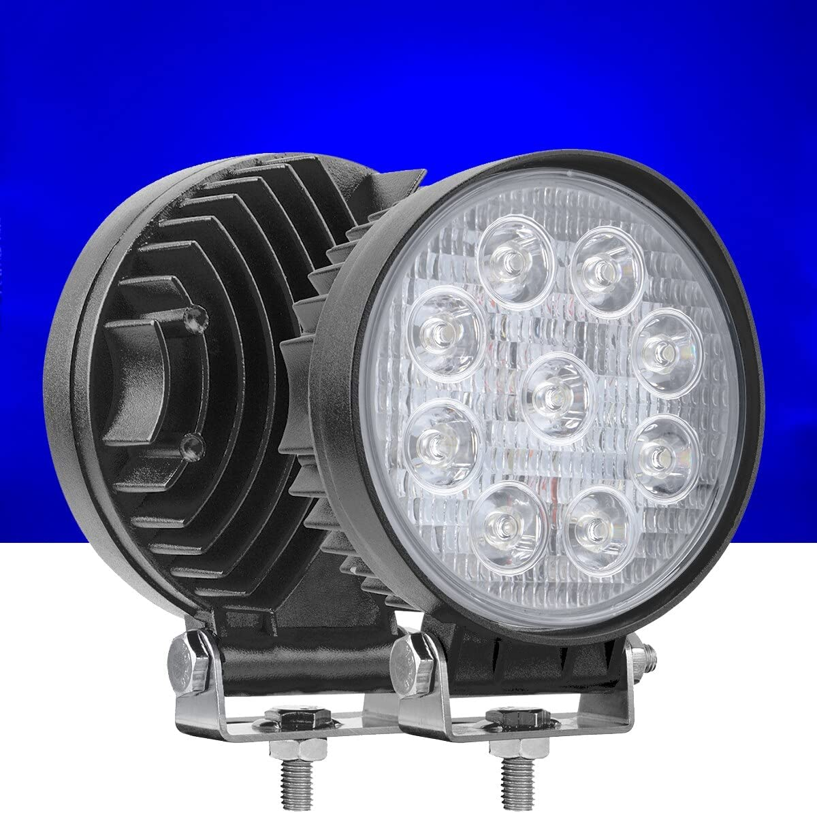
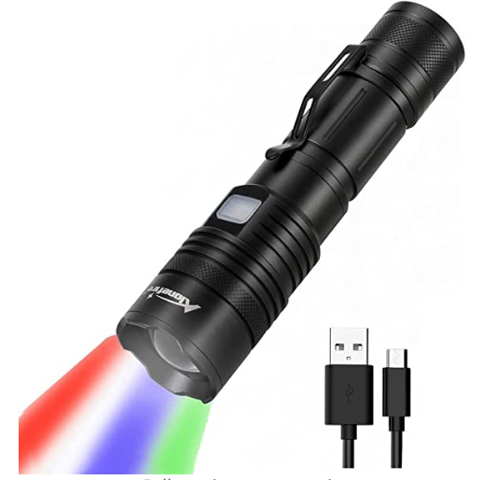
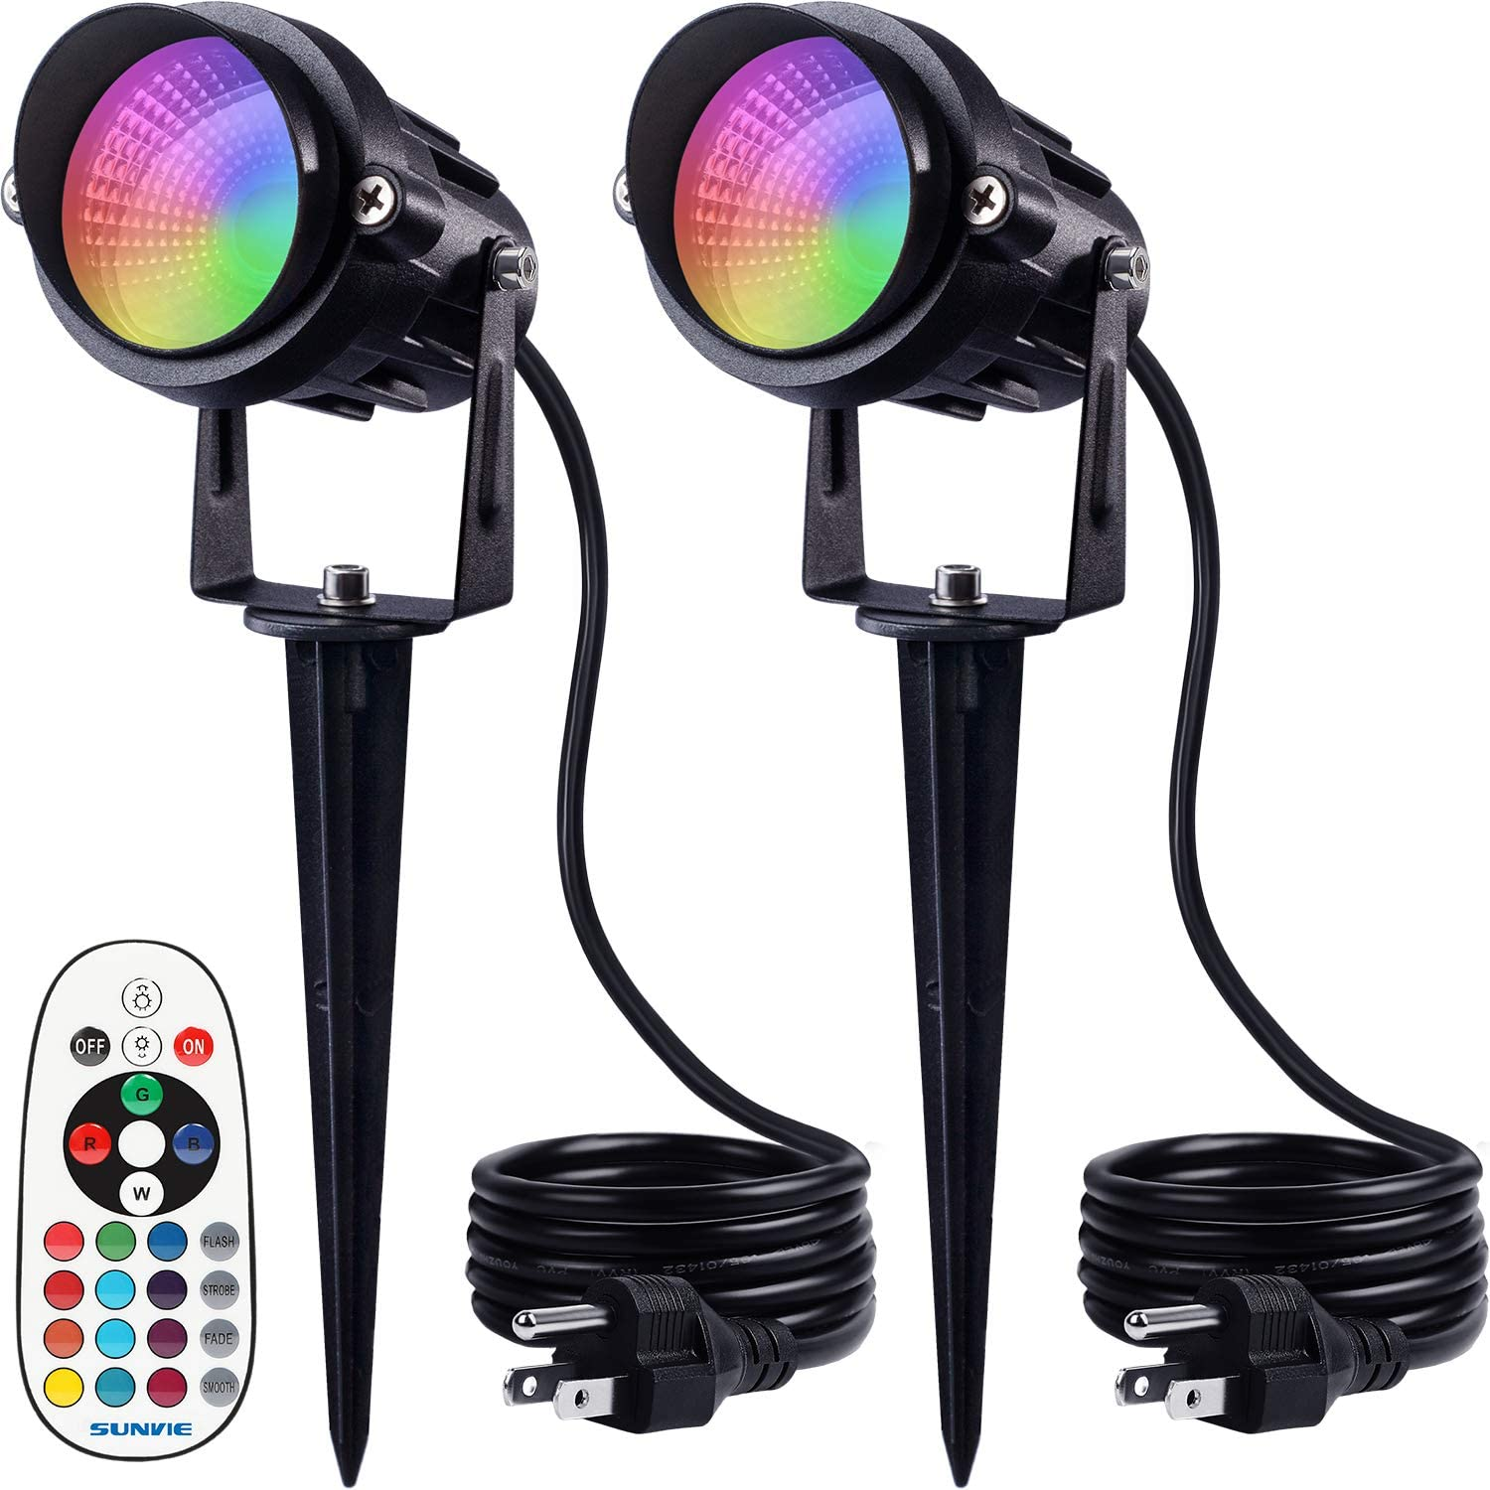
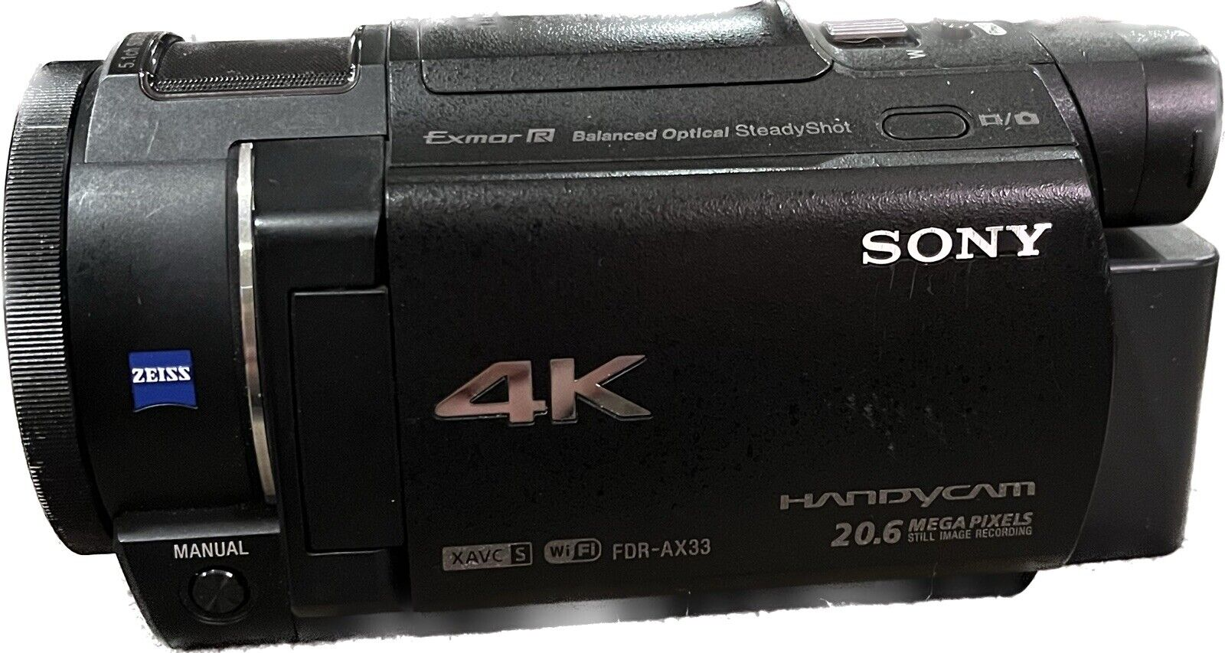
P/F Attempts
Goal is to observe flame only, and not get interference from smoke
Indicator Material
Thermocouple Rake
FLIR Camera
PD #2
PD #1
PD #1
PD #3 +BPF
Sony Handycam FDR-AX33
300 lm Blue LED
600 lm Blue LED
900 lm Blue LED
2025 lm Blue LED
6/13/2023

Slide 16
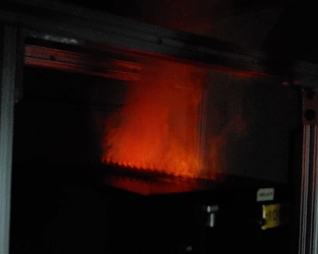
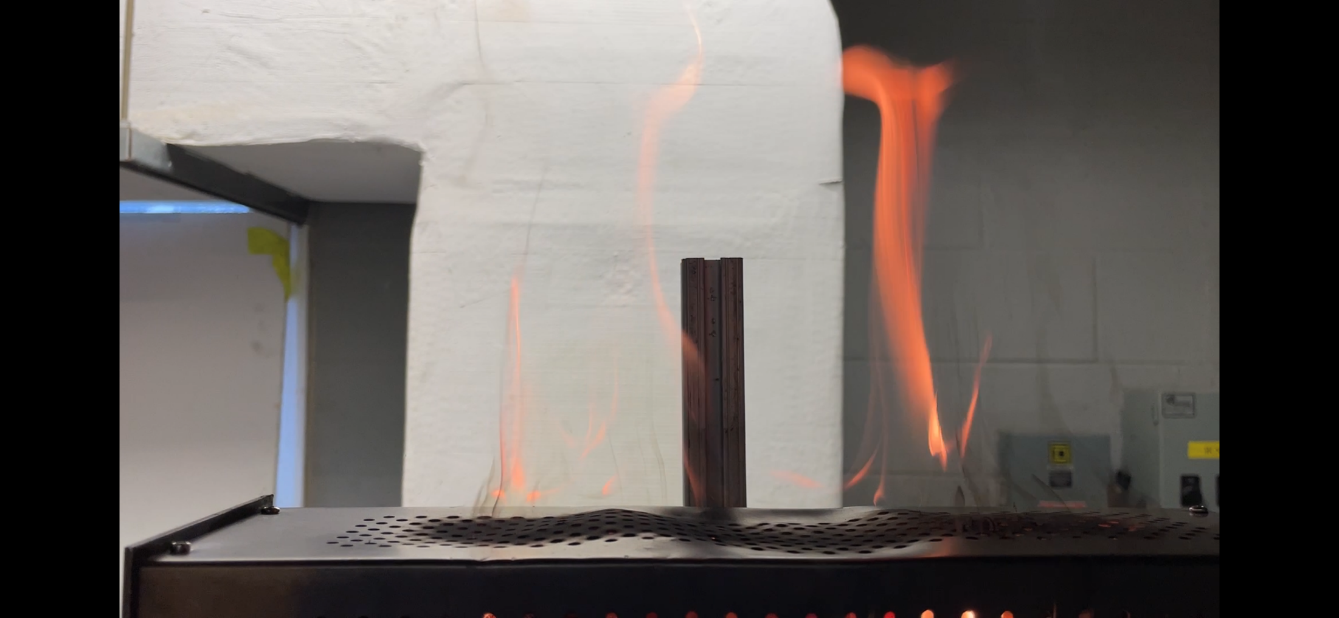
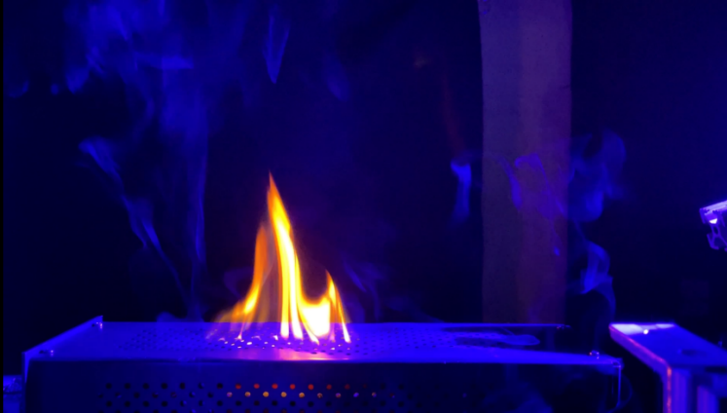
Lighting Conditions Matter
Bad
Better
Dark Room; Glowing Smoke, not real flame
Best
Ambient Lighting; translucent flames hard to see
Blue light in Dark Room – great contrast
6/13/2023
Notes:
Here’s the photodiode I am currently working with from Thorlabs. I chose this diode bc I wanted the sensor to hone in on flame and not smoke (the CO2 and H20). You can see the diode’s response correlates to the sweet spot I’ve marked on the right image.
I am going to go through some of the validation strategies I've tried thus far with this NIR photodiode and explain why I cannot seem to validate the photodiode as a reliable (repeatable and reproducible) candidate for flame detection.
FoV Test -15° to 15 ° (15° increments; 28 burner locations/test spots to cover a 6”, 12”, 18” radius)
Gain is MID (data is from one trial, but the pattern persists)

Slide 17
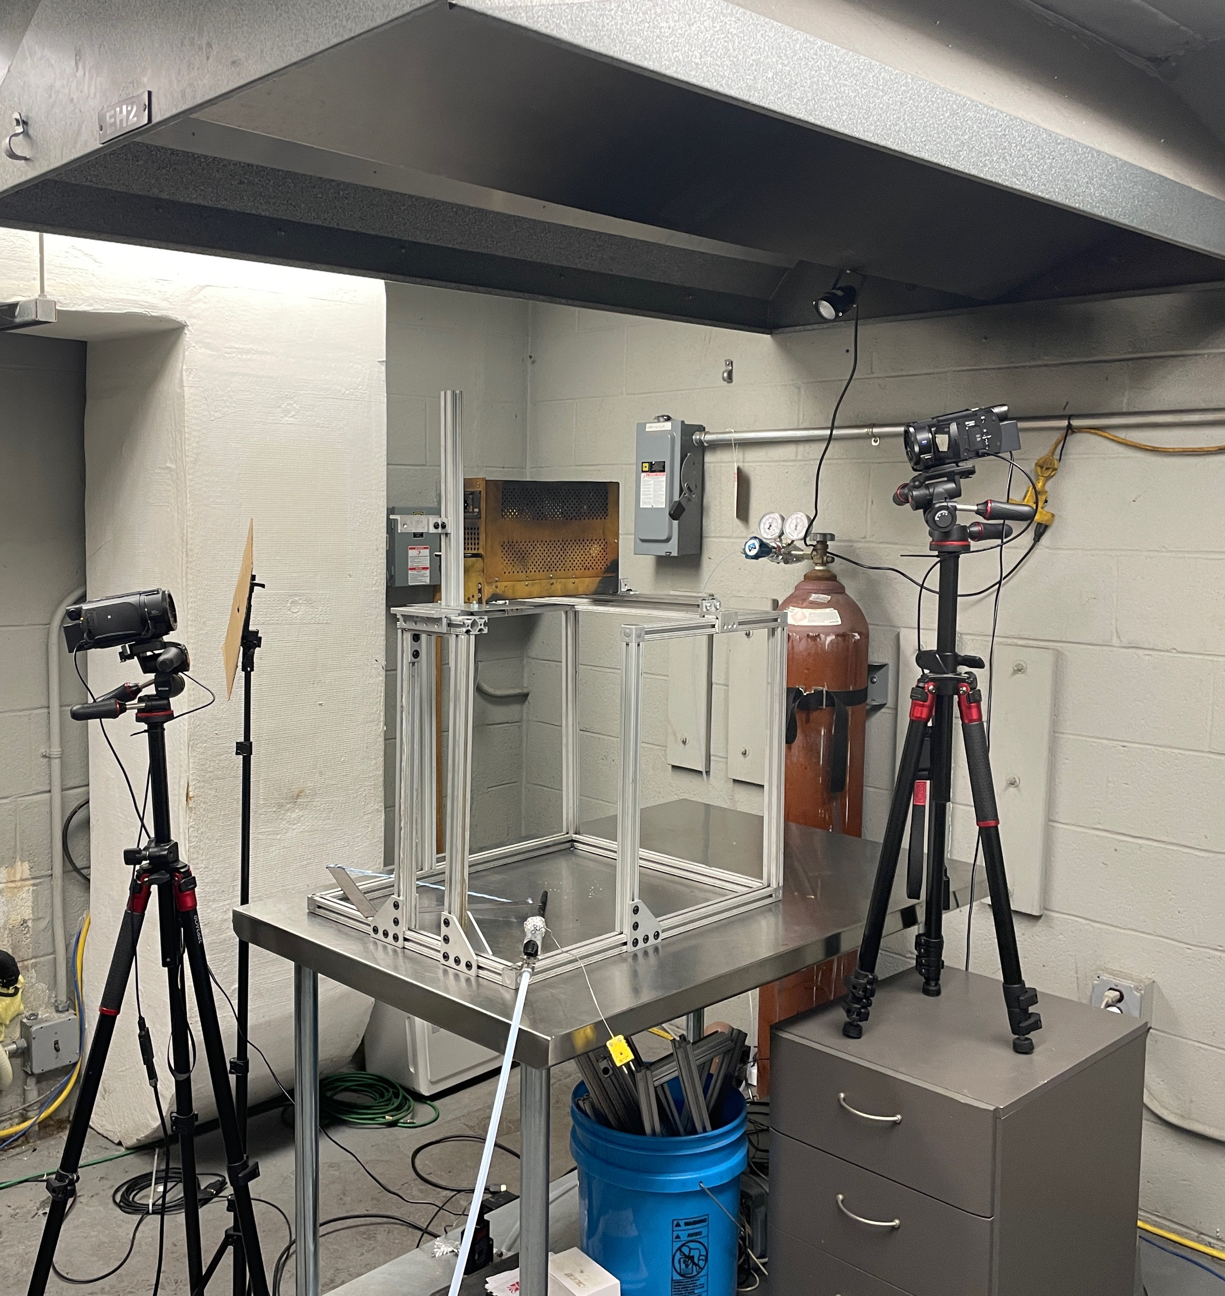
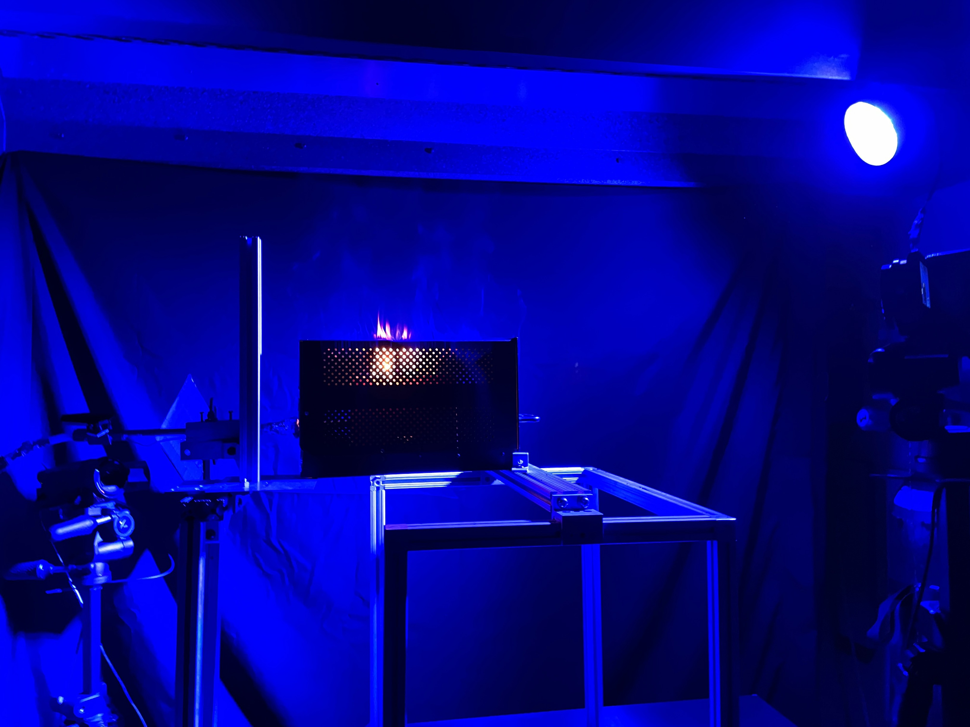
Camera/Blue LED System For Flame Detection
Minimum Camera requirements:
1080-pixel resolution
30 frames per second (fps)
field-of-view (FOV) of 90 degrees
Color quality must closely match actual color condition seen by human eye (webcams not recommended for this reason)
Small cardboard panel to block blue light from low camera view
Lighting Requirements:
blue (450-495nm range) LED
minimum of 2000 lumen (typically 27W LED)
Test facility must otherwise be completely dark
6/13/2023

Slide 18
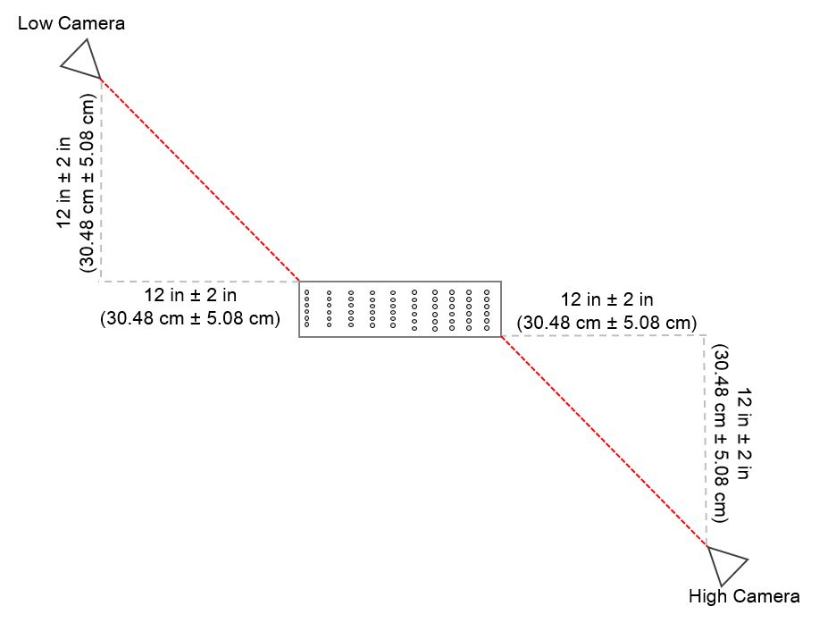
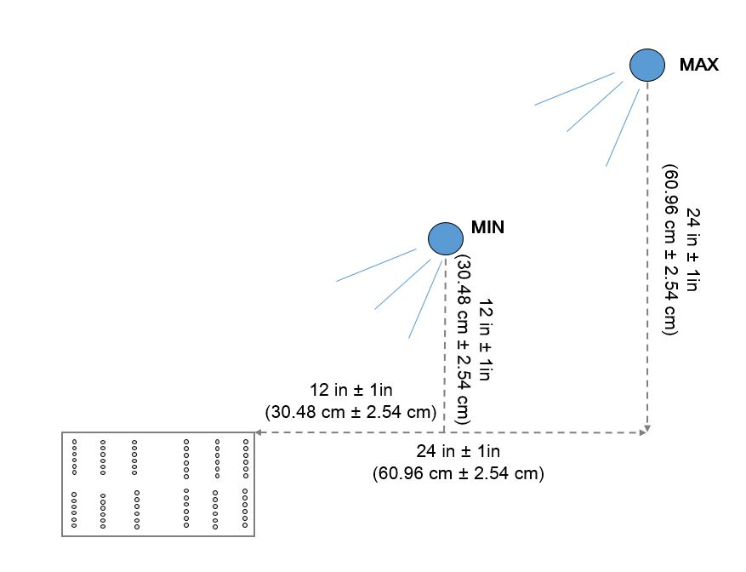
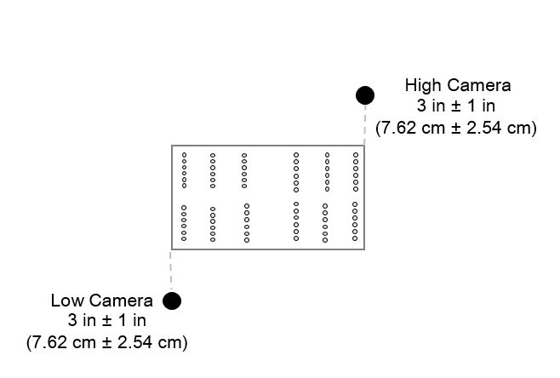
Blue LED & Camera Set-Up
Dual-Camera Positions (Top View)
Blue LED Position (Range)
No specific angle of LED; needs to simply encapsulate entire enclosure.
No specific camera angles; needs to capture all vented enclosure surfaces.
Dual-Camera Positions (Front View)
6/13/2023
Notes:
Tip – run a lighter across all vented surfaces and make sure the camera sees the lighter plume. Then you are good to go.

Slide 19
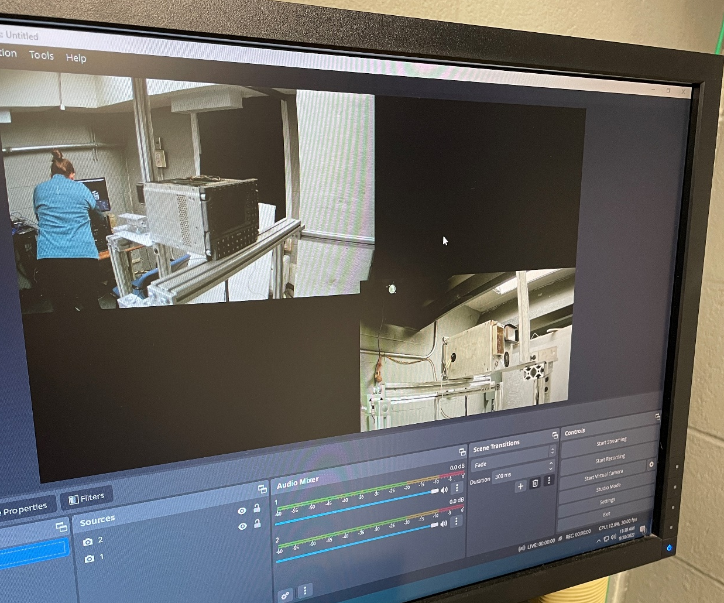
Video Capture and Analysis Software
OBS and Kinovea are simply options. Instead of OBS, one can manually hit record on the 2 cameras and analyze 2 separate video files. And instead of Kinovea, flame duration can be obtained using the time stamps on a PC’s default video player or reacting with a manual stopwatch while witnessing the video.
6/13/2023

Slide 20
Video Analysis Round Robin
Sent out 4 FAA test videos files to be analyzed by anyone who wanted to participate
Instructions: Observe the 4 distinct test videos provided and evaluate the test for pass or fail, reporting flame duration times.
Goal: achieve consensus on the flame duration time (number of seconds) for each test
6/13/2023

Slide 21
Sample Video
6/13/2023

Slide 22
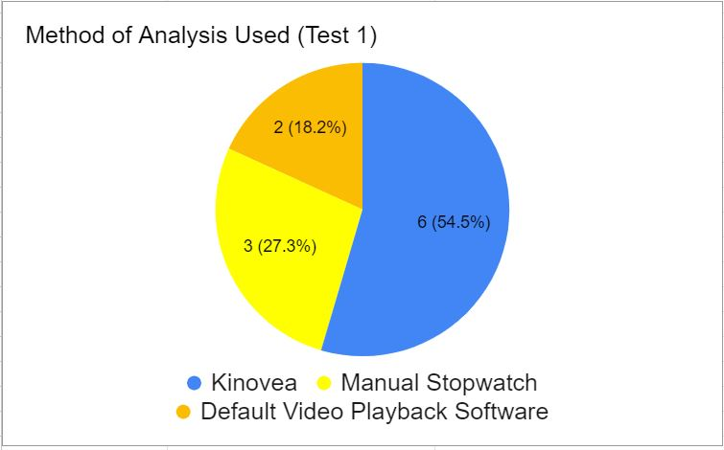
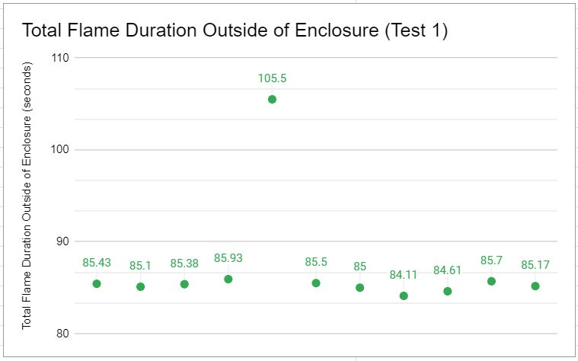
Round Robin Results
11 participants
AVERAGE AMONG 4 TESTS
Margin of Error | 2.30s
Relative STD | 4.06%
TEST 1
Margin of Error | 3.63s
Relative STD | 7.06%
TEST 2
Margin of Error | 1.10s
Relative STD | 1.75%
TEST 3
Margin of Error | 0.92s
Relative STD | 1.35%
TEST 4
Margin of Error | 3.56s
Relative STD | 6.08%
6/13/2023
Notes:
Observations:
Instructions could have been clearer. The 2-camera views in one video file confused people’s eyes. Some results were double counting of same flame. Pitfall: Test 4 - A lot of precision/same reports (around 90s) but little accuracy (true flame time was more like 103s)
I think a lot of people either stopped watching the video early or just missed the tiny flaming coming out the right side.

Slide 23
Validation Status
FAA submitted new method as a CP to RTCA committee in Feb 2023 for comments
Next Steps
Complete a traditional lab Round Robin to verify test set-up and that results are similar/acceptable
Approval of CP for DO-160H publication
6/13/2023
2/13/2023
Notes:
Next Steps depend on general acceptance of CP from the RTCA committee

Slide 24
Questions?
Contact Information:
Steve Rehn
General Engineer, FAA Fire Safety Branch
Steven.rehn@faa.gov
Lindsey Anaya
General Engineer, FAA Fire Safety Branch
Lindsey.p.Anaya@faa.gov
6/13/2023
2/13/2023

