Slide 1
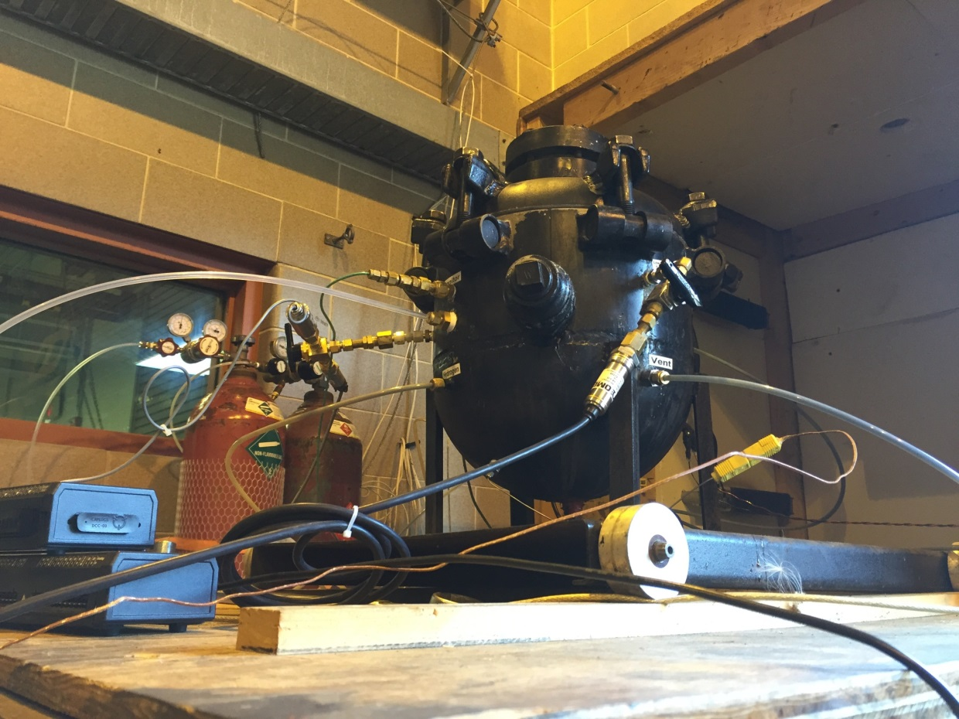
FLAMMABILITY LIMITS OF LITHIUM BATTERY THERMAL RUNAWAY VENT GAS IN AIR AND THE INERTING EFFECTS OF HALON 1301
Matthew Karp
Rutgers University
FAA

Slide 2
1 Introduction
1.1 Relevant Definitions
1.2 Topic Background
1.3 Aviation Regulations
1.4 Scope of Study
1.5 Test Equipment
1.6 Test Procedure

Slide 3
Definitions
Lower Flammability Limit (LFL) is the minimum concentration of a fuel in an oxidizer that will ignite. Less fuel will be too lean to ignite.
Upper Flammability limit (UFL) is the maximum concentration of a fuel in an oxidizer that will ignite. More fuel will be too rich to ignite.
Minimum Inerting Concentration (MIC) is the minimum concentration of an inertant required to prevent ignition regardless of fuel concentration.
This is also where the LFL meets the UFL

Slide 4
Background
This table shows variables and its effect on the flammability limits
An increase in the variable… | Causes the flammability limits to…
Spark Energy [1] | Expand
Ambient Temperature [1] | Expand
Ambient Pressure [2] | Constrict
Pressure Vessel Volume [3] | Constrict
The application of flammability limits should be applied carefully while considering all possible variables. The above variables have been shown to effect data outcome.

Slide 5
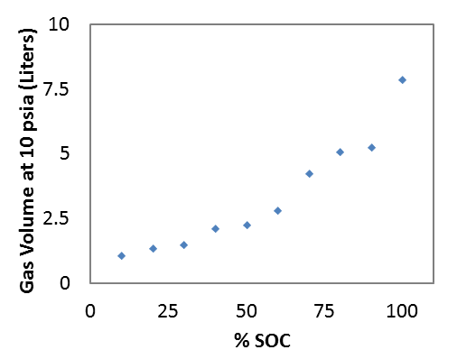
Background
Testing was conducted to determine the constituents of 18650-sized LiCoO₂ rechargeable lithium-ion battery cell vent gases at various states of charge [4].
The three main constituents were found to be carbon monoxide (CO), carbon dioxide (CO₂), and hydrogen (H₂) [4]. The remaining constituents are various hydrocarbons [4].
It was found that increasing the SOC increases the overall lithium battery vent gas volume and changes the lithium battery vent gas composition [4].
These tests were used to confirm the chemical makeup of the premixed lithium-ion battery vent gas (Li-Ion pBVG) used for testing.

Slide 6
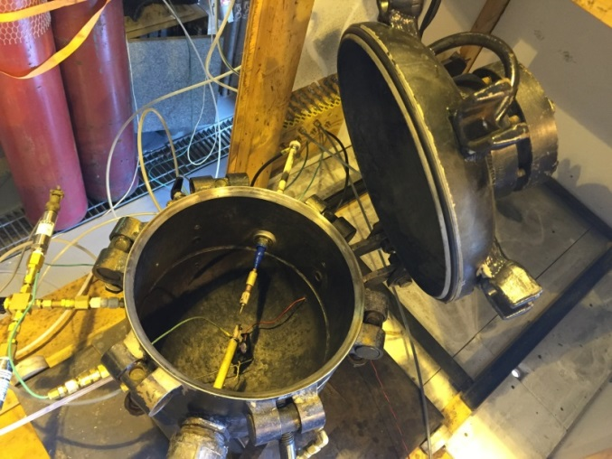
Background
Lithium batteries are commonly used and can be packed in bulk and shipped in the cargo holds of freighter aircraft
Currently lithium batteries are banned from bulk shipment on passenger aircraft [5].
A lithium battery in thermal runaway can propagate from cell to cell and box to box [6]
1668 degrees F in lithium-ion cells (rechargeable) [6]
2009 degrees F in lithium metal cells (non-rechargeable) [6]

Slide 7
Regulations
Class C cargo compartment utilizes [7]
Fire resistant liner
Early fire detection
An isolated and built in fire extinguishing system
5 %vol Halon 1301 knockdown concentration
3 %vol Halon 1301 sustained for remaining duration of flight
* Title 14 Code of Federal Regulations (CRF) part 25 §25.857
But is that sufficient for lithium-ion battery fires?
The objective of this work is to determine if the 5 %vol knockdown and the 3 %vol sustained of Halon 1301 in a Class C cargo compartment are sufficient to render the buildup of a lithium-ion battery vent gas (Li-Ion BVG) in air inert.

Slide 8
Scope
Experimentally determine the LFL and UFL of hydrogen and air mixtures
Experimentally determine the inerting effects of Halon 1301 on hydrogen and air mixtures
LFL and UFL with 10 %vol Halon 1301
LFL and UFL with 20 %vol Halon 1301
MIC of Halon 1301 on hydrogen and air mixtures

Slide 9
Scope
Experimentally determine the LFL and UFL of Li-Ion pBVG and air mixtures
Experimentally determine the inerting effects of Halon 1301 on Li-Ion pBVG and air mixtures
LFL and UFL with 5 %vol Halon 1301
LFL and UFL with 7 %vol Halon 1301
LFL and UFL with 8 %vol Halon 1301
MIC of Halon 1301 on Li-Ion pBVG and air mixtures

Slide 10
Scope
Compare experimental results to calculated results using Le Chatelier's mixing rule for determining the flammability limits of lithium battery vent gas in air.
Predict flammability limits for various states of charge using Le Chatelier’s mixing rule.

Slide 11
2 Test Procedures
2.1 Testing Equipment
2.2 Testing Procedure
2.3 Test Criterion
2.4 Test Example
2.5 Determining Limits

Slide 12
21.7 Liter 316L stainless steel pressure vessel
Pressure Transducers
0-30 psi and 0-100 psi
pressure rise
Pressure Transducer
0-15 psi
partial pressures
Thermocouple
High speed and low speed
data acquisition system

Slide 13
Two stainless steel electrodes
3.2 mm diameter 316L
12 V mixing fan
* The addition of the 12 V mixing fan greatly improved test reproducibility for hydrogen – air – Halon 1301 gas mixtures *

Slide 14
Testing Equipment
Components not described in the previous slides are:
15 kV, 30mA luminous tube transformer
To generate spark energy
Needle valves
To accurately insert gases into testing vessel
Vacuum Pump
To void the testing vessel of initial gases

Slide 15
Testing Equipment
The premixed bottled lithium battery vent gas constituents are listed below [4]
The most prevalent gases are hydrogen, carbon monoxide, and carbon dioxide.
Gas | %vol
Hydrogen | 27.60
Carbon Monoxide | 22.90
Carbon Dioxide | 30.10
Methane | 6.37
Propylene | 4.48
Ethylene | 2.21
Butane | 1.57
Ethane | 1.17
1-Butane | 0.56
Propane | 0.27
Rather than collecting Li-Ion battery vent gases, a bottle of premixed battery vent gases (Praxair NI BT1.58X1CASN) was purchased to match the composition of collected battery gases.

Slide 16
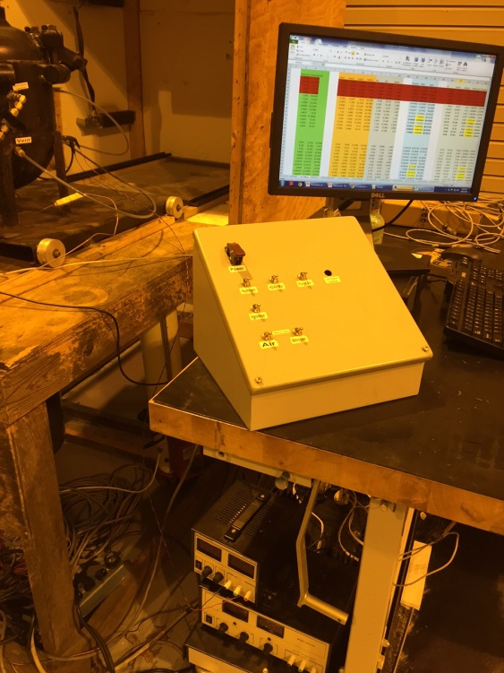
Testing Procedure
The test procedure from start to finish requires approximately 45 minutes per test. The steps are summarized below:
Evacuate test vessel with vacuum to an average of 0.14 psi
Use partial pressure to accurately input the required ratio of gases to a total of 14.7 psi
Turn on 12 V mixing fan
Turn off fan
Ignite mixture
Measure pressure rise
Analyze data
Repeat steps 1 through 7

Slide 17
Test Criterion
A flammability limit of 5 % pressure rise over initial pressure is used to consider a mixture flammable
Five test results are averaged to determine the flammability limits They are to be:
Below the 5 % pressure rise limit
Within 0.05 %vol fuel concentration of one another

Slide 18
Test Example
This test started at 14.68 psi and rose to 15.51 psi after ignition. After subtracting 0.016 psi for pressure rise from spark alone, There is a pressure rise of 0.814 psi and a percent pressure rise of 5.54 %. This is greater than 5 %, therefore, this particular test is considered flammable.
0.814 psi pressure rise
5.54 % pressure rise
Deemed Flammable
The above graph demonstrates a flammable test result.

Slide 19
Determining LFL
Perform test near flammability limit of 5 % pressure rise.
Increase or decrease concentration until test is conducted below 5 % pressure rise
Conduct four more tests within 0.05 % fuel concentration of one another without exceeding 5 % pressure rise.
Repeat steps 1 through 3 if necessary and average five results.
Data point greater than 5 % pressure rise
The above graph demonstrates how the LFL is determined.

Slide 20
3 Flammability Limits and MIC of Hydrogen and Air Mixtures with and without Halon 1301
3.1 Overview
3.2 Nose Cap MIC of Hydrogen, Air, and Halon 1301 Mixtures
3.3 Flammability Curve of Hydrogen, Air, and Halon 1301 Gas Mixtures

Slide 21
Overview
Mixture | LFL, %vol Hydrogen | UFL, %vol Hydrogen
Hydrogen – Air | 4.95±0.40 | 76.52±0.44
Hydrogen – Air – 10 % Halon 1301 | 9.02±0.51 | 45.70±0.41
Hydrogen – Air – 20 % Halon 1301 | 11.55±0.48 | 28.39±0.47
Mixture | MIC, %vol Halon 1301
Hydrogen – Air – Halon 1301 | 26.72±0.43
100 tests were conducted to determine date used in determining the flammability curve of hydrogen, air, and Halon 1301 mixtures.

Slide 22
Nose Cap MIC of Hydrogen, Air, and Halon 1301 Mixtures
21 tests were conducted to determine the minimum inerting concentration of Halon 1301 in hydrogen – air mixtures to be 26.72±0.43 %vol Halon at 16.2 %vol hydrogen
The above graph displays where the LFL meets the UFL to form the MIC.

Slide 23
Flammability Curve of Hydrogen, Air, and Halon 1301 Gas Mixtures
The UFL constricts faster than the LFL as the %vol Halon 1301 increases.
Inside the curve is considered flammable while outside is considered nonflammable.
Flammable
Using the above graph, any ratio of hydrogen, air, and Halon 1301 can be determined to be a flammable or nonflammable mixture.

Slide 24
4 Testing Validation
4.1 Validation Overview
4.2 LFL and UFL Validation Analysis
4.2 MIC Validation Analysis

Slide 25
Tester | LFL, %vol Hydrogen | UFL, %vol Hydrogen
Matthew Karp with Mixing Fan (5 % pressure rise) | 4.95±0.40 | 76.52±0.44
Matthew Karp without Mixing Fan (5 % pressure rise) | 5.35 | 78.18
Steve Rehn without Mixing Fan (3 % Pressure Rise) [8] | 4.7 | 78.87
Factory Mutual Research Corporation (Visual Upward Flame Propagation) [9] | 4 | 76
EN 1839 (B) 14 L Vessel (5 % Pressure Rise) [10] | 4.2 | 77
EN 1839 (T) 80 mm Diameter (Visual Method) [10] | 3.6 | 76.6
Herzberg & Cashdollar 8 L Vessel (3 % Pressure Rise) [11] | 5±0.5 | 76.8±0.2
Average | 4.56 | 77.11

Slide 26
LFL and UFL Validation Analysis
The averaged LFL and UFL of the seven experiments are 4.56 %vol and 77.11 %vol hydrogen respectively with a standard deviation of 0.54 %vol and 0.88 %vol hydrogen respectively
The experimentally determined flammability limits of this study are 4.95±0.40 %vol and 76.52±0.44 %vol hydrogen for the LFL and UFL respectively.
The test results of this study are both within a standard deviation of the averaged results and therefore validate the test data.

Slide 27
MIC Validation Analysis
Results from this study found a MIC of 26.72 %vol Halon 1301 while Factory Mutual Corporation found the MIC to be 28 %vol Halon 1301 yielding a 4.68 percent difference
Factory Mutual Research Corporation used the visual method and this study used the pressure rise method
Tester | MIC, %vol Halon 1301
Matthew Karp with Mixing Fan (5 % Pressure Rise) | 26.72±0.43
Factory Mutual Research Corporation (Visual Upward Flame Propagation) [6] | 28
Being that these experiments used different testing methods and still yields similar results, it can be concluded that the test results are accurate and reproducible.

Slide 28
5 Flammability Limits and MIC of Li-Ion pBVG and Air Mixtures with and without Halon 1301
5.1 Premixed Lithium-Ion Battery Vent Gas (Li-Ion pBVG) Mixture Constituents
5.2 Overview
5.3 Nose Cap MIC of Li-Ion pBVG, Air, and Halon 1301 Mixtures
5.4 Flammability Curve of Li-Ion pBVG, Air, and Halon 1301 Mixtures

Slide 29
Li-Ion pBVG Mixture Constituents
The premixed bottled lithium battery vent gas constituents are listed below [4]
The most prevalent gases are hydrogen, carbon monoxide, and carbon dioxide.
Gas | %vol
Hydrogen | 27.60
Carbon Monoxide | 22.90
Carbon Dioxide | 30.10
Methane | 6.37
Propylene | 4.48
Ethylene | 2.21
Butane | 1.57
Ethane | 1.17
1-Butane | 0.56
Propane | 0.27
Rather than collecting Li-Ion battery vent gases, a bottle of premixed battery vent gases (Praxair NI BT1.58X1CASN) was purchased to match the composition of collected battery gases.

Slide 30
Overview
Mixture | LFL, %vol Li-Ion pBVG | UFL, %vol Li-Ion pBVG
Li-Ion pBVG – Air | 7.88±0.41 | 37.14±0.42
Li-Ion pBVG – Air – 5% Halon 1301 | 13.80±0.49 | 26.07±0.43
Li-Ion pBVG – Air – 7% Halon 1301 | 16.15±0.4 | 23.31±0.44
Li-Ion pBVG – Air – 8% Halon 1301 | 17.62±0.52 | 21.84±0.65
Mixture | MIC, %vol Halon 1301
Lithium Battery Vent Gas – Air – Halon 1301 | 8.59±0.52
97 tests were conducted to determine date used in determining the flammability curve of Li-Ion pBVG, air, and Halon 1301 mixtures.

Slide 31
Nose Cap MIC of Lithium Battery, Air, and Halon 1301 Mixtures
34 tests were conducted to determine the minimum inerting concentration of Halon 1301 in mixed Li-Ion pBVG – air mixtures to be 8.59±0.52 %vol Halon at 19.52 %vol Li-Ion pBVG
The above graph displays where the LFL meets the UFL to form the MIC.

Slide 32
Flammability Curve of Li-Ion pBVG, Air, and Halon 1301 Mixtures
The UFL constricts faster than the LFL as the %vol Halon 1301 increases.
Inside the curve is considered flammable while outside is considered nonflammable.
Using the above graph, any ratio of Li-Ion pBVG, air, and Halon 1301 can be determined to be a flammable or nonflammable mixture.

Slide 33
6 Le Chatelier’s Mixing Rule
6.1 Le Chatelier’s Mixing Rule [12]
6.2 Comparison of Experimental and Calculated Flammability Limits for Li-Ion pBVG
6.3 Prediction and Analysis for Various States of Charge using Le Chatelier’s Mixing Rule

Slide 34
Le Chatelier’s Mixing Rule [12]
Calculate the constituents of the mixed gas neglecting the presence of air.
Create binary gases by combining part of or all of a nonflammable gas with one or more flammable gas and recalculate gas constituents.
Record the flammability limits of the mixtures constituents from tables or curves.
Calculate the flammability limits of the mixed gas using Le Chatelier’s mixing rule equation
$$L=\frac{100}{\frac{p_{1}}{N_{1}}+\frac{p_{2}}{N_{2}}+\frac{p_{3}}{N_{3}}+…}$$
Where L is either the LFL or the UFL of the gas mixture, p₁, p₂, p₃ … are the percentages of the mixtures constituents, and N₁, N₂, N₃ … are either the LFL or UFL of the individual constituents [12].
*Note that if the constituents do not add up to 100 percent, one could substitute the actual total percentage.

Slide 35
Comparison of Experimental and Calculated Flammability Limits for Li-Ion pBVG
The LFL has a percent difference of 1.79 %
The UFL has a percent difference of 4.53 %
Le Chatelier’s mixing rule has been shown to be an effective measure for estimating the flammability limits of Li-Ion pBVGes

Slide 36
Prediction and Analysis for Various States of Charge using Le Chatelier’s Mixing Rule
Collected vent gas constituents from a 7.7 Wh lithium-ion pouch cell at 50 %, 100 %, and 150 % state of charge are used for the predictions listed in the table below [13].
SOC | LFL | UFL | Flammability Range
50 % SOC | 4.6 | 25.1 | 20.5
100 % SOC | 6.8 | 34.0 | 27.2
150 % SOC | 4.8 | 29.3 | 24.4
The above chart predicts the flammability limits of lithium-ion battery thermal runaway vent gas in air at various SOCs.

Slide 37
Prediction and Analysis for Various States of Charge using Le Chatelier’s Mixing Rule
The SOC appears to have a parabolic affect with the widest flammability limits occurring around 100 % SOC
Flammability limits appear to decrease as the SOC strays from 100 %
The above graph demonstrates the lithium-ion battery thermal runaway vent gas in air is most flammable at 100 % SOC

Slide 38
7 Conclusion
7.1 Comparison of Flammability Limits
7.3 Aircraft Regulation Sufficiency
7.4 Conclusion
7.5 References

Slide 39
Comparison of Flammability Limits
Halon 1301 has a greater inerting effect on the LFL of the mixed Li-Ion pBVG compared to hydrogen.
Halon 1301 has a similar inerting effects on the UFL of the mixed Li-Ion pBVG compared to hydrogen.
The above graph displays the flammability curve of hydrogen, air, and Halon 1301 and Li-Ion pBVG, air, and Halon 1301 in its entirety.

Slide 40
Are Regulations Sufficient?
Class C cargo compartment utilizes [7]
Early fire detection
An isolated and built in fire extinguishing system
Fire resistant liner
5 %vol Halon 1301 knockdown concentration
3 %vol Halon 1301 sustained for remaining duration of flight
* Title 14 Code of Federal Regulations (CRF) part 25 §25.857
But is that sufficient for lithium-ion battery fires?

Slide 41
Regulations may not be Sufficient
Testing indicate the aforementioned concentrations of Halon 1301 is not sufficient to render all concentrations of lithium battery vent gas and air mixtures nonflammable.
At 5 %vol Halon 1301 the flammability limits range from 13.80 %vol to 26.07 %vol lithium battery vent gas.
Testing suggests that 8.59 %vol Halon 1301 is required to yield all ratios of the lithium battery vent gas in air inert as indicated by the MIC

Slide 42
Conclusion
Reproducible data is accumulated.
The results were compared to previous works conducted in the same lab as well as in other labs and is within a reasonable margin of uncertainty.
Federal regulations appear to be inefficient at inerting all concentrations of lithium-ion thermal runaway vent gases in air
Le Chatelier’s mixing rule is effective in determining the flammability limits of Li-Ion pBVG and air mixtures

Slide 43
References
[1] Zabetakis, Michael George. Flammability characteristics of combustible gases and vapors. No. BULL-627. Bureau Of Mines Washington DC, 1965.
[2] Rehn, Steven. Flammability of hydrogen at sub-atmospheric pressures and reduced oxygen concentrations. Diss. Rutgers University-Graduate School-New Brunswick, 2014.
[3] Cashdollar, Kenneth L., et al. "Flammability of methane, propane, and hydrogen gases." Journal of Loss Prevention in the Process Industries 13.3 (2000): 327-340.
[4] Maloney, Thomas. Lithium Battery Thermal Runaway Vent Gas Analysis. By Thomas Maloney. Office of Aviation Research, Federal Aviation Administration, 2015.
[5] IATA. Lithium Battery Guidance Document. 7 Jan. 2016. Guidance for complying with provisions applicable to the transport by air of lithium batteries as set out in the 57th Edition of the IATA Dangerous Goods Regulations (DGR).
[6] 2012 Fire Safety Highlights. Office of Aviation Research, Federal Aviation Administration, 2012.
[7] Webster, Harry. Flammability assessment of bulk-packed, rechargeable lithium-ion cells in transport category aircraft. Office of Aviation Research, Federal Aviation Administration, 2006
[8] Rehn, Steven. Flammability of hydrogen at sub-atmospheric pressures and reduced oxygen concentrations. Diss. Rutgers University-Graduate School-New Brunswick, 2014.
[9] Bajpai, Satya N., and John P. Wagner. "Inerting Characteristics of Halogenated Hydrocarbons (Halons)." Industrial & Engineering Chemistry Product Research and Development 14.1 (1975): 54-59.
[10] Schroeder, V., and K. Holtappels. "Explosion characteristics of hydrogen-air and hydrogen-oxygen mixtures at elevated pressures." International Conference on hydrogen safety, Congress Palace, Pisa, Italy. 2005.
[11] Cashdollar, Kenneth L., et al. "Flammability of methane, propane, and hydrogen gases." Journal of Loss Prevention in the Process Industries 13.3 (2000): 327-340.
[12] Coward, Hubert Frank, and George William Jones. Limits of flammability of gases and vapors. No. BM-BULL-503. Bureau of Mines Washington DC, 1952.
[13] Horn, Quinn, and PE Principal Engineer. "Thermal Runaway and Safety of Large Lithium-Ion Battery Systems."

Slide 44
Determining UFL
Perform test near flammability limit of 5 % pressure rise.
Increase or decrease concentration until test is conducted below 5 % pressure rise
Conduct four more tests within 0.05 % fuel concentration of one another without exceeding 5 % pressure rise.
Repeat steps 1 through 3 if necessary and average five results.
The above graph demonstrates how the UFL is determined.

Slide 45
Systematic Error Analysis
Percent Gas Concentration
3-4 pressure transducer readings
Transducer accuracy ± 0.05 psi
Leaking vessel
Leaks at 0.000534 psi/min, test approximately 45 min
Percent Pressure Rise
Two pressure transducer readings
Transducer accuracy ± 0.08 psi

Slide 46
Random Error Analysis
Random error is determined by subtracting the best fit line flammability limit (orange line) by the calculated flammability limit (red line).
In this example the random error is calculated to be 0.07 psi
The above graph demonstrates how the random error is determined.

Slide 47
LFL and UFL of Hydrogen and Air Mixtures
15 tests were conducted to determine that the LFL of hydrogen and air mixtures is 4.95±0.40 %vol hydrogen
21 tests were conducted to determine that the UFL of hydrogen and air mixtures is 76.52±0.44 %vol hydrogen
These data points are used for test validation of experimental procedures.

Slide 48
LFL and UFL of Hydrogen, Air, and 10 %vol Halon 1301 Mixtures
13 tests were conducted to determine that the LFL of hydrogen – air – Halon 1301 with 10 %vol Halon is 9.02±0.51 %vol hydrogen
21 tests were conducted to determine that the UFL of hydrogen – air – Halon 1301 with 10 %vol Halon is 45.70±0.41 %vol hydrogen
Hydrogen is known to have wide flammability limits and is a major contributor to the constituents of Li-Ion BVGes, especially at a SOC at or above ~50 %.

Slide 49
LFL and UFL of Hydrogen, Air, and 20 %vol Halon 1301 Mixtures
14 tests were conducted to determine that the LFL of hydrogen – air – Halon 1301 with 20 %vol Halon is 11.55±0.48 %vol hydrogen
16 tests were conducted to determine that the UFL of hydrogen – air – Halon 1301 with 20 %vol Halon is 28.39±0.47 %vol hydrogen
Hydrogen is known to have wide flammability limits and is a major contributor to the constituents of Li-Ion BVGes, especially at a SOC at or above ~50 %.

Slide 50
LFL and UFL of Li-Ion pBVG and Air Mixtures
16 tests were conducted to determine that the LFL of Li-Ion pBVG – air mixture is 7.88±0.41 %vol Li-Ion pBVG
13 tests were conducted to determine that the UFL of Li-Ion pBVG – air mixture is 37.14±0.42 %vol Li-Ion pBVG
These data points are used to determine part of the flammability diagram for Li-Ion pBVG, air, and Halon 1301 mixtures.

Slide 51
LFL and UFL of Li-Ion pBVG, Air, and 5 %vol Halon 1301 Mixtures
17 tests were conducted to determine that the LFL of Li-Ion pBVG – air – Halon 1301 5 %vol mixture is 13.80±0.49 %vol Li-Ion pBVG
12 tests were conducted to determine that the UFL of Li-Ion pBVG – air – Halon 1301 5 %vol mixture is 26.07±0.43 %vol Li-Ion pBVG
5 %vol of Halon 1301 is used as the fire extinguishing knockdown concentration in Class C cargo compartments.

Slide 52
LFL and UFL of Li-Ion pBVG, Air, and 7 %vol Halon 1301 Mixtures
10 tests were conducted to determine that the LFL of Li-Ion pBVG – air – Halon 1301 7 %vol mixture is 16.15±0.4 %vol Li-Ion pBVG
14 tests were conducted to determine that the UFL of Li-Ion pBVG – air – Halon 1301 7 %vol mixture is 23.31±0.44 %vol Li-Ion pBVG
These data points are used to determine part of the flammability diagram for Li-Ion pBVG, air, and Halon 1301 mixtures.

Slide 53
LFL and UFL of Li-Ion pBVG, Air, and 8 %vol Halon 1301 Mixtures
8 tests were conducted to determine that the LFL of Li-Ion pBVG – air – Halon 1301 8 %vol mixture is 17.62±0.52 %vol Li-Ion pBVG
7 tests were conducted to determine that the UFL of Li-Ion pBVG – air – Halon 1301 8 %vol mixture is 21.84±0.65 %vol Li-Ion pBVG
These data points are used to determine part of the flammability diagram for Li-Ion pBVG, air, and Halon 1301 mixtures.

Slide 54
Review Effectiveness of Le Chatelier’s Mixing Rule in Determining Flammability Limits of Li-Ion pBVG in Air Mixtures
The LFL has a 1.79 % difference
The UFL has a 4.53 % difference
The above graph demonstrates the effectiveness of Le Chatelier's mixing rule in determining the flammability limits of lithium battery gases in air.

Slide 55
Comparison of Flammability Limits
Mixture | LFL, % Fuel Vol | UFL, % Fuel Vol
Hydrogen – Air | 4.95±0.40 | 76.52±0.44
Hydrogen – Air – 10 % Halon 1301 | 9.02±0.51 | 45.70±0.41
Hydrogen – Air – 20 % Halon 1301 | 11.55±0.48 | 28.39±0.47
Lithium Battery Vent Gas – Air | 7.88±0.41 | 37.14±0.42
Lithium Battery Vent Gas – Air – 5% Halon 1301 | 13.80±0.49 | 26.07±0.43
Lithium Battery Vent Gas – Air – 7% Halon 1301 | 16.15±0.4 | 23.31±0.44
Lithium Battery Vent Gas – Air – 8% Halon 1301 | 17.62±0.52 | 21.84±0.65
Mixture | MIC, % Halon 1301 Vol
Hydrogen – Air – Halon 1301 | 26.72±0.43
Lithium Battery Vent Gas – Air – Halon 1301 | 8.59±0.52
The above data points are used to determine the flammability curve of hydrogen, air, and Halon 1301 and Li-Ion pBVG, air, and Halon 1301.

Slide 56
Future Work
Knowledge of flammability limits and flammability curves are essential in analyzing and mitigating the risks associated with various gases
There is still more to study in the field of lithium battery vent gas flammability for the application of aircraft fire safety
Testing can be conducted to determine the flammability limits and maximum pressure rise of lithium batteries of varying sizes or cell chemistry at varying states of charge.
Testing can also be conducted to determine the effectiveness of various gases or gas mixtures in inerting lithium battery vent gases.
Flammability testing is laborious. Therefore, there are plans to automate the test apparatus. This will allow for safer, more accurate, and quicker testing while reducing labor.

