Slide 1
Initial Evaluation of ATDs for Testing of Obliquely-Oriented Seats
Seventh Triennial International Fire & Cabin Safety Research Conference
Amanda Taylor
3 December 2013

Slide 2
Talk Overview
Background
Existing ATDs
THOR
Test Set-Up
Configuration 1
Configuration 2
Oblique Testing Hardware Failures
Specialized Instrumentation
Injuries
Future Work

Slide 3
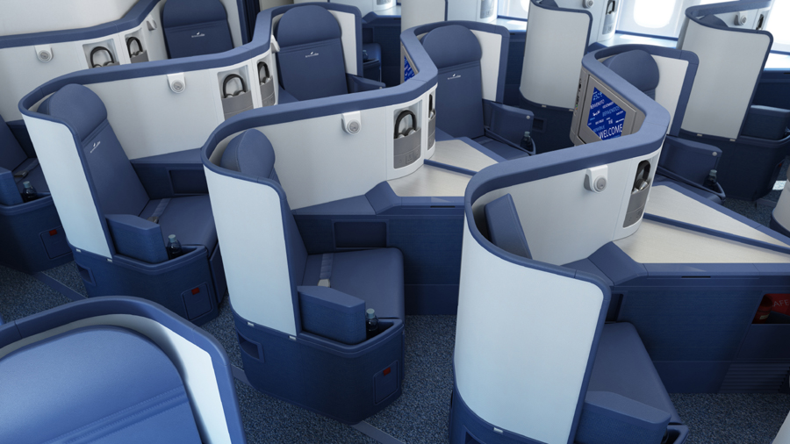
Background
Transport category passenger seats continue to evolve, with the latest development being a partially enclosed (pod) seat that is oriented obliquely with respect to the aircraft centerline, in what is commonly referred to as a “herringbone” arrangement.
Delta

Slide 4
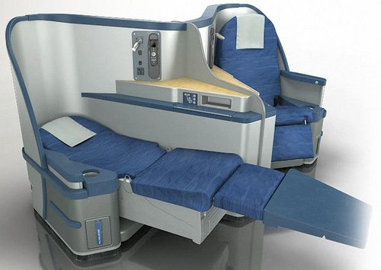
Background
Forward-facing seats are defined as being oriented 18° or less with respect to aircraft centerline.
Side-facing seats are defined as oriented 19° to 90° with respect to the aircraft centerline.
US Airways

Slide 5
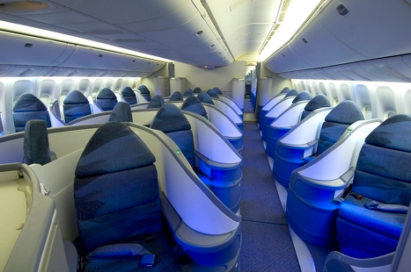
Background
Anthropomorphic Test Devices (ATDs) are designed to perform in a relatively confined environment (automotive interiors).
Aviation testing presents a challenge to crash testing because excessive flailing can occur.
Air Canada

Slide 6
Background
Oblique seats present a novel loading environment that may permit significant flailing and have an off-axis loading direction.
The current ATDs utilized are designed primarily for mostly forward- or purely side-facing applications.
An ATD capable of evaluating injury risks due to combined forward and lateral loading is necessary.

Slide 7
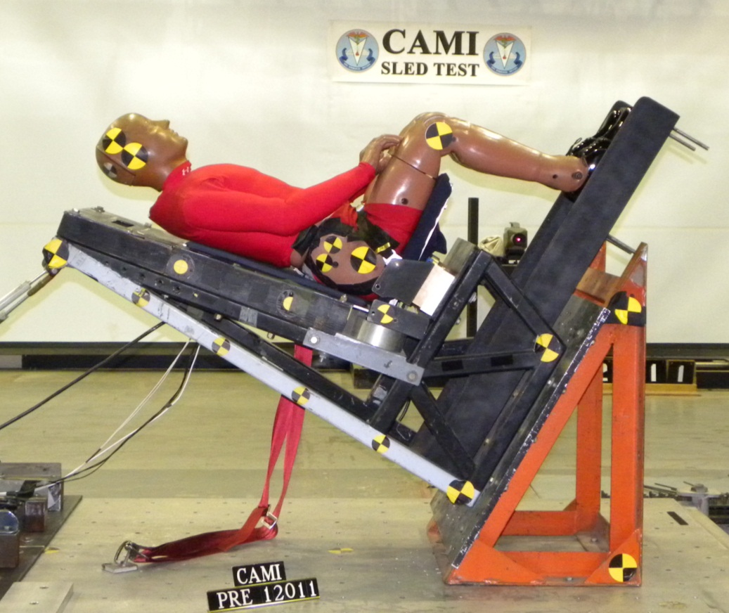
Existing Aviation ATDs
Hybrid II
49CFR Part 572 B
Instrumentation
Accelerometers
Head, Pelvis
Load Cells
Lumbar, Femur

Slide 8
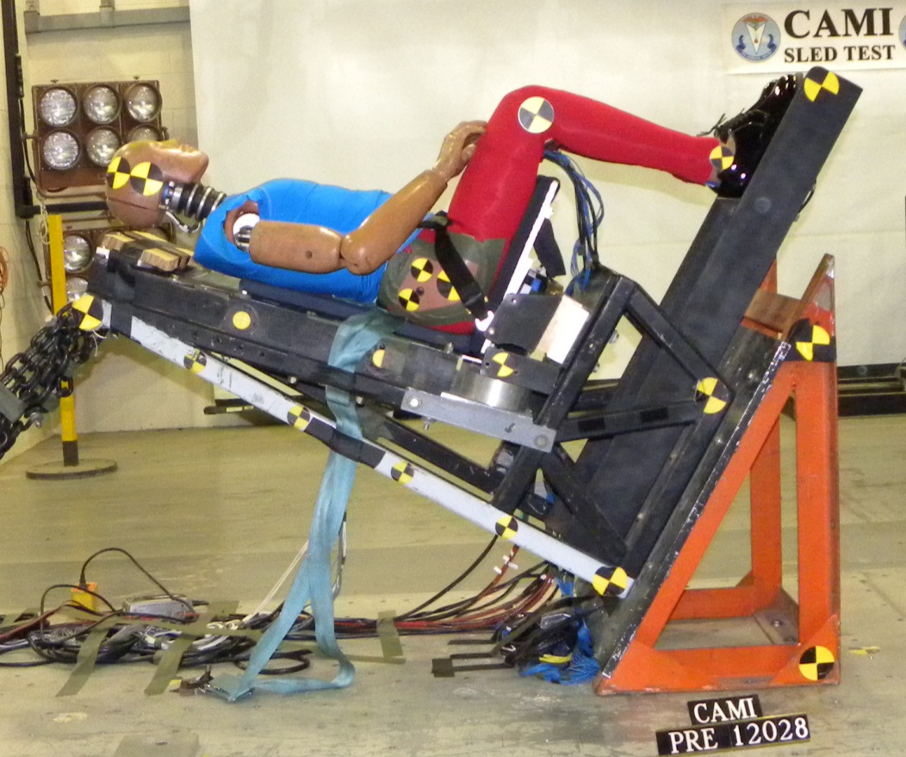
Existing Aviation ATDs
FAA-Hybrid III
SAE paper 1999-01-1609
Accepted for all FAA tests using Hybrid II in AIR-100-3-3-2000
Instrumentation
Accelerometers
Head, Pelvis
Load Cells
Neck, Thorax, Lumbar, Femur, Tibia

Slide 9
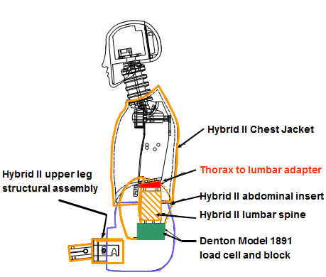
Existing Aviation ATDs
FAA-Hybrid III is predominately made up of Hybrid III parts except:
Hybrid II lumbar spine
Hybrid II abdominal insert
Hybrid II chest jacket
Hybrid II upper leg bone
Hybrid II lumbar load cell and pelvic adaptor block
Custom thorax/lumbar adaptor

Slide 10
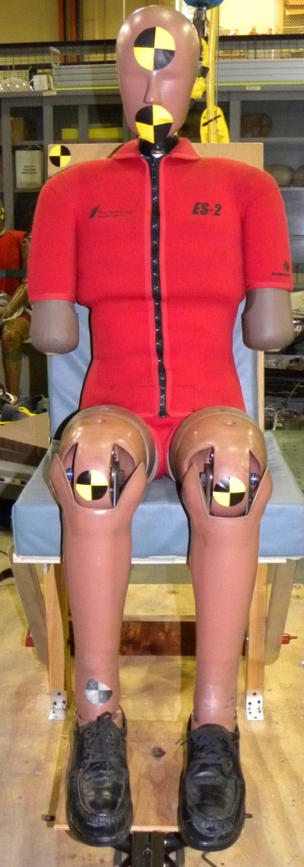
Existing Aviation ATDs
ES-2re
49CFR Part 572 U
Instrumentation
Accelerometers
Head, Thorax, Ribs, Pelvis
Load cells
Neck, Lumbar, Pelvis, Femur, Tibia
Displacement transducers
Rib deflection
The ES-2re was designed for purely side-facing loading conditions.

Slide 11
Existing Aviation ATDs
The ES-2re was excluded from the initial impact tests due to concerns over permanent damage to rib sliders and abdomen during forward flailing.
The test scenario where the dummy flails over the rigid half wall would likely have resulted in deformation to the ribs.
Its performance instead was evaluated numerically in a separate project.

Slide 12
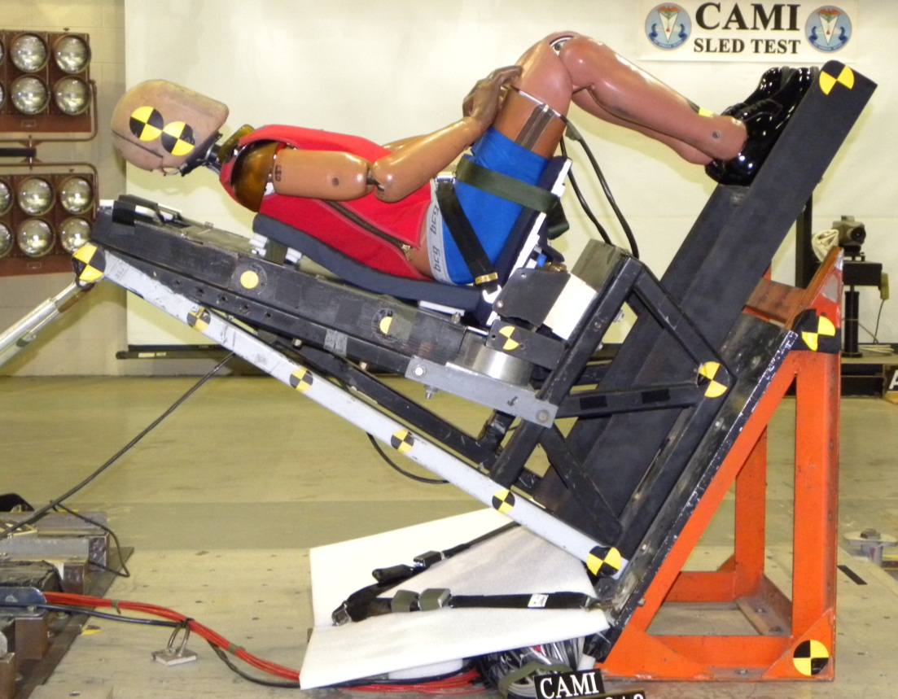
THOR
Test Device for Human Occupant Restraint (THOR-NT)
Loaned from NHTSA
Instrumentation (over 100 channels)
Accelerometers
Head, Thorax, Sternum, Abdomen, Pelvis, Foot
Load Cells
Face, Neck, Shoulder, Thorax, Pelvis, Femur, Tibia
Potentiometers, Tilt sensors, Knee Displacement

Slide 13
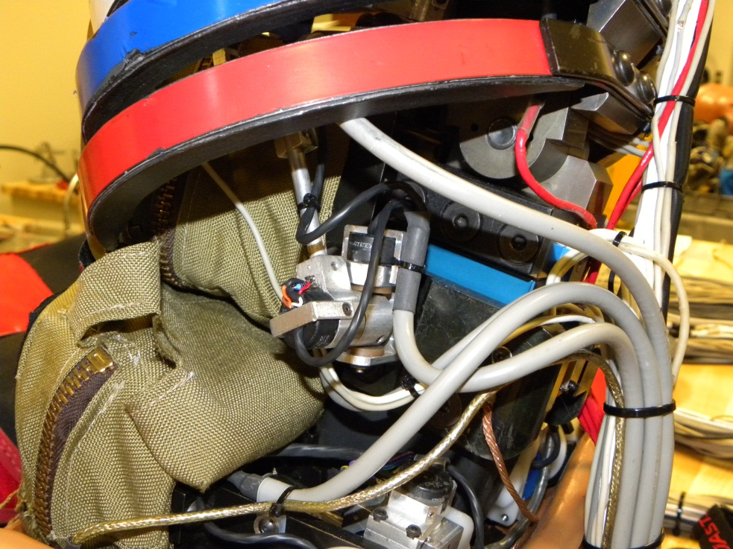
THOR
The THOR ATD is under development in the automotive community as a potential replacement for the Hybrid III for frontal crash tests.
It has an extensive array of instrumentation, particularly in the thoracic and abdominal regions.

Slide 14
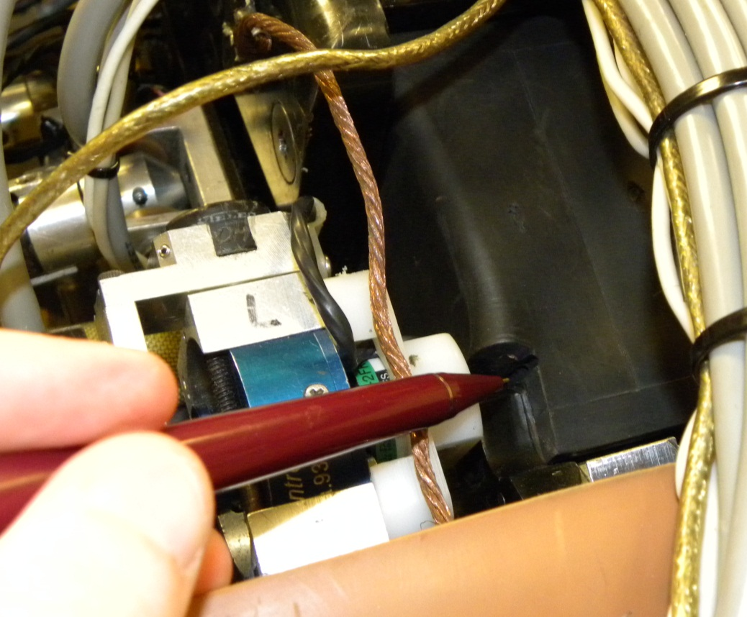
THOR
While this instrumentation would greatly increase the types of injuries that could be predicted, it was excluded after visual inspection of the internal structures.
Extensive damage to the instrumentation and the lumbar spine element would likely occur during any test that induced lateral or forward flexion at the lumbar.

Slide 15
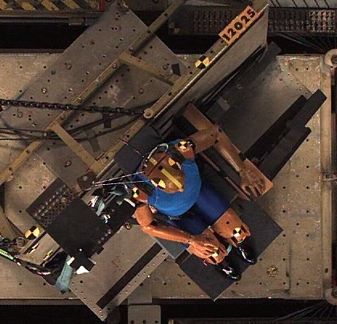
Test Set Up
At CAMI’s request, the SAE Seat Committee conducted an industry survey to determine typical oblique seat configurations.
Based on the information received, a rigid couch was configured to reflect two seat configurations and permit orientation at thirty and forty-five degrees with respect to the aircraft center line.

Slide 16
Test Set Up
The Hybrid II was selected for the initial tests to explore the likely occupant kinematics.
Given the unknown loading conditions, the Hybrid II is more durable than the FAA-Hybrid III.
For the second phase of testing, the FAA-Hybrid III was selected because of its expanded set of instrumentation, which allows a greater ability to measure potential injury risks.
Tests were completed using the deceleration sled with the 16 G, 44 feet per second impact severity defined in 14 CFR 25.562.

Slide 17
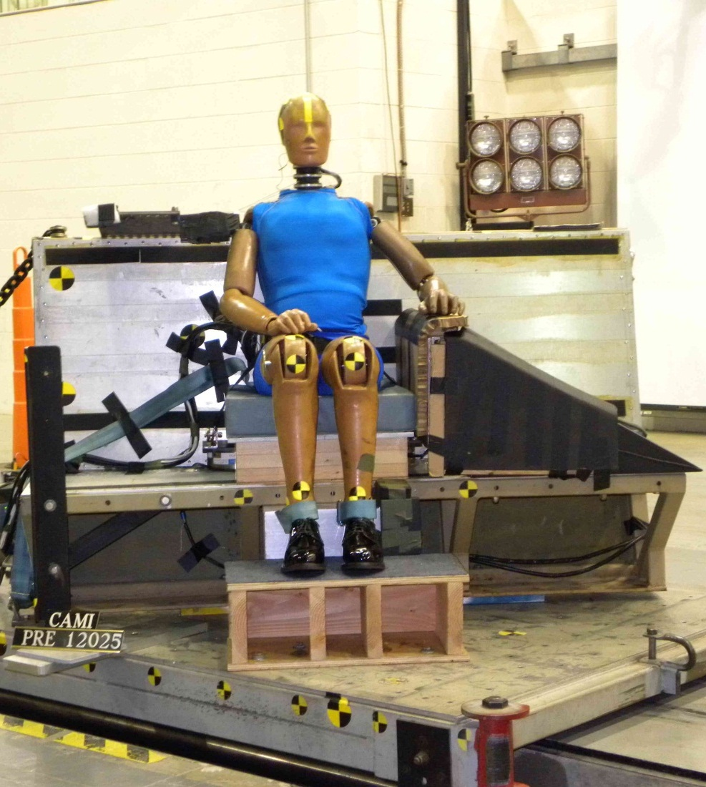
Configuration 1
Emulates scenario where an occupant is seated next to an interior feature that is rigid below the armrest level down to the floor and very flexible above it.
Interior feature emulated by rigid half wall.
ATD restrained using a conventional belt
Legs restrained laterally at the ankles with belt webbing.

Slide 18
Configuration 1
Hybrid II Interaction With Rigid Half Wall

Slide 19
Configuration 1
FAA-Hybrid III Interaction With Rigid Half Wall

Slide 20
Configuration 1
FAA-Hybrid III Interaction With Rigid Half Wall

Slide 21
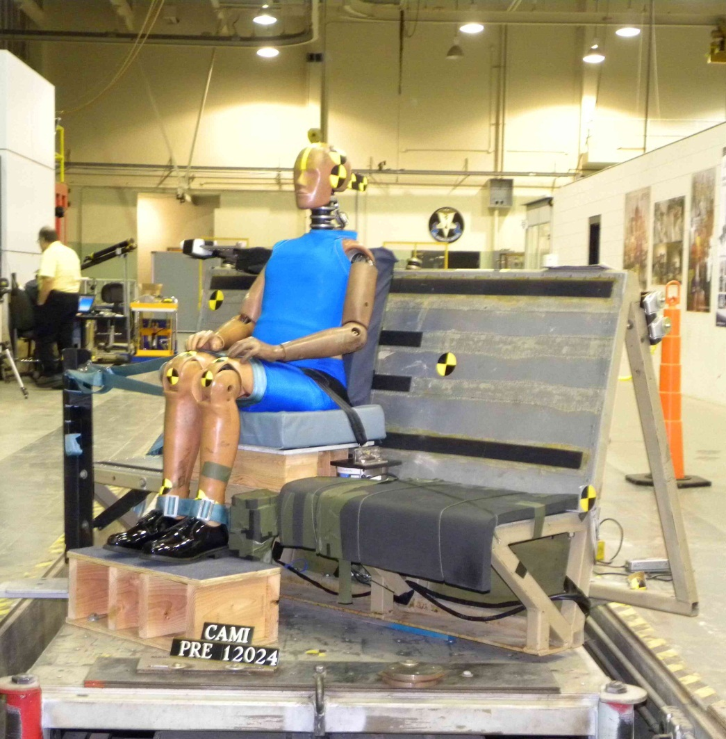
Configuration 2
Emulates a scenario where occupant is seated next to an interior feature that restricts the motion of the legs and pelvis, but not the upper torso.
ATD restrained using both a conventional belt and a body-centered lap belt (no shoulder strap).
Legs restrained laterally at the thighs and ankles with belt webbing.

Slide 22
Configuration 2
FAA-Hybrid III Pelvis and Leg Motion Limited
Notes:
Hybrid III 45°

Slide 23
Configuration 2
Hybrid III Pelvis and Leg Motion Limited
Notes:
Hybrid III 45°

Slide 24
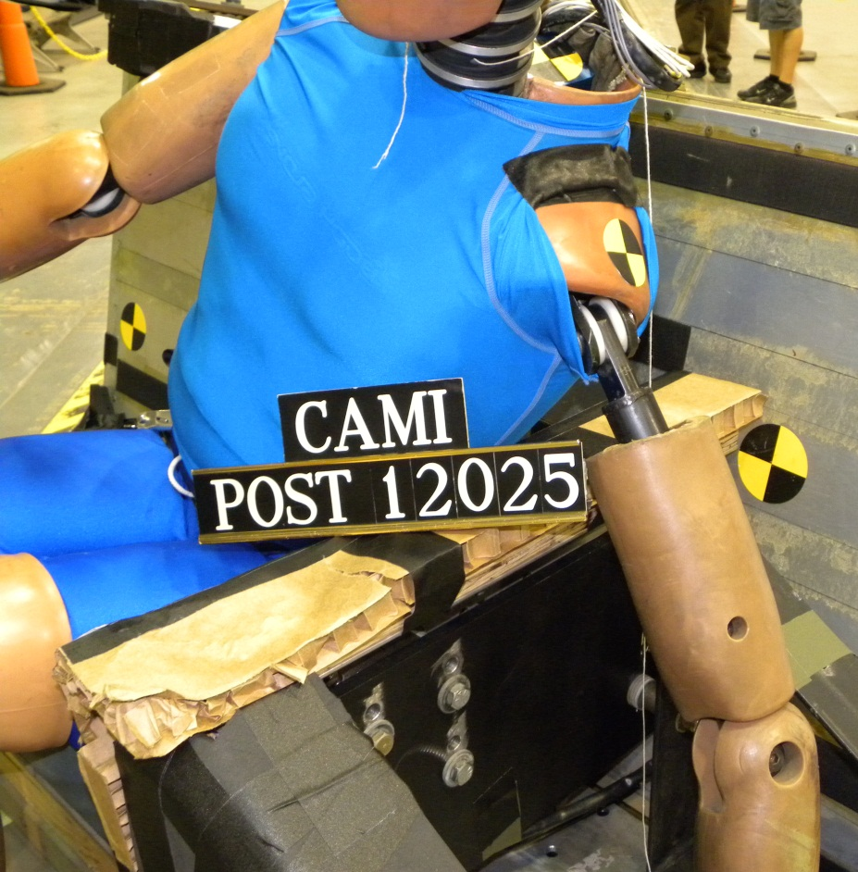
Oblique Testing Hardware Failures
FAA-Hybrid III tested with rigid half wall at 45°
Humerus broke during first test.

Slide 25
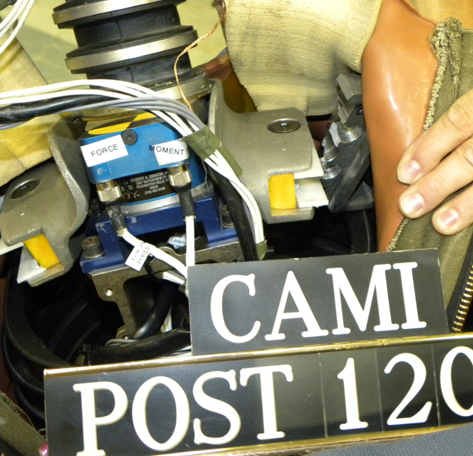
Oblique Testing Hardware Failures
FAA-Hybrid III tested with rigid half wall at 45°.
Failure of both clavicles during second test.
Humerus replaced between tests.
Estimated failure force = 1,350 lbs

Slide 26
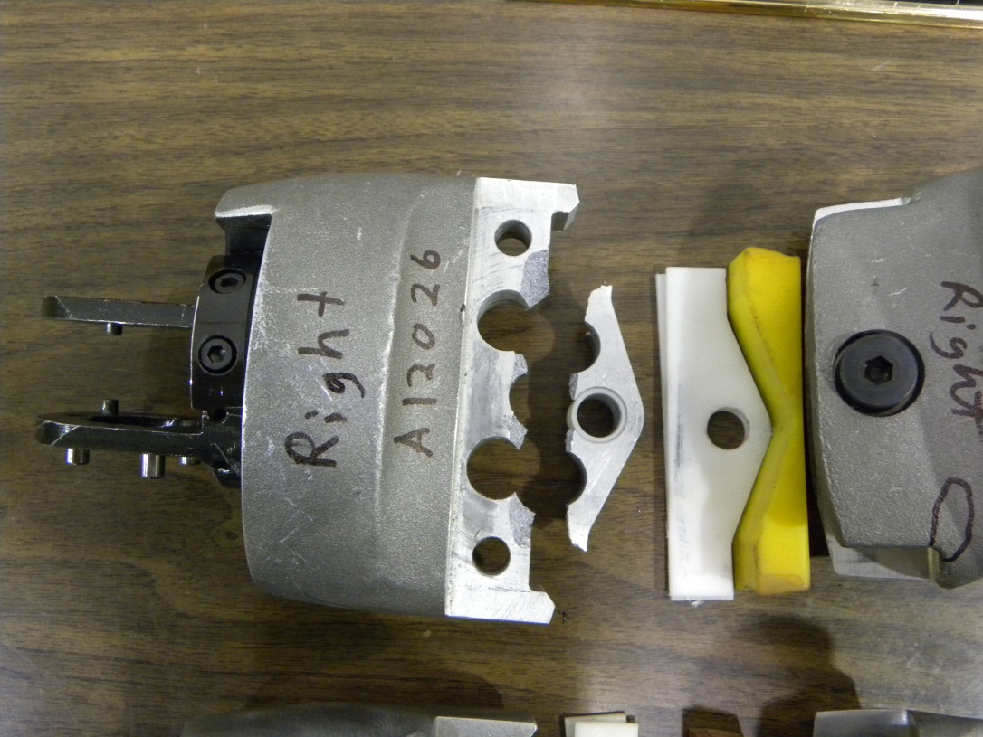
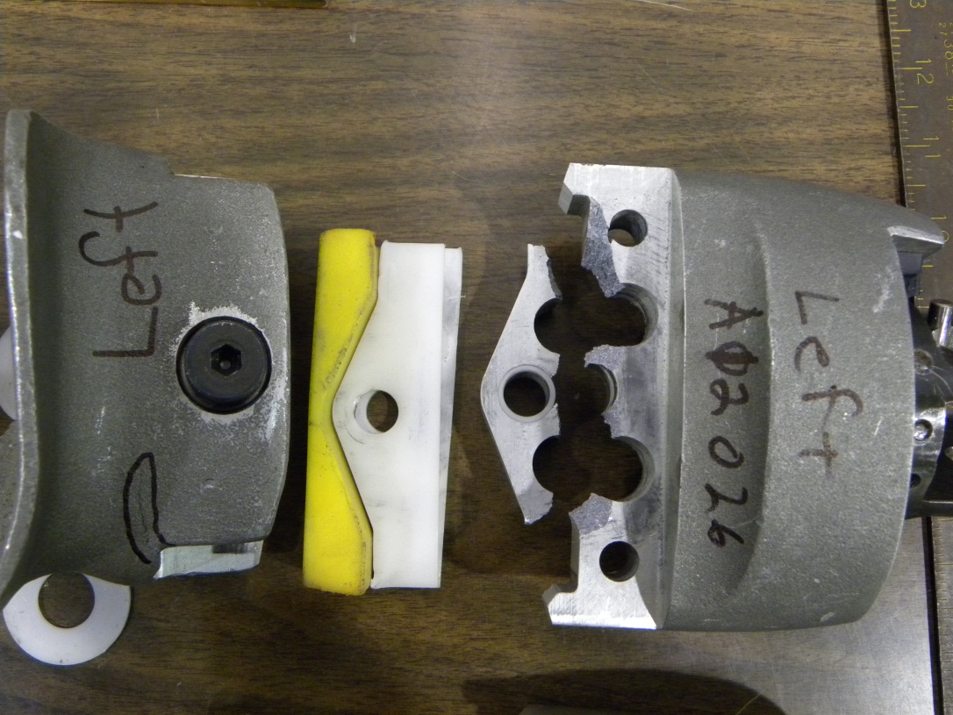
Oblique Testing Hardware Failures
FAA-Hybrid III clavicle failure.

Slide 27
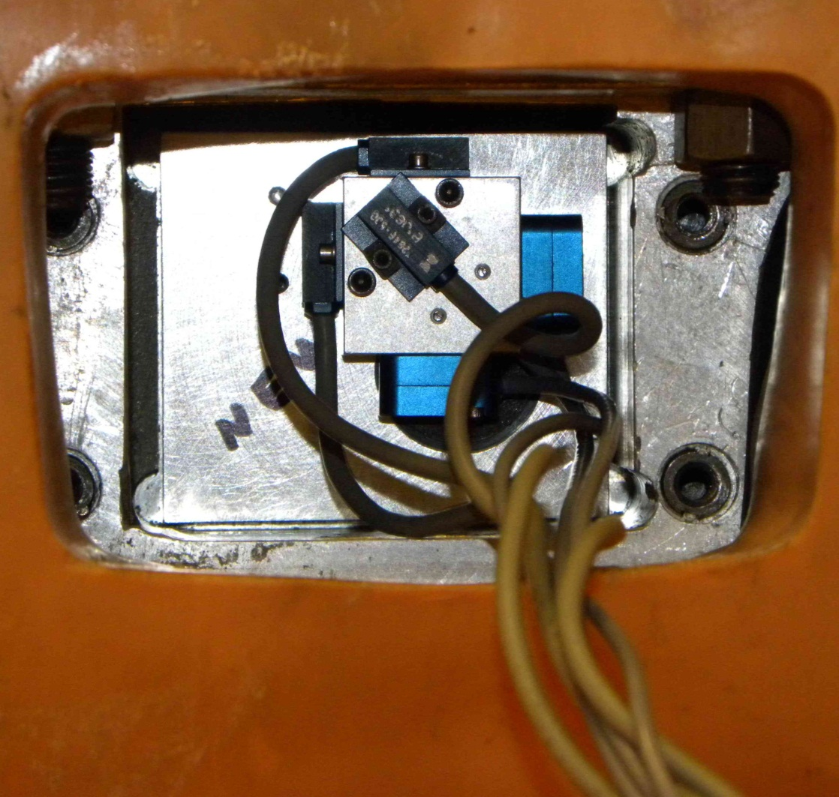
Specialized Instrumentation
Angular rate sensors used to track body segment orientation.
Mounted coincident with linear accelerometers

Slide 28
Specialized Instrumentation
Angular velocity of each major body segment can be used to derive the relative orientation throughout the impact.

Slide 29
Specialized Instrumentation
Difference in absolute angular positions yield the relative angle between the two body segments.
Rotation in all three directions must be combined to determine the relative orientation in 3 dimensions.

Slide 30
Specialized Instrumentation
Application of this technology may allow evaluation of spinal loads relative to spinal twist and flexion.
Once validated, this procedure could provide crucial data since injury tolerance may be linked to spinal misalignment.

Slide 31
Injuries
The Abbreviated Injury Scale (AIS) is an anatomical-based coding system created by the Association for the Advancement of Automotive Medicine to classify and describe the severity of specific individual injuries.
AIS is ranked on a scale from 1 to 6, with 1 being minor and 6 being fatal.

Slide 32
Head Injuries
Head Injury Criteria (HIC) is the maximum integral value of the head acceleration.
The only head contact in this test series was body-to-body, which is not a pass/fail criteria.
However, the observed contact suggests potential injury.

Slide 33
Neck Injuries
Normalized neck injury criteria (N_{ij}) was used to evaluate neck injury risk in fore-aft loading.
Not currently used in aviation testing but a limit of 1 is called out in automotive testing (FMVSS 208).
Angle | Half Wall | Upper Neck Nij
45° | No | 0.78
45° | Yes | 0.96
30° | Yes | 1.38
30° | No | 0.74
Federal Motor Vehicle Safety Standard

Slide 34
Neck Injuries
FAA-sponsored research indicates a strong correlation between neck tension applied by inertial forces and neck injury during lateral loading.
An axial neck tension limit of 405 lbs represents a 25% risk of a severe (AIS 3+) neck injury.
A moment of 1,018 in-lb measure can be considered a threshold below which neck injury is not expected.
A resultant shear (F_{xy}) limit of 185 lb represents a 25% risk of a severe (AIS 3+) neck injury.
These limits are based upon ES-2re data and only for the upper neck load cell.

Slide 35
Neck Injuries
Values for the FAA-Hybrid III, using the ES-2re limits for which a transfer function is not yet defined.

Slide 36
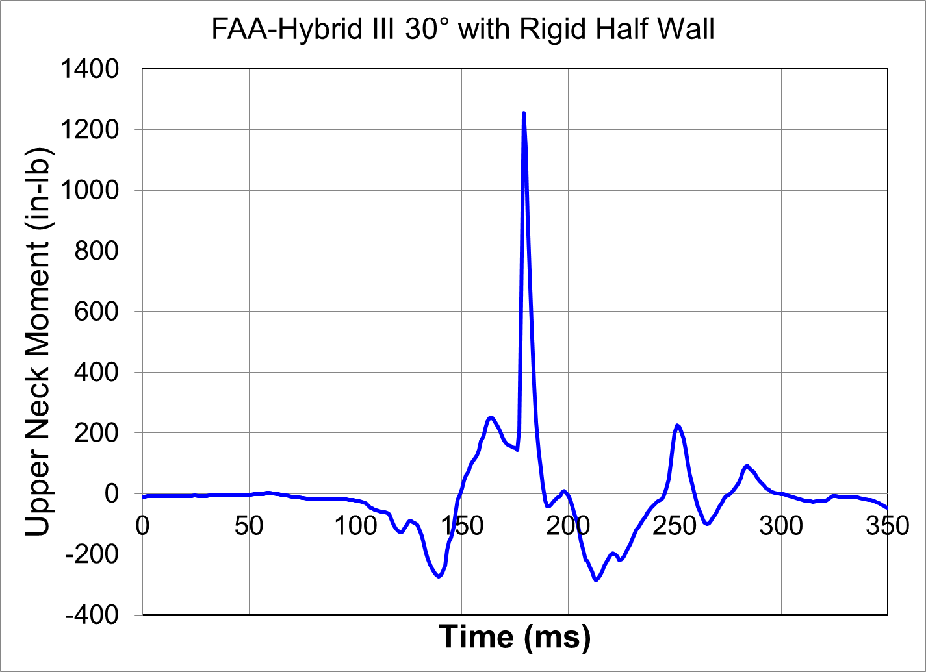
Body to Body Contact

Slide 37
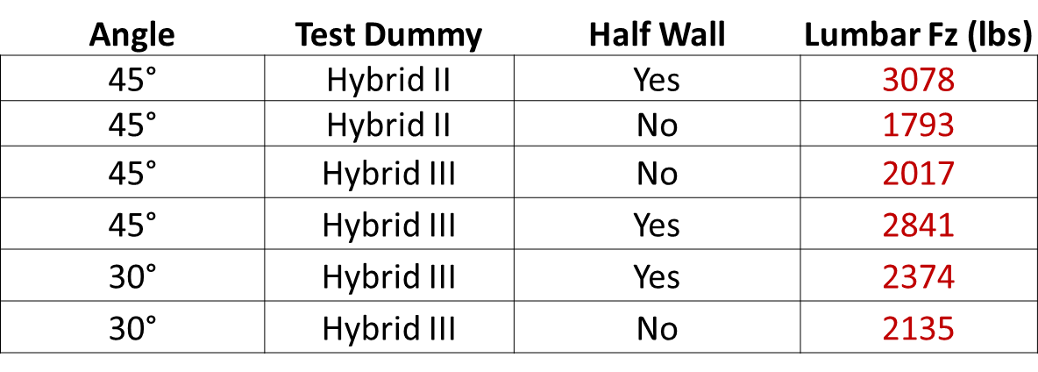
Lumbar Loads
Axial compression limit is 1,500 lb (9% risk of a detectable spinal injury).
Maximum tensile loads were significantly higher than the compressive limit.
Tension and compression injury values could be similar (true for the upper spine, i.e. the neck).

Slide 38
Potential Injury Measures
The FAA-Hybrid III was outfitted with a 5-axis load cell at the T-12 location, which measures moment and tension for the mid spine.
The Heliosafe modification allows for the reintroduction of the Hybrid III chest potentiometer to measure deflection, which is an injury criterion in FMVSS 208.

Slide 39
Injuries
This test series demonstrated that there are many potential injury risks that can occur when an occupant flails in an oblique orientation.
Potential injuries include:
Fractures to the sternum, pelvis, and ribs due to contact with a structure.
Leg fractures due to inertial loading.
Head and neck injuries due to either direct contact or inertial loading.

Slide 40
Injuries
This is essentially a combination of the risks of both a purely side-facing occupant and a purely forward-facing occupant.
The fully instrumented FAA-Hybrid III was able to measure parameters that can be used to predict some of the potential injuries; of the available dummies, it is the best choice for oblique seat research tests at this time.

Slide 41
Future Work
A follow-on study funded by the FAA is being conducted by the Medical College of Wisconsin (MCW) to determine what specific injuries occur in these oblique orientations and develop injury criteria.
The CAMI and MCW work is to support the Fire & Cabin Safety Technical Community Representative Group 2011/12 Project 2: Injury Criteria for Obliquely-Oriented Seats.

Slide 42
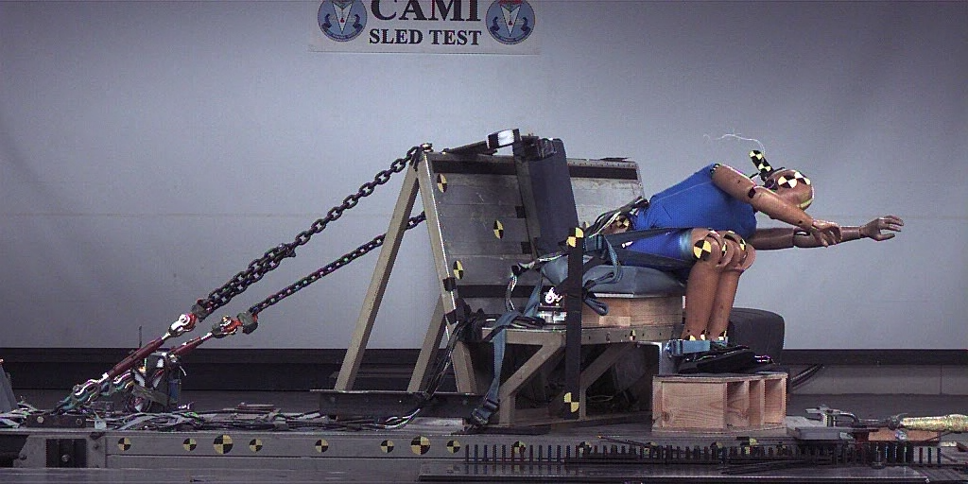
Questions?

