Slide 1
Aircraft Emergency Evacuation Study with Injured Passengers
Hae Chang Gea
Department of Mechanical and Aerospace Engineering
Rutgers University, New Jersey, USA
Program Manager: Dr. Mac McLean, FAA, CAMI

Slide 2
Aircraft Emergency Evacuation
Simulations can…
  study many what-if scenarios;
  incorporate various hazardous conditions;
  evaluate the impact of new devices;
  better understanding of the entire evacuation process.
Crew Redirection Algorithm
Crew Redirection with Interior Access Vehicles for Emergency Evacuation
Crew Redirection with Injured Passenger for Emergency Evacuation

Slide 3
Injured Passengers
Injured Passengers
  We are referring to all passengers who move in slower speed than regular passengers.
  Examples: injured passengers, disabled passengers, and passengers need special assistant.

Slide 4
Injured Passengers: Review of Previous Study
In previous study
- different injured passengers speed
- different number of injured passenger
- different locations of injured passengers
Overall Evacuation time is increased as number or location of injured passengers
Different aisle row locations dose not impact significantly for overall evacuation time
From the worst case of seating study, the injured passenger should avoid the seats which are around 4-5 rows behind the middle exits.

Slide 5

Crew Redirection For Injured Passenger
Basic crew redirection disciplines are applied same as regular crew redirection algorithm
Single injured passenger assigned along the aisle
Crew redirection is modified depending on available exit and injured passenger’s location

Slide 6
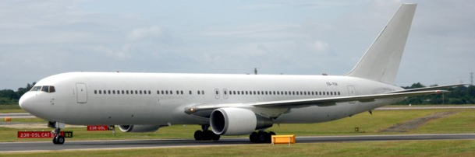
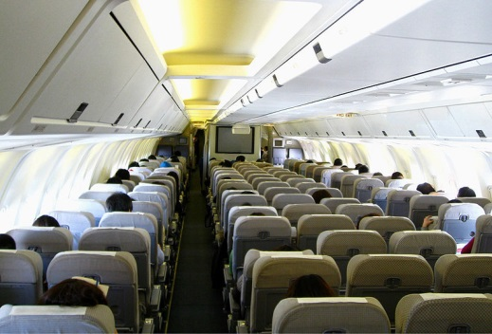
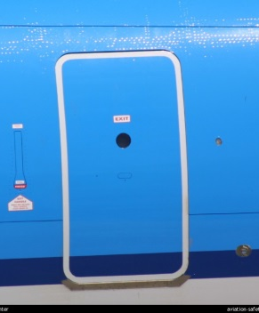
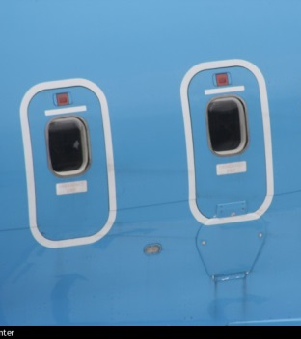
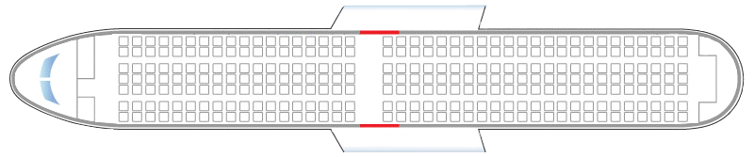
Simulation Model: B 767-300
Seat Number: 285
Seat Layout: 2-3-2
Exit Number: 8 Pairs
Exit Type: 4 Type A
4 Type III
Type A
2: Type III
Type A
Type A
2: Type III
Type A

Slide 7

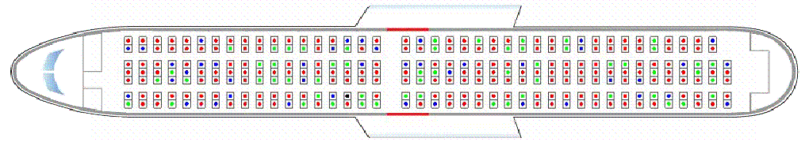
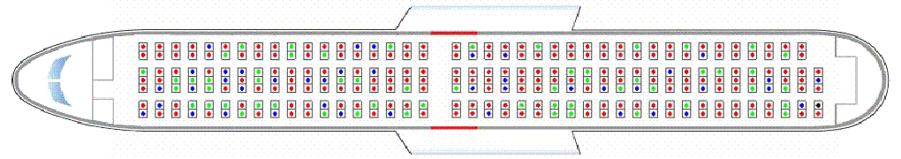


B 767-300 Simulation
2 front exits and a pair of mid exit are available
Injured passenger is placed along the 2nd row
Animation InjuredC2_2.dat NC

Slide 8
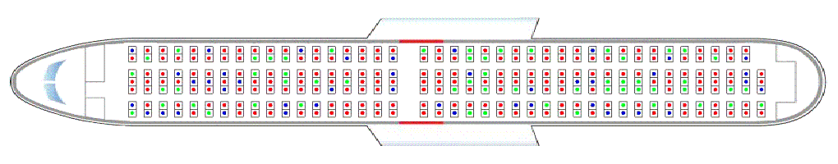
B 767-300 Simulation: No Crew
Evacuation time without inured passenger: 155 sec
Location of Injured Passenger (column number)

Slide 9
B 767-300 Simulation: No Crew
Overall Evacuation Time
Evacuation time without inured passenger: 155 sec
Injured Passenger Evacuation Time
Location of Injured Passenger (column number)

Slide 10
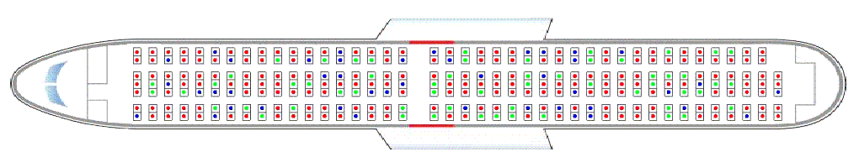
B 767-300 Simulation: Crew
Evacuation time without inured passenger: 90.5 sec
Location of Injured Passenger (column number)

Slide 11
B 767-300 Simulation: No Crew
Overall Evacuation Time
Evacuation time without inured passenger: 90.5 sec
Location of Injured Passenger (column number)

Slide 12
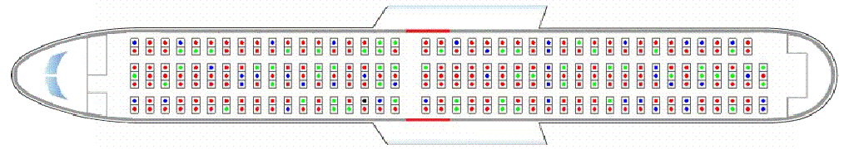
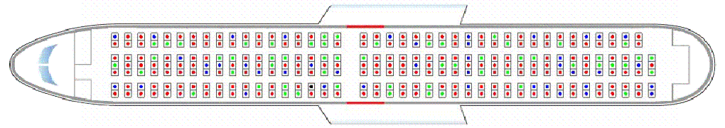
B 767-300 Simulation: No Crew
Overall Evacuation Time
Evacuation time without inured passenger: 90.5 sec
Injured Passenger Evacuation Time
Location of Injured Passenger (column number)

Slide 13
B 767-300 Simulation: No Crew
No Crew with Injured Passenger
Evacuation time was reduced about 65 sec
Crew with Injured Passenger
Location of Injured Passenger (column number)
Locations of injured passenger dose not effect much

Slide 14
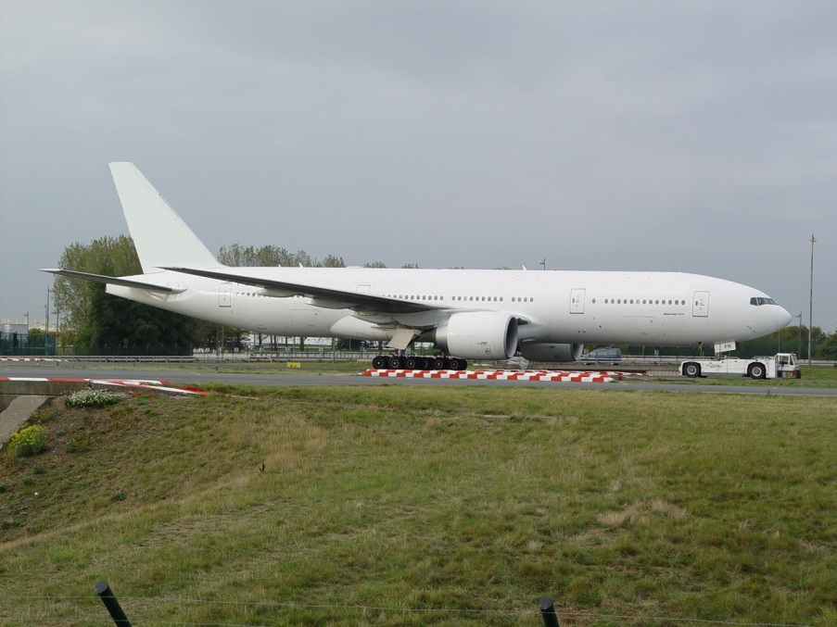
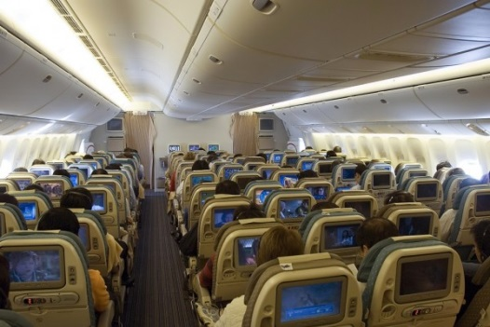
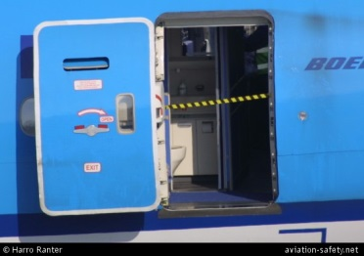
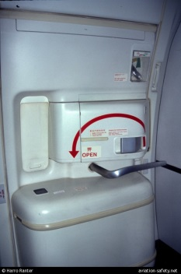
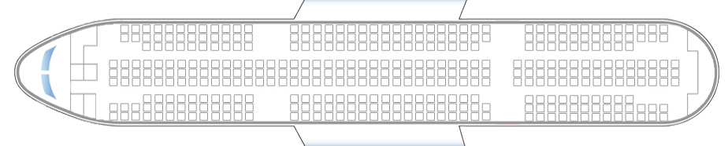
Simulation Model: B 777-200
Seat Number: 440
Seat Layout: 3-3-3
Exit Number: 4 Pairs
Exit Type: 8 Type A
Type A
Type A
Type A
Type A
Type A
Type A
Type A
Type A

Slide 15

Simulation Model: B 777-300
Half number of exits are fully available during evacuation
4 different sets of usable exit combinations are simulated by Monte Carlo Test
Injured passenger is placed along 4th row from the bottom
Conf. A
Conf. C
Conf. B
Conf. D

Slide 16
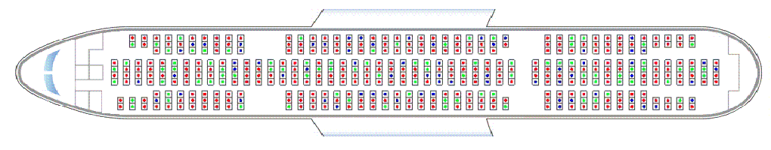

B 777-300: Conf. A-No Crew
Evacuation time without inured passenger: 84 sec
Location of Injured Passenger (column number)

Slide 17
B 767-300 Simulation: No Crew
Overall Evacuation Time
Evacuation time without inured passenger: 84 sec
Location of Injured Passenger (column number)

Slide 18
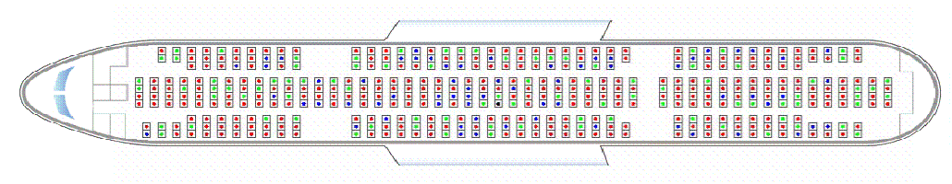

B 767-300 Simulation: No Crew
Overall Evacuation Time
Evacuation time without inured passenger: 84 sec
Injured passenger evacuation time
Location of Injured Passenger (column number)

Slide 19
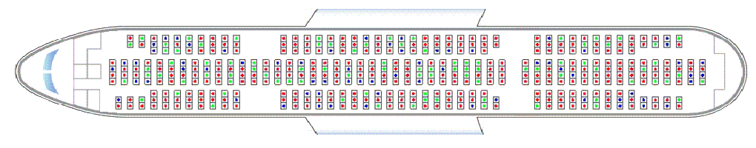
B 777-300: Conf. A- Crew
Evacuation time without inured passenger: 68.89sec
Location of Injured Passenger (column number)

Slide 20
B 777-200: Conf. A- Crew
Overall Evacuation Time
Evacuation time without inured passenger: 68.89sec
Location of Injured Passenger (column number)

Slide 21
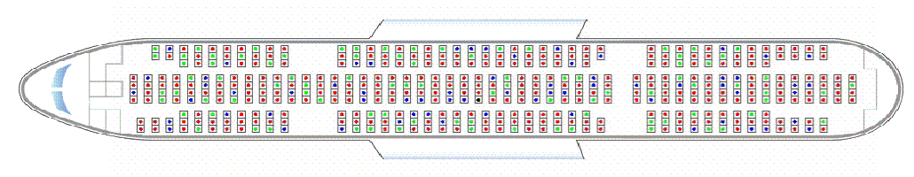

B 777-200: Conf. A- Crew
Overall Evacuation Time
Evacuation time without inured passenger: 68.89sec
Injured passenger evacuation time
Location of Injured Passenger (column number)

Slide 22
B 777-200: Conf. A
No Crew with Injured Passenger
Crew with Injured Passenger
Location of Injured Passenger (column number)
The locations of injured passenger should be close to the exits

Slide 23
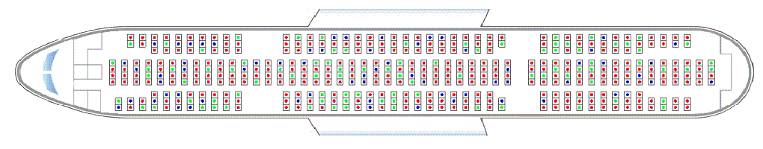
B 777-200: Conf. B- No Crew
Evacuation time without inured passenger: 153.5 sec
Location of Injured Passenger (column number)

Slide 24
B 777-200: Conf. B- No Crew
Overall Evacuation Time
Evacuation time without inured passenger: 153.5 sec
Location of Injured Passenger (column number)

Slide 25
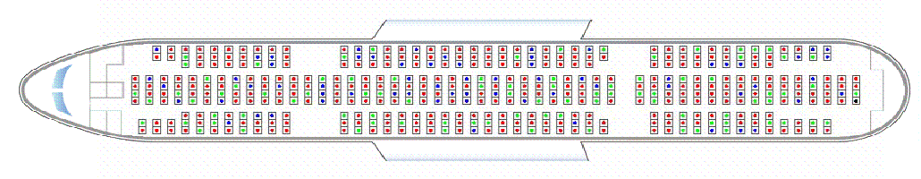

B 777-200: Conf. B- No Crew
Overall Evacuation Time
Evacuation time without inured passenger: 153.5 sec
Injured passenger evacuation time
Location of Injured Passenger (column number)

Slide 26
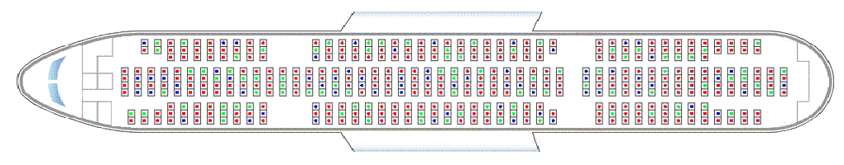
B 777-200: Conf. B- Crew
Evacuation time without inured passenger: 79.6sec
Location of Injured Passenger (column number)

Slide 27
B 777-200: Conf. B- Crew
Overall Evacuation Time
Evacuation time without inured passenger: 79.6sec
Location of Injured Passenger (column number)

Slide 28
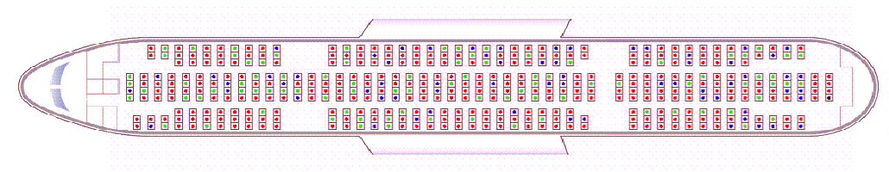

B 777-200: Conf. B- Crew
Overall Evacuation Time
Injured passenger evacuation time
Evacuation time without inured passenger: 79.6sec
Location of Injured Passenger (column number)

Slide 29
B 777-200: Conf. B
No Crew with Injured Passenger
Crew with Injured Passenger
Location of Injured Passenger (column number)
Long distance to the exits will increase evacuation time

Slide 30
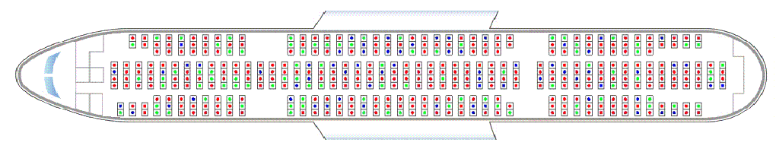
B 777-200: Conf. C- No Crew
Evacuation time without inured passenger: 118sec
Location of Injured Passenger (column number)

Slide 31
B 777-200: Conf. C- No Crew
Overall Evacuation Time
Evacuation time without inured passenger: 118sec
Location of Injured Passenger (column number)

Slide 32
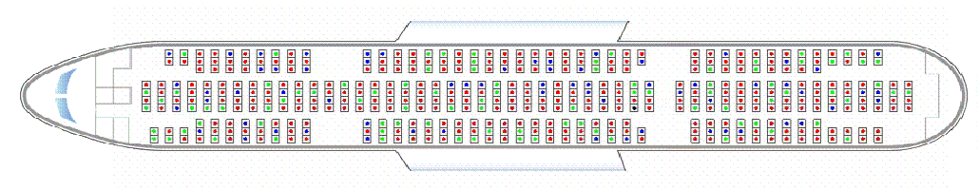

B 777-200: Conf. C- No Crew
Overall Evacuation Time
Evacuation time without inured passenger: 118sec
Injured passenger evacuation time
Location of Injured Passenger (column number)

Slide 33
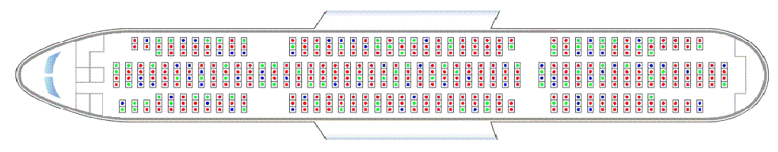
B 777-200: Conf. C-Crew
Evacuation time without inured passenger: 79.5sec
Location of Injured Passenger (column number)

Slide 34
B 777-200: Conf. C- Crew
Overall Evacuation Time
Evacuation time without inured passenger: 79.5sec
Location of Injured Passenger (column number)

Slide 35

B 777-200: Conf. C- Crew
Overall Evacuation Time
Evacuation time without inured passenger: 79.5sec
Injured passenger evacuation time
Location of Injured Passenger (column number)

Slide 36
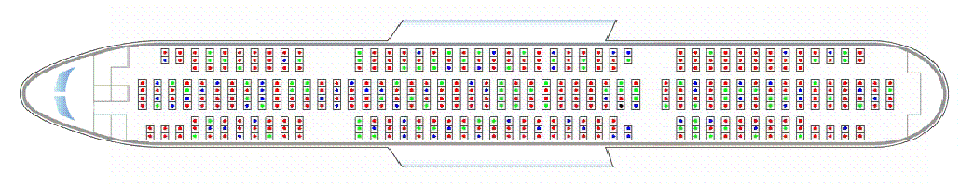

B 777-200: Conf. C- Crew
Overall Evacuation Time
Evacuation time without inured passenger: 79.5sec
Injured passenger evacuation time
Location of Injured Passenger (column number)

Slide 37
B 777-200: Conf. C
No Crew with Injured Passenger
Crew with Injured Passenger
Location of Injured Passenger (column number)
By redirecting injured passenger to closest exit, evacuation time can be reduced instead just applying basic crew redirection

Slide 38
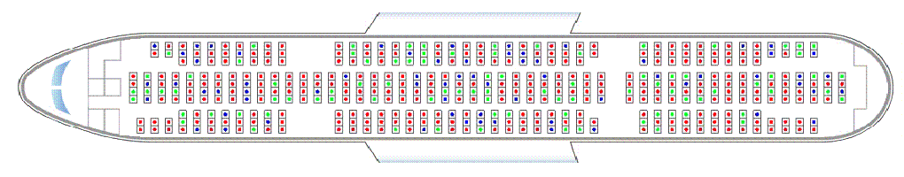
B 777-200: Conf. D- No Crew
Evacuation time without inured passenger: 127sec
Location of Injured Passenger (column number)

Slide 39
B 777-200: Conf. D- No Crew
Overall Evacuation Time
Evacuation time without inured passenger: 127sec
Location of Injured Passenger (column number)

Slide 40
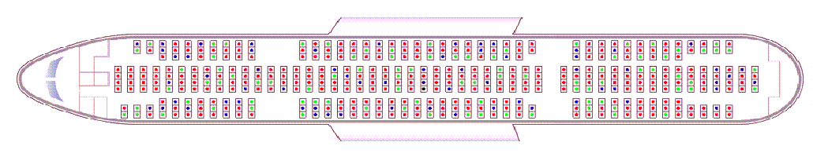
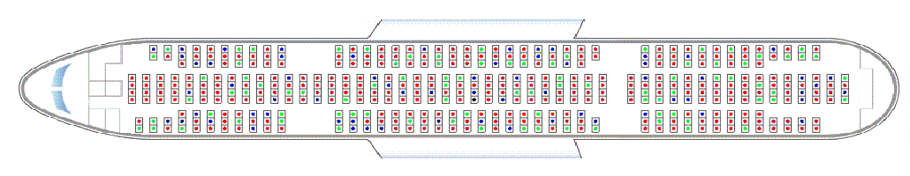
B 777-200: Conf. D- No Crew
Overall Evacuation Time
Evacuation time without inured passenger: 127sec
Injured passenger evacuation time
Location of Injured Passenger (column number)

Slide 41
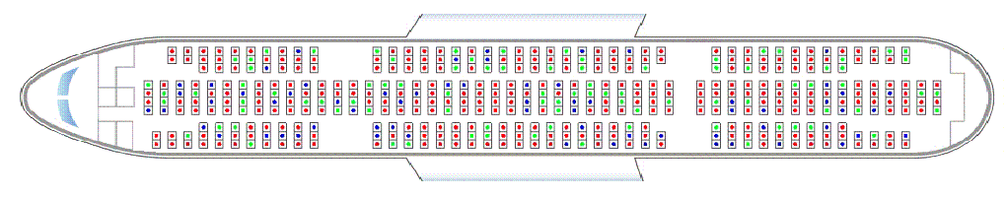
B 777-200: Conf. D- Crew
Evacuation time without inured passenger: 79.5sec
Location of Injured Passenger (column number)

Slide 42
B 777-200: Conf. D- Crew
Overall Evacuation Time
Evacuation time without inured passenger: 79.5sec

Slide 43
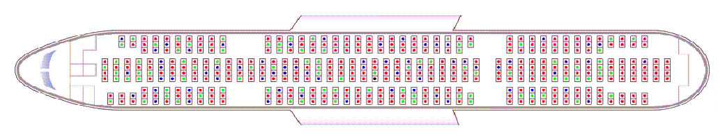

B 777-200: Conf. D- Crew
Overall Evacuation Time
Evacuation time without inured passenger: 79.5sec
Injured passenger evacuation time
Location of Injured Passenger (column number)

Slide 44
B 777-200: Conf. D- Crew
No Crew with Injured Passenger
Crew with Injured Passenger
Location of Injured Passenger (column number)

Slide 45
Conclusions
Crew redirection with injured passenger situations were studied.
Crew redirection reduced overall evacuation time compared with no crew redirection
Overall evacuation time was increased when injured passenger’ location is far from the exit for both crew and no crew redirections
Closest seats to exits are recommended for injured passenger to reduce overall evacuation time
Depending on the injured passenger’s location, crew redirection should be applied differently

